Slide 2
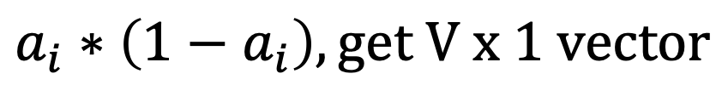
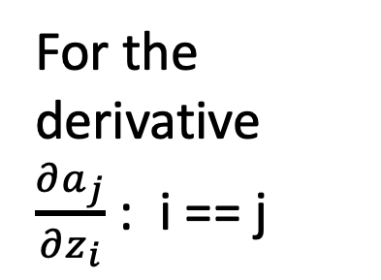
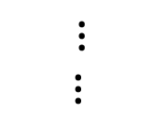



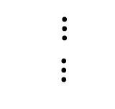


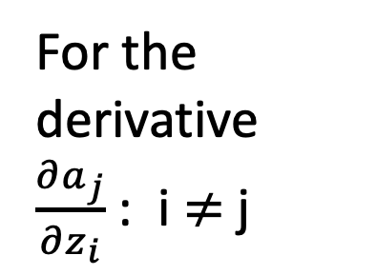


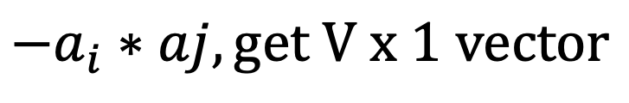
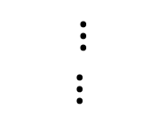







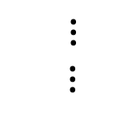





For the derivative $\frac{∂a_{j}}{∂z_{i}}$ : i == j
For the derivative $\frac{∂a_{j}}{∂z_{i}}$ : i $≠$j
$$0$$
$$a_{1}$$
$${−a}_{i}$$
$$a_{1}$$
$$a_{1}$$
$${−a}_{i}$$
$$a_{2}$$
$$0$$
$$a_{2}$$
$$a_{2}$$
$⋮$
$⋮$
$⋮$
$⋮$
$$a_{i}$$
$${1−a}_{i}$$
$$a_{i}$$
$${−a}_{i}$$
$$0$$
$$a_{i}$$
$⋮$
$⋮$
$⋮$
$⋮$
$$0$$
$$a_{V}$$
$${−a}_{i}$$
$$a_{v}$$
$$a_{V}$$
$$a_{i}∗\left(1−a_{i}\right), get V x 1 vector$$
$${−a}_{i}∗aj, get V x 1 vector$$

Slide 3
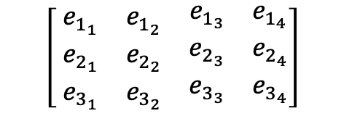
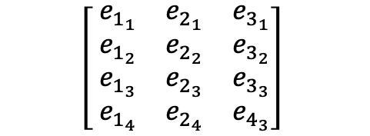
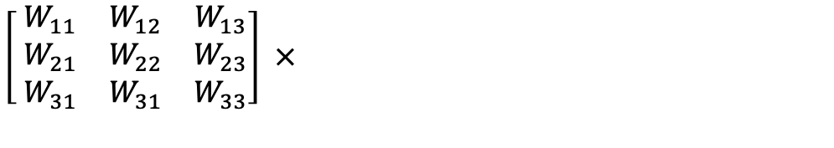
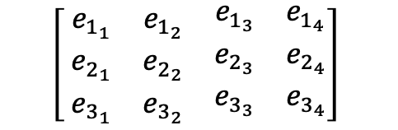
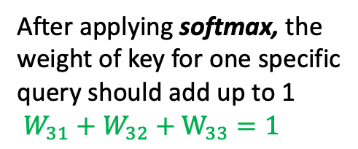
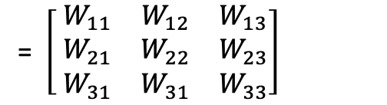

First word embedding vector of Key
The importance of first key to second query
First word embedding vector of Query
$$\left[ \begin{matrix}e_{1_{1}} & e_{1_{2}} & \begin{matrix}e_{1_{3}} & e_{1_{4}}\end{matrix} \\ e_{2_{1}} & e_{2_{2}} & \begin{matrix}e_{2_{3}} & e_{2_{4}}\end{matrix} \\ e_{3_{1}} & e_{3_{2}} & \begin{matrix}e_{3_{3}} & e_{3_{4}}\end{matrix}\end{matrix}\right]$$
$$\left[ \begin{matrix}e_{1_{1}} & e_{2_{1}} & e_{3_{1}} \\ e_{1_{2}} & e_{2_{2}} & e_{3_{2}} \\ \begin{aligned}e_{1_{3}} \\ e_{1_{4}}\end{aligned} & \begin{aligned}e_{2_{3}} \\ e_{2_{4}}\end{aligned} & \begin{aligned}e_{3_{3}} \\ e_{4_{3}}\end{aligned}\end{matrix}\right]$$
= $\left[ \begin{matrix}W_{11} & W_{12} & W_{13} \\ W_{21} & W_{22} & W_{23} \\ W_{31} & W_{31} & W_{33}\end{matrix}\right]$
$$×$$
Query, LQ x D
Key
D x LK
After applying softmax, the weight of key for one specific query should add up to 1
$W_{31}+W_{32}+W_{33}=1$
$$\left[ \begin{matrix}e_{1_{1}} & e_{1_{2}} & \begin{matrix}e_{1_{3}} & e_{1_{4}}\end{matrix} \\ e_{2_{1}} & e_{2_{2}} & \begin{matrix}e_{2_{3}} & e_{2_{4}}\end{matrix} \\ e_{3_{1}} & e_{3_{2}} & \begin{matrix}e_{3_{3}} & e_{3_{4}}\end{matrix}\end{matrix}\right]$$
$\left[ \begin{matrix}W_{11} & W_{12} & W_{13} \\ W_{21} & W_{22} & W_{23} \\ W_{31} & W_{31} & W_{33}\end{matrix}\right]$ $×$

Slide 4
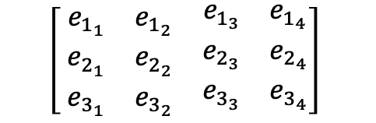
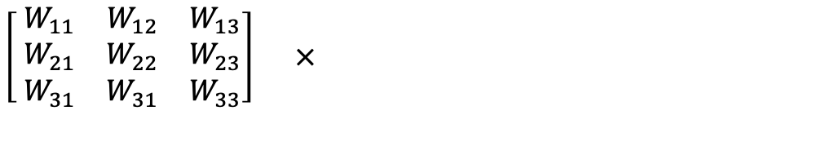

$$\left[ \begin{matrix}e_{1_{1}} & e_{1_{2}} & \begin{matrix}e_{1_{3}} & e_{1_{4}}\end{matrix} \\ e_{2_{1}} & e_{2_{2}} & \begin{matrix}e_{2_{3}} & e_{2_{4}}\end{matrix} \\ e_{3_{1}} & e_{3_{2}} & \begin{matrix}e_{3_{3}} & e_{3_{4}}\end{matrix}\end{matrix}\right]$$
The first embedding vector for output first dimension =
$\left[ \begin{matrix}W_{11} & W_{12} & W_{13} \\ W_{21} & W_{22} & W_{23} \\ W_{31} & W_{31} & W_{33}\end{matrix}\right]$ $×$
$W_{11}e_{1_{1}}+W_{12}e_{2_{1}}$ + $W_{31}e_{3_{1}}$
= The first value embedding vector first dimension * weight of first value to first query+
The second value embedding vector first dimension * weight of second value to first query +
The third value embedding vector first dimension * weight of thrid value to first query
Attention Weight LQ x LK
Value
LK x D

Slide 5
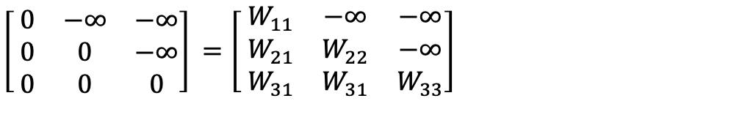
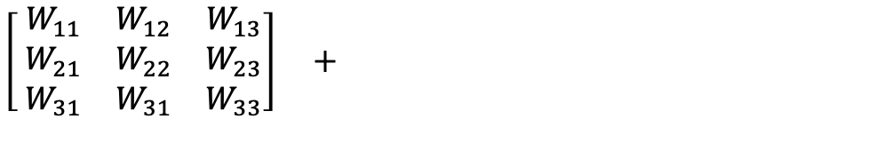
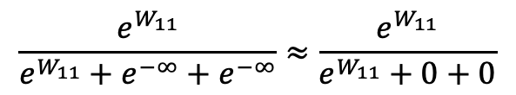
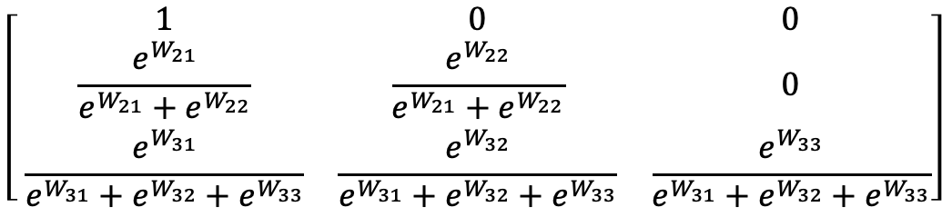
$\left[ \begin{matrix}0 & −∞ & −∞ \\ 0 & 0 & −∞ \\ 0 & 0 & 0\end{matrix}\right]$ $=\left[ \begin{matrix}W_{11} & −∞ & −∞ \\ W_{21} & W_{22} & −∞ \\ W_{31} & W_{31} & W_{33}\end{matrix}\right]$
$\left[ \begin{matrix}W_{11} & W_{12} & W_{13} \\ W_{21} & W_{22} & W_{23} \\ W_{31} & W_{31} & W_{33}\end{matrix}\right]$ $+$
QK^T LQ x LK
M
LQ x LK
After Performing Softmax
$$\left[ \begin{matrix}1 & 0 & 0 \\ \frac{e^{W_{21}}}{e^{W_{21}}+e^{W_{22}}} & \frac{e^{W_{22}}}{e^{W_{21}}+e^{W_{22}}} & 0 \\ \frac{e^{W_{31}}}{e^{W_{31}}+e^{W_{32}}+e^{W_{33}}} & \frac{e^{W_{32}}}{e^{W_{31}}+e^{W_{32}}+e^{W_{33}}} & \frac{e^{W_{33}}}{e^{W_{31}}+e^{W_{32}}+e^{W_{33}}}\end{matrix}\right]$$
$$\frac{e^{W_{11}}}{e^{W_{11}}+e^{−∞}+e^{−∞}}≈\frac{e^{W_{11}}}{e^{W_{11}}+0+0}$$

Slide 6
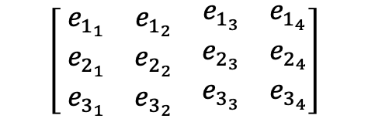
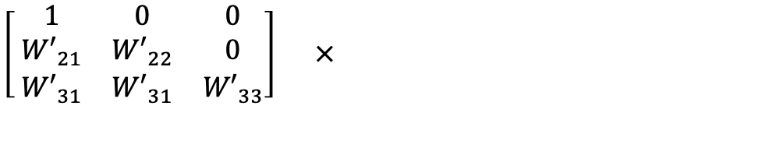


The weight of second key to first query.
$$\left[ \begin{matrix}e_{1_{1}} & e_{1_{2}} & \begin{matrix}e_{1_{3}} & e_{1_{4}}\end{matrix} \\ e_{2_{1}} & e_{2_{2}} & \begin{matrix}e_{2_{3}} & e_{2_{4}}\end{matrix} \\ e_{3_{1}} & e_{3_{2}} & \begin{matrix}e_{3_{3}} & e_{3_{4}}\end{matrix}\end{matrix}\right]$$
$\left[ \begin{matrix}1 & 0 & 0 \\ {W′}_{21} & {W′}_{22} & 0 \\ {W′}_{31} & {W′}_{31} & {W′}_{33}\end{matrix}\right]$ $×$
The first embedding vector for output first dimension =
$$e_{1_{1}}$$
The second embedding vector for output third dimension =
Attention Weight LQ x LK
Value
LK x D
${W′}_{21}e_{1_{3}}+{W′}_{22}$ $e_{2_{3}}$

Slide 7
Dense layer can be positional Encoding layer
Single- Head Attention
Multi Head Attention
N-heads Dense
Layer
N-heads Queries
Dense
Layer
Query
Dense
Layer
Query
Maybe the same dense
Maybe the same dense
N-heads Dense
Layer
N-heads Keys
Input Embedding
Dense
Layer
Input Embedding
Key
Dense
Layer
Value
Maybe the same dense
Maybe the same dense
N-heads Dense
Layer
N-heads Values
Dense
Layer
Value
Dense
Layer
Value

Slide 8
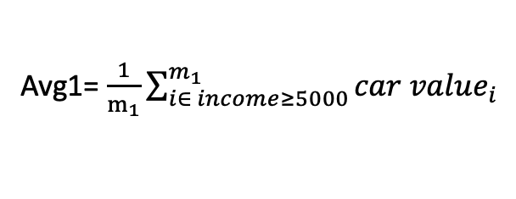
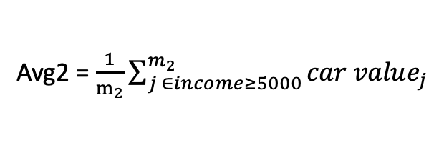
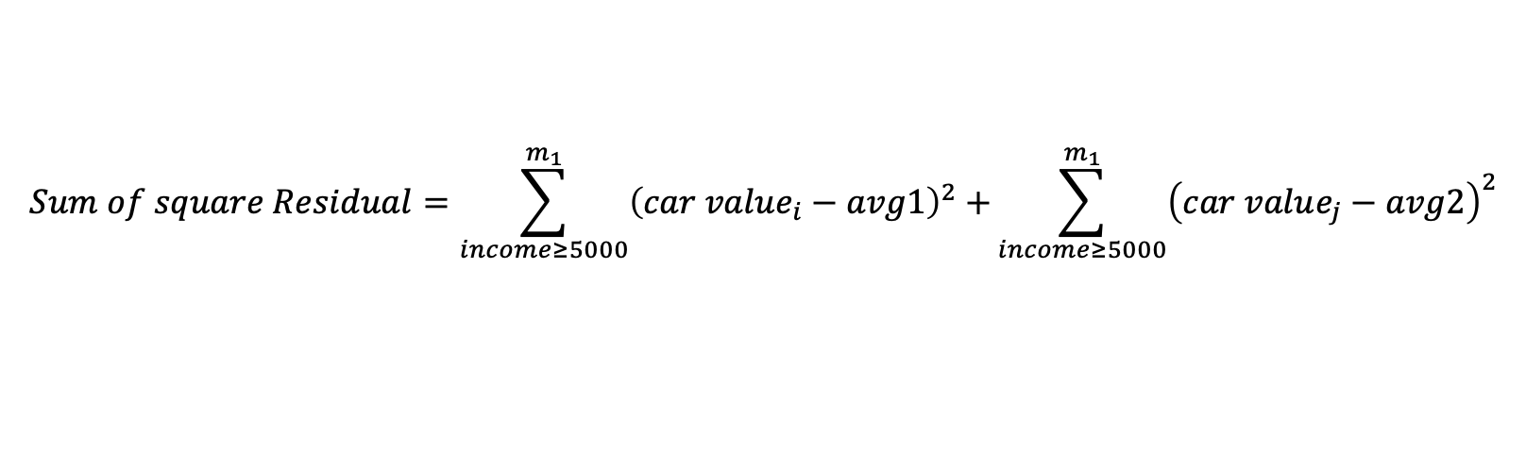
Income < 5000
True
False
Avg1= $\frac{1}{m_{1}}\sum_{i∈ income≥5000}^{m_{1}}{car value_{i}}$
Avg2 = $\frac{1}{m_{2}}\sum_{j ∈income≥5000}^{m_{2}}{car value_{j}}$
$$Sum of square Residual=\sum_{income≥5000}^{m_{1}}{{\left(car value_{i}−avg1\right)}^{2}+}\sum_{income≥5000}^{m_{1}}{{\left(car value_{j}−avg2\right)}^{2}}$$

Slide 9
E.g. Use income to predict car value
Income | Car Value | Average
6000 | 10,000 |  | -8,000
8000 | 20,000 | 18,000 | 2,000
10000 | 24,000 |  | 6,000
Income < 5000
True
False
-8000
2000, 6000

