Slide 2
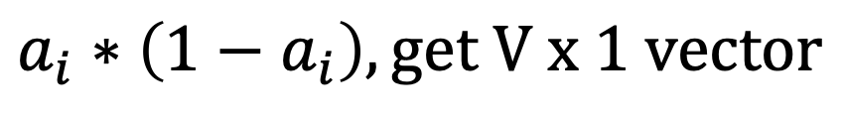
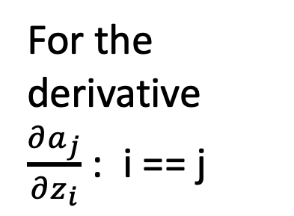
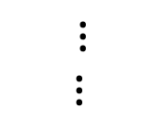



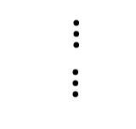


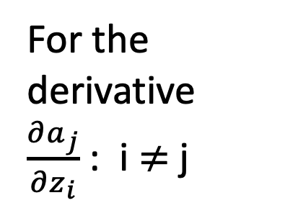


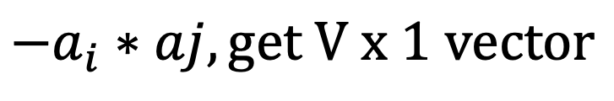
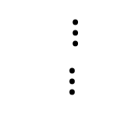







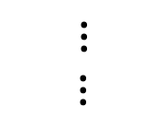





For the derivative $\frac{∂a_{j}}{∂z_{i}}$ : i == j
For the derivative $\frac{∂a_{j}}{∂z_{i}}$ : i $≠$j
$$0$$
$$a_{1}$$
$$a_{i}$$
$$a_{1}$$
$$a_{1}$$
$$a_{i}$$
$$a_{2}$$
$$0$$
$$a_{2}$$
$$a_{2}$$
$⋮$
$⋮$
$⋮$
$⋮$
$$a_{i}$$
$${1−a}_{i}$$
$$a_{i}$$
$$a_{i}$$
$$0$$
$$a_{i}$$
$⋮$
$⋮$
$⋮$
$⋮$
$$0$$
$$a_{V}$$
$$a_{i}$$
$$a_{v}$$
$$a_{V}$$
$$a_{i}∗\left(1−a_{i}\right), get V x 1 vector$$
$${−a}_{i}∗aj, get V x 1 vector$$

