Slide 2
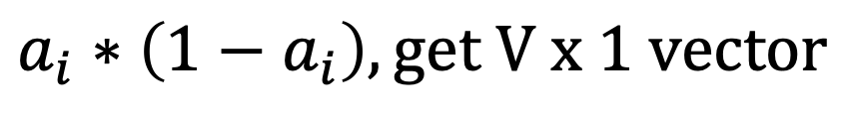
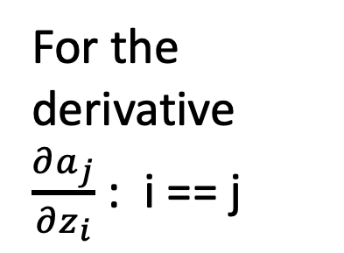
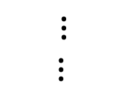



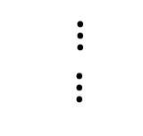


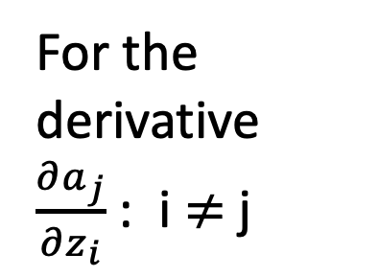


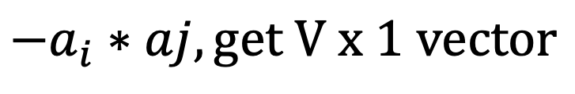
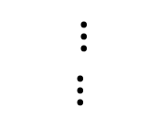







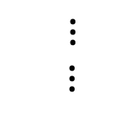





For the derivative $\frac{∂a_{j}}{∂z_{i}}$ : i == j
For the derivative $\frac{∂a_{j}}{∂z_{i}}$ : i $≠$j
$$0$$
$$a_{1}$$
$${−a}_{i}$$
$$a_{1}$$
$$a_{1}$$
$${−a}_{i}$$
$$a_{2}$$
$$0$$
$$a_{2}$$
$$a_{2}$$
$⋮$
$⋮$
$⋮$
$⋮$
$$a_{i}$$
$${1−a}_{i}$$
$$a_{i}$$
$${−a}_{i}$$
$$0$$
$$a_{i}$$
$⋮$
$⋮$
$⋮$
$⋮$
$$0$$
$$a_{V}$$
$${−a}_{i}$$
$$a_{v}$$
$$a_{V}$$
$$a_{i}∗\left(1−a_{i}\right), get V x 1 vector$$
$${−a}_{i}∗aj, get V x 1 vector$$

Slide 3
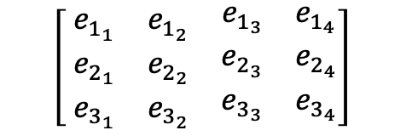
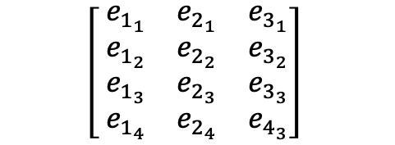
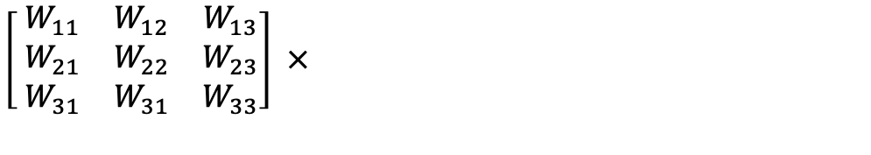
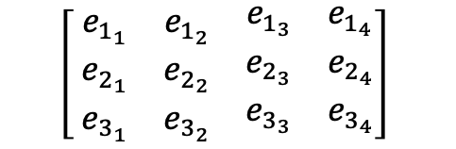
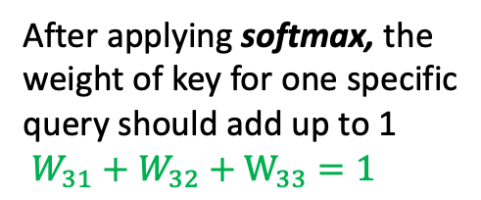
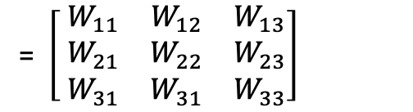

First word embedding vector of Key
The importance of first key to second query
First word embedding vector of Query
$$\left[ \begin{matrix}e_{1_{1}} & e_{1_{2}} & \begin{matrix}e_{1_{3}} & e_{1_{4}}\end{matrix} \\ e_{2_{1}} & e_{2_{2}} & \begin{matrix}e_{2_{3}} & e_{2_{4}}\end{matrix} \\ e_{3_{1}} & e_{3_{2}} & \begin{matrix}e_{3_{3}} & e_{3_{4}}\end{matrix}\end{matrix}\right]$$
$$\left[ \begin{matrix}e_{1_{1}} & e_{2_{1}} & e_{3_{1}} \\ e_{1_{2}} & e_{2_{2}} & e_{3_{2}} \\ \begin{aligned}e_{1_{3}} \\ e_{1_{4}}\end{aligned} & \begin{aligned}e_{2_{3}} \\ e_{2_{4}}\end{aligned} & \begin{aligned}e_{3_{3}} \\ e_{4_{3}}\end{aligned}\end{matrix}\right]$$
= $\left[ \begin{matrix}W_{11} & W_{12} & W_{13} \\ W_{21} & W_{22} & W_{23} \\ W_{31} & W_{31} & W_{33}\end{matrix}\right]$
$$×$$
Query, LQ x D
Key
D x LK
After applying softmax, the weight of key for one specific query should add up to 1
$W_{31}+W_{32}+W_{33}=1$
$$\left[ \begin{matrix}e_{1_{1}} & e_{1_{2}} & \begin{matrix}e_{1_{3}} & e_{1_{4}}\end{matrix} \\ e_{2_{1}} & e_{2_{2}} & \begin{matrix}e_{2_{3}} & e_{2_{4}}\end{matrix} \\ e_{3_{1}} & e_{3_{2}} & \begin{matrix}e_{3_{3}} & e_{3_{4}}\end{matrix}\end{matrix}\right]$$
$\left[ \begin{matrix}W_{11} & W_{12} & W_{13} \\ W_{21} & W_{22} & W_{23} \\ W_{31} & W_{31} & W_{33}\end{matrix}\right]$ $×$

Slide 4
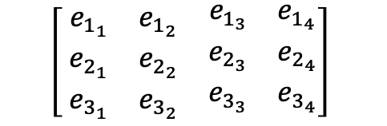
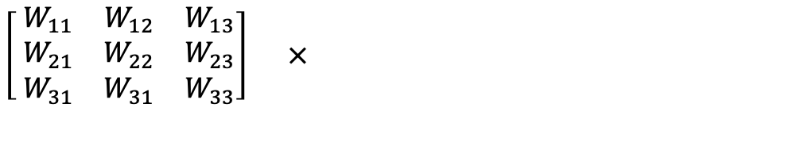

$$\left[ \begin{matrix}e_{1_{1}} & e_{1_{2}} & \begin{matrix}e_{1_{3}} & e_{1_{4}}\end{matrix} \\ e_{2_{1}} & e_{2_{2}} & \begin{matrix}e_{2_{3}} & e_{2_{4}}\end{matrix} \\ e_{3_{1}} & e_{3_{2}} & \begin{matrix}e_{3_{3}} & e_{3_{4}}\end{matrix}\end{matrix}\right]$$
The first embedding vector for output first dimension =
$\left[ \begin{matrix}W_{11} & W_{12} & W_{13} \\ W_{21} & W_{22} & W_{23} \\ W_{31} & W_{31} & W_{33}\end{matrix}\right]$ $×$
$W_{11}e_{1_{1}}+W_{12}e_{2_{1}}$ + $W_{31}e_{3_{1}}$
= The first value embedding vector first dimension * weight of first value to first query+
The second value embedding vector first dimension * weight of second value to first query +
The third value embedding vector first dimension * weight of thrid value to first query
Attention Weight LQ x LK
Value
LK x D

Slide 5
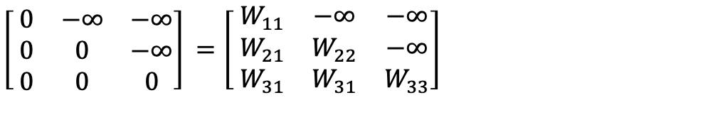
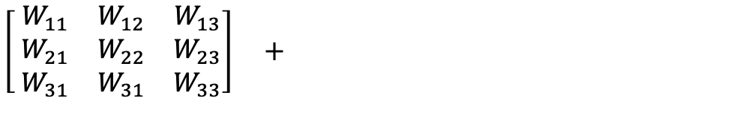
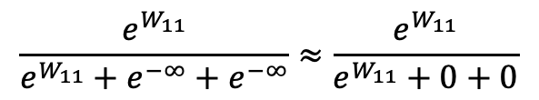
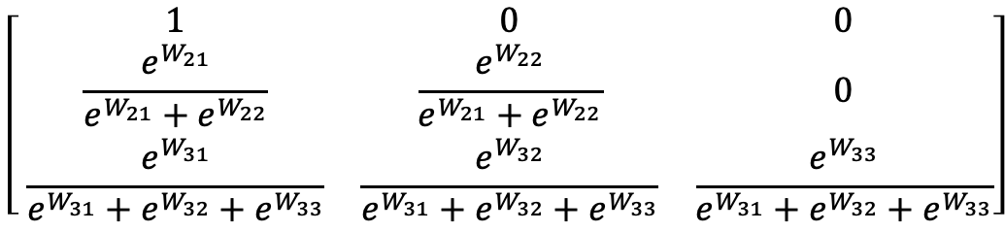
$\left[ \begin{matrix}0 & −∞ & −∞ \\ 0 & 0 & −∞ \\ 0 & 0 & 0\end{matrix}\right]$ $=\left[ \begin{matrix}W_{11} & −∞ & −∞ \\ W_{21} & W_{22} & −∞ \\ W_{31} & W_{31} & W_{33}\end{matrix}\right]$
$\left[ \begin{matrix}W_{11} & W_{12} & W_{13} \\ W_{21} & W_{22} & W_{23} \\ W_{31} & W_{31} & W_{33}\end{matrix}\right]$ $+$
QK^T LQ x LK
M
LQ x LK
After Performing Softmax
$$\left[ \begin{matrix}1 & 0 & 0 \\ \frac{e^{W_{21}}}{e^{W_{21}}+e^{W_{22}}} & \frac{e^{W_{22}}}{e^{W_{21}}+e^{W_{22}}} & 0 \\ \frac{e^{W_{31}}}{e^{W_{31}}+e^{W_{32}}+e^{W_{33}}} & \frac{e^{W_{32}}}{e^{W_{31}}+e^{W_{32}}+e^{W_{33}}} & \frac{e^{W_{33}}}{e^{W_{31}}+e^{W_{32}}+e^{W_{33}}}\end{matrix}\right]$$
$$\frac{e^{W_{11}}}{e^{W_{11}}+e^{−∞}+e^{−∞}}≈\frac{e^{W_{11}}}{e^{W_{11}}+0+0}$$

Slide 6
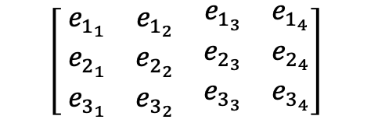
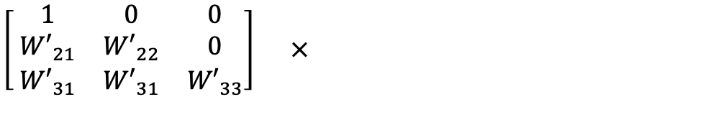


The weight of second key to first query.
$$\left[ \begin{matrix}e_{1_{1}} & e_{1_{2}} & \begin{matrix}e_{1_{3}} & e_{1_{4}}\end{matrix} \\ e_{2_{1}} & e_{2_{2}} & \begin{matrix}e_{2_{3}} & e_{2_{4}}\end{matrix} \\ e_{3_{1}} & e_{3_{2}} & \begin{matrix}e_{3_{3}} & e_{3_{4}}\end{matrix}\end{matrix}\right]$$
$\left[ \begin{matrix}1 & 0 & 0 \\ {W′}_{21} & {W′}_{22} & 0 \\ {W′}_{31} & {W′}_{31} & {W′}_{33}\end{matrix}\right]$ $×$
The first embedding vector for output first dimension =
$$e_{1_{1}}$$
The second embedding vector for output third dimension =
Attention Weight LQ x LK
Value
LK x D
${W′}_{21}e_{1_{3}}+{W′}_{22}$ $e_{2_{3}}$

Slide 7
Dense layer can be positional Encoding layer
Single- Head Attention
Multi Head Attention
N-heads Dense
Layer
N-heads Queries
Dense
Layer
Query
Dense
Layer
Query
Maybe the same dense
Maybe the same dense
N-heads Dense
Layer
N-heads Keys
Input Embedding
Dense
Layer
Input Embedding
Key
Dense
Layer
Value
Maybe the same dense
Maybe the same dense
N-heads Dense
Layer
N-heads Values
Dense
Layer
Value
Dense
Layer
Value

Slide 8
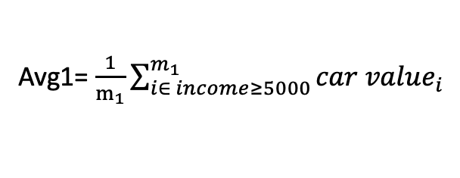
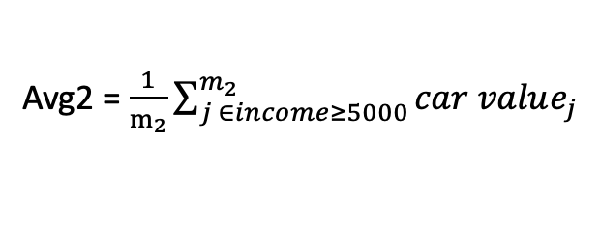
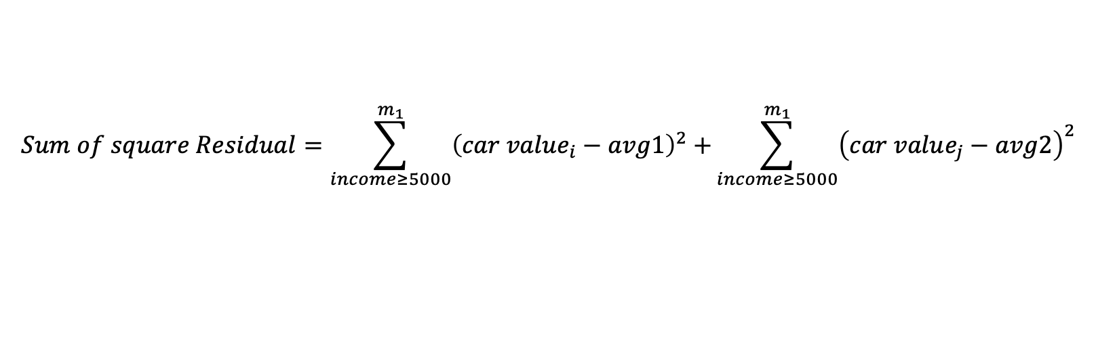
Income < 5000
True
False
Avg1= $\frac{1}{m_{1}}\sum_{i∈ income≥5000}^{m_{1}}{car value_{i}}$
Avg2 = $\frac{1}{m_{2}}\sum_{j ∈income≥5000}^{m_{2}}{car value_{j}}$
$$Sum of square Residual=\sum_{income≥5000}^{m_{1}}{{\left(car value_{i}−avg1\right)}^{2}+}\sum_{income≥5000}^{m_{1}}{{\left(car value_{j}−avg2\right)}^{2}}$$

Slide 9
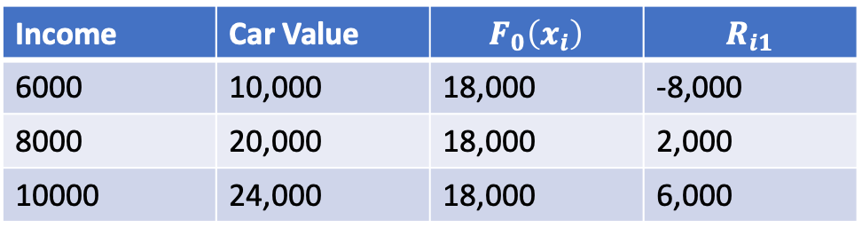
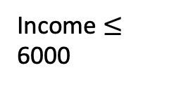
E.g. Use income to predict car value
Income | Car Value | $$F_{0}\left(x_{i}\right)$$ | $$R_{i1}$$
6000 | 10,000 | 18,000 | -8,000
8000 | 20,000 | 18,000 | 2,000
10000 | 24,000 | 18,000 | 6,000
Income $≤$ 6000
True
False
-8000
2000, 6000
Predict Residuals Values Instead of True Value

Slide 10
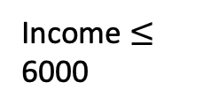
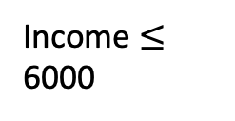
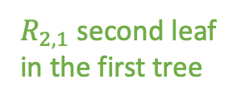
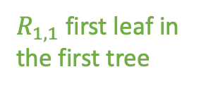
E.g. Use income to predict car value
Income | Car Value | $$F_{0}\left(x_{i}\right)$$ | $$R_{i1}$$
6000 | 10,000 | 18,000 | -8,000
8000 | 20,000 | 18,000 | 2,000
10000 | 24,000 | 18,000 | 6,000
Income $≤$ 6000
Income $≤$ 6000
True
False
True
False
-8000
2000, 6000
-8000
4000
$R_{1,1}$ first leaf in the first tree
$R_{2,1}$ second leaf in the first tree

Slide 11

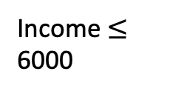
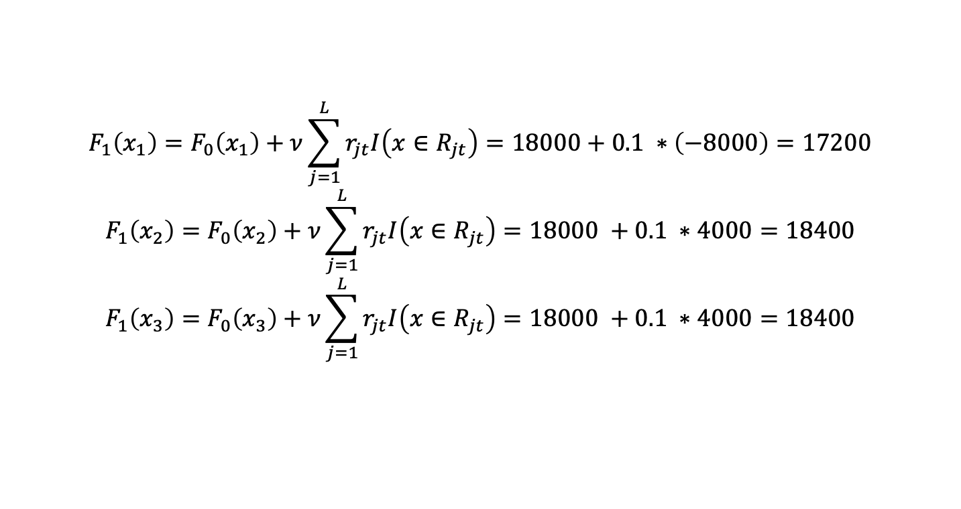

Calculate $F_{1}\left(x_{i}\right)$
Income $≤$ 6000
True
False
-8000
4000
Assume $ν=0.1$
$$F_{1}\left(x_{1}\right)=F_{0}\left(x_{1}\right)+ν\sum_{j=1}^{L}{r_{jt}I\left(x∈R_{jt}\right)=18000+0.1 ∗\left(−8000\right)=17200}$$
$$F_{1}\left(x_{2}\right)=F_{0}\left(x_{2}\right)+ν\sum_{j=1}^{L}{r_{jt}I\left(x∈R_{jt}\right)=18000 +0.1 ∗4000=18400}$$
$$F_{1}\left(x_{3}\right)=F_{0}\left(x_{3}\right)+ν\sum_{j=1}^{L}{r_{jt}I\left(x∈R_{jt}\right)=18000 +0.1 ∗4000=18400}$$

Slide 12
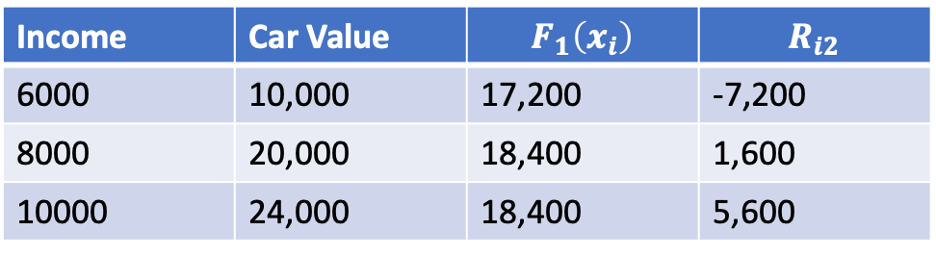
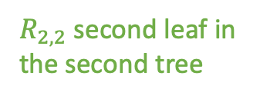
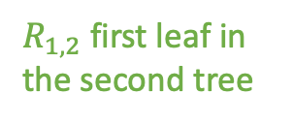
Then t= 2, (A), calculate $r_{i2}$ using $F_{1}\left(x_{i}\right)$
Income | Car Value | $$F_{1}\left(x_{i}\right)$$ | $$R_{i2}$$
6000 | 10,000 | 17,200 | -7,200
8000 | 20,000 | 18,400 | 1,600
10000 | 24,000 | 18,400 | 5,600
t= 2, (B) & (C )
Income $≤$ 6000
Income $≤$ 6000
False
True
False
True
False
-7200
1600, 5600
-7200
3600
$R_{1,2}$ first leaf in the second tree
$R_{2,2}$ second leaf in the second tree

Slide 13
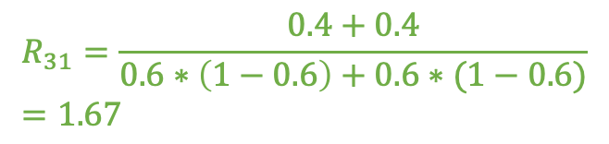
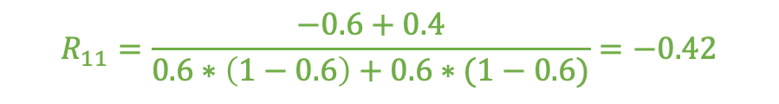


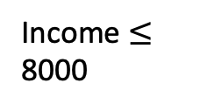
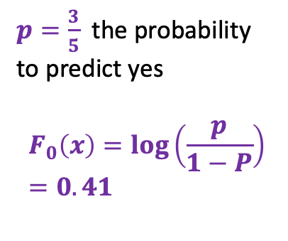
Income | Age | Has Car | Residual
6000 | 25 | No | 0 - 0.6 = -0.6
8000 | 30 | Yes | 1 – 0.6 = 0.4
10000 | 29 | No | 0 - 0.6 = -0.6
12000 | 33 | Yes | 1 – 0.6 = 0.4
15000 | 38 | Yes | 1 – 0.6 = 0.4
$p=\frac{3}{5}$ the probability to predict yes
$$F_{0}\left(x\right)=\log\left(\frac{p}{1−P}\right)=0.41$$
t= 1, (B) & (C )
Income $≤$ 8000
$$R_{11}=\frac{−0.6+0.4}{0.6∗\left(1−0.6\right)+0.6∗(1−0.6)}=−0.42$$
True
False
Note: P is only the same for the first tree, it will change when build next tree
-0.6, 0.4
age $≤$ 29
True
False
-0.6
0.4, 0.4
$$R_{21}=\frac{−0.6}{0.6∗\left(1−0.6\right)}=−2.5$$
$$R_{31}=\frac{0.4+0.4}{0.6∗\left(1−0.6\right)+0.6∗(1−0.6)}=1.67$$

Slide 14
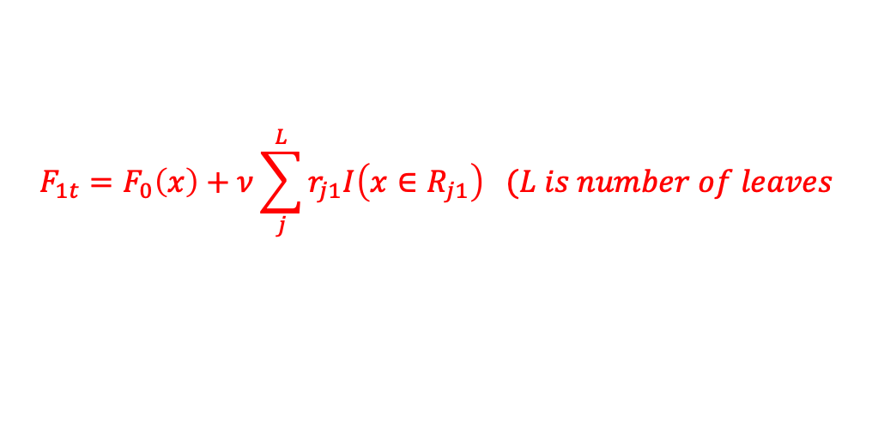
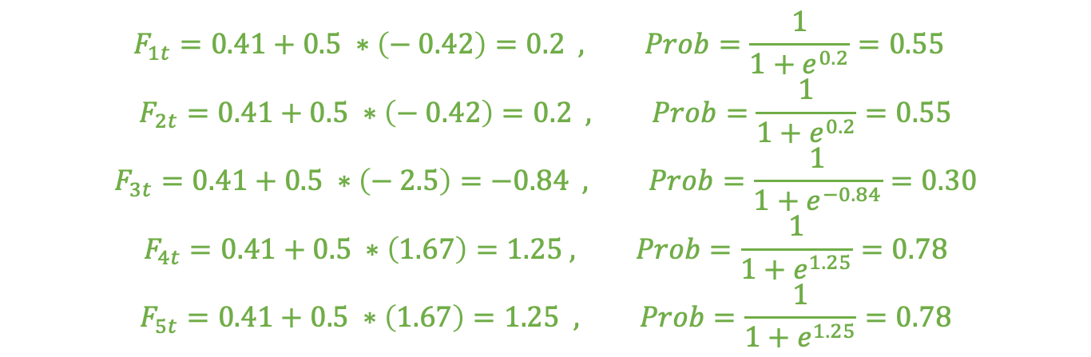
t= 1, (D)
Then Update the Log (odds) and Probability, assume learning rate = 0.5
$$F_{1t}=F_{0}\left(x\right)+ν\sum_{j}^{L}{r_{j1}I\left(x∈R_{j1}\right) (L is number of leaves}$$
Income | Age | Has Car | Predicted Prob | Residual
6000 | 25 | No | 0.55 | -0.55
8000 | 30 | Yes | 0.55 | 0.45
10000 | 29 | No | 0.30 | -0.3
12000 | 33 | Yes | 0.78 | 0.22
15000 | 38 | Yes | 0.78 | 0.22
Use these values to build the second tree
$$F_{1t}=0.41+0.5 ∗\left(− 0.42\right)=0.2 , Prob=\frac{1}{1+e^{0.2}}=0.55$$
$$F_{2t}=0.41+0.5 ∗\left(− 0.42\right)=0.2 , Prob=\frac{1}{1+e^{0.2}}=0.55$$
$$F_{3t}=0.41+0.5 ∗\left(− 2.5\right)=−0.84 , Prob=\frac{1}{1+e^{−0.84}}=0.30$$
$$F_{4t}=0.41+0.5 ∗\left(1.67\right)=1.25 , Prob=\frac{1}{1+e^{1.25}}=0.78$$
$$F_{5t}=0.41+0.5 ∗\left(1.67\right)=1.25 , Prob=\frac{1}{1+e^{1.25}}=0.78$$

Slide 15
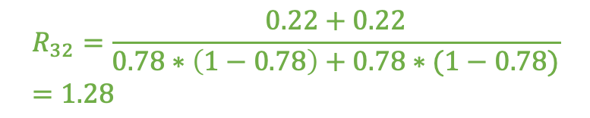
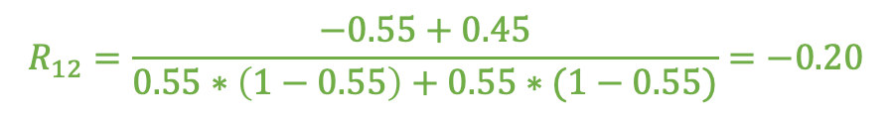
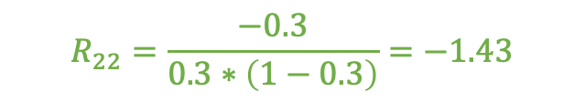
t= 2, (B) & (C )
Income $≤$ 8000
$$R_{12}=\frac{−0.55+0.45}{0.55∗\left(1−0.55\right)+0.55∗(1−0.55)}=−0.20$$
True
False
-0.55, 0.45
age $≤$ 29
True
False
-0.3
0.22, 0.22
$$R_{32}=\frac{0.22+0.22}{0.78∗\left(1−0.78\right)+0.78∗(1−0.78)}=1.28$$
$$R_{22}=\frac{−0.3}{0.3∗\left(1−0.3\right)}=−1.43$$

Slide 16
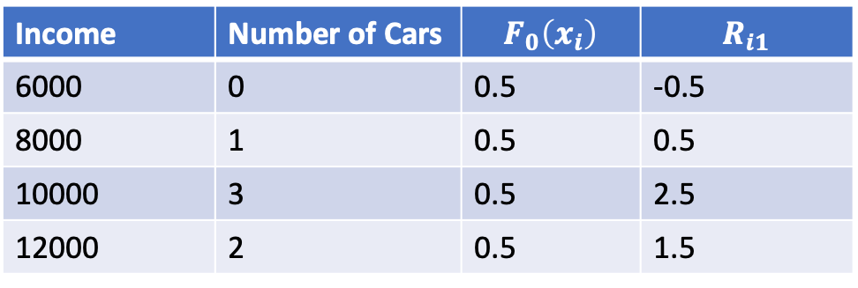

XGBOOST
Step 2(A)
E.g. Use income How many car a person has
And set $λ$ regularization parameter as 1
Income | Number of Cars | $$F_{0}\left(x_{i}\right)$$ | $$R_{i1}$$
6000 | 0 | 0.5 | -0.5
8000 | 1 | 0.5 | 0.5
10000 | 3 | 0.5 | 2.5
12000 | 2 | 0.5 | 1.5
Income $≤$ 6000

Slide 17
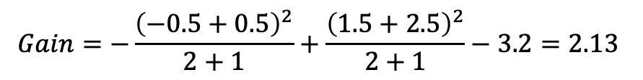
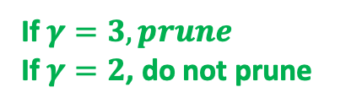
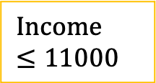
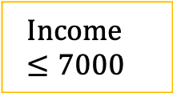





XGBOOST
Step 2(B),
(C ), (D)
$$Root_{Similarity}=\frac{{\left(−0.5+0.5+1.5+2.5\right)}^{2}}{4+1}=3.2$$
$$Income≤7000e$$
$$Gain=−\frac{{(−0.5)}^{2}}{1+1}+\frac{{\left(0.5+1.5+2.5\right)}^{2}}{3+1}−3.2=1.99$$
True
False
-0.5
0.5,2.5,1.5
$$Income≤9000e$$
$$Gain=−\frac{{\left(−0.5+0.5\right)}^{2}}{2+1}+\frac{{\left(1.5+2.5\right)}^{2}}{2+1}−3.2=2.13$$
True
False
If $γ=3, prune$
If $γ=2$, do not prune
Pick This Tree
-0.5, 0.5
2.5,1.5
$$Income≤11000e$$
$$Gain=−\frac{({−0.5+0.5+2.5)}^{2}}{3+1}+\frac{{1.5}^{2}}{1+1}−3.2=−0.51$$
True
False
If choose this tree, even $γ=0$, do not prevent prune, since Gain < 0
-0.5,0.5,2.5
1.5

Slide 18





XGBOOST
Step 2(E)
$$Income≤9000e$$
$$r_{11}=\frac{−0.5+0.5}{2+1}=0$$
True
False
$$r_{12}=\frac{2.5−1.5}{2+1}=0.33$$
-0.5, 0.5
2.5,1.5
$$F_{1}\left(x_{1}\right)=F_{0}\left(x_{1}\right)+ν\sum_{j=1}^{L}{r_{jt}I\left(x∈R_{jt}\right)=0.5+0.8 ∗0=0.5}$$
$$F_{1}\left(x_{2}\right)=F_{0}\left(x_{2}\right)+ν\sum_{j=1}^{L}{r_{jt}I\left(x∈R_{jt}\right)=0.5 +0.8 ∗0=0.5}$$
$$F_{1}\left(x_{3}\right)=F_{0}\left(x_{3}\right)+ν\sum_{j=1}^{L}{r_{jt}I\left(x∈R_{jt}\right)=0.5 +0.8 ∗0.33=0.76}$$
$$F_{1}\left(x_{4}\right)=F_{0}\left(x_{3}\right)+ν\sum_{j=1}^{L}{r_{jt}I\left(x∈R_{jt}\right)=0.5 +0.8 ∗0.33=0.76}$$
XGBOOST
Step 2(F)
Assume $ν=0.8$

Slide 19

XGBOOST
Step 2(A) t= 2
Income | Number of Cars | $$F_{0}\left(x_{i}\right)$$ | $$R_{i1}$$
6000 | 0 | 0.5 | -0.5
8000 | 1 | 0.5 | 0.5
10000 | 3 | 0.76 | 2.24
12000 | 2 | 0.76 | 1.24
Use these values to build the second tree

Slide 20

XGBOOST
Step 2(A)
E.g. Use income If person has a car
And set $λ$ regularization parameter as 1
Income | Has Car? | $$F_{0}\left(x_{i}\right)$$ | $$P_{0}\left(x_{i}\right)$$ | $$R_{i1}$$
6000 | No | 0 | 0.5 | -0.5
8000 | No | 0 | 0.5 | -0.5
10000 | Yes | 0 | 0.5 | 0.5
12000 | Yes | 0 | 0.5 | 0.5

Slide 21








XGBOOST
Step 2 (B),
(C ), (D), (E)
$$Root_{Similarity}=\frac{{\left(−0.5−0.5+0.5+0.5\right)}^{2}}{4+1}=0$$
$$Income≤7000e$$
$$Gain=−\frac{{\left(−0.5\right)}^{2}}{0.5∗(1−0.5)+1}+\frac{{\left(−0.5+0.5+0.5\right)}^{2}}{(\sum_{i=1}^{3}{ }0.5∗\left(1−0.5\right))+1}−0=0.34$$
False
True
-0.5
-0.5,0.5,0.5
$$Income≤9000e$$
$$Gain=−\frac{{\left(−0.5−0.5\right)}^{2}}{\sum_{i=1}^{2}{ }0.5∗\left(1−0.5\right))+1}+\frac{{\left(0.5+0.5\right)}^{2}}{\sum_{i=1}^{2}{ }0.5∗\left(1−0.5\right))+1}−0=1.33$$
True
False
(D)
If $γ=1, prune$
If $γ=0.5$, do not prune
Pick This Tree
-0.5, -0.5
0.5, 0.5
(C)
If Minimum Cover $=1, Do not allow this leaf, Prune$
If Minimum Cover $=0, allow this leaf$, not prune
$Cover=0.5∗\left(1−0.5\right))$+ $0.5∗\left(1−0.5\right))=0.5$
$$Income≤11000e$$
$$Gain=−\frac{({−0.5−0.5+0.5)}^{2}}{\sum_{i=1}^{3}{ }0.5∗\left(1−0.5\right))+}+\frac{{0.5}^{2}}{0.5∗\left(1−0.5\right)+1}−0=0.34$$
True
False
-0.5,-0.5,0.5
0.5

Slide 22








XGBOOST
Step 2(E)
$$Income≤9000e$$
$$r_{11}=\frac{−0.5−0.5}{\sum_{i=1}^{2}{ }0.5∗\left(1−0.5\right))+1}=−0.67$$
True
False
$$r_{12}=\frac{0.5+0.5}{\sum_{i=1}^{2}{ }0.5∗\left(1−0.5\right))+1}=0.67$$
-0.5, -0.5
0.5,0.5
XGBOOST
Step 2(F)
Assume $ν=0.8$
$$F_{1}\left(x_{1}\right)=F_{0}\left(x_{1}\right)+ν\sum_{j=1}^{L}{r_{jt}I\left(x∈R_{jt}\right)=0+0.8 ∗\left(−0.67\right)=−0.53 }$$
$$F_{1}\left(x_{2}\right)=F_{0}\left(x_{2}\right)+ν\sum_{j=1}^{L}{r_{jt}I\left(x∈R_{jt}\right)=0 +0.8 ∗\left(−0.67\right)=−0.53}$$
$$F_{1}\left(x_{3}\right)=F_{0}\left(x_{3}\right)+ν\sum_{j=1}^{L}{r_{jt}I\left(x∈R_{jt}\right)=0 +0.8 ∗0.67=0.53}$$
$$F_{1}\left(x_{4}\right)=F_{0}\left(x_{3}\right)+ν\sum_{j=1}^{L}{r_{jt}I\left(x∈R_{jt}\right)=0 +0.8 ∗0.67=0.53}$$
$$Prob=\frac{1}{1+e^{−(−0.53)}}=0.37$$
$$Prob=\frac{1}{1+e^{−(−0.53)}}=0.37$$
$$Prob=\frac{1}{1+e^{−0.53}}=0.63$$
$$Prob=\frac{1}{1+e^{−0.53}}=0.63$$

Slide 23

XGBOOST
Step 2(A) t= 2
Income | Has Car? | $$F_{1}\left(x_{i}\right)$$ | $$P_{1}\left(x_{i}\right)$$ | $$R_{i2}$$
6000 | No | -0.53 | 0.37 | -0.37
8000 | No | -0.53 | 0.37 | -0.37
10000 | Yes | 0.53 | 0.63 | 0.37
12000 | Yes | 0.53 | 0.63 | 0.37
Use these values to build the second tree

Slide 24

Income | Has Car?
6000 | No
8000 | No
10000 | Yes
12000 | Yes
etc | etc…
Income | Has Car?
6000 | No
etc | etc…
Income | Has Car?
8000 | No
etc | etc…
Income | Has Car?
10000 | Yes
etc | etc…
Income | Has Car?
12000 | Yes
etc | etc…
The sum of weight in each quantiles is equal
Sum of weight in First Quantile = Sum of Weight in Second Quantile

Slide 25





$weight=$ 0.8 * (1-0.8) =0.16
X is predicted
$weight=$ 0.6 * (1-0.6) =0.24
$weight=$ 0.3 * (1-0.3) =0.21
$weight=$ 0.2 * (1-0.2) =0.16
If don’t have much confidence if previously predicted probability close to 0.5, the weights are large

Slide 26
Income | Has Car?
6000 | No
8000 | No
10000 | Yes
12000 | Yes
etc | etc…
A large Dataset, XGBoost splits data so that each drive gets a unique set of records
Income | Has Car?
6000 | No
etc | etc…
Hard
Drive
Income | Has Car?
12000 | Yes
etc | etc…
Hard
Drive
Then If CPU needs data, both Drive can be reading data at the same time
CPU

Slide 27




Sparsity-Aware Split Finding
E.g. Use income How many car a person has
And set $λ$ regularization parameter as 1
Income | Number of Cars | $$F_{0}\left(x_{i}\right)$$ | $$R_{i1}$$
6000 | 0 | 0.5 | -0.5
8000 | 1 | 0.5 | 0.5
10000 | 3 | 0.5 | 2.5
? | 2 | 0.5 | 2.5
12000 | 2 | 0.5 | 1.5
? | 5 | 0.5 | 4.5
Only use this table to select threshold
$$Root_{Similarity}=\frac{{\left(−0.5+0.5+2.5+2.5+1.5+4.5\right)}^{2}}{6+1}=17.29$$
Income | Number of Cars | $$F_{0}\left(x_{i}\right)$$ | $$R_{i1}$$
6000 | 0 | 0.5 | -0.5
8000 | 1 | 0.5 | 0.5
10000 | 1 | 0.5 | 2.5
12000 | 5 | 0.5 | 1.5
Income | Number of Cars | $$F_{0}\left(x_{i}\right)$$ | $$R_{i1}$$
? | 3 | 0.5 | 2.5
? | 4 | 0.5 | 4.5

Slide 28








$$Gain_{left}$$
$$Gain_{Right}$$
$$Gain_{left}=−\frac{{\left(−0.5+2.5+4.5\right)}^{2}}{3+1}+\frac{{\left(0.5+1.5+2.5\right)}^{2}}{3+1}−17.29=−1.66$$
$$Income≤7000e$$
$$Income≤7000e$$
True
False
True
False
$$Gain_{right}=−\frac{{\left(−0.5\right)}^{2}}{1+1}+\frac{{\left(0.5+1.5+2.5+2.5+4.5\right)}^{2}}{3+1}−17.29=4.88$$
-0.5, (2.5,4.5)
-0.5
0.5,2.5,1.5
(2.5,4.5)
0.5,2.5,1.5
$$Gain_{left}=−\frac{{\left(−0.5+0.5+2.5+4.5\right)}^{2}}{4+1}+\frac{{\left(1.5+2.5\right)}^{2}}{2+1}−17.29=−2.15$$
$$Income≤9000e$$
$$Income≤9000e$$
$$Gain_{right}=−\frac{{\left(−0.5+0.5\right)}^{2}}{4+1}+\frac{{\left(1.5+2.5+2.5+4.5\right)}^{2}}{2+1}−17.29=6.91$$
True
False
True
False
-0.5, 0.5
(2.5,4.5)
2.5,1.5
-0.5, 0.5
2.5,1.5
(2.5,4.5)
Pick This Tree
$$Income≤11000e$$
$$Income≤11000e$$
$$Gain_{left}=−\frac{({−0.5+0.5+2.5+2.5+4.5)}^{2}}{5+1}+\frac{{\left(1.5\right)}^{2}}{1+1}−17.2=−1.12$$
True
False
True
False
$$Gain_{right}=−\frac{({−0.5+0.5+2.5)}^{2}}{3+1}+\frac{{\left(1.5+2.5+4.5\right)}^{2}}{3+1}−17.2=2.34$$
-0.5,0.5,2.5
(2.5,4.5)
1.5
-0.5,0.5,2.5
1.5
(2.5,4.5)

Slide 29

$$Income≤9000e$$
Default Path for Missing values
True
False
-0.5, 0.5
2.5,1.5
(2.5,4.5)
Income | Number of Cars
? | ?
? | ?

Slide 30



Slide 31





Margin
Margin
To predict positive example
To predict positive example
$$p^{(i)}\left|\left|θ\right|\right|≥1 if p^{\left(i\right)} small positve number,$$
$$p^{(i)}\left|\left|θ\right|\right|≥1 if p^{\left(i\right)}large positve number,$$
$need\left|\left|θ\right|\right|$ to be large, and objective want $\left|\left|θ\right|\right|$ small
$\left|\left|θ\right|\right|$ can be smaller
To predict negative example
To predict negative example
$$p^{(i)}\left|\left|θ\right|\right|<1 if p^{\left(i\right)} small negative number$$
$$p^{(i)}\left|\left|θ\right|\right|<1 if p^{\left(i\right)} large negative number$$
$, need\left|\left|θ\right|\right|$ to be large
$\left|\left|θ\right|\right|$ can be smaller

Slide 32



$Suppose x is two dimensional vector and l=\left[\begin{matrix}3 \\ 3\end{matrix}\right]$, so $\left[\begin{matrix}x1 \\ x2\end{matrix}\right]=\left[\begin{matrix}3 \\ 3\end{matrix}\right]$ is the maximum point

Slide 33











Decision Boundary
Assume $θ_{0}=−0.5,θ_{1}=1,θ_{2}=1,θ_{3}=0$
$$f1=similarity \left(x^{\left(i\right)}−l^{\left(1\right)}\right)$$
$$f2=similarity \left(x^{\left(i\right)}−l^{\left(2\right)}\right)$$
$$f3=similarity \left(x^{\left(i\right)}−l^{\left(3\right)}\right)$$
$$For x_{1}$$
$$θ_{0}+θ_{1}f1+θ_{2}f2+θ_{3}f3=−0.5+1∗1+1∗0+0∗0$$
= 0.5 ->. Positive
$$For x_{2}$$
$$θ_{0}+θ_{1}f1+θ_{2}f2+θ_{3}f3=−0.5+1∗0+1∗1+0∗0$$
= 0.5 ->. Positive
$$For x_{3}$$
$$θ_{0}+θ_{1}f1+θ_{2}f2+θ_{3}f3=−0.5+1∗0+1∗0+0∗1$$
= - 0.5 ->. negative

