Slide 1
Instant Insanity on 12 qubits
Half the qubits, no penalty terms, and a 44% hit rate on AWS SV1 against a 0.146% random baseline.
Daksh Goswami · Rueben · Ishal
Qiskit Fall Fest Connecticut 2026 · qBraid challenge · UConn Quantum Computing
Notes:
Four cubes, four colours. Stack them so every colour shows once on each side. We solve it with QAOA on an encoding that uses half the qubits of the starter's.

Slide 2
A tiny puzzle with a brutal search space
331,776
8
< 1 s
ways to stack four cubes
that actually work
for classical brute force
Every cube shows one of three opposite-face pairs on the front/back axis and a different pair on left/right, so each cube has exactly 6 legal choices. A tower is solved when all four sides show all four colours.
Brute force already wins at N = 4.
We say so on every slide that reports a number. What the quantum route buys is a method that never enumerates — and a cost curve we can measure as the puzzle grows.
Notes:
331,776 stackings, 8 solved orientations, which are one tower from eight angles.

Slide 3
Make every bitstring legal, and the penalties disappear
One-hot (starter)
Compact (ours)
6 qubits per cube → 24 for four cubes
most bitstrings are illegal
penalties for "one pair per axis"
penalty for "a pair cannot serve both axes"
XY mixer + W-state preparation
3 qubits per cube → 12 for four cubes
all 8 states map onto the 6 legal choices
no bitstring is ever illegal
no penalty terms, nothing to tune
plain X mixer is enough
24 → 12 qubits
cost = Σ over axes and colours of (dₖ − 2)²
zero exactly for a solved tower
Notes:
Six legal choices fit in three qubits, which hold eight states. Map all eight onto the six. Then the structural rules are in the encoding, not in penalty weights.

Slide 4
We checked the model before we trusted a single shot
1
Hamiltonian = cost
On every one of the 4,096 bitstrings. Difference exactly 0.0, not a tolerance.
2
Two cost implementations
A vectorised one and a plain-Python one written straight from the definition.
3
Decoder, both directions
No zero-cost bitstring fails the starter's solves(); no positive-cost one passes it.
4
Fast simulator = Qiskit
The hand-written statevector used in the angle search agrees to 1e-15.
Every success rate we report is the fraction of shots that pass the classical checker — never the fraction below an energy threshold.
Notes:
A low energy is not proof. Each reported tower is rebuilt and handed to the starter notebook's own solves().

Slide 5
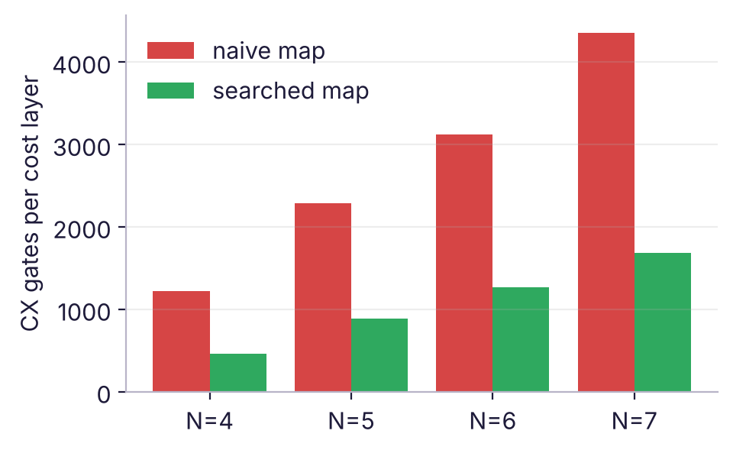
The state-to-choice map is a free 2.6× saving
Two of the eight states are duplicates. Which ones is ours to choose, and it changes the Walsh expansion of the cost — so it changes how many Z strings the Hamiltonian has and how long they are. We searched all 720 × 36 maps and scored each by the CX gates one cost layer needs. Same Hamiltonian, same answers, cheaper circuit.
1216
460
6 → 4
CX per layer, naive map
CX per layer, searched
longest Z string
The search is pure classical preprocessing: it runs once, costs seconds, and the circuit it produces is provably the same Hamiltonian.
Notes:
This was free performance. We did not change the physics, only the labelling.

Slide 6
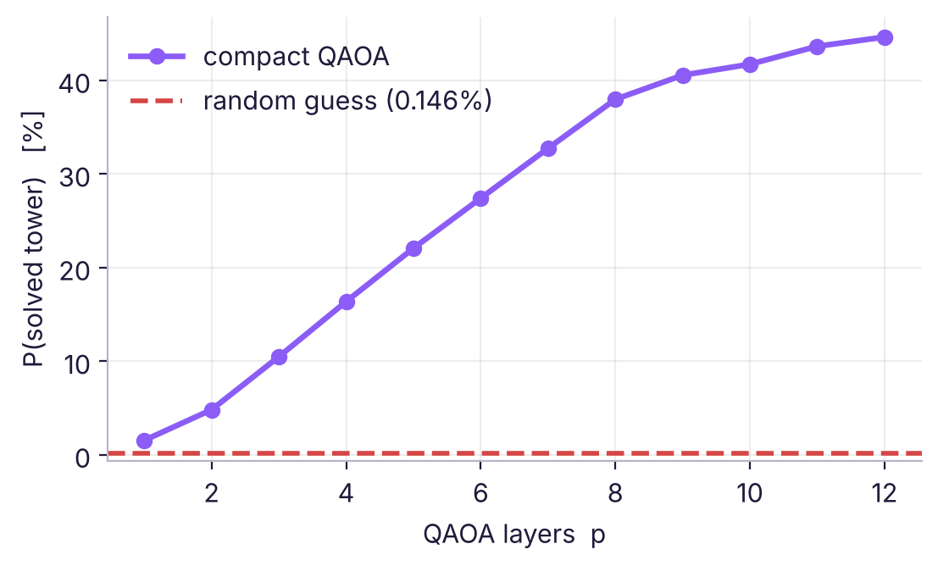
How we optimised mattered more than the circuit
CVaR instead of the mean
Minimising the average cost is not the same as maximising P(solved): the average is dominated by the bulk of bad bitstrings. CVaR averages only the best 30%, so the optimiser chases the low-cost tail where the answers are.
Layer-by-layer growth
Optimising 2p angles from a random start stalls. Instead solve p = 1, interpolate those angles into a p + 1 schedule, re-optimise. Every layer starts from a good guess.
Same Hamiltonian, same hardware: ~2% → 44.6%
Notes:
Random-restart COBYLA on the mean stalled near 2 percent. CVaR plus layerwise growth reached 45 on the identical Hamiltonian.

Slide 7
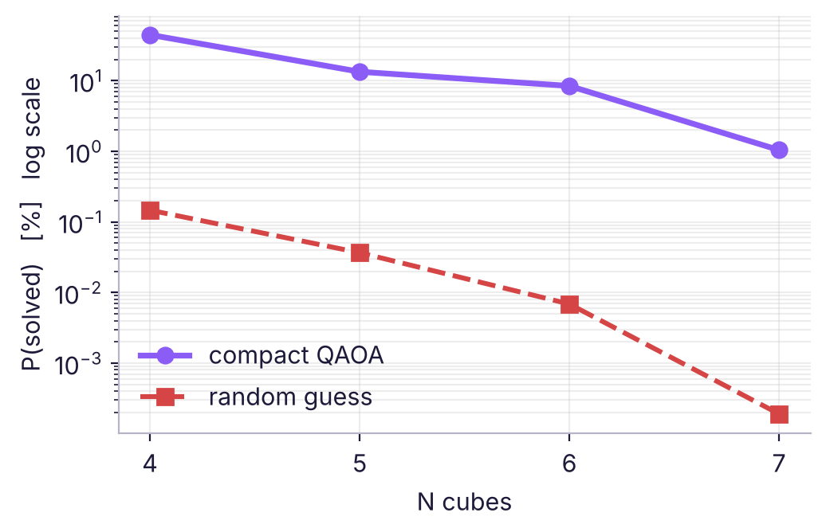
Results, and how they scale with N
N | Qubits | CX/layer | p | P(solved) | Random | Lift
4 | 12 | 460 | 12 | 44.20% | 0.1465% | ×302
5 | 15 | 890 | 10 | 13.37% | 0.0366% | ×365
6 | 18 | 1264 | 10 | 8.43% | 0.0069% | ×1227
7 | 21 | 1686 | 8 | 1.04% | 0.0002% | ×5457
N = 4 ran on AWS SV1: 884 of 2000 shots = 44.20% measured, against 44.62% predicted. Inside sampling error.
The lift over random grows with N, but the absolute success rate falls, because the solution fraction shrinks faster than the algorithm gains. We report both, not only the flattering one.
Puzzles with N > 4 from the starter's make_puzzle(n, seed): N=5 seed 16, N=6 seed 86, N=7 seed 68. Every N re-verified against the classical cost, and its alias map re-searched, before any angle search.
Notes:
Four cubes on SV1, the larger ones on the local simulator.

Slide 8
What we are not claiming
No quantum speedup. Brute force solves the four-cube puzzle in a fraction of a second, far faster than building, optimising and sampling these circuits. The honest comparison is against random guessing inside the same encoding, and that is what every table reports. The general N-cube problem is NP-complete, and nothing here changes that.
Next. The cost layer is the bottleneck, and most of it is weight-3 and weight-4 Z strings. Order them to share CX ladders between neighbouring terms, and warm-start the angles for N + 1 from the optimised schedule at N — the layerwise growth already hints it transfers.
Notes:
The thing we would try next is CX-ladder sharing across neighbouring Z terms.

