Slide 1
How to deal with Categorical Variables in ML?

Slide 2
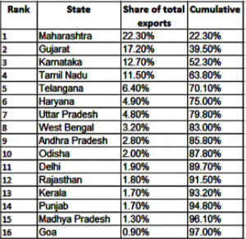
Categorical variables (wiki) are those that represent a fixed number of possible values, rather than a continuous number.
They differ from ordinal variables in that the
distance from one category to another ought to be equal regardless of the number of categories, as opposed to ordinal variables which have some intrinsic ordering.
ML algorithms wants numbers, and not strings, as their inputs so we need some method of coding to convert Categorical variables to Numeric.

Slide 3
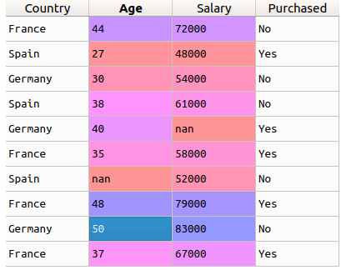
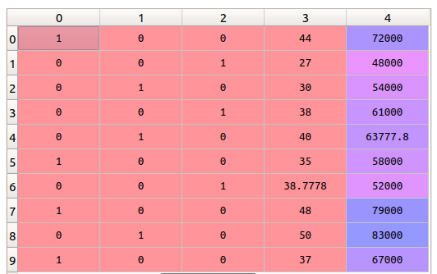
What we know already?
Dummy Variables/One Hot Encoding- is the most common way of converting Categorical variables to Numeric
One-Hot Encoding
Dummy Variable means the same as OHE except that in Dummy variables we drop one of the columns

Slide 4
Disadvantage of Label Encoding/Dummy Variable
Curse of Dimensionality- When there are too many categories of a CATEGORICAL variable (High Cardinality), creating dummy variables or even ONE Hot encoding will result into too many new columns.
For example if you have 10k rows and one categorical column (say X1) that has 100 different categories, after creation of Dummy Variables there will be 10k rows and 99 columns (100 columns in case of One Hot Encoding) from just column X1. This will make it very hard for any ML model to fit the data well.
So what Should we do?
Drop the column? What if the column is an important one
Bin the different categories? As a beginner, this is something I used to do often. Keep the most occurring Categories
and group the remaining into 1 category and give it some name (say Other).
So, in the above example we find out that only 20 of the categories in the Variable X has a good proportion in the data, say they form 85-90% of the data and rest 80 categories comprise the remaining 15-20%. So, we group the 80 categories together and call it others. Then, as usual we go for dummy variable/OHE. Note, now we hall have only 20/21 new columns ( DV/OHE respectively). This may save us from CoD to a large extent.
However this is flawed!

Slide 5
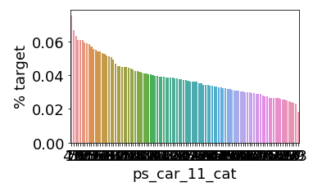
What if the data ( and the different categories) look like this?
Each Category has almost equal proportion. So one cannot select a few of them as the most common in the data.
When we plot the different categories wrt % target( avg Probability of target in case of Classification and Avg in case of Regression), each of the different categories has a different proportion/Avg, highlighting that each category has a different relation with the target variable, there our previous approach may not be the best way forward.

Slide 6
Target Encoding
Use the target variable
Classification
Regression
Take Probability of the TARGET of each category in the Categorical Column
Take Average of the TARGET of each category in the Categorical Column

Slide 7
Frequency Encoding
Take the Frequency of each category from the training data

Slide 8
Binary Encoding
Convert the Categories into numeric using any Label Encoding
Convert Label Encoding into its binary equivalent
Split each bit into a column and have its input as 1/0 from the binary equivalent of the number.

Slide 9
Ref:
https://www.kdnuggets.com/2015/12/beyond-one-hot-exploration-categorical-variables.html

