Slide 1


教育部
新型態資安實務課程計畫
課程模組:網站安全模組
單元模組:網站安全分析
網站安全分析工具
Burpsuite實戰
錄影標號:Burpsuite
錄影教師:龍大大
資訊安全基礎實務課程 A practical introduction to security

Slide 2
網站安全分析工具
Burpsuite

Slide 3
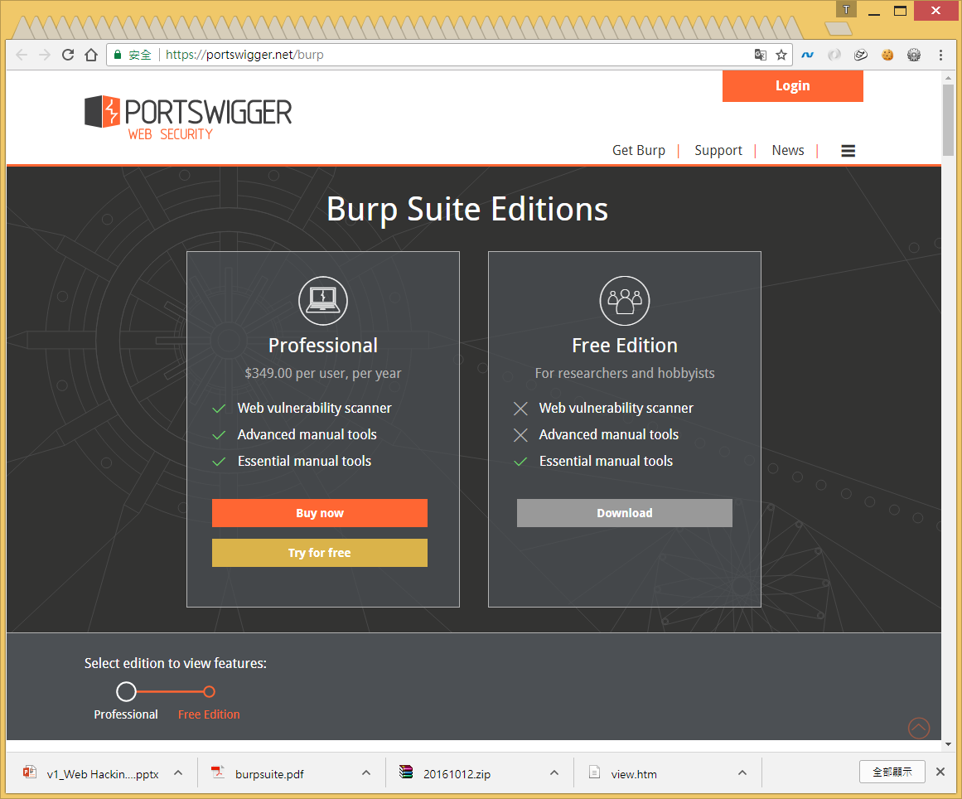

Burp Suite https://en.wikipedia.org/wiki/Burp_suite
官方網址 https://portswigger.net/
Burp Suite is a graphical tool for testing Web application security.
The tool is written in Java and developed by PortSwigger Security.
The tool has 2 versions:
Free version that can be downloaded free of charge(Free Edition)
Full version that can be purchased after a trial period (Professional Edition).

Slide 4
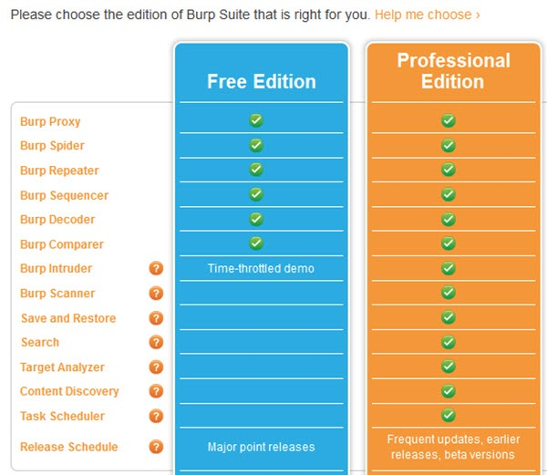

Slide 5
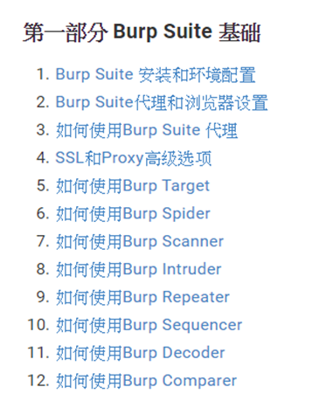
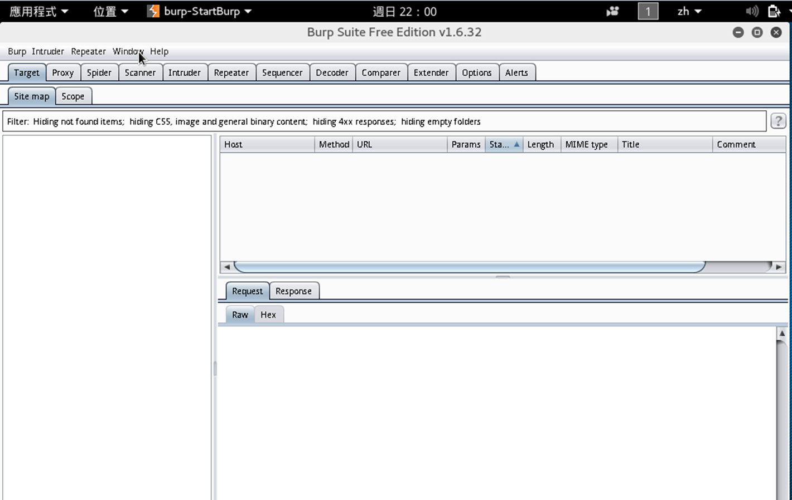
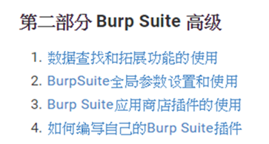
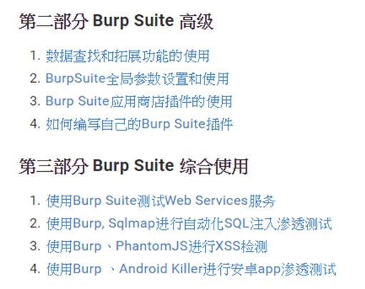
burpsuite實戰指南 https://t0data.gitbooks.io/burpsuite/content/

Slide 6
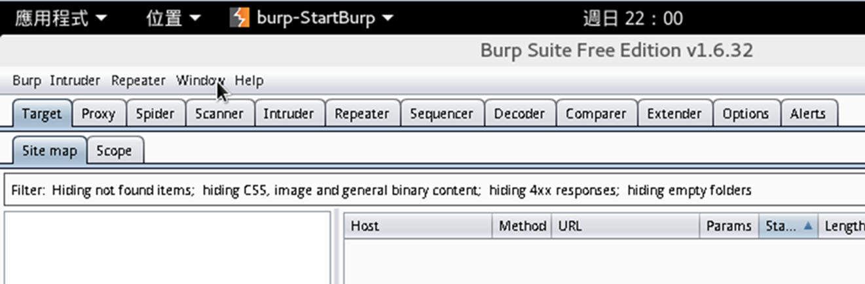
Burp suite::tools https://portswigger.net/burp/help/suite_burptools.html
tools | Description
Target | This tool contains detailed information about your target applications, and lets you drive the process of testing for vulnerabilities.
Proxy | This is an intercepting web proxy that operates as a man-in-the-middle between the end browser and the target web application. It lets you intercept, inspect and modify the raw traffic passing in both directions.
Spider | This is an intelligent application-aware web spider that can crawl an application to locate its content and functionality.
Scanner [Pro version] | This is an advanced web vulnerability scanner, which can automatically discover numerous types of vulnerabilities.
Intruder | This is a powerful tool for carrying out automated customized attacks against web applications. It is highly configurable and can be used to perform a wide range of tasks to make your testing faster and more effective.
Repeater | This is a simple tool for manually manipulating and reissuing individual HTTP requests, and analyzing the application's responses.
Sequencer | This is a sophisticated tool for analyzing the quality of randomness in an application's session tokens or other important data items that are intended to be unpredictable.
Decoder | This is a useful tool for performing manual or intelligent decoding and encoding of application data.
Comparer | This is a handy utility for performing a visual "diff" between any two items of data, such as pairs of similar HTTP messages.
Extender | This lets you load Burp extensions, to extend Burp's functionality using your own or third-party code.

Slide 7


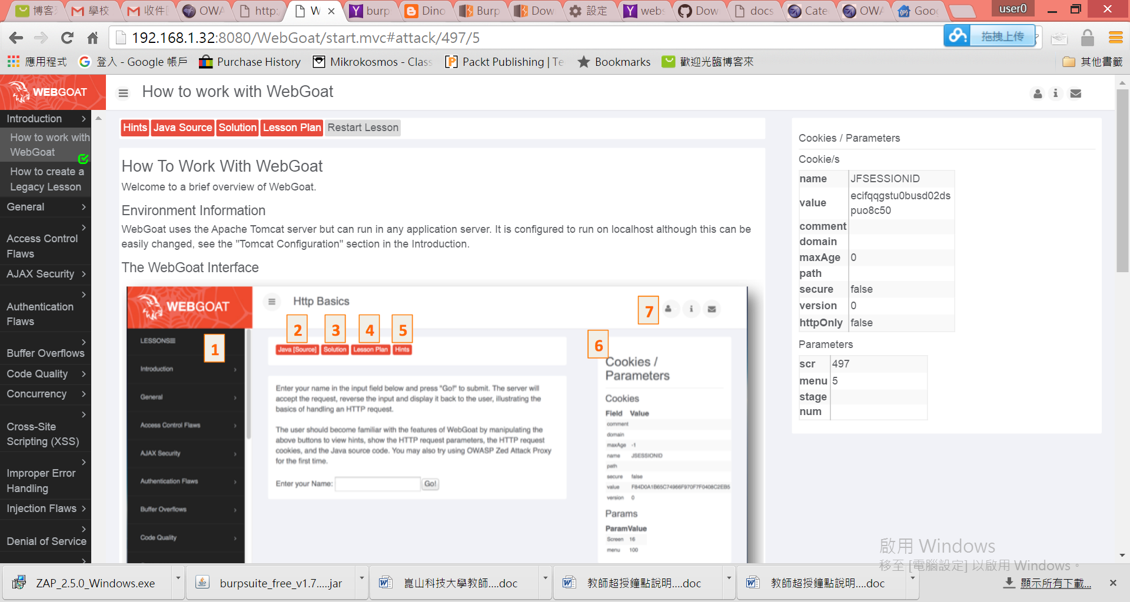





Burp suite:: 強大功能
web proxy|web debugger
Intercept browser traffic using man-in-the-middle proxy
漏洞平台
利用Burp Suite進行暴力破解

Slide 8
Burpsuite教學平台
Kali linux

Slide 9
Burpsuite
實戰
Web101/Web-6:Burp Suite

Slide 10
題目敘述
題目參考來源:https://github.com/allanlw/builds-hackme
管理者的網站常是駭客最想登入的地方。
要做到權限控管需要小心設計，因為設計不良的網站，常會使駭客攔截封包後修改並送出，進而造成網站機敏內容外洩。
你知道如何使用非管理者身分在設計不良的網站取得管理者權限登入嗎?
本題任務是請你完成上述使命?
提示1: 你知道如何攔截並修改封包嗎?
提示2: 你可以使用Burp Suite等工具

Slide 11
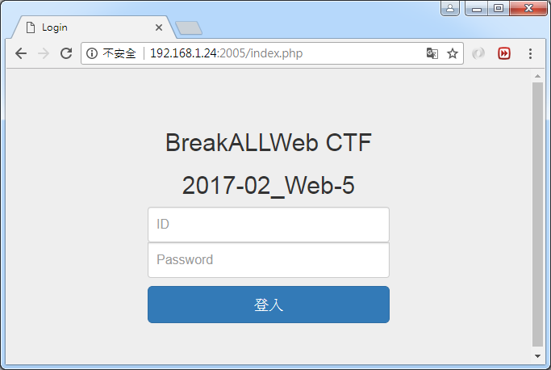
題目

Slide 12
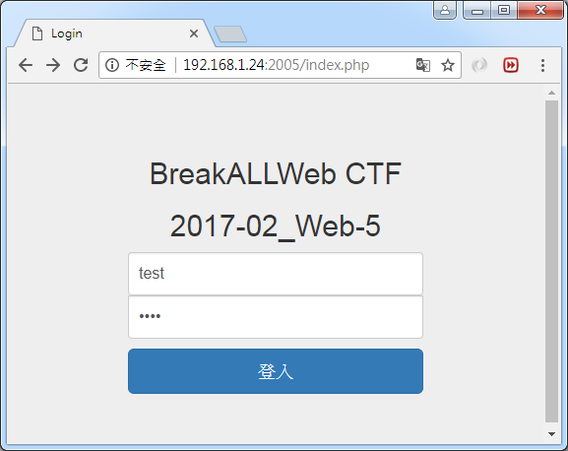
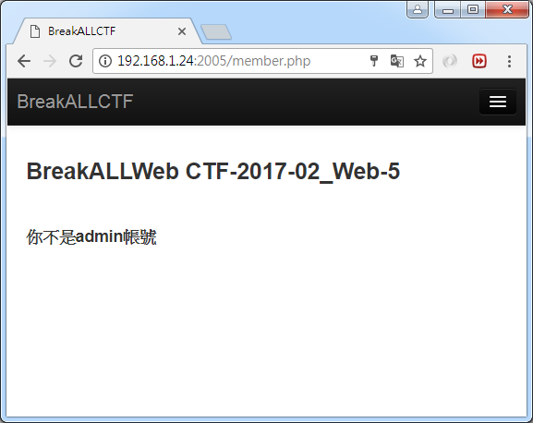
題目

Slide 13
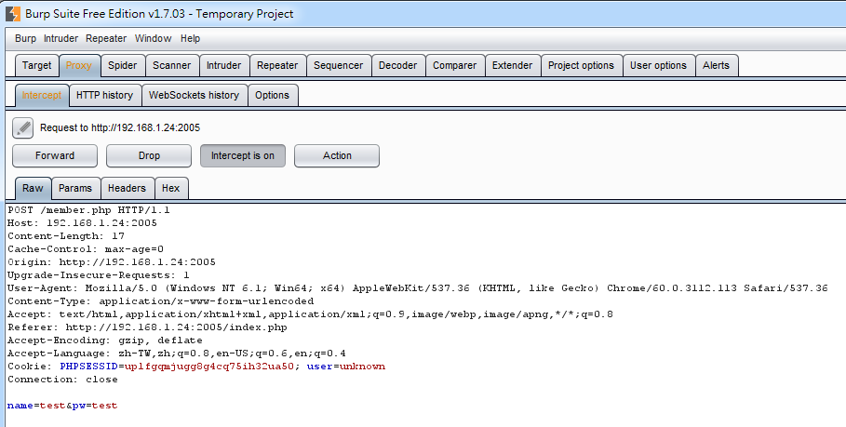
題目

Slide 14
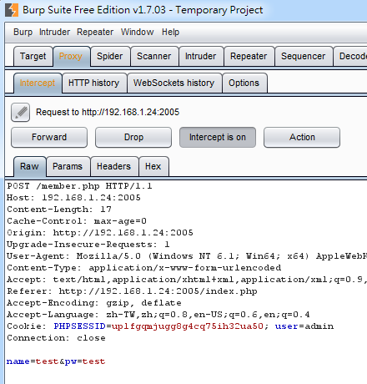
題目

Slide 15
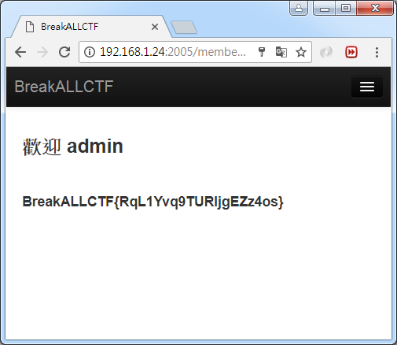
題目

