Slide 1
機器學習演算法分析與實測
機器學習與資訊安全
學生:
老師:偉大的恩師龍大大

Slide 2
agenda
機器學習與人工智慧
機器學習類型
監督式學習
非監督式學習
監督式學習演算法與實測
非監督式學習演算法與實測

Slide 3
機器學習與人工智慧

Slide 4
機器學習

Slide 5
人工智慧

Slide 6
機器學習類型

Slide 7
機器學習類型
監督式學習
非監督式學習
半監督式學習
強化學習

Slide 8
監督式學習

Slide 9
非監督式學習

Slide 10
半監督式學習

Slide 11
強化學習

Slide 12
監督式學習演算法與實測

Slide 13
監督式學習演算法

Slide 14
非監督式學習演算法與實測

Slide 15
非監督式學習演算法
聚類分析（cluster analysis）
關聯規則（association rule）
維度縮減（dimensionality reduce）
GAN

Slide 16
聚類分析 cluster analysis
K-means

Slide 17
K-means
similarity相似度
歐基李德距離Euclidean distance
1. 先設定好要分成多少(k)群。
2. 隨機給k個群心。
3. 每個資料都會所有k個群心算歐式距離(歐基李德距離Euclidean distance，其實就是直線距離公式，這邊距離當然也可以換成別種距離公式，但基本上都還是以歐式距離為主)。
4. 將每筆資料分類判給距離最近的那個群心。
5. 每個群心內都會有被分類過來的資料，根據這些資料重新計算新的群心。
6. 一直重複3–5，直到所有群心不在有太大的變動(收斂)，結束。

Slide 18
K-means演算法實測
https://github.com/My-Machine-Learning-Projects-2020/K-Means-Clustering-with-Python-part-2
資料
"","Private","Apps","Accept","Enroll","Top10perc","Top25perc","F.Undergrad","P.Undergrad","Outstate","Room.Board","Books","Personal","PhD","Terminal","S.F.Ratio","perc.alumni","Expend","Grad.Rate"

Slide 19
K-means演算法實測
https://github.com/My-Machine-Learning-Projects-2020/K-Means-Clustering-with-Python-part-2

Slide 20
K-means演算法實測
https://github.com/My-Machine-Learning-Projects-2020/K-Means-Clustering-with-Python-part-2
資料
"","Private","Apps","Accept","Enroll","Top10perc","Top25perc","F.Undergrad","P.Undergrad","Outstate","Room.Board","Books","Personal","PhD","Terminal","S.F.Ratio","perc.alumni","Expend","Grad.Rate"

Slide 21
a data frame with 777 observations on the following 18 variables.
# * Private A factor with levels No and Yes indicating private or public university
# * Apps Number of applications received
# * Accept Number of applications accepted
# * Enroll Number of new students enrolled
# * Top10perc Pct. new students from top 10% of H.S. class
# * Top25perc Pct. new students from top 25% of H.S. class
# * F.Undergrad Number of fulltime undergraduates
# * P.Undergrad Number of parttime undergraduates
# * Outstate Out-of-state tuition
# * Room.Board Room and board costs
# * Books Estimated book costs
# * Personal Estimated personal spending
# * PhD Pct. of faculty with Ph.D.’s
# * Terminal Pct. of faculty with terminal degree
# * S.F.Ratio Student/faculty ratio
# * perc.alumni Pct. alumni who donate
# * Expend Instructional expenditure per student
# * Grad.Rate Graduation rate

Slide 22
K-means演算法實測
https://github.com/My-Machine-Learning-Projects-2020/K-Means-Clustering-with-Python-part-2
from sklearn.cluster import KMeans
import numpy as np
X = np.array([[1, 2], [1, 4], [1, 0], [10, 2], [10, 4], [10, 0]])
kmeans = KMeans(n_clusters=4, random_state=0).fit(X)

Slide 23
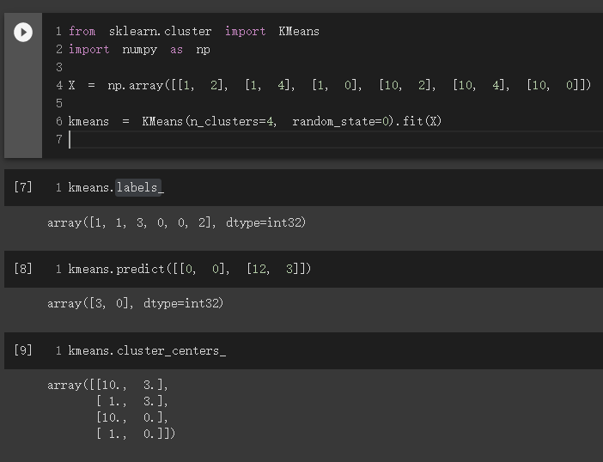
K-means演算法實測

Slide 24
from sklearn.cluster import KMeans
import numpy as np
X = np.array([[1, 2], [1, 4], [1, 0], [10, 2], [10, 4], [10, 0]])
kmeans = KMeans(n_clusters=4, random_state=0).fit(X)
kmeans = KMeans(n_clusters=4, random_state=0).fit(X)
https://scikit-learn.org/stable/modules/generated/sklearn.cluster.KMeans.html

Slide 25
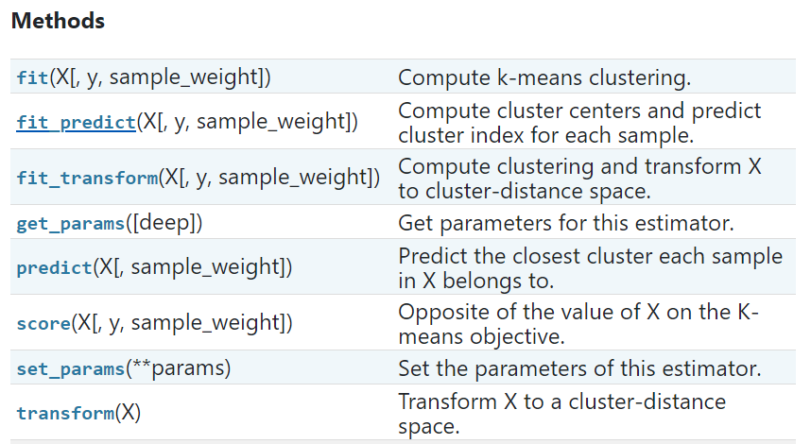
https://scikit-learn.org/stable/modules/generated/sklearn.cluster.KMeans.html

Slide 26
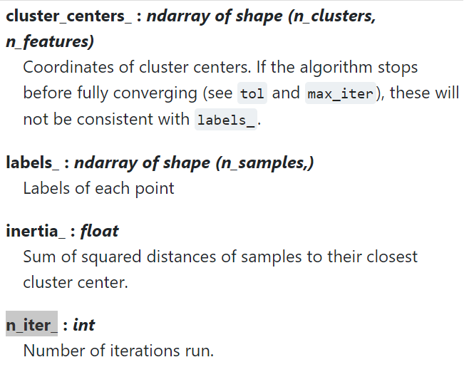
https://scikit-learn.org/stable/modules/generated/sklearn.cluster.KMeans.html

Slide 27
K-means演算法實測
https://github.com/bamtak/machine-learning-implemetation-python/blob/master/KMeans.ipynb

Slide 28
kmeans.n_iter_
kmeans.labels_
kmeans.cluster_centers_
kmeans.predict([[0, 0], [12, 3]])

