Slide 1
機器學習演算法分析與實測
機器學習與資訊安全
學生:
老師:偉大的恩師龍大大

Slide 2
agenda
機器學習與人工智慧
機器學習類型
機器學習開發環境與套件
監督式學習
非監督式學習
監督式學習演算法與實測
非監督式學習演算法與實測

Slide 3
機器學習與人工智慧

Slide 4
機器學習

Slide 5
人工智慧

Slide 6
機器學習類型

Slide 7
機器學習類型
監督式學習
非監督式學習
半監督式學習
強化學習

Slide 8
監督式學習

Slide 9
非監督式學習

Slide 10
半監督式學習

Slide 11
強化學習

Slide 12
機器學習開發環境與套件

Slide 13
機器學習開發環境與套件

Slide 14
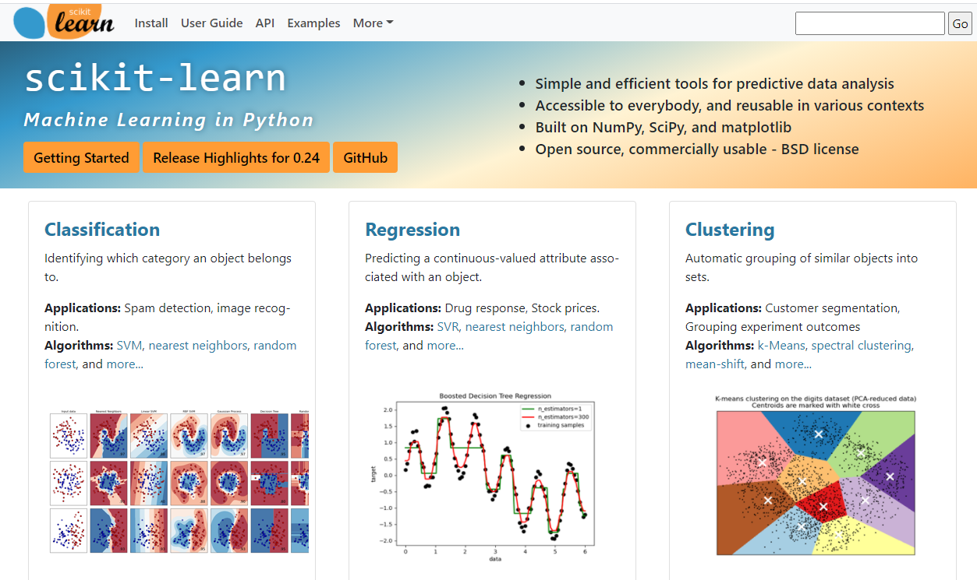
https://scikit-learn.org/stable/index.html

Slide 15
監督式學習演算法與實測

Slide 16
監督式學習演算法 Supervised learning
Classification 分類
Regression 回歸

Slide 17
https://www.geeksforgeeks.org/ml-nearest-centroid-classifier/
監督式學習演算法與實測
Classification 分類

Slide 19
https://scikit-learn.org/stable/modules/neighbors.html#nearest-neighbors-classification
監督式學習演算法與實測
Classification 分類
Nearest Centroid Classifier

Slide 20
from sklearn.neighbors import NearestCentroid
import numpy as np
X = np.array([[-1, -1], [-2, -1], [-3, -2], [1, 1], [2, 1], [3, 2]])
y = np.array([1, 1, 1, 2, 2, 2])
clf = NearestCentroid()
clf.fit(X, y)
print(clf.predict([[-0.8, -1]]))

Slide 21
監督式學習演算法與實測
Regression 回歸

Slide 22
from sklearn import linear_model
reg = linear_model.LinearRegression()
reg.fit ([[0, 0], [1, 1], [2, 2]], [0, 1, 2])
reg.coef_

Slide 23
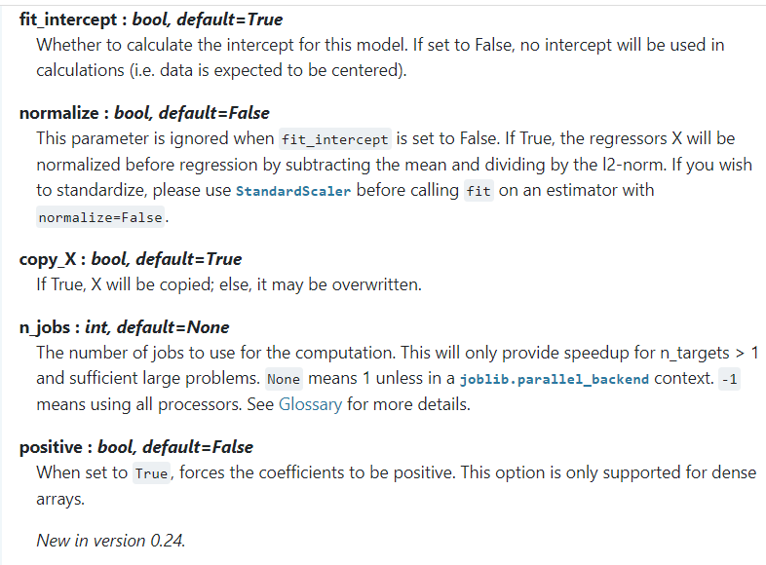
class sklearn.linear_model.LinearRegression
(*, fit_intercept=True, normalize=False, copy_X=True, n_jobs=None, positive=False)

Slide 24
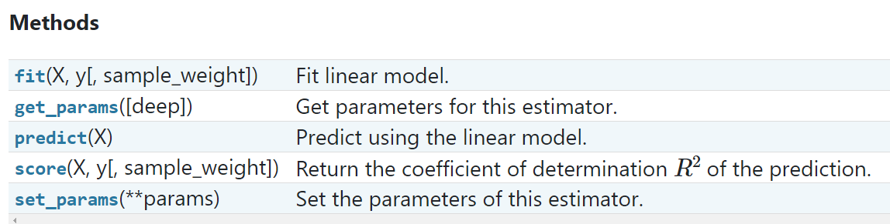

Slide 25
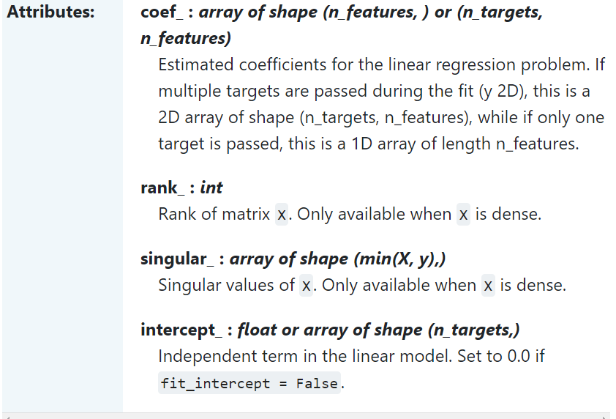

Slide 26
非監督式學習演算法與實測

Slide 27
非監督式學習演算法
聚類分析（cluster analysis）
關聯規則（association rule）
維度縮減（dimensionality reduce）
GAN

Slide 28
聚類分析 cluster analysis
K-means

Slide 29
K-means
similarity相似度
歐基李德距離Euclidean distance
1. 先設定好要分成多少(k)群。
2. 隨機給k個群心。
3. 每個資料都會所有k個群心算歐式距離(歐基李德距離Euclidean distance，其實就是直線距離公式，這邊距離當然也可以換成別種距離公式，但基本上都還是以歐式距離為主)。
4. 將每筆資料分類判給距離最近的那個群心。
5. 每個群心內都會有被分類過來的資料，根據這些資料重新計算新的群心。
6. 一直重複3–5，直到所有群心不在有太大的變動(收斂)，結束。

Slide 30
K-means演算法實測
https://github.com/My-Machine-Learning-Projects-2020/K-Means-Clustering-with-Python-part-2
資料
"","Private","Apps","Accept","Enroll","Top10perc","Top25perc","F.Undergrad","P.Undergrad","Outstate","Room.Board","Books","Personal","PhD","Terminal","S.F.Ratio","perc.alumni","Expend","Grad.Rate"

Slide 31
K-means演算法實測
https://github.com/My-Machine-Learning-Projects-2020/K-Means-Clustering-with-Python-part-2

Slide 32
K-means演算法實測
https://github.com/My-Machine-Learning-Projects-2020/K-Means-Clustering-with-Python-part-2
資料
"","Private","Apps","Accept","Enroll","Top10perc","Top25perc","F.Undergrad","P.Undergrad","Outstate","Room.Board","Books","Personal","PhD","Terminal","S.F.Ratio","perc.alumni","Expend","Grad.Rate"

Slide 33
a data frame with 777 observations on the following 18 variables.
# * Private A factor with levels No and Yes indicating private or public university
# * Apps Number of applications received
# * Accept Number of applications accepted
# * Enroll Number of new students enrolled
# * Top10perc Pct. new students from top 10% of H.S. class
# * Top25perc Pct. new students from top 25% of H.S. class
# * F.Undergrad Number of fulltime undergraduates
# * P.Undergrad Number of parttime undergraduates
# * Outstate Out-of-state tuition
# * Room.Board Room and board costs
# * Books Estimated book costs
# * Personal Estimated personal spending
# * PhD Pct. of faculty with Ph.D.’s
# * Terminal Pct. of faculty with terminal degree
# * S.F.Ratio Student/faculty ratio
# * perc.alumni Pct. alumni who donate
# * Expend Instructional expenditure per student
# * Grad.Rate Graduation rate

Slide 34
K-means演算法實測
https://github.com/My-Machine-Learning-Projects-2020/K-Means-Clustering-with-Python-part-2
from sklearn.cluster import KMeans
import numpy as np
X = np.array([[1, 2], [1, 4], [1, 0], [10, 2], [10, 4], [10, 0]])
kmeans = KMeans(n_clusters=4, random_state=0).fit(X)

Slide 35
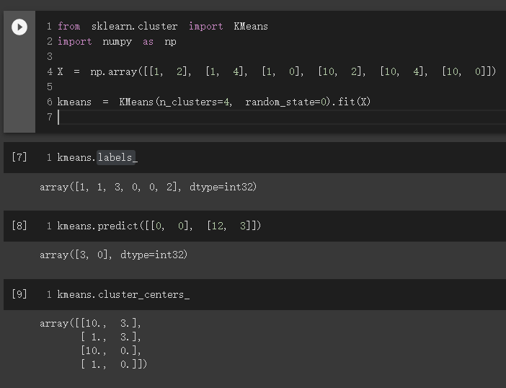
K-means演算法實測

Slide 36
from sklearn.cluster import KMeans
import numpy as np
X = np.array([[1, 2], [1, 4], [1, 0], [10, 2], [10, 4], [10, 0]])
kmeans = KMeans(n_clusters=4, random_state=0).fit(X)
kmeans = KMeans(n_clusters=4, random_state=0).fit(X)
https://scikit-learn.org/stable/modules/generated/sklearn.cluster.KMeans.html

Slide 37
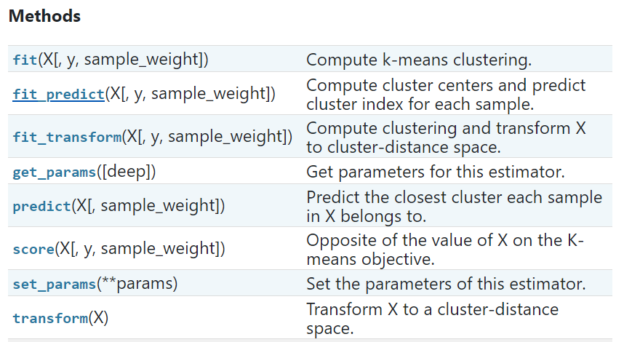
https://scikit-learn.org/stable/modules/generated/sklearn.cluster.KMeans.html

Slide 38
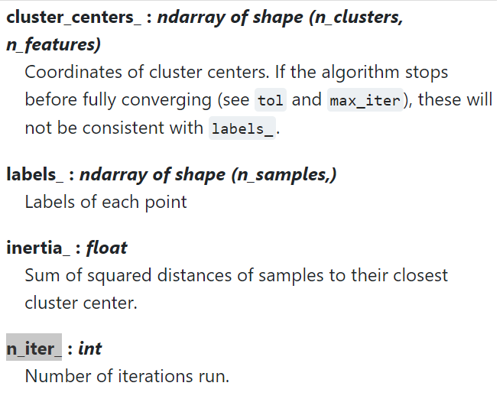
https://scikit-learn.org/stable/modules/generated/sklearn.cluster.KMeans.html

Slide 39
K-means演算法實測
https://github.com/bamtak/machine-learning-implemetation-python/blob/master/KMeans.ipynb

Slide 40
kmeans.n_iter_
kmeans.labels_
kmeans.cluster_centers_
kmeans.predict([[0, 0], [12, 3]])

