Slide 1
CNN

Slide 2
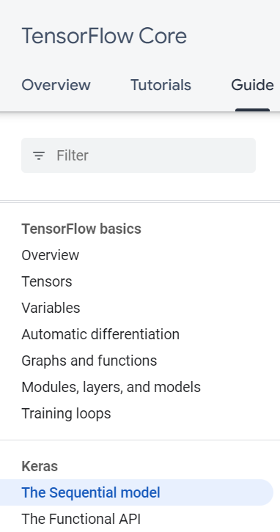

Slide 3
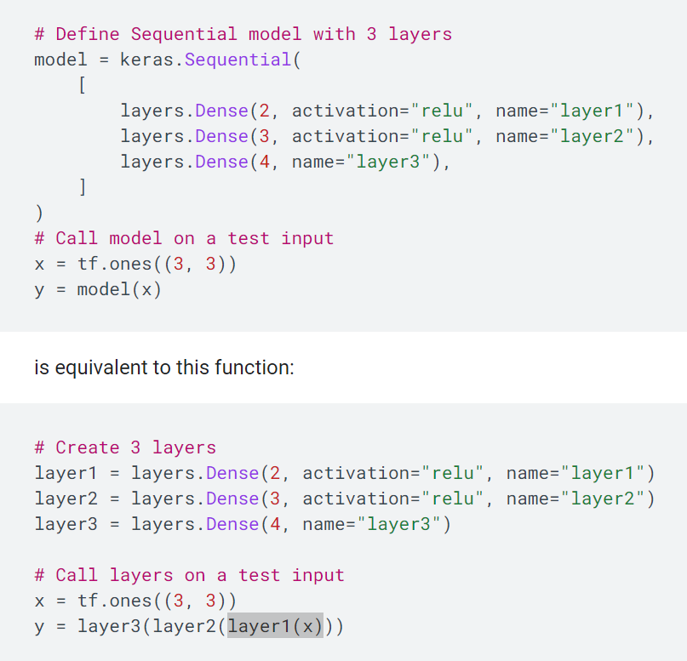
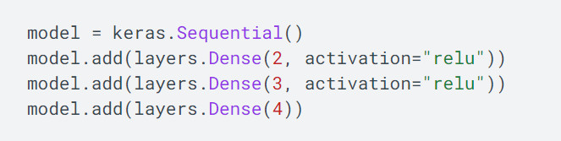
The Sequential model
y = model(x)
layer3
layer2
layer1
x
x = tf.ones((3, 3))

Slide 4
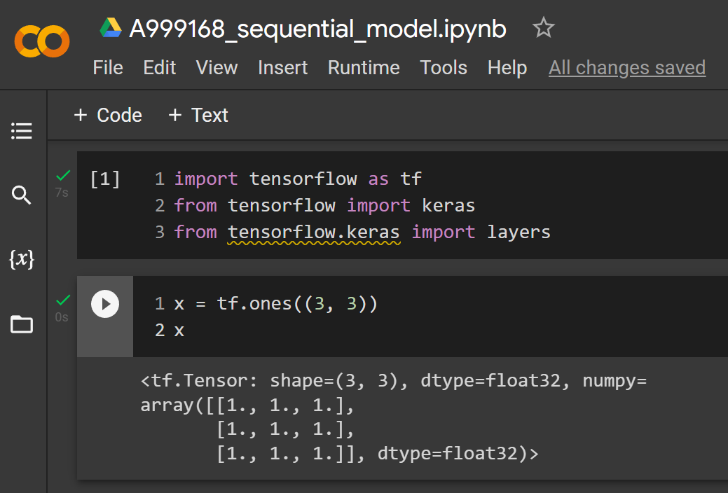
x
x = tf.ones((3, 3))
# Define Sequential model with 3 layers
model = keras.Sequential(
[
layers.Dense(2, activation="relu", name="layer1"),
layers.Dense(3, activation="relu", name="layer2"),
layers.Dense(4, name="layer3"),
]
)
# Call model on a test input
x = tf.ones((3, 3))
y = model(x)

Slide 5
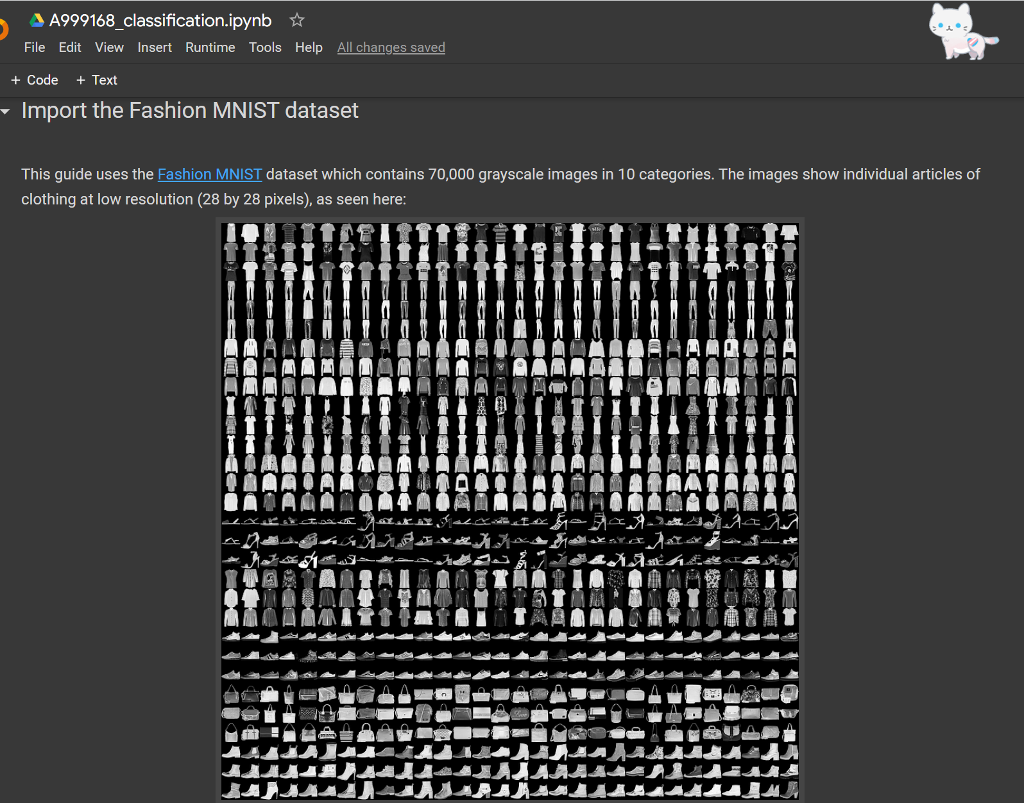
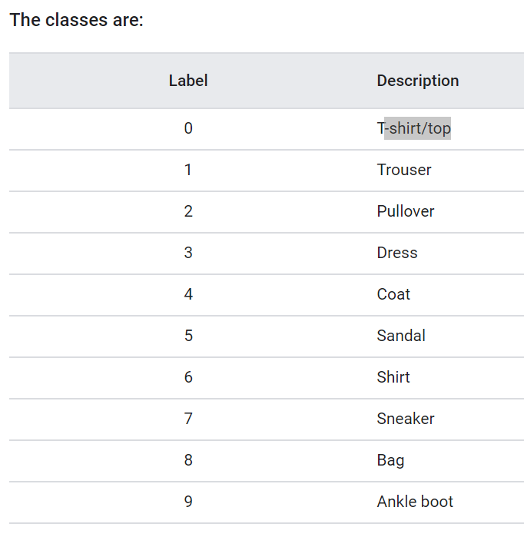
Fashion MNIST dataset
grayscale images
== > PIXEL 8 bits
(2⁸ =256)
0 ----255

Slide 6
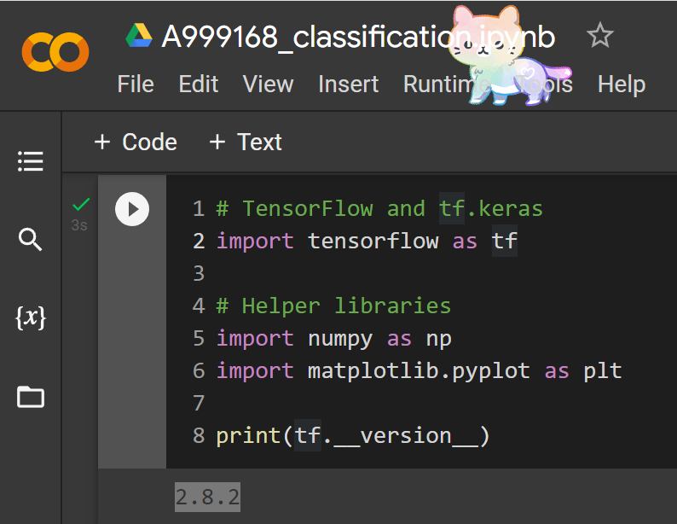

Slide 7
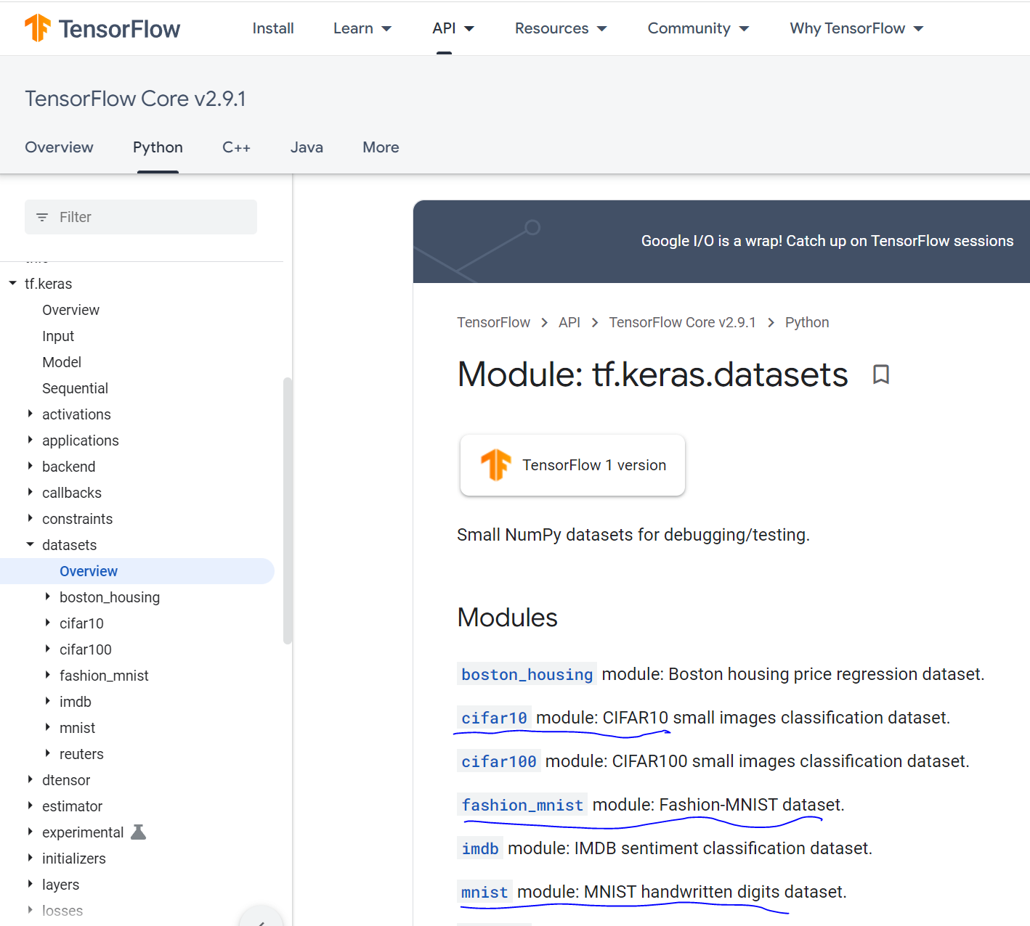
fashion_mnist
=
tf.keras.datasets.fashion_mnist
(train_images, train_labels), (test_images, test_labels)
= fashion_mnist.load_data()
https://www.tensorflow.org/api_docs/python/tf/keras/datasets/fashion_mnist/load_data

Slide 8
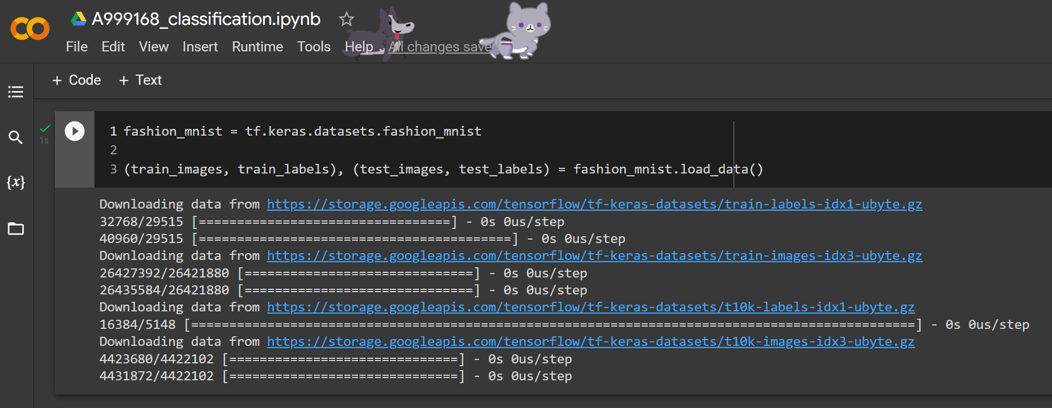

Slide 9
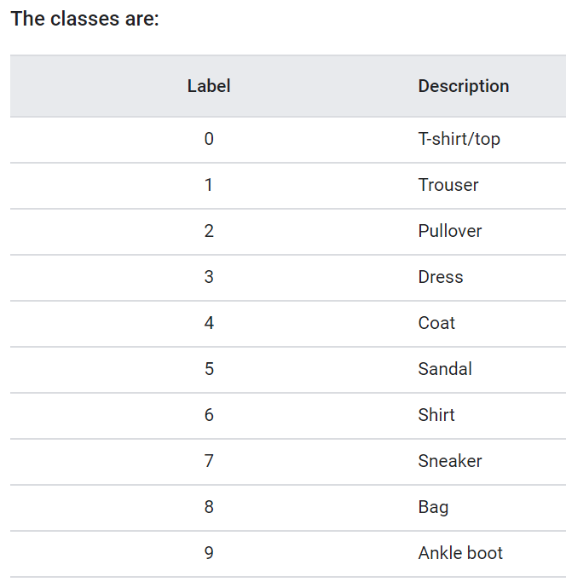
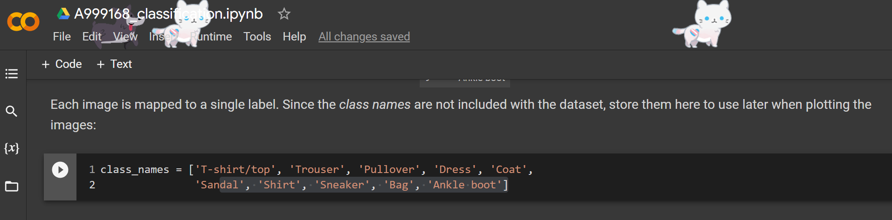

Slide 10
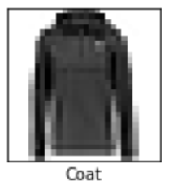
model = tf.keras.Sequential([
tf.keras.layers.Flatten(input_shape=(28, 28)),
tf.keras.layers.Dense(128, activation='relu'),
tf.keras.layers.Dense(10)
])
activation='relu'
10
Flatten
128
………
28*28 =764
input_shape=
(28, 28))

Slide 11
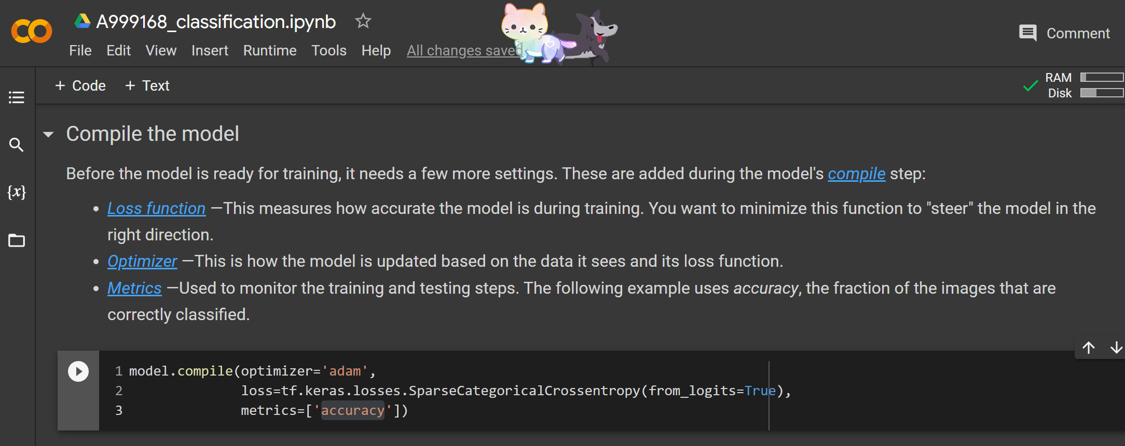
Compile the model

Slide 12
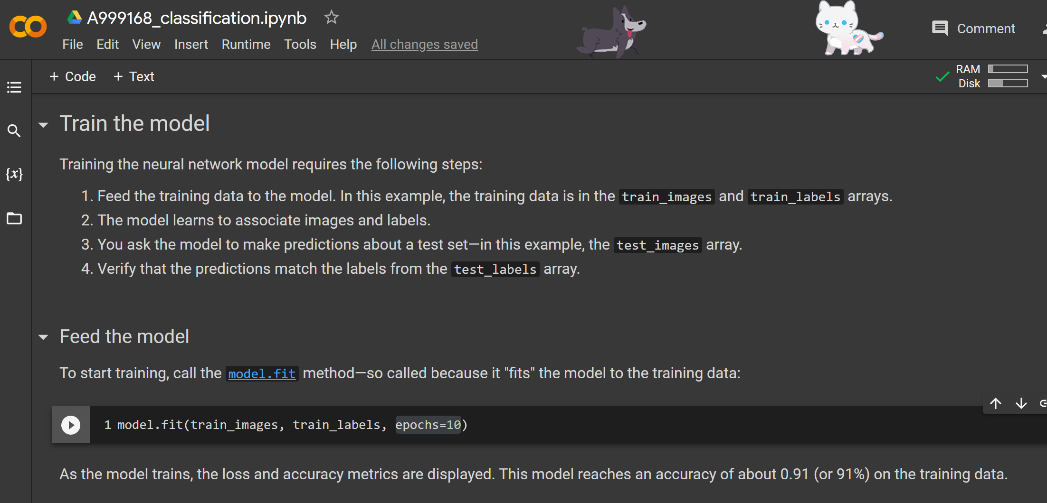
Train the model == >這樣就建好模型了

Slide 13
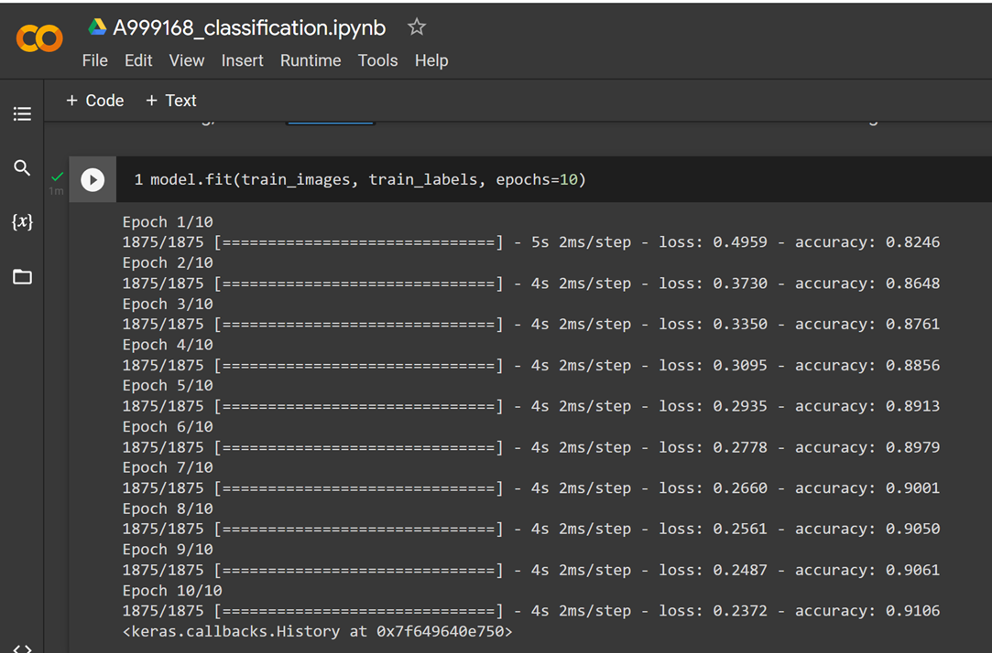

Slide 14
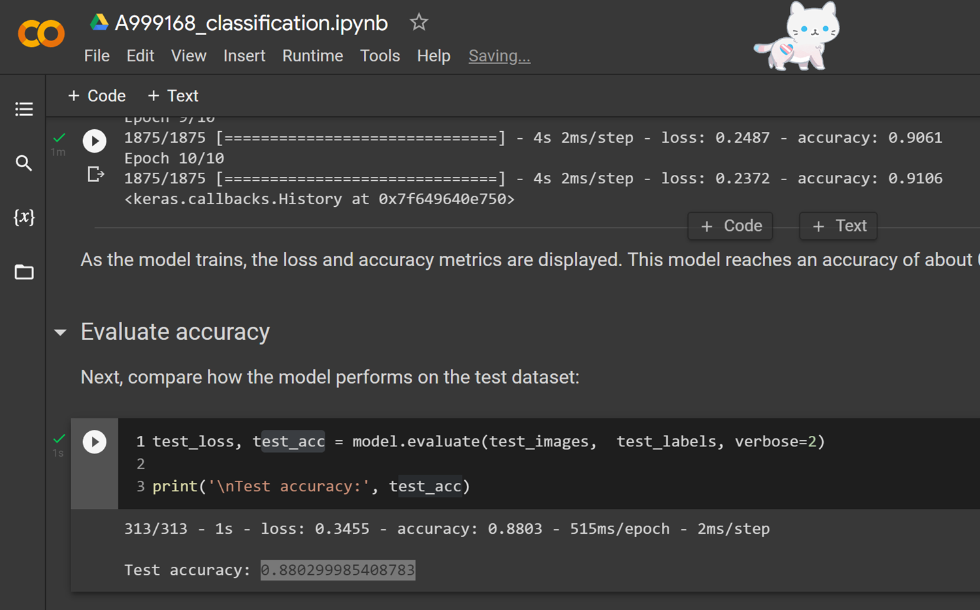
預測:

Slide 15
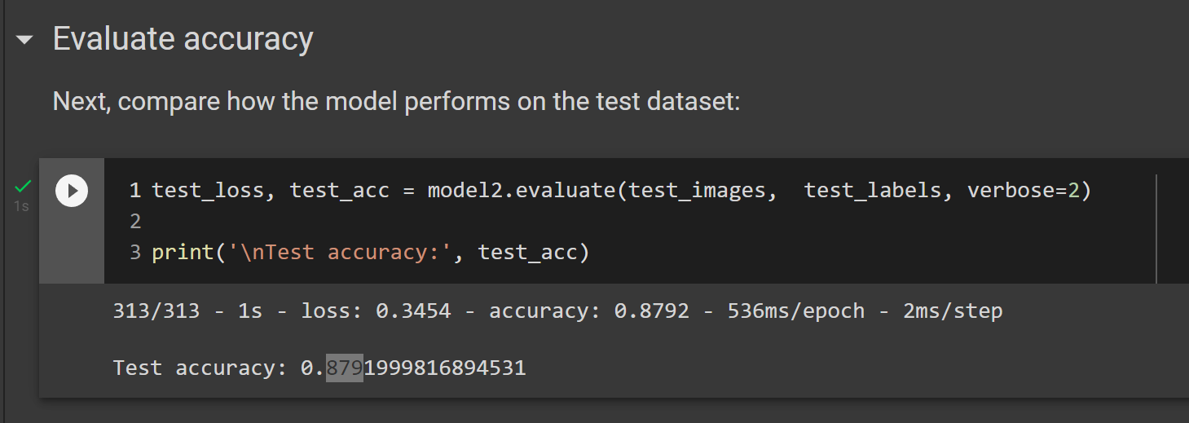
作業:
activation='relu'
10
Flatten
128
64
………
……
28*28 =764
input_shape=
(28, 28))
model2 = tf.keras.Sequential([
tf.keras.layers.Flatten(input_shape=(28, 28)),
tf.keras.layers.Dense(128, activation='relu'),
tf.keras.layers.Dense(64, activation='relu'),
tf.keras.layers.Dense(10)
])

Slide 16
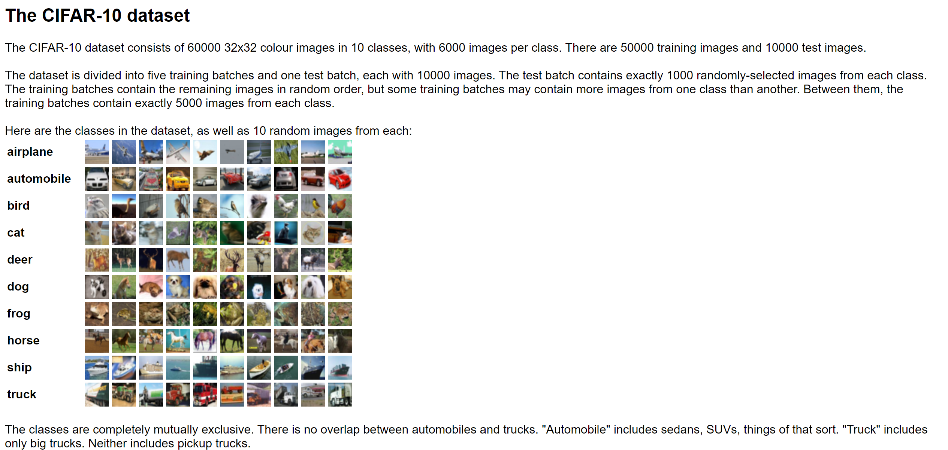
The CIFAR-10 dataset
https://www.cs.toronto.edu/~kriz/cifar.html

Slide 17
