Slide 1
資訊安全分析與系統實戰
A888168
恩師龍大大

Slide 2
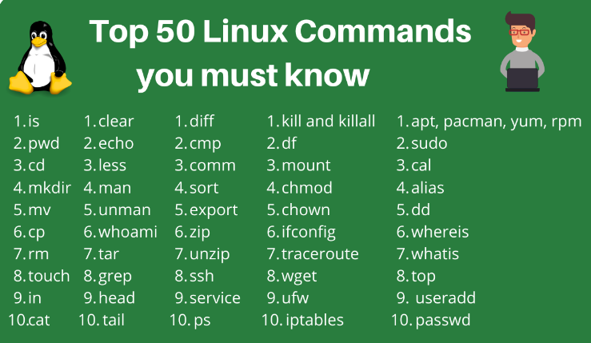
Linux常用指令
Linux Commands
https://www.hostinger.com/tutorials/linux-commands
https://www.digitalocean.com/community/tutorials/linux-commands
ls
cat

Slide 3
Windows常用指令

Slide 4
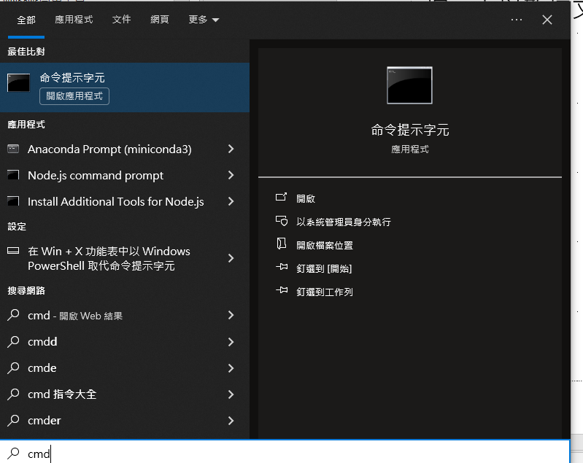
cmd

Slide 5
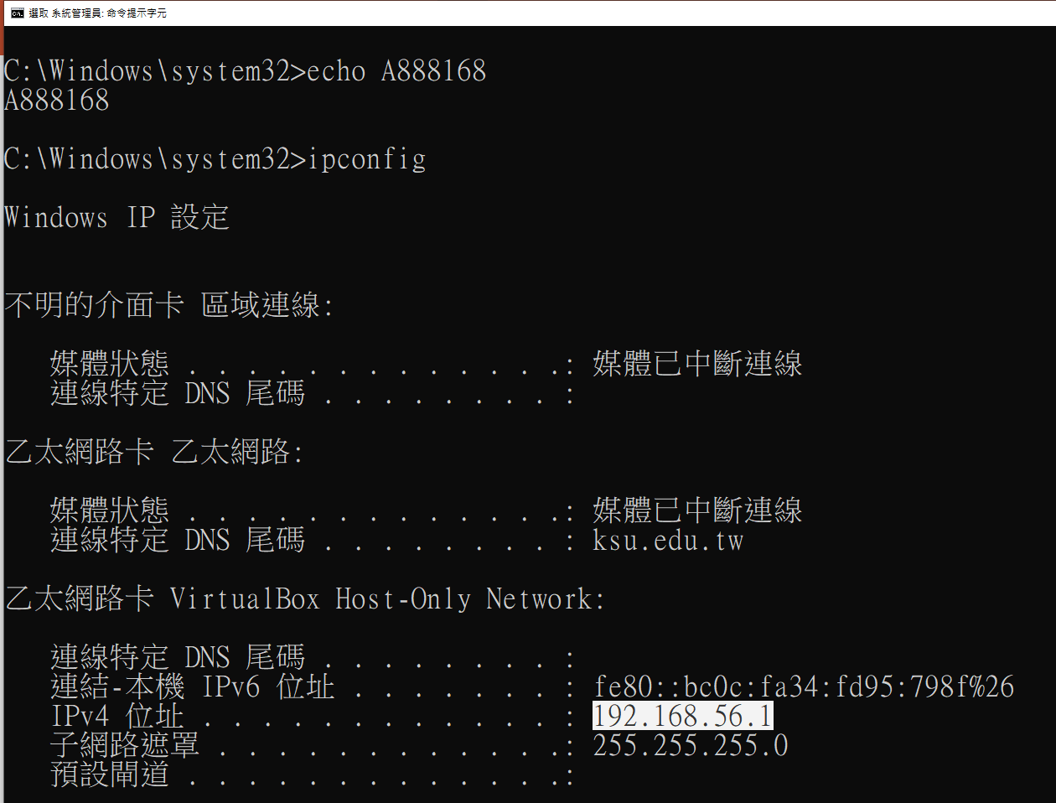
ipconfig

Slide 6
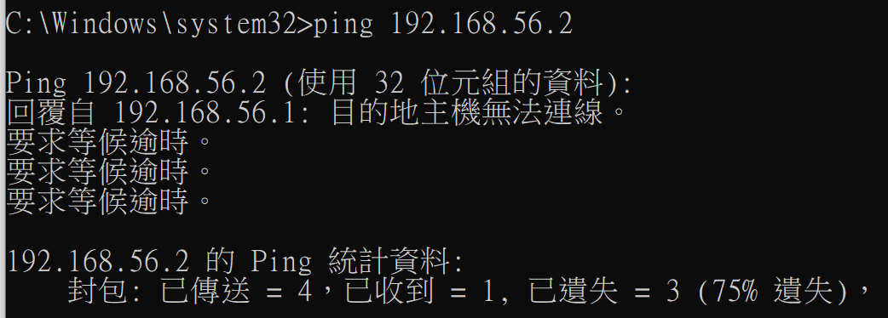
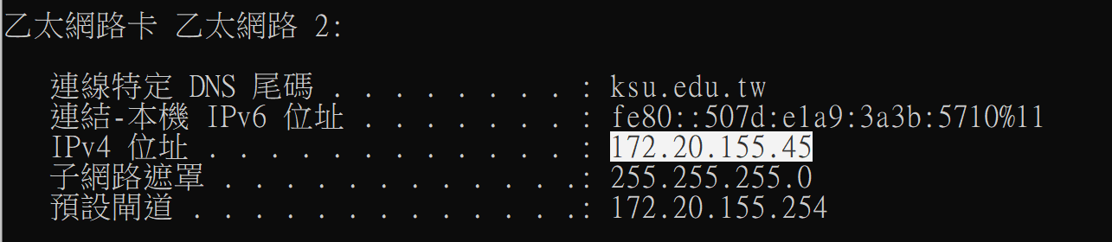
ping

Slide 7
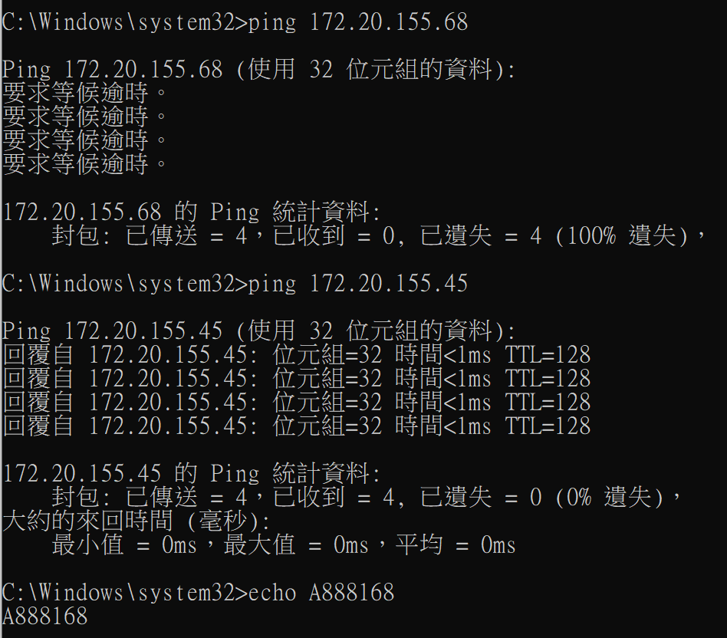

Slide 8
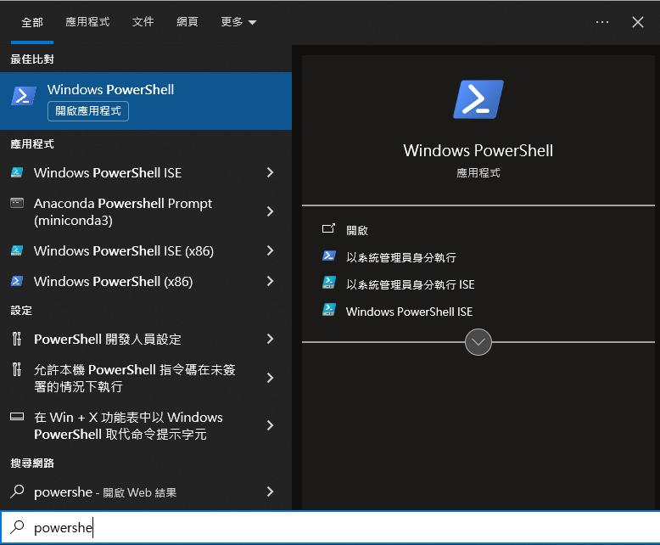
Windows powershell常用工具

Slide 9
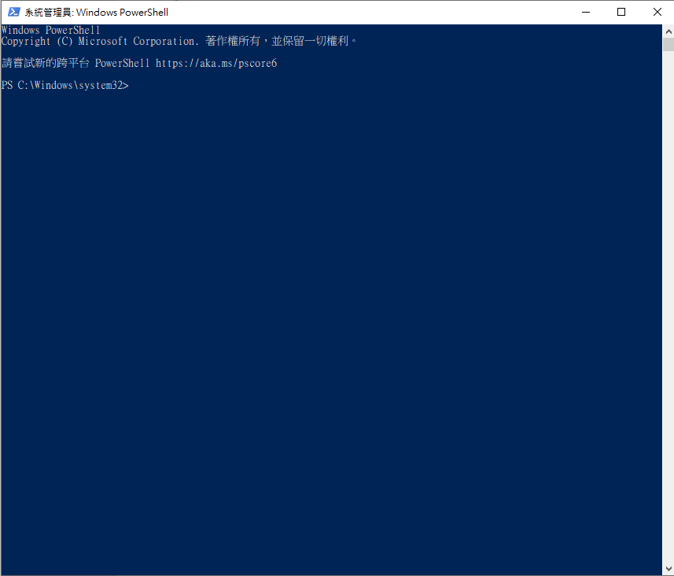

Slide 10
