Slide 1
LINUX Commands

Slide 2
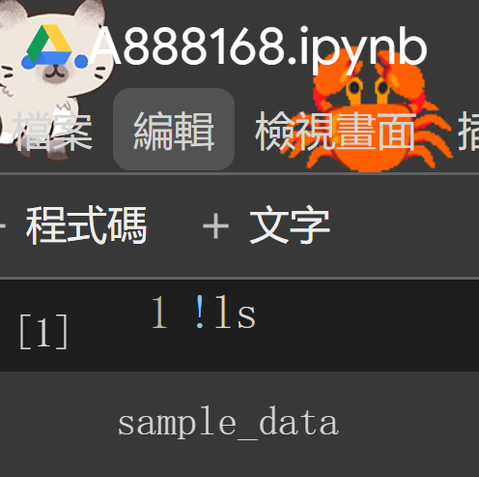
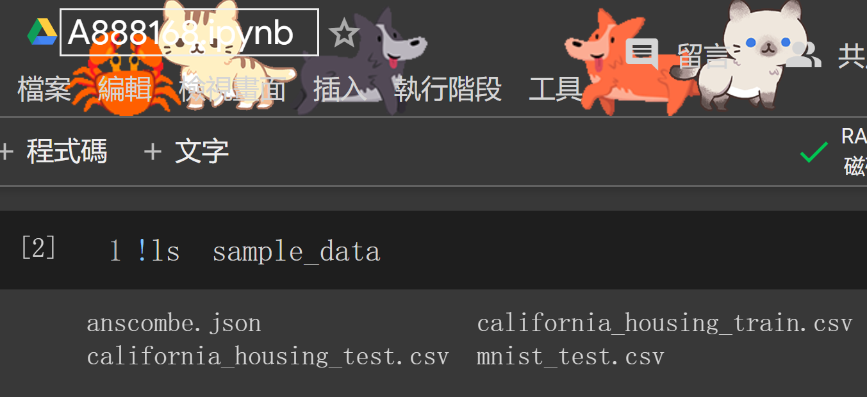
ls
https://blog.gtwang.org/linux/linux-ls-command-tutorial/

Slide 3
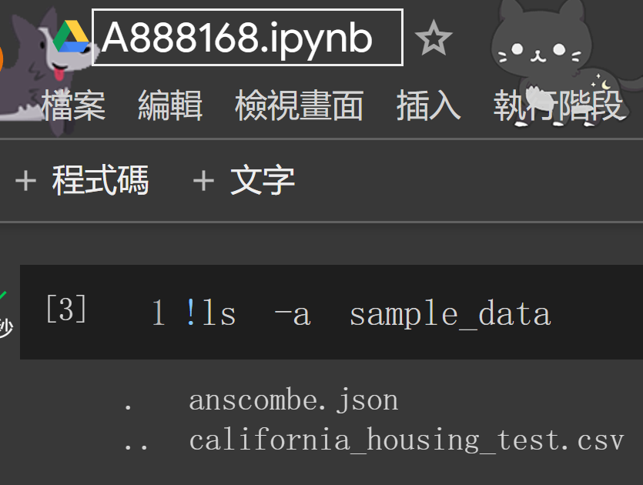

Slide 4
