Slide 1
程式架構說明
DCGAN

Slide 2
Problem statement

Slide 3
Other works
THe GAN framework was first introduced by Goodfellowet al. [8] to generate visually realistic images and, since then, many improvements and interesting applications have been proposed
Wang and Gupta [41] use a Structured GAN to learn surface normals and then combine it with a Style GAN to generate natural indoor
scenes.

Slide 4
synthetic data重要性
using synthetic data for various prediction tasks, including gaze estimation [43], text detection and classification in RGB images [9, 15],font recognition [42], object detection [10, 27], hand pose estimation in depth images [38, 37], scene recognition in RGB-D [11], semantic segmentation of urban scenes [31], and human pose estimation [26, 3, 18, 14,
28, 30]

Slide 5
解答
With recent progress in graphics, it has become more
tractable to train models on synthetic images, potentially
avoiding the need for expensive annotations. However,
learning from synthetic images may not achieve the
desired performance due to a gap between synthetic and
real image distributions. To reduce this gap, we propose
Simulated+Unsupervised (S+U) learning, where
the task is to learn a model to improve the realism of
a simulator’s output using unlabeled real data, while
preserving the annotation information from the simulator.
We develop a method for S+U learning that uses an
adversarial network similar to Generative Adversarial
Networks (GANs), but with synthetic images as inputs
instead of random vectors. We make several key modifications
to the standard GAN algorithm to preserve annotations,
avoid artifacts, and stabilize training: (i) a
‘self-regularization’ term, (ii) a local adversarial loss,
and (iii) updating the discriminator using a history of
refined images. We show that this enables generation
of highly realistic images, which we demonstrate both
qualitatively and with a user study. We quantitatively
evaluate the generated images by training models for
gaze estimation and hand pose estimation. We show
a significant improvement over using synthetic images,
and achieve state-of-the-art results on the MPIIGaze
dataset without any labeled real data.

Slide 6
成果

Slide 7
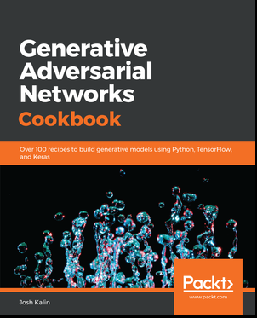
https://github.com/PacktPublishing/Generative-Adversarial-Networks-Cookbook

Slide 8
程式架構說明
生成模型
generator.py
主模型
gan.py
對抗模型
discriminator.pyy
核心程式
train.py
系統主程式
run.py

