Slide 1
黃誌祥_pandas資料分析學習報告20201111
4060e059

Slide 2
Pandas 介紹

Slide 3
1.在異質數據的讀取、轉換和處理上，都讓分析人員更容易處理。例如：從列欄試算表中找到想要的值。
2. Pandas 提供兩種主要的資料結構，Series 與 DataFrame。Series 顧名思義就是用來處理時間序列相關的資料(如感測器資料等)，主要為建立索引的一維陣列。DataFrame 則是用來處理結構化(Table like)的資料，有列索引與欄標籤的二維資料集，例如關聯式資料庫、CSV 等等。
3.透過載入至 Pandas 的資料結構物件後，可以透過結構化物件所提供的方法，來快速地進行資料的前處理，如資料補值，空值去除或取代等。
4.更多的輸入來源及輸出整合性，例如：可以從資料庫讀取資料進入 Dataframe，也可將處理完的資料存回資料庫。
安裝 Pandas: pip install pandas
參考資料:https://oranwind.org/python-pandas-ji-chu-jiao-xue/

Slide 4
資料科學介紹

Slide 5
是一門利用資料學習知識，並且從資料中提取出有價值的部分來生產資料產品。結合了諸多領域中的理論和技術，包括應用數學、統計、圖形識別、機器學習、資料視覺化、資料倉儲以及高效能計算。資料科學通過運用各種相關的資料來幫助非專業人士理解問題。
資料科學技術可以幫助我們如何正確的處理資料並協助我們在生物學、社會科學、人類學等領域進行研究調研。此外，資料科學也對商業競爭有極大的幫助
參考資料:https://zh.Wikipedia.org/wiki/%E6%95%B0%E6%8D%AE%E7%A7%91%E5%AD%A6

Slide 6
Pandas實戰

Slide 7
NumPy Basics: Arrays and Vectorized Computation

Slide 8
The NumPy ndarray: A Multidimensional Array Object

Slide 9
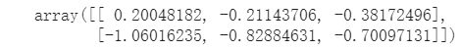
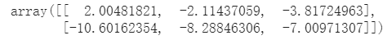
必須先進行import NumPy的動作，才能使用其函式庫內的相關功能。
import numpy as np
隨機生成數據 維度生成(行,列)
data = np.random.randn(2, 3)
data
也可以進行運算
data * 10

Slide 10
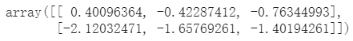
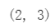
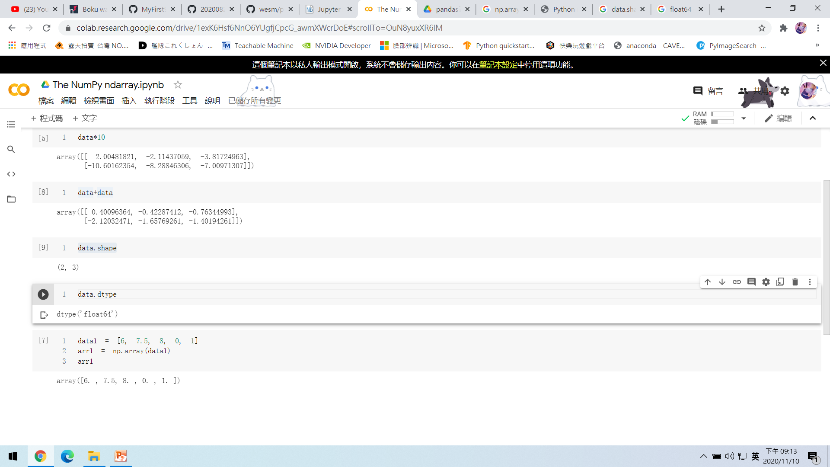
如果直接輸入data+data
也可以來看字的維度、長度
data.shape
data.dtype 數據類型
雙精度浮點數

Slide 11
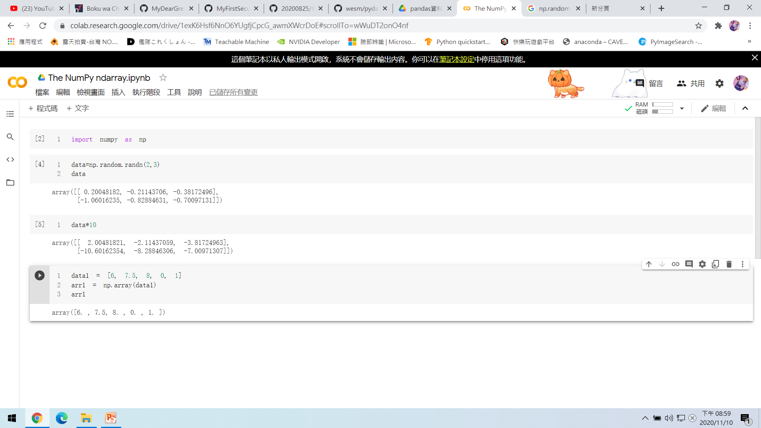
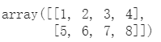
1.Greating ndarrays(創建n維數組)
使用array函數，輸入一個序列，list:
data1 = [6, 7.5, 8, 0, 1]
arr1 = np.array(data1) 轉換成數值型態的陣列
arr1
嵌套序列能被轉換為多維數組:
data2 = [[1, 2, 3, 4], [5, 6, 7, 8]]
arr2 = np.array(data2)
arr2

Slide 12
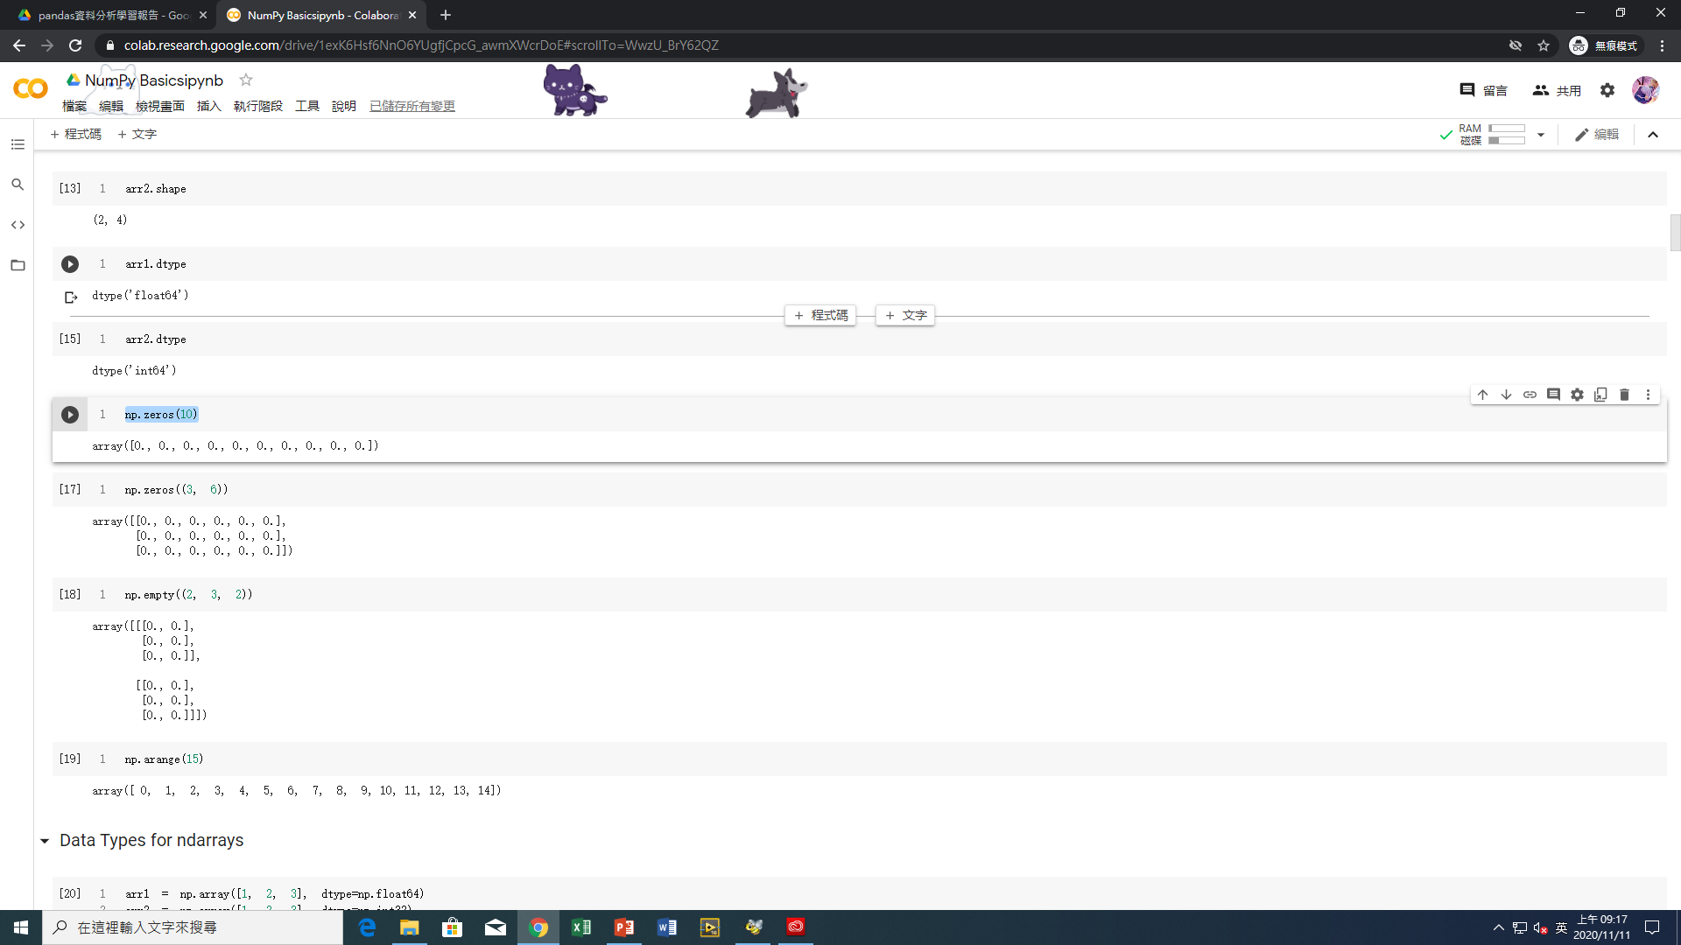
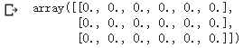
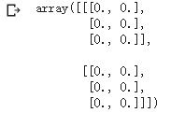
np.zeros(10) 建立以0為元素的矩陣
np.zeros((3, 6))
np.empty((2, 3, 2)) empty創建的數組中，包含的均是無意義的數值

Slide 13
np.arange(15) 從0開始算15個
### Data Types for ndarrays
arr1 = np.array([1, 2, 3], dtype=np.float64)
arr2 = np.array([1, 2, 3], dtype=np.int32)
arr1.dtype
arr2.dtype
arr = np.array([1, 2, 3, 4, 5])
arr.dtype 轉換資料型別
float_arr = arr.astype(np.float64)
float_arr.dtype

Slide 14

arr = np.array([3.7, -1.2, -2.6, 0.5, 12.9, 10.1])
arr
arr.astype(np.int32)
numeric_strings = np.array(['1.25', '-9.6', '42'], dtype=np.string_)
numeric_strings.astype(float)
int_array = np.arange(10)
calibers = np.array([.22, .270, .357, .380, .44, .50], dtype=np.float64)
int_array.astype(calibers.dtype)

Slide 15


empty_uint32 = np.empty(8, dtype='u4')
empty_uint32
### Arithmetic with NumPy Arrays
arr = np.array([[1., 2., 3.], [4., 5., 6.]])
arr
arr * arr
arr - arr

Slide 16


1 / arr
arr ** 0.5
arr2 = np.array([[0., 4., 1.], [7., 2., 12.]])
arr2
arr2 > arr

Slide 17
### Basic Indexing and Slicing
arr = np.arange(10)
arr
arr[5]
arr[5:8]
arr[5:8] = 12
arr
arr_slice = arr[5:8]
arr_slice

Slide 18
arr_slice[1] = 12345
Arr
arr_slice[:] = 64
arr
arr2d = np.array([[1, 2, 3], [4, 5, 6], [7, 8, 9]])
arr2d[2]

Slide 19


arr2d[0][2]
arr2d[0, 2]
arr3d = np.array([[[1, 2, 3], [4, 5, 6]], [[7, 8, 9], [10, 11, 12]]])
arr3d
arr3d[0]

Slide 20

old_values = arr3d[0].copy()
arr3d[0] = 42
arr3d
arr3d[0] = old_values
arr3d

Slide 21
arr3d[1, 0]
x = arr3d[1]
x
x[0]
### Indexing with slices
arr
arr[1:6]

Slide 22


arr2d
arr2d[:2]
arr2d[:2, 1:]
arr2d[1, :2]
arr2d[:2, 2]

Slide 23


arr2d[:, :1]
arr2d[:2, 1:] = 0
arr2d

Slide 24
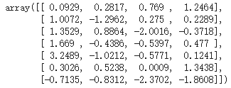
### Boolean Indexing
names = np.array(['Bob', 'Joe', 'Will', 'Bob', 'Will', 'Joe', 'Joe'])
data = np.random.randn(7, 4)
names
data

Slide 25

names == 'Bob‘
data[names == 'Bob']
data[names == 'Bob', 2:]
data[names == 'Bob', 3]

Slide 26


cond = names == 'Bob'
data[~cond]
mask = (names == 'Bob') | (names == 'Will')
mask
data[mask]

Slide 27
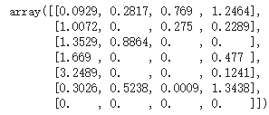
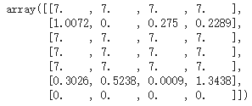
data[data < 0] = 0
data
data[names != 'Joe'] = 7
data

Slide 28
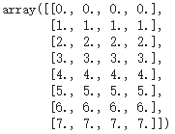
### Fancy Indexing
arr = np.empty((8, 4))
for i in range(8):
arr[i] = i
arr

Slide 29


arr[[4, 3, 0, 6]]
arr[[-3, -5, -7]]
arr = np.arange(32).reshape((8, 4))
arr
arr[[1, 5, 7, 2], [0, 3, 1, 2]]

Slide 30


arr[[1, 5, 7, 2]][:, [0, 3, 1, 2]]
### Transposing Arrays and Swapping Axes
arr = np.arange(15).reshape((3, 5))
arr
arr.T

Slide 31


arr = np.random.randn(6, 3)
arr
np.dot(arr.T, arr)
arr = np.arange(16).reshape((2, 2, 4))
arr
arr.transpose((1, 0, 2))

Slide 32
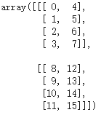
arr
arr.swapaxes(1, 2)

Slide 33
### Universal Functions: Fast Element-Wise Array Functions
arr = np.arange(10)
arr
np.sqrt(arr)
np.exp(arr)
x = np.random.randn(8)
y = np.random.randn(8)
x
y
np.maximum(x, y)

Slide 34

arr = np.random.randn(7) * 5
arr
remainder, whole_part = np.modf(arr)
remainder
whole_part
arr
np.sqrt(arr)
np.sqrt(arr, arr)
arr

Slide 35
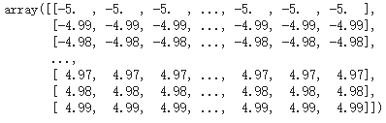
### Array-Oriented Programming with Arrays
points = np.arange(-5, 5, 0.01) # 1000 equally spaced points
xs, ys = np.meshgrid(points, points)
ys

Slide 36
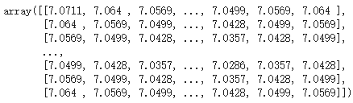
z = np.sqrt(xs ** 2 + ys ** 2)
z

Slide 37
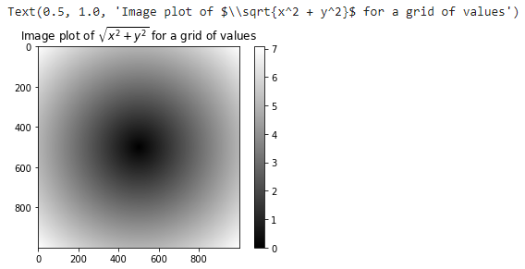
import matplotlib.pyplot as plt
plt.imshow(z, cmap=plt.cm.gray); plt.colorbar()
plt.title("Image plot of $\sqrt{x^2 + y^2}$ for a grid of values")

Slide 38
plt.draw()
plt.close('all')
### Expressing Conditional Logic as Array Operations
xarr = np.array([1.1, 1.2, 1.3, 1.4, 1.5])
yarr = np.array([2.1, 2.2, 2.3, 2.4, 2.5])
cond = np.array([True, False, True, True, False])
result = [(x if c else y)
for x, y, c in zip(xarr, yarr, cond)]
result

Slide 39

result = np.where(cond, xarr, yarr)
result
arr = np.random.randn(4, 4)
arr
arr > 0
np.where(arr > 0, 2, -2)

Slide 40

np.where(arr > 0, 2, arr) # set only positive values to 2
### Mathematical and Statistical Methods
arr = np.random.randn(5, 4)
arr
arr.mean()
np.mean(arr)
arr.sum()

Slide 41

arr.mean(axis=1)
arr.sum(axis=0)
arr = np.array([0, 1, 2, 3, 4, 5, 6, 7])
arr.cumsum()
arr = np.array([[0, 1, 2], [3, 4, 5], [6, 7, 8]])
arr
arr.cumsum(axis=0)
arr.cumprod(axis=1)

Slide 42
### Methods for Boolean Arrays
arr = np.random.randn(100)
(arr > 0).sum() # Number of positive values
bools = np.array([False, False, True, False])
bools.any()
bools.all()

Slide 43

### Sorting
arr = np.random.randn(6)
arr
arr.sort()
arr
arr = np.random.randn(5, 3)
arr
arr.sort(1)
arr

Slide 44
large_arr = np.random.randn(1000)
large_arr.sort()
large_arr[int(0.05 * len(large_arr))] # 5% quantile
### Unique and Other Set Logic
names = np.array(['Bob', 'Joe', 'Will', 'Bob', 'Will', 'Joe', 'Joe'])
np.unique(names)
ints = np.array([3, 3, 3, 2, 2, 1, 1, 4, 4])
np.unique(ints)
sorted(set(names))

Slide 45
values = np.array([6, 0, 0, 3, 2, 5, 6])
np.in1d(values, [2, 3, 6])
### File Input and Output with Arrays
arr = np.arange(10)
np.save('some_array', arr)
np.load('some_array.npy')
np.savez('array_archive.npz', a=arr, b=arr)
arch = np.load('array_archive.npz')
arch['b']

Slide 46

np.savez_compressed('arrays_compressed.npz', a=arr, b=arr)
!rm some_array.npy
!rm array_archive.npz
!rm arrays_compressed.npz
### Linear Algebra
x = np.array([[1., 2., 3.], [4., 5., 6.]])
y = np.array([[6., 23.], [-1, 7], [8, 9]])
x
y
x.dot(y)

Slide 47

np.dot(x, y)
np.dot(x, np.ones(3))
x @ np.ones(3)

Slide 48

from numpy.linalg import inv, qr
X = np.random.randn(5, 5)
mat = X.T.dot(X)
inv(mat)
mat.dot(inv(mat))
q, r = qr(mat)
r

Slide 49


### Pseudorandom Number Generation
samples = np.random.normal(size=(4, 4))
samples
from random import normalvariate
N = 1000000
%timeit samples = [normalvariate(0, 1) for _ in range(N)]
%timeit np.random.normal(size=N)

Slide 50
np.random.seed(1234)
rng = np.random.RandomState(1234)
rng.randn(10)

Slide 51

### Example: Random Walks
import random
position = 0
walk = [position]
steps = 1000
for i in range(steps):
step = 1 if random.randint(0, 1) else -1
position += step
walk.append(position)
plt.figure()

Slide 52
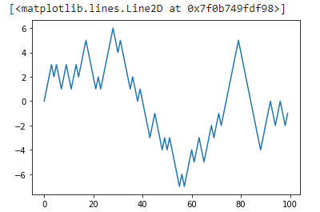
plt.plot(walk[:100])

Slide 53
np.random.seed(12345)
nsteps = 1000
draws = np.random.randint(0, 2, size=nsteps)
steps = np.where(draws > 0, 1, -1)
walk = steps.cumsum()
walk.min() walk.max()
(np.abs(walk) >= 10).argmax()

Slide 54
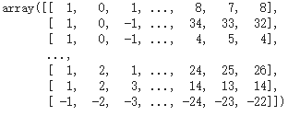
### Simulating Many Random Walks at Once
nwalks = 5000
nsteps = 1000
draws = np.random.randint(0, 2, size=(nwalks, nsteps)) # 0 or 1
steps = np.where(draws > 0, 1, -1)
walks = steps.cumsum(1)
walks
walks.max() walks.min()

Slide 55
hits30 = (np.abs(walks) >= 30).any(1)
hits30
hits30.sum() # Number that hit 30 or -30
crossing_times = (np.abs(walks[hits30]) >= 30).argmax(1)
crossing_times.mean()
steps = np.random.normal(loc=0, scale=0.25,
size=(nwalks, nsteps))

Slide 56
Data Wrangling: Join, Combine,

Slide 57
import numpy as np
import pandas as pd
pd.options.display.max_rows = 20
np.random.seed(12345)
import matplotlib.pyplot as plt
plt.rc('figure', figsize=(10, 6))
np.set_printoptions(precision=4, suppress=True)

Slide 58
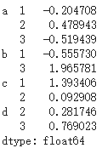
### Hierarchical Indexing
data = pd.Series(np.random.randn(9),
index=[['a', 'a', 'a', 'b', 'b', 'c', 'c', 'd', 'd'],
[1, 2, 3, 1, 3, 1, 2, 2, 3]])
data

Slide 59
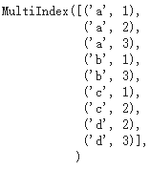

data.index
data['b']
data['b':'c']
data.loc[['b', 'd']]

Slide 60

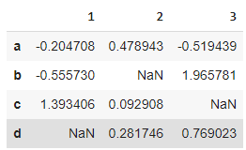
data.loc[:, 2]
data.unstack()

Slide 61
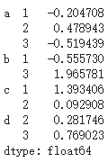
data.unstack().stack()

Slide 62
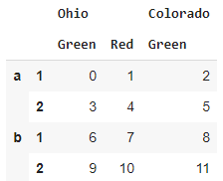
frame = pd.DataFrame(np.arange(12).reshape((4, 3)),
index=[['a', 'a', 'b', 'b'], [1, 2, 1, 2]],
columns=[['Ohio', 'Ohio', 'Colorado'],
['Green', 'Red', 'Green']])
frame

Slide 63
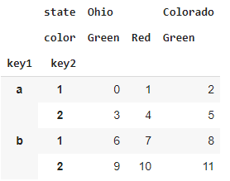
frame.index.names = ['key1', 'key2']
frame.columns.names = ['state', 'color']
frame

Slide 64
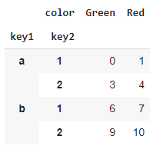
frame['Ohio']
##### MultiIndex.from_arrays([['Ohio', 'Ohio', 'Colorado'], ['Green', 'Red', 'Green']], names=['state', 'color'])

Slide 65
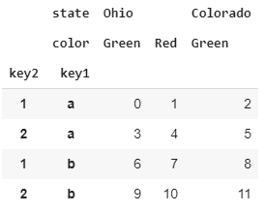
### Reordering and Sorting Levels
frame.swaplevel('key1', 'key2')

Slide 66
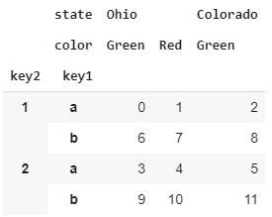
frame.sort_index(level=1)
frame.swaplevel(0, 1).sort_index(level=0)

Slide 67
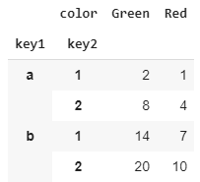
### Summary Statistics by Level
frame.sum(level='key2')
frame.sum(level='color', axis=1)

Slide 68
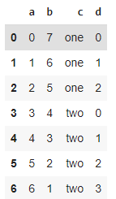
### Indexing with a DataFrame's columns
frame = pd.DataFrame({'a': range(7), 'b': range(7, 0, -1),
'c': ['one', 'one', 'one', 'two', 'two',
'two', 'two'],
'd': [0, 1, 2, 0, 1, 2, 3]})
frame

Slide 69
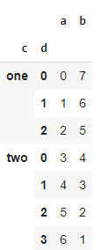
frame2 = frame.set_index(['c', 'd'])
frame2

Slide 70
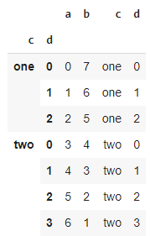
frame.set_index(['c', 'd'], drop=False)

Slide 71
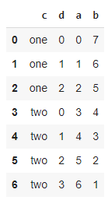
frame2.reset_index()

Slide 72
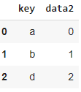
## Combining and Merging Datasets
### Database-Style DataFrame Joins
df1 = pd.DataFrame({'key': ['b', 'b', 'a', 'c', 'a', 'a', 'b'],
'data1': range(7)})
df2 = pd.DataFrame({'key': ['a', 'b', 'd'],
'data2': range(3)})
df1
df2

Slide 73
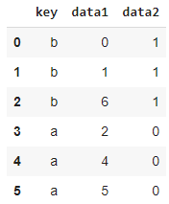
pd.merge(df1, df2)

Slide 74
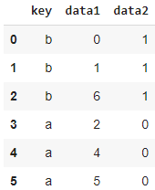
pd.merge(df1, df2, on='key')

Slide 75
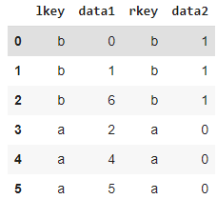
df3 = pd.DataFrame({'lkey': ['b', 'b', 'a', 'c', 'a', 'a', 'b'],
'data1': range(7)})
df4 = pd.DataFrame({'rkey': ['a', 'b', 'd'],
'data2': range(3)})
pd.merge(df3, df4, left_on='lkey', right_on='rkey')

Slide 76
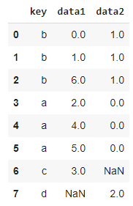
pd.merge(df1, df2, how='outer')

Slide 77
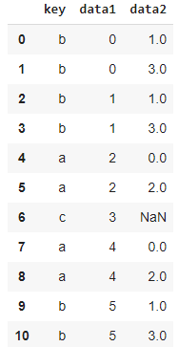
df1 = pd.DataFrame({'key': ['b', 'b', 'a', 'c', 'a', 'b'],
'data1': range(6)})
df2 = pd.DataFrame({'key': ['a', 'b', 'a', 'b', 'd'],
'data2': range(5)})
df1
df2
pd.merge(df1, df2, on='key', how='left')

Slide 78
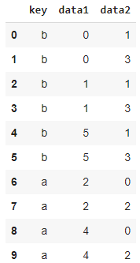
pd.merge(df1, df2, how='inner')

Slide 79
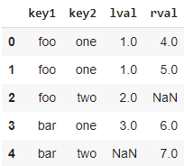
left = pd.DataFrame({'key1': ['foo', 'foo', 'bar'],
'key2': ['one', 'two', 'one'],
'lval': [1, 2, 3]})
right = pd.DataFrame({'key1': ['foo', 'foo', 'bar', 'bar'],
'key2': ['one', 'one', 'one', 'two'],
'rval': [4, 5, 6, 7]})
pd.merge(left, right, on=['key1', 'key2'], how='outer')

Slide 80
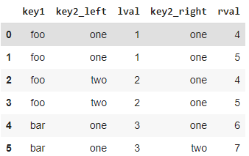
pd.merge(left, right, on='key1')
pd.merge(left, right, on='key1', suffixes=('_left', '_right'))

Slide 82
Universal Functions: Fast Element-Wise Array Functions

Slide 84
小型專案分析

