Slide 1
使用CNN來分類肺部疾病

Slide 2
載入函式庫
from keras.preprocessing.image import ImageDataGenerator, load_img
from keras.models import Sequential
from keras.layers import Conv2D, MaxPooling2D
from keras.layers import Activation, Dropout, Flatten, Dense
from keras import backend as K

Slide 3
import os
import numpy as np
import pandas as np
import matplotlib.pyplot as plt
%matplotlib inline

Slide 4
確認資料集的地址
print(os.listdir("../input/chest_xray/chest_xray"))
print(os.listdir("../input/chest_xray/chest_xray/train"))
print(os.listdir("../input/chest_xray/chest_xray/train/"))

Slide 5
顯示資料集內容
['val', 'train', 'test', '.DS_Store']
['NORMAL', '.DS_Store', 'PNEUMONIA']
['NORMAL', '.DS_Store', 'PNEUMONIA']

Slide 6
顯示正常的圖片
img_name = 'NORMAL2-IM-0588-0001.jpeg'
img_normal = load_img('../input/chest_xray/chest_xray/train/NORMAL/' + img_name)
print('NORMAL')
plt.imshow(img_normal)
plt.show()
NORMAL

Slide 7
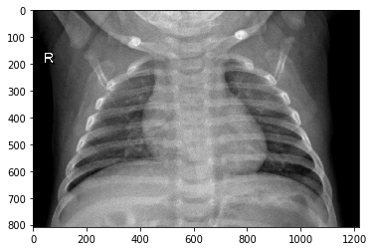

Slide 8
顯示不正常的圖片
img_name = 'person63_bacteria_306.jpeg'
img_pneumonia = load_img('../input/chest_xray/chest_xray/train/PNEUMONIA/' + img_name)
print('PNEUMONIA')
plt.imshow(img_pneumonia)
plt.show()

Slide 9
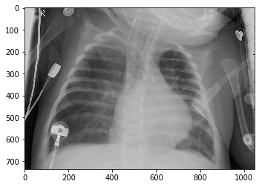

Slide 10
img_width, img_height = 150, 150 將圖片縮放到(150,150)
train_data_dir = '../input/chest_xray/chest_xray/train'
validation_data_dir = '../input/chest_xray/chest_xray/val'
test_data_dir = '../input/chest_xray/chest_xray/test'
nb_train_samples = 5217 (訓練資料集)
nb_validation_samples = 17 (驗證資料集)
epochs = 20 (訓練次數)
batch_size = 16 (設定批量次數)

Slide 11
if K.image_data_format() == 'channels_first':
設定輸入顏色通道
input_shape = (3, img_width, img_height)
else:
input_shape = (img_width, img_height, 3)
將圖片式定為(150,150,3) RGB 3色通道

Slide 12
建立模型
model = Sequential()
model.add(Conv2D(32, (3, 3), input_shape=input_shape))
model.add(Activation('relu'))
model.add(MaxPooling2D(pool_size=(2, 2)))

Slide 13
model.add(Conv2D(32, (3, 3)))
model.add(Activation('relu'))
model.add(MaxPooling2D(pool_size=(2, 2)))
model.add(Conv2D(64, (3, 3)))
model.add(Activation('relu'))
model.add(MaxPooling2D(pool_size=(2, 2)))

Slide 14
model.add(Flatten())
model.add(Dense(64))
model.add(Activation('relu'))
model.add(Dropout(0.5))
model.add(Dense(1))
model.add(Activation('sigmoid'))
model.layers

Slide 15
Compile 完成後的模型
model.compile(loss=‘binary_crossentropy’,
設定損失函數
optimizer='rmsprop',
設定優化函數
metrics=['accuracy']
顯示訓練指標)

Slide 16
設定輸入圖片參數
train_datagen = ImageDataGenerator(
rescale=1. / 255,
shear_range=0.2,
zoom_range=0.2,
horizontal_flip=True)

Slide 17
test_datagen = ImageDataGenerator(rescale=1. / 255)

Slide 18
train_generator = train_datagen.flow_from_directory(
train_data_dir,
target_size=(img_width, img_height),
batch_size=batch_size,
class_mode='binary')
Found 5216 images belonging to 2 classes.

Slide 19
validation_generator = test_datagen.flow_from_directory(
validation_data_dir,
target_size=(img_width, img_height),
batch_size=batch_size,
class_mode='binary‘)
Found 16 images belonging to 2 classes.

Slide 20
test_generator = test_datagen.flow_from_directory(
test_data_dir,
target_size=(img_width, img_height),
batch_size=batch_size,
class_mode='binary')')
Found 624 images belonging to 2 classes.

Slide 21
開始訓練模型
model.fit_generator(
train_generator,
steps_per_epoch=nb_train_samples // batch_size,
epochs=epochs,
validation_data=validation_generator,
validation_steps=nb_validation_samples // batch_size)

Slide 22
查看訓練準確度
# evaluate the model
scores = model.evaluate_generator(test_generator)
print("\n%s: %.2f%%" % (model.metrics_names[1], scores[1]*100))
acc: 87.34%

