Slide 1
Kaggle Cat&Dog Clasiaction

Slide 2
Agenda
Kaggle Cat&Dog Clasiaction

Slide 3
Kaggle
Cat&Dog Clasiaction

Slide 4
資料載入與處理
技術

Slide 5
資料載入與處理技術
https://www.tensorflow.org/tutorials/load_data/images
Retrieve the images
[1]使用 keras.preprocessing載入資料
[2]使用 tf.data載入資料

Slide 6
CNND Dog cat 分類
CNNs for image classification

Slide 7
資料來源
https://www.tensorflow.org/tutorials/images/classification

Slide 8
學習到的主題
Overfitting
解決Overfitting的技術: data Argementation
解決Overfitting的技術:dropout

Slide 9
model = Sequential([
Conv2D(16, 3, padding='same', activation='relu', input_shape=(IMG_HEIGHT, IMG_WIDTH ,3)),
MaxPooling2D(),
Conv2D(32, 3, padding='same', activation='relu'),
MaxPooling2D(),
Conv2D(64, 3, padding='same', activation='relu'),
MaxPooling2D(),
Flatten(),
Dense(512, activation='relu'),
Dense(1)
])

Slide 10
model.compile(optimizer='adam',
loss=tf.keras.losses.BinaryCrossentropy(from_logits=True),
metrics=['accuracy'])

Slide 11
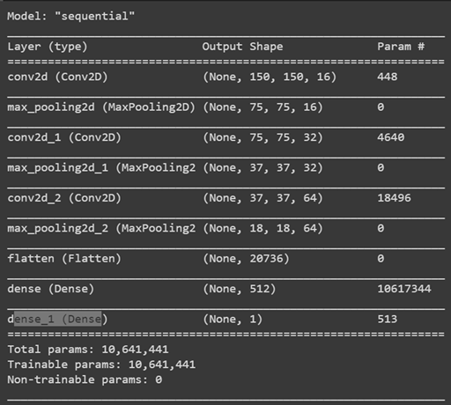
model.summary()

Slide 12
fit() vs fit_generator() 有何差別?
history = model.fit_generator(
train_data_gen,
steps_per_epoch=total_train // batch_size,
epochs=epochs,
validation_data=val_data_gen,
validation_steps=total_val // batch_size
)

Slide 13
acc = history.history['accuracy']
val_acc = history.history['val_accuracy']
loss=history.history['loss']
val_loss=history.history['val_loss']
epochs_range = range(epochs)
plt.figure(figsize=(8, 8))
plt.subplot(1, 2, 1)
plt.plot(epochs_range, acc, label='Training Accuracy')
plt.plot(epochs_range, val_acc, label='Validation Accuracy')
plt.legend(loc='lower right')
plt.title('Training and Validation Accuracy')
plt.subplot(1, 2, 2)
plt.plot(epochs_range, loss, label='Training Loss')
plt.plot(epochs_range, val_loss, label='Validation Loss')
plt.legend(loc='upper right')
plt.title('Training and Validation Loss')
plt.show()

Slide 14
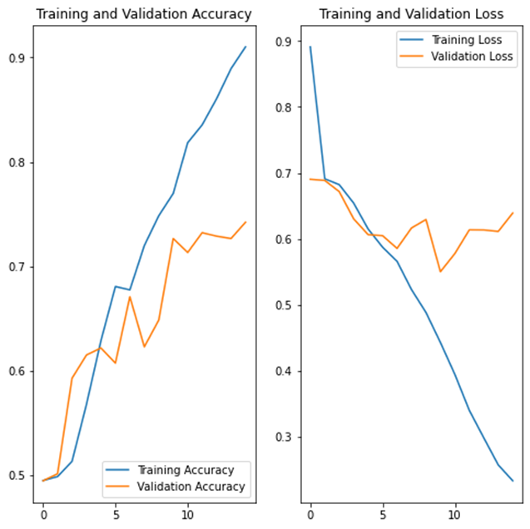

Slide 15
Overfitting
過度調適
問題

Slide 16
解決Overfitting
過度調適
問題的技術

Slide 17
解決Overfitting的技術: data Argementation
解決Overfitting的技術:dropout

Slide 18
解決Overfitting的技術: data Argementation
使用f.keras ImageDataGenerator class
Pass different transformations to the dataset and it will take care of applying it during the training process.

Slide 19
horizontal flip
image_gen = ImageDataGenerator(rescale=1./255, horizontal_flip=True)

Slide 20
ImageDataGenerator

Slide 21
tf.keras.preprocessing.image_dataset_from_directory(
directory,
labels="inferred",
label_mode="int",
class_names=None,
color_mode="rgb",
batch_size=32,
image_size=(256, 256),
shuffle=True,
seed=None,
validation_split=None,
subset=None,
interpolation="bilinear",
follow_links=False,
)

Slide 22
keras.preprocessing.image.ImageDataGenerator(featurewise_center=False,
samplewise_center=False,
featurewise_std_normalization=False,
samplewise_std_normalization=False,
zca_whitening=False,
zca_epsilon=1e-06,
rotation_range=0,
width_shift_range=0.0,
height_shift_range=0.0,
brightness_range=None,
shear_range=0.0,
zoom_range=0.0,
channel_shift_range=0.0,
fill_mode='nearest',
cval=0.0,
horizontal_flip=False,
vertical_flip=False,
rescale=None,
preprocessing_function=None,
data_format=None,
validation_split=0.0,
dtype=None)
https://keras.io/zh/preprocessing/image/

Slide 23
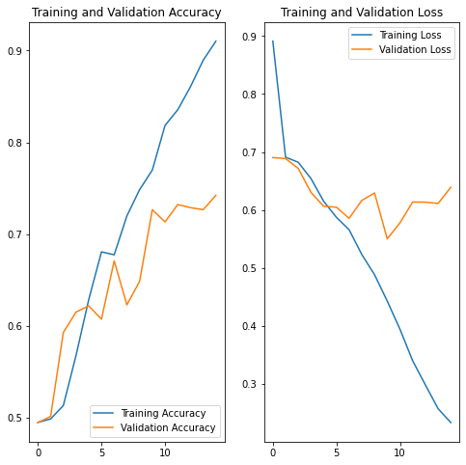
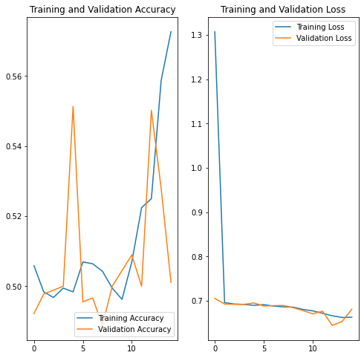

Slide 24
結論

