Slide 1
AI4High::從資料科學到機器學習與人工智慧
Neural Network::From Perception to MLP
AI::Keras/Tensorflow Way

Slide 2




手把手實作

Slide 3
Neural Network
From Perception to MLP

Slide 4
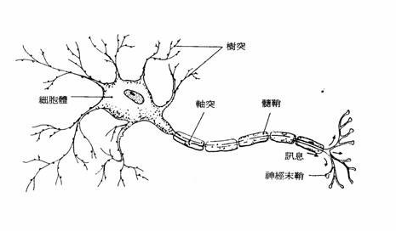
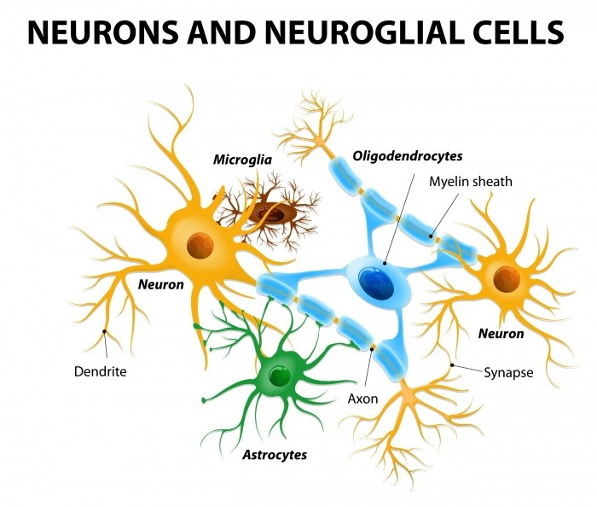
神經網路
生物神經系統的結構，神經元(Neuron)之間互相連結，由外部神經元接收信號，再層層傳導至其他神經元，最後作出反應的過程
neural network
https://ithelp.ithome.com.tw/articles/10191528

Slide 5
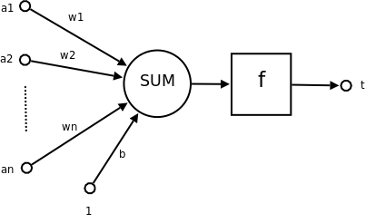
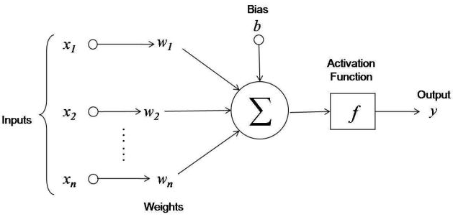
模型化➔類神經網路
Artificial neural network(ANN)
感知機 perceptron
Weight(權重)
激活函數
Activation function
Bias(偏權值)

Slide 6
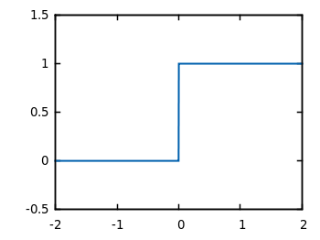
激活函數:Activation function Step Function

Slide 7
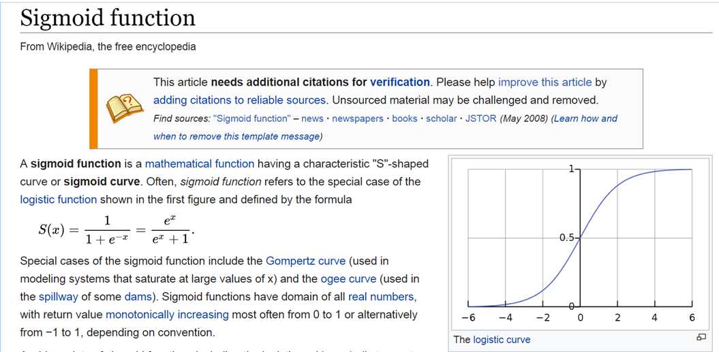
激活函數:Activation function Sigmoid function
https://en.wikipedia.org/wiki/Sigmoid_function

Slide 8
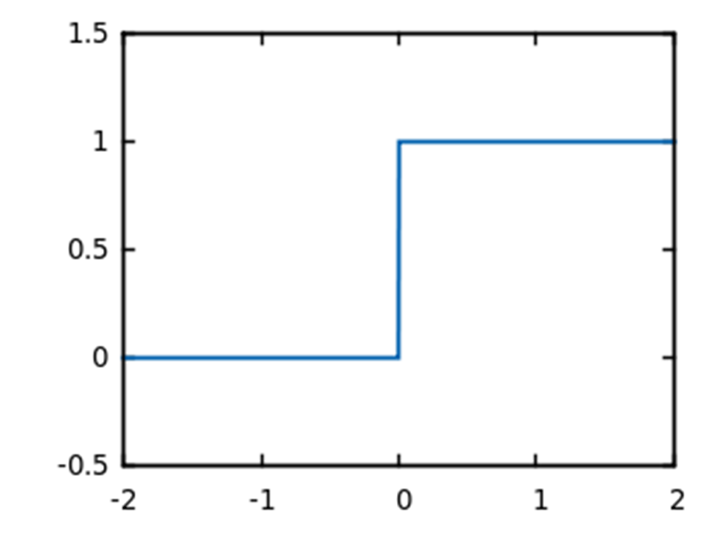
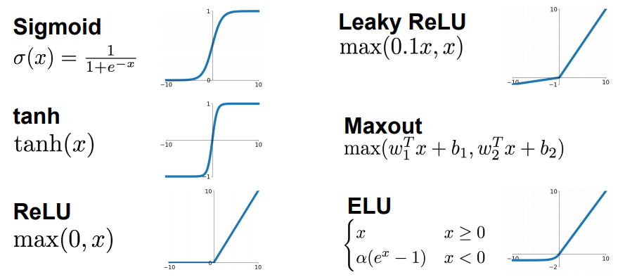
各種激活函數:Activation function

Slide 9
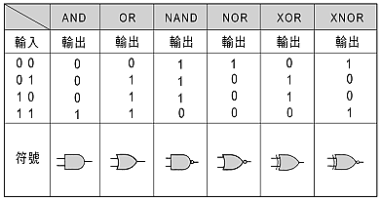
真值表[邏輯閘]

Slide 10
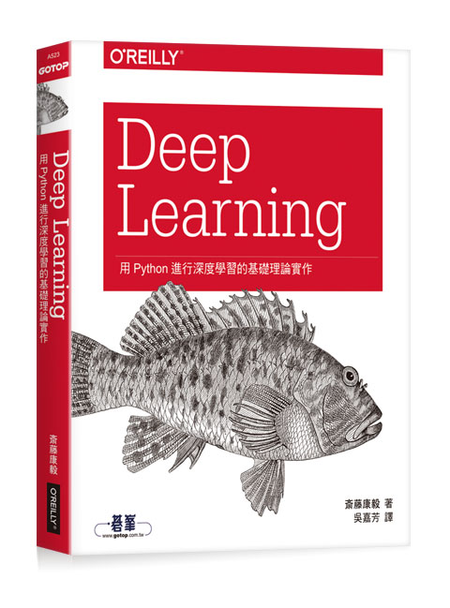
Deep Learning：用Python進行深度學習的基礎理論實作
作者： 斎藤康毅 譯者： 吳嘉芳
出版社：歐萊禮 出版日期：2017/08/17
第一章 Python入門
第二章 感知器
第三章 神經網路
第四章 神經網路的學習
第五章 誤差反向傳播法
第六章 與學習有關的技巧
第七章 卷積神經網路
第八章 深度學習
附錄A Softmax-with-Loss層的計算圖
參考文獻
https://github.com/oreilly-japan/deep-learning-from-scratch

Slide 11
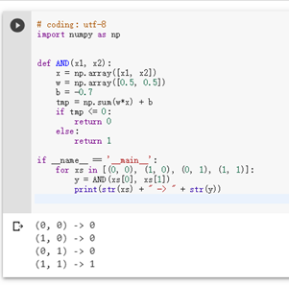
# coding: utf-8
import numpy as np
def AND(x1, x2):
x = np.array([x1, x2])
w = np.array([0.5, 0.5])
b = -0.7
tmp = np.sum(w*x) + b
if tmp <= 0:
return 0
else:
return 1
if __name__ == '__main__':
for xs in [(0, 0), (1, 0), (0, 1), (1, 1)]:
y = AND(xs[0], xs[1])
print(str(xs) + " -> " + str(y))
https://github.com/MyDearGreatTeacher/AI4high/blob/master/LogicalGate.ipynb

Slide 12
類神經網路起手式:感知器
作業:完成OR gate, NOR及NAND gate的實作

Slide 13
真值表[邏輯閘]
作業:完成OR gate, NOR及NAND gate的實作

Slide 14
第二章 感知器
# coding: utf-8
import numpy as np
def AND(x1, x2):
x = np.array([x1, x2])
w = np.array([0.5, 0.5])
b = -0.7
tmp = np.sum(w*x) + b
if tmp <= 0:
return 0
else:
return 1
if __name__ == '__main__':
for xs in [(0, 0), (1, 0), (0, 1), (1, 1)]:
y = AND(xs[0], xs[1])
print(str(xs) + " -> " + str(y))
# coding: utf-8
import numpy as np
def OR(x1, x2):
x = np.array([x1, x2])
w = np.array([0.5, 0.5])
b = -0.2
tmp = np.sum(w*x) + b
if tmp <= 0:
return 0
else:
return 1
if __name__ == '__main__':
for xs in [(0, 0), (1, 0), (0, 1), (1, 1)]:
y = OR(xs[0], xs[1])
print(str(xs) + " -> " + str(y))

Slide 15
第二章 感知器
# coding: utf-8
import numpy as np
def AND(x1, x2):
x = np.array([x1, x2])
w = np.array([0.5, 0.5])
b = -0.7
tmp = np.sum(w*x) + b
if tmp <= 0:
return 0
else:
return 1
if __name__ == '__main__':
for xs in [(0, 0), (1, 0), (0, 1), (1, 1)]:
y = AND(xs[0], xs[1])
print(str(xs) + " -> " + str(y))
# coding: utf-8
import numpy as np
def NAND(x1, x2):
x = np.array([x1, x2])
w = np.array([-0.5, -0.5])
b = 0.7
tmp = np.sum(w*x) + b
if tmp <= 0:
return 0
else:
return 1
if __name__ == '__main__':
for xs in [(0, 0), (1, 0), (0, 1), (1, 1)]:
y = NAND(xs[0], xs[1])
print(str(xs) + " -> " + str(y))

Slide 16
第二章 感知器
# coding: utf-8
import numpy as np
def OR(x1, x2):
x = np.array([x1, x2])
w = np.array([0.5, 0.5])
b = -0.2
tmp = np.sum(w*x) + b
if tmp <= 0:
return 0
else:
return 1
if __name__ == '__main__':
for xs in [(0, 0), (1, 0), (0, 1), (1, 1)]:
y = OR(xs[0], xs[1])
print(str(xs) + " -> " + str(y))
# coding: utf-8
import numpy as np
def NOR(x1, x2):
x = np.array([x1, x2])
w = np.array([0.5, 0.5])
b = 0.2
tmp = np.sum(w*x) + b
if tmp <= 0:
return 0
else:
return 1
if __name__ == '__main__':
for xs in [(0, 0), (1, 0), (0, 1), (1, 1)]:
y = NOR(xs[0], xs[1])
print(str(xs) + " -> " + str(y))

Slide 17
類神經網路起手式:感知器
Solving XOR with a single Perceptron

Slide 18
真值表[邏輯閘]
解的出來嗎??

Slide 19
手把手
Neural network
解XOR問題

Slide 20
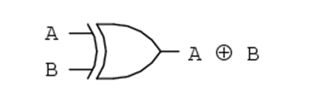
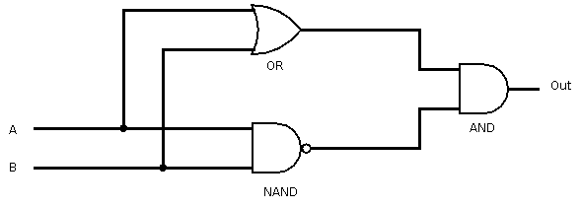
第二章 感知器
# coding: utf-8
from and_gate import AND
from or_gate import OR
from nand_gate import NAND
def XOR(x1, x2):
s1 = NAND(x1, x2)
s2 = OR(x1, x2)
y = AND(s1, s2)
return y
if __name__ == '__main__':
for xs in [(0, 0), (1, 0), (0, 1), (1, 1)]:
y = XOR(xs[0], xs[1])
print(str(xs) + " -> " + str(y))

Slide 21
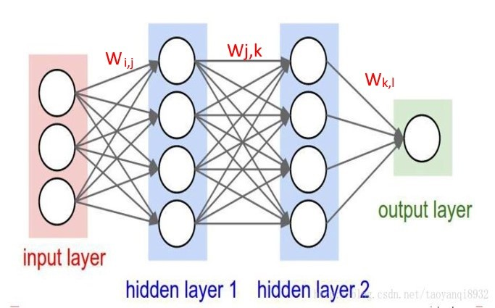
多層感知機 Multilayer perceptron, MLP

Slide 22


Slide 23
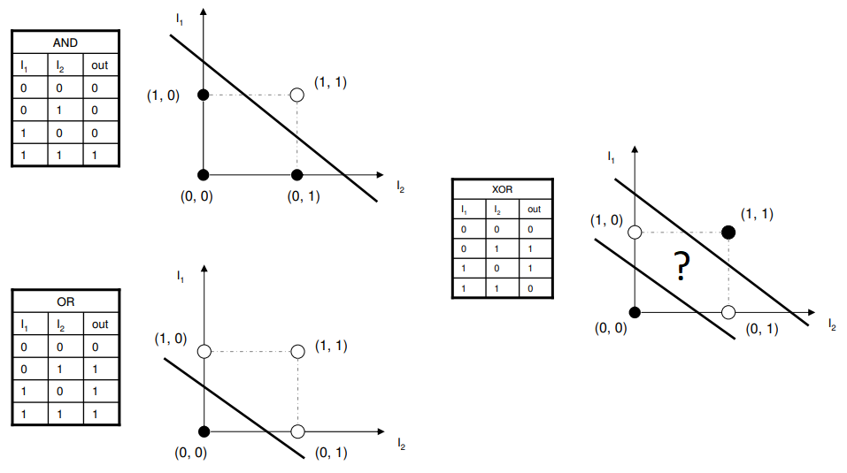
linearly separable

Slide 24
Tensorflow
Neural network
解XOR問題

Slide 25
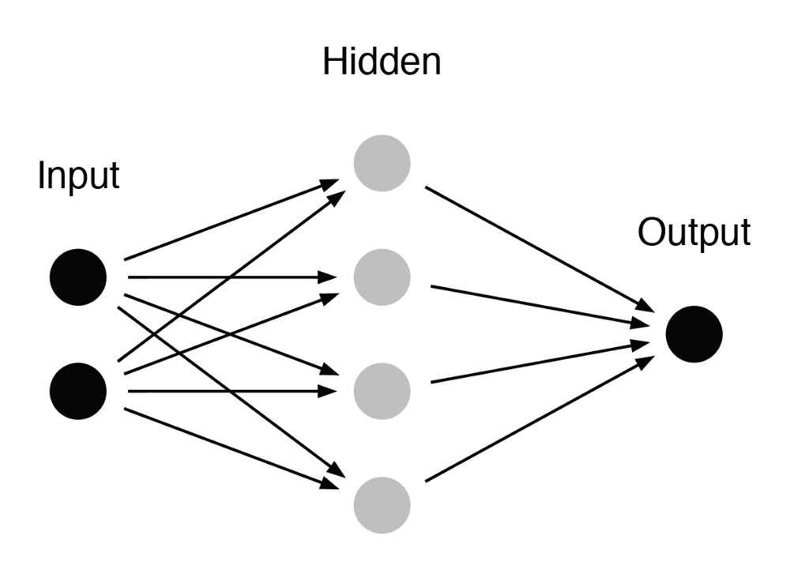
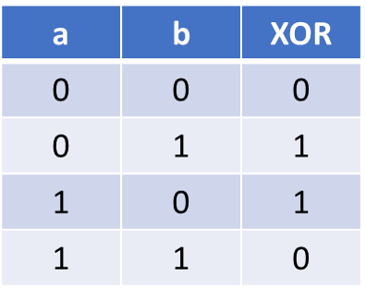
https://colab.research.google.com/drive/1GHLKYErMpD7Kl0frAecbxmEjQFlK0HKM#scrollTo=yI7GEh2XWbOz
https://www.yueye.org/2017/xor-with-tensorflow.html
2 x 4 x 1 的 MLP 模型
layer1
layer2
x_ = np.array([[0, 0], [1, 0], [0, 1], [1, 1]])
y_ = np.array([[0], [1], [1], [0]])

Slide 26
Tensorflow解XOR問題
import numpy as np
import tensorflow as tf
data = tf.placeholder(tf.float32, shape=(4, 2))
label = tf.placeholder(tf.float32, shape=(4, 1))
with tf.variable_scope('layer1') as scope:
weight = tf.get_variable(name='weight', shape=(2, 2))
bias = tf.get_variable(name='bias', shape=(2,))
x = tf.nn.sigmoid(tf.matmul(data, weight) + bias)
with tf.variable_scope('layer2') as scope:
weight = tf.get_variable(name='weight', shape=(2, 1))
bias = tf.get_variable(name='bias', shape=(1,))
x = tf.matmul(x, weight) + bias
preds = tf.nn.sigmoid(x)
TF_XOR_GOOD.ipynb

Slide 27
Tensorflow解XOR問題
loss = tf.reduce_mean(tf.nn.sigmoid_cross_entropy_with_logits(labels=label, logits=x))
learning_rate = tf.placeholder(tf.float32)
optimizer = tf.train.GradientDescentOptimizer(learning_rate).minimize(loss)
train_data = np.array([[0, 0], [0, 1], [1, 0], [1, 1]])
train_label = np.array([[0], [1], [1], [0]])

Slide 28
Tensorflow解XOR問題
with tf.Session() as sess:
sess.run(tf.global_variables_initializer())
for step in range(10000):
if step < 3000:
lr = 1
elif step < 6000:
lr = 0.1
else:
lr = 0.01
_, l, pred = sess.run([optimizer, loss, preds],
feed_dict={data: train_data, label: train_label, learning_rate: lr})
if step % 500:
print('Step: {} -> Loss: {} -> Predictions: {}'.format(step, l, pred))

Slide 29
Keras
解XOR問題

Slide 30
from keras.models import Sequential
from keras.layers.core import Dense, Dropout, Activation
from keras.optimizers import SGD
import numpy as np
X = np.array([[0,0],[0,1],[1,0],[1,1]])
y = np.array([[0],[1],[1],[0]])
model = Sequential()
model.add(Dense(8, input_dim=2))
model.add(Activation('tanh'))
model.add(Dense(1))
model.add(Activation('sigmoid'))
model.summary()
sgd = SGD(lr=0.1)
model.compile(loss='binary_crossentropy', optimizer=sgd)
#model.fit(X, y, show_accuracy=True, batch_size=1, nb_epoch=1000)
model.fit(X, y, batch_size=1, nb_epoch=1000)
print(model.predict_proba(X))
Keras 解XOR問題
tanh

Slide 31
具有學習能力的神經網路
分類 Classification
AI4high/NN_具有學習能力的Perceptron_1.ipynb

Slide 32
Machine learning basics
https://github.com/zotroneneis/machine_learning_basics
所有的演算法都是從0開始實現，無需其他的機器學習庫。
Linear Regression
Logistic Regression
Perceptron
k-nearest-neighbor
k-Means clustering
Simple neural network with one hidden layer
Multinomial Logistic Regression
Decision tree for classification
Decision tree for regression

Slide 33
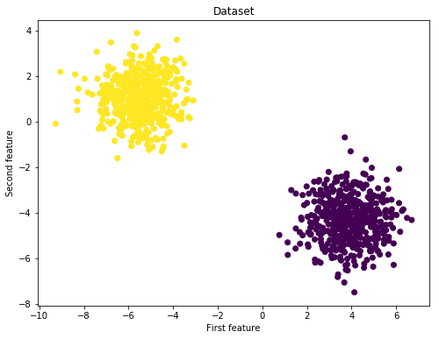
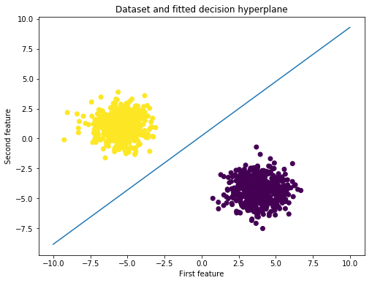
分類問題

Slide 34
具有學習能力的感知機
https://github.com/zotroneneis/machine_learning_basics/blob/master/perceptron.ipynb
import numpy as np
import matplotlib.pyplot as plt
from sklearn.datasets import make_blobs
from sklearn.model_selection import train_test_split
np.random.seed(123)
% matplotlib inline

Slide 35
具有學習能力的感知機
https://github.com/zotroneneis/machine_learning_basics/blob/master/perceptron.ipynb
X, y = make_blobs(n_samples=1000, centers=2)
fig = plt.figure(figsize=(8,6))
plt.scatter(X[:,0], X[:,1], c=y)
plt.title("Dataset")
plt.xlabel("First feature")
plt.ylabel("Second feature")
plt.show()

Slide 36
具有學習能力的感知機
https://github.com/zotroneneis/machine_learning_basics/blob/master/perceptron.ipynb
import numpy as np
import matplotlib.pyplot as plt
from sklearn.datasets import make_blobs
from sklearn.model_selection import train_test_split
np.random.seed(123)
% matplotlib inline

Slide 37
y_true = y[:, np.newaxis]
X_train, X_test, y_train, y_test = train_test_split(X, y_true)
print(f'Shape X_train: {X_train.shape}')
print(f'Shape y_train: {y_train.shape})')
print(f'Shape X_test: {X_test.shape}')
print(f'Shape y_test: {y_test.shape}')

Slide 38
Perceptron model class
class Perceptron():
def __init__(self):
pass
def train(self, X, y, learning_rate=0.05, n_iters=100):
……………………………
return self.weights, self.bias
def step_function(self, x):
return np.array([1 if elem >= 0 else 0 for elem in x])[:, np.newaxis]
def predict(self, X):
a = np.dot(X, self.weights) + self.bias
return self.step_function(a)

Slide 39
Perceptron model class
def train(self, X, y, learning_rate=0.05, n_iters=100):
n_samples, n_features = X.shape
# Step 0: Initialize the parameters
self.weights = np.zeros((n_features,1))
self.bias = 0

Slide 40
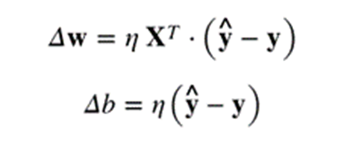
Perceptron model class
def train(self, X, y, learning_rate=0.05, n_iters=100):
n_samples, n_features = X.shape
# Step 0: Initialize the parameters
self.weights = np.zeros((n_features,1))
self.bias = 0
For I in range(n_iters):
# Step 1: Compute the activation
a = np.dot(X, self.weights) + self.bias
# Step 2: Compute the output
y_predict = self.step_function(a)
# Step 3: Compute weight updates
delta_w = learning_rate * np.dot(X.T, (y - y_predict))
delta_b = learning_rate * np.sum(y - y_predict)
# Step 4: Update the parameters
self.weights += delta_w
self.bias += delta_b
return self.weights, self.bias
W(新的)=W(前一回)+△W(誤差變動)
b(新的)=b(前一回)+△b(誤差變動)

Slide 41
training the model
p = Perceptron()
w_trained, b_trained
= p.train(X_train, y_train,learning_rate=0.05, n_iters=500)

Slide 42
Testing
y_p_train = p.predict(X_train)
y_p_test = p.predict(X_test)
print(f"training accuracy: {100 - np.mean(np.abs(y_p_train - y_train)) * 100}%")
print(f"test accuracy: {100 - np.mean(np.abs(y_p_test - y_test)) * 100}%")

Slide 43
def plot_hyperplane(X, y, weights, bias):
"""
Plots the dataset and the estimated decision hyperplane
"""
slope = - weights[0]/weights[1]
intercept = - bias/weights[1]
x_hyperplane = np.linspace(-10,10,10)
y_hyperplane = slope * x_hyperplane + intercept
fig = plt.figure(figsize=(8,6))
plt.scatter(X[:,0], X[:,1], c=y)
plt.plot(x_hyperplane, y_hyperplane, '-')
plt.title("Dataset and fitted decision hyperplane")
plt.xlabel("First feature")
plt.ylabel("Second feature")
plt.show()
plot_hyperplane(X, y, w_trained, b_trained)

Slide 44
Tensorflow
Neural network

Slide 45


第6章 神經網路演算法 109
6.1 神經網路演算法基礎 109
6.2 用TensorFlow實現門函數 110
6.3 使用門函數和激勵函數 113
6.4 用TensorFlow實現單層神經網路 117
6.5 用TensorFlow實現神經網路常見層 120
6.6 用TensorFlow實現多層神經網路 126
6.7 線性預測模型的優化 131
6.8 用TensorFlow基於神經網路實現井字棋 136
TensorFlow機器學習實戰指南
(美)尼克‧麥克盧爾 機械工業
https://github.com/nfmcclure/tensorflow_cookbook

Slide 46
Neural Network
zoo

Slide 47

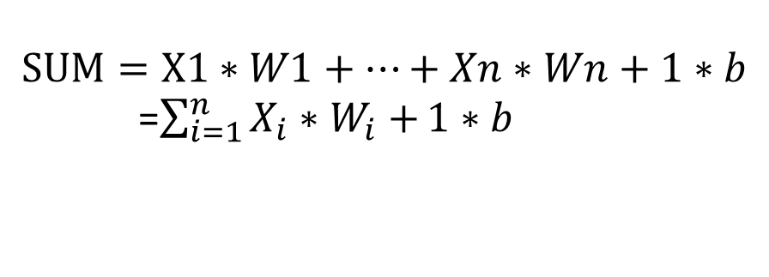
模型化➔類神經網路
Artificial neural network(ANN)
感知機 perceptron
Weight(權重)
激活函數
Activation function
X1
W1
輸入
Input
X2
W2
Y
輸出
Output
SUM
f
………..
Wn
$$Y=f(SUM)$$
b
Xn
Bias(偏權值)
1
$$SUM=X1∗W1+…+Xn∗Wn+1∗b$$
=$\sum_{i=1}^{n}{X_{i}∗W_{i}+}1∗b$

Slide 48
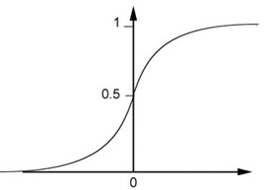
Neural Network
Neuron
Sigmoid Function
2
1
4
-1
-2
0.98
Activation function
-1
1
weights
1
bias
Notes:
sigmoid

Slide 49
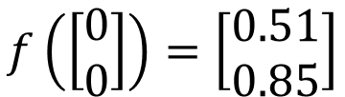
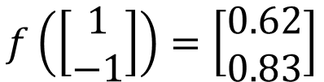

Fully Connect Feedforward Network
1
0.73
2
0.72
3
0.51
0
-2
-1
-1
1
0
-2
-1
0.5
-2
0.12
-1
0.85
0
1
-1
4
0
0
2
This is a function.
$$f\left(\left[\begin{matrix}1 \\ −1\end{matrix}\right]\right)=\left[\begin{matrix}0.62 \\ 0.83\end{matrix}\right]$$
$$f\left(\left[\begin{matrix}0 \\ 0\end{matrix}\right]\right)=\left[\begin{matrix}0.51 \\ 0.85\end{matrix}\right]$$
Input vector, output vector
Given parameters $θ$, define a function
Given network structure, define a function set
Notes:
For example, if we modify “1” to “2”, then we have another function

Slide 50
多層感知機 Multilayer perceptron, MLP
Wi,j
Wj,k
Wk,l
output layer
Input layer
output layer
1個節點
hidden layer 1
hidden layer 2
層與層的節點全部
都有連結的稱之為
Fully Connected Layer
(Affine)(Dense)
Input layer
100個節點
Hidden layer 1
1000個節點
Hidden layer 2
1000個節點
有多少個W與b參數??

Slide 51
Deep Fully Connect Feedforward Network
neuron
Input
Layer 1
Layer 2
Layer L
Output
……
y₁
……
y₂
……
……
……
……
……
……
y_{M}
Input Layer
Output Layer
Hidden Layers
Deep means many hidden layers

Slide 52
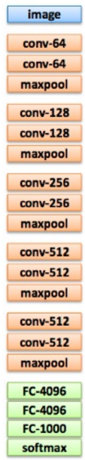
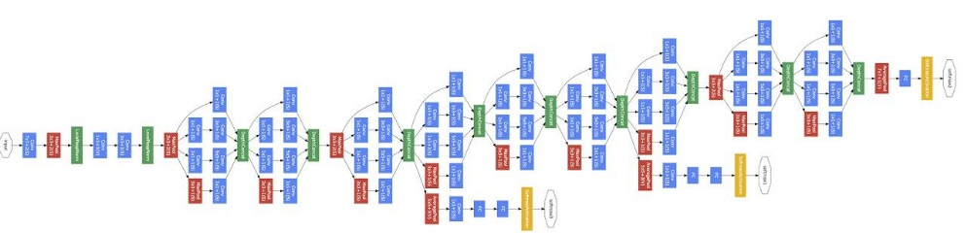
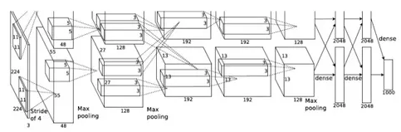
Deep = Many hidden layers
22 layers
http://cs231n.stanford.edu/slides/winter1516_lecture8.pdf
19 layers
8 layers
6.7%
7.3%
16.4%
AlexNet (2012)
VGG (2014)
GoogleNet (2014)

Slide 53

Deep = Many hidden layers
101 layers
152 layers
Special
structure
3.57%
7.3%
6.7%
16.4%
AlexNet (2012)
VGG
(2014)
GoogleNet
(2014)
Residual Net
(2015)
Taipei
101
Notes:
，曾於2004年12月31日至2010年1月4日間擁有世界第一高樓的紀錄

Slide 54
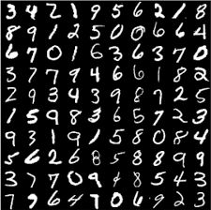
multiclass
classification

Slide 55
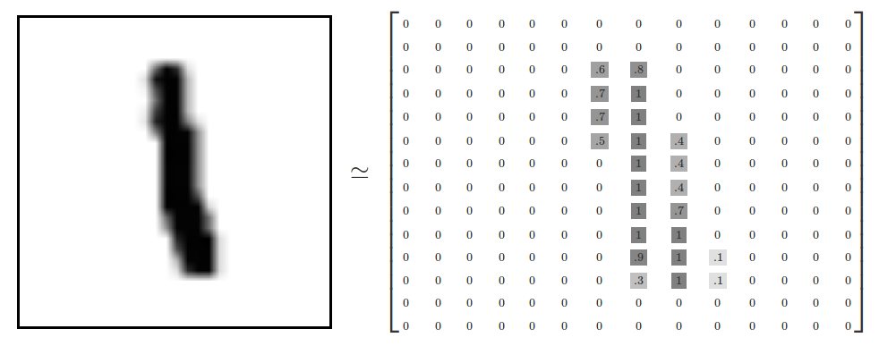
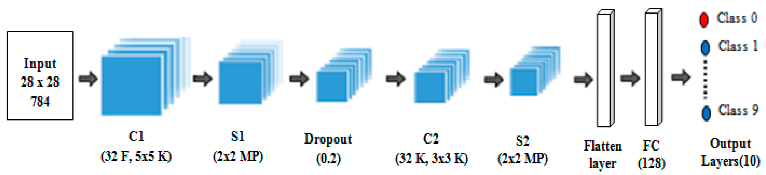
每一張手寫的數字都是28*28(=784)
用28*28矩陣來代表一張圖
輸入層有
784個單元
網路架構設計:使用那些層
Convolution? Pooling? Dropout?Dense?

Slide 56
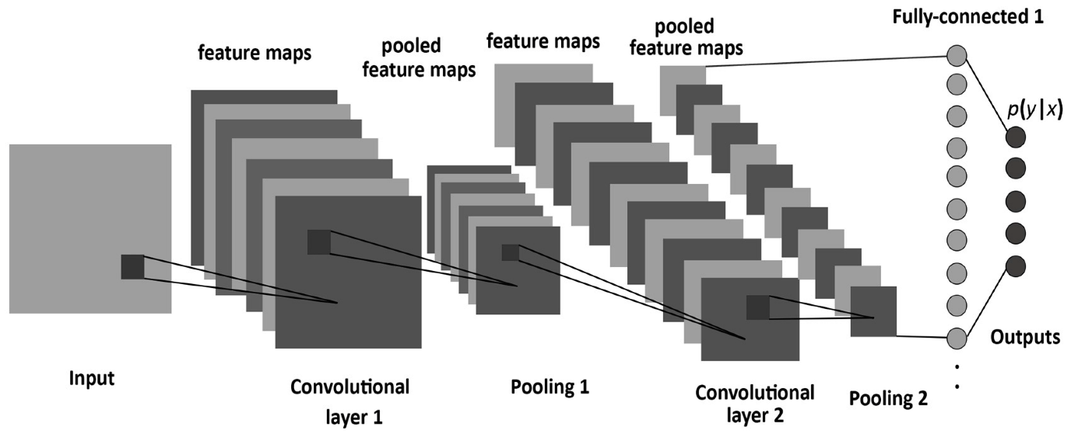
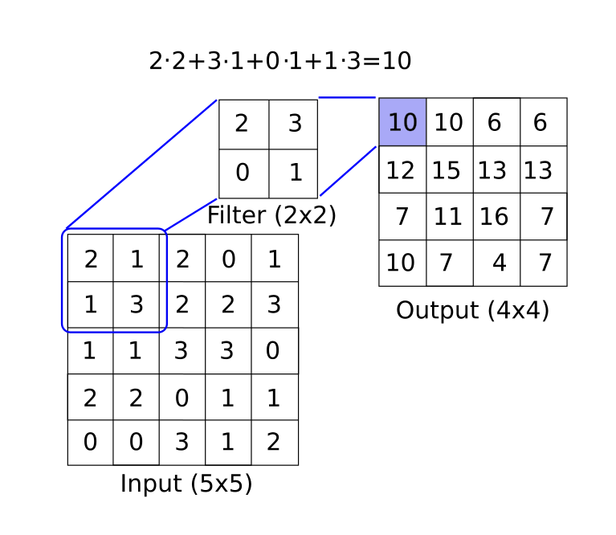
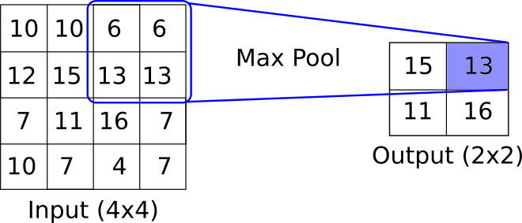
Convolution運算
ＭaxPooling運算

Slide 57
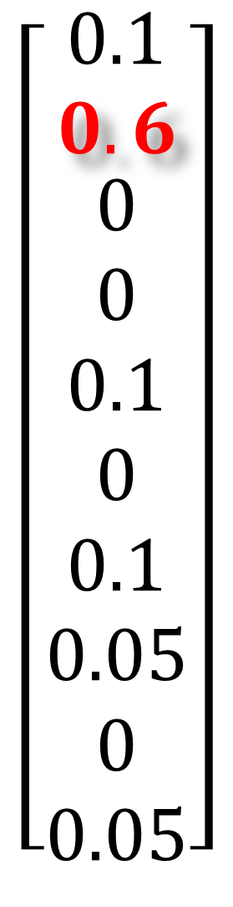
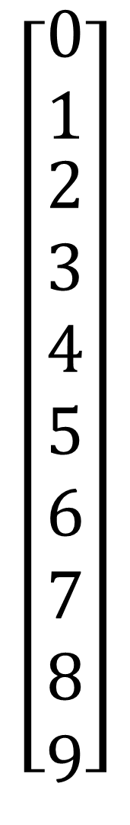

計算的答案
真實的答案
$$\left[\begin{aligned}\begin{aligned}0 \\ 1\end{aligned} \\ 2 \\ 3 \\ 4 \\ 5 \\ 6 \\ 7 \\ 8 \\ 9\end{aligned}\right]$$
$$\left[\begin{aligned}\begin{aligned}0.1 \\ 0.6\end{aligned} \\ 0 \\ 0 \\ 0.1 \\ 0 \\ 0.1 \\ 0.05 \\ 0 \\ 0.05\end{aligned}\right]$$
$$\left[\begin{aligned}\begin{aligned}0 \\ 1\end{aligned} \\ 0 \\ 0 \\ 0 \\ 0 \\ 0 \\ 0 \\ 0 \\ 0\end{aligned}\right]$$
輸出層有
10個單元
代表0-9
的機率
機率最高
的就判定
是哪個數字
計算後
輸出結果
multiclass
classification
全部加起
來的機率
為1

Slide 58
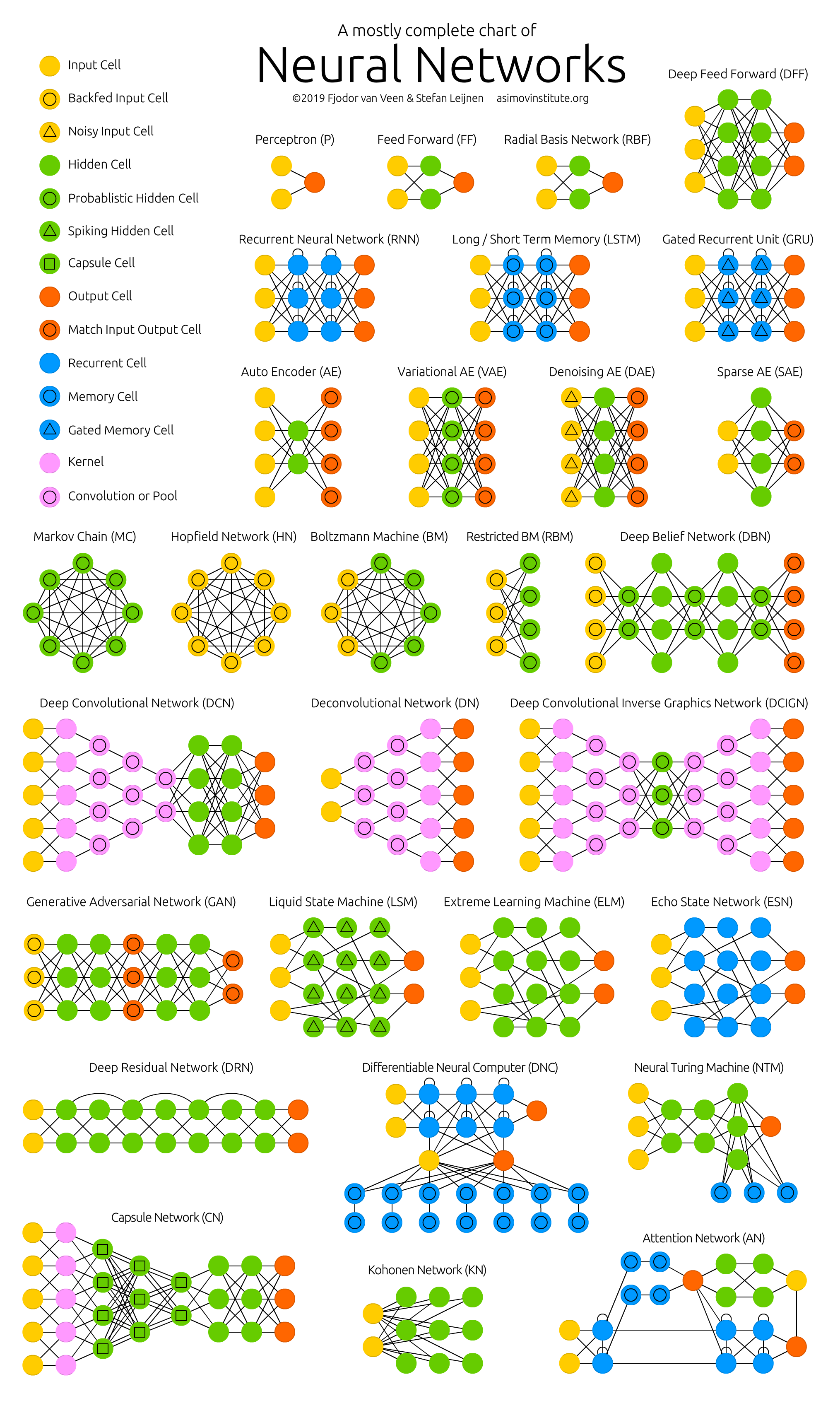
http://www.asimovinstitute.org/neural-network-zoo/

Slide 59
http://www.asimovinstitute.org/neural-network-zoo/

