Slide 1
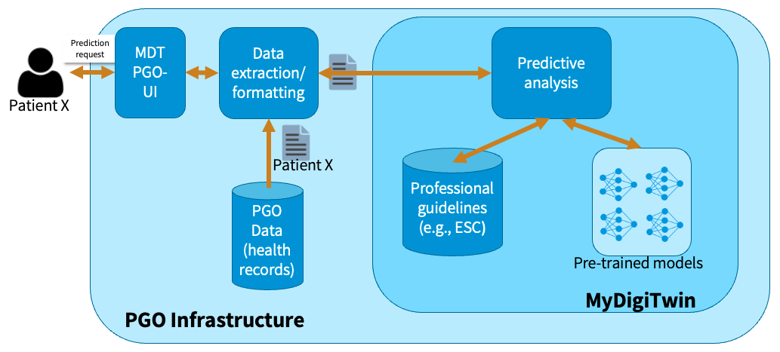
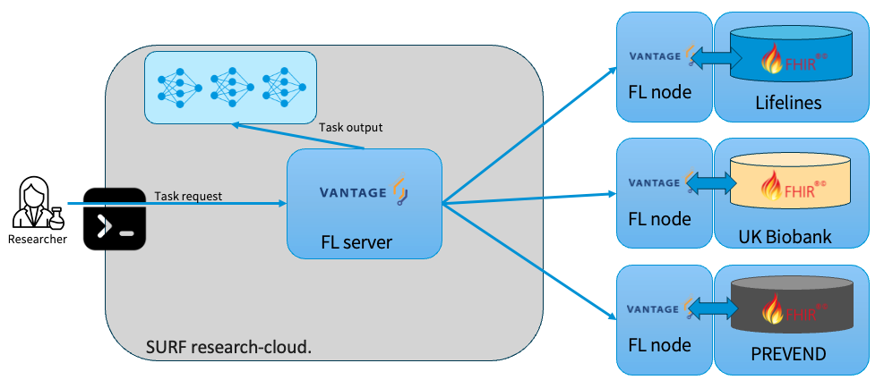
MyDigiTwin
End-user context
Research context

Slide 2


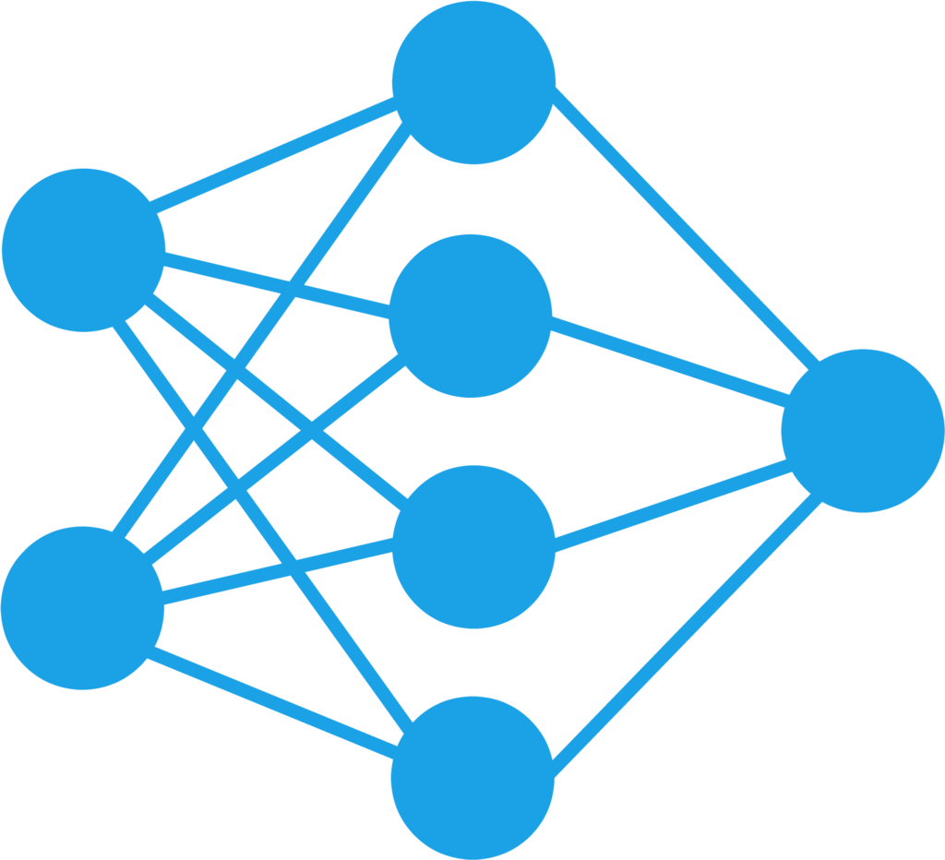
MyDigiTwin
UI
Data extraction/ formatting
Predictive analysis
Patient X
Professional
Guidelines
PGO
Data
(health records)
MyDigiTwin
PGO Infrastructure

Slide 3






MyDigiTwin
UI
Data extraction/ formatting
Predictive analysis
FHIR-compliant
data
Patient
Patient
data
Professional
Guidelines
PGO
Data
(health records)
MyDigiTwin
PGO Infrastructure
Harmonization tools
FL node
Lifelines
Aggregator
Harmonization tools
FL node
FL server
UK Biobank
Harmonization tools
Researcher
Federated algorithm
FL node
PREVEND
Federated algorithm
Features (FHIRPath)
Glomerular filtration rate/1.73 sq M (CKD-EPI)
Bundle.entry.select(resource as Observation).
where(code.coding.code='1751-7').value
Date of inclusion
Bundle.entry.select(resource as ResearchSubject).
period.start

Slide 4

Work in progress - FL – vantage6
Federated algorithm
Selection of variables
Features
Glomerular filtration rate/1.73 sq M (CKD-EPI)
Harmonization tools
Bundle.entry.select(resource as Observation).
where(code.coding.code='1751-7').value
Date of inclusion
Bundle.entry.select(resource as ResearchSubject).
period.start
FL node
Lifelines
Harmonization tools
Task request
FL node
Researcher
FL server
UK Biobank
Harmonization tools
FL node
PREVEND

Slide 5
Envisioned end-user context
Glomerular filtration rate/1.73 sq M (CKD-EPI)
FHIR bundle:
nictiz.fhir.nl.stu3.zib2017 - 2.2.8
Bundle.entry.select(resource as Observation).
where(code.coding.code='1751-7').value
Date of inclusion
Bundle.entry.select(resource as ResearchSubject).
period.start
Models trained with FHIR-compliant inputs.

Slide 6
Variables and datasets
Integration of new cohort studies/reference datasets
Data harmonization
Lifelines additional variables + new datasets variables
Setting up new nodes
End-to-end PoC will be key
Harmonization tools
FL node
UK Biobank
Harmonization tools
FL server
FL node
PREVEND

Slide 7
Let’s stay in touch
www.eScienceCenter.nl
info@esciencecenter.nl
+31 (0)20 460 4770

