Slide 1
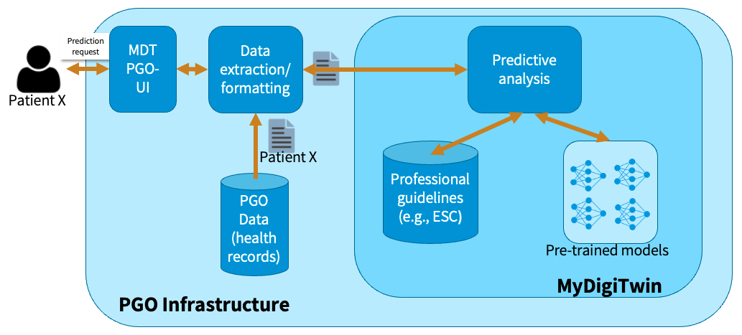
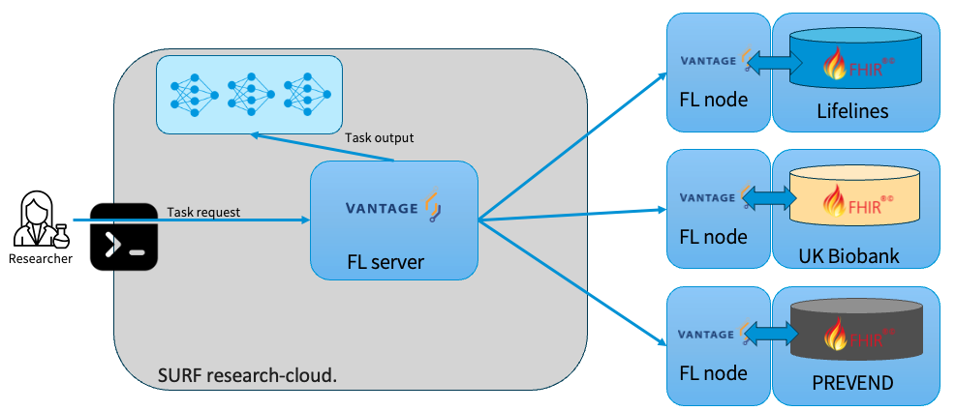
MyDigiTwin
End-user context
Research context

Slide 2



MyDigiTwin
UI
Data extraction/ formatting
Predictive analysis
PGO
Data
(health records)
Patient X
Professional
Guidelines
PGO Infrastructure
MyDigiTwin

Slide 3




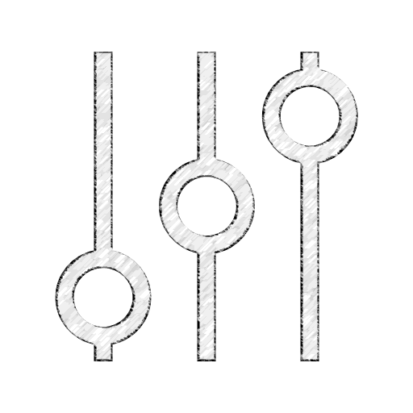


MyDigiTwin
UI
Data extraction/ formatting
Predictive analysis
Patient
compliant
data
PGO
Data
(health records)
Patient
data
Professional
Guidelines
PGO Infrastructure
MyDigiTwin
Harmonization tools
Aggregator
FL node
Lifelines
Harmonization tools
FL server
FL node
RDS 2
Federated algorithm
Harmonization tools
Researcher
FL node
RDS 3
Aggregated data:
E.g., Model parameters,
Gradients
Federated algorithm
Features (FHIRPath), e.g.:
Glomerular filtration rate/1.73 sq M (CKD-EPI)
Bundle.entry.select(resource as Observation).
where(code.coding.code='1751-7').value
Date of inclusion
Bundle.entry.select(resource as ResearchSubject).
period.start

Slide 4

Work in progress - FL – vantage6
Features
Federated algorithm
Selection of variables
Glomerular filtration rate/1.73 sq M (CKD-EPI)
Harmonization tools
Bundle.entry.select(resource as Observation).
where(code.coding.code='1751-7').value
Date of inclusion
Bundle.entry.select(resource as ResearchSubject).
period.start
FL node
Lifelines
Harmonization tools
Task request
FL node
UK Biobank
Researcher
FL server
Harmonization tools
FL node
PREVEND

Slide 5
Envisioned end-user context
Glomerular filtration rate/1.73 sq M (CKD-EPI)
Bundle.entry.select(resource as Observation).
where(code.coding.code='1751-7').value
FHIR bundle:
nictiz.fhir.nl.stu3.zib2017 - 2.2.8
Date of inclusion
Bundle.entry.select(resource as ResearchSubject).
period.start
Models trained with FHIR-compliant inputs.

Slide 6
Variables and datasets
Integration of new cohort studies/reference datasets
Data harmonization
Lifelines additional variables + new datasets variables
Setting up new nodes
End-to-end PoC will be key
Harmonization tools
FL node
UK Biobank
FL server
Harmonization tools
FL node
PREVEND

Slide 7
Let’s stay in touch
www.eScienceCenter.nl
info@esciencecenter.nl
+31 (0)20 460 4770

