Slide 1

LUGGAGE TRACKER WITH AUTOMATIC LOCKING SYSTEM
My Emb Solution
copyright 2016 “:P koi copy na karle"
System Team

Slide 2
Project Idea Overview
Gps Luggage Tracker is a system through which we can find the location of luggage/Bag ,gadgets or whatever on which you install it as well it’s have an automatic bag locking system which can be used when luggage might be lost or one think something suspicious goes on with the luggage .
In this automatic locking system you’r bag is locked and a camera gets on at that time as well as a bugger system is also installed to buzz when one’s try to open the bag forcefully

Slide 3
Projects Requirements
GpS Module
Locking Mechanism For Bags “Quite different For Each Bag”
Cam Module
Buzzer System
Micro-controller/Microprocessor “We can decide later on”
GSM Module “To Send Pics Collect by Cam”

Slide 4

Project Scope
For Big Brands of Luggage Bags .
At Airport Bag tagging
For Tour&Travels companies
Personal Peoples Luggage Safety
Luggage Checkin’s
For Courier Service

Slide 5
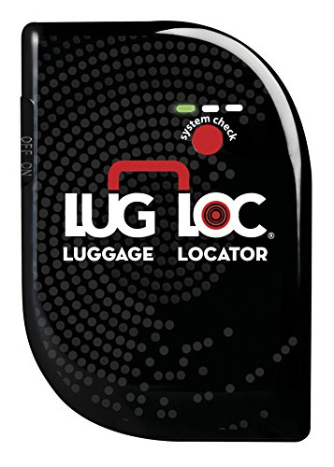
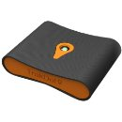

Rivals Already in Market
LugLoc, Award Winning Luggage Locator in the World. 15 Day Rechargeable Battery…
Trakdot Luggage Tracker
Loc8ing Air Travel Tag
Lots More..

Slide 6
Challenges Faced
GPS couldn’t work on indoor .So , for indoor positioning we required to think about it.
How to on Automatic locking system after losing our bag .
Need To focus Cam and Relocate Cam position so it give overall overview of outside when bag lost
How Pics Which are clicked will send to us.

Slide 7
Reference Available About Product
/GPS-TRAVELLER/DOCUMENTS/PROJECTPREVIEW/LOACATION LOCATOR.PDF
/GPS-TRAVELLER/DOCUMENTS/PROJECTPREVIEW/UNTITLED.PDF
/GPS-TRAVELLER/DOCUMENTS/PROJECTPREVIEW/ImperialGps.PDF

