Slide 1
TWG – Technical Workgroup Updates #6
TWG#1-Singapore / TWG#2-Thailand / TWG#3-HongKong / TWG#4-China GZ / TWG#5-Japan Osaka / TWG#6-Thailand
Notes:
#1 – TWG – ABT / QR payment overseas
#2 – TWG – Various forms of QR. Static/Dynamic, Common QR/Local QR etc..

Slide 2
QR Framework Progress
Recap
Payment flow comment
Run through spec.
Forex Layer sharing

Slide 3
1. Recap

Slide 4

TWG Technical Updates
Where are we now?

Slide 5



QR Framework – Timeline
Field
#2 Forex Layer
2019
Q4
#3
QR Framework-API
2019
Q3-4
#1
All-In-One-QR Repository
2019
Q2
2019
Q1
2019
Q1

Slide 6
QR Framework Progress
No | Components | Status | Who needs to build
1 | Component #1 – “All-in-one-QR-code” repository | Completed workgroup discussion – each member to build their own | Country to do outbound
2 | Component #3 – QR Framework API | Completed 4 API definition Final leg - put into a proper spec. Put design for comment and finalisation | Country to do inbound
3 | Component #2 – Forex Layer | To do by this Q2 2019 | Country to do outbound

Slide 7
2. Payment flow - comment

Slide 8
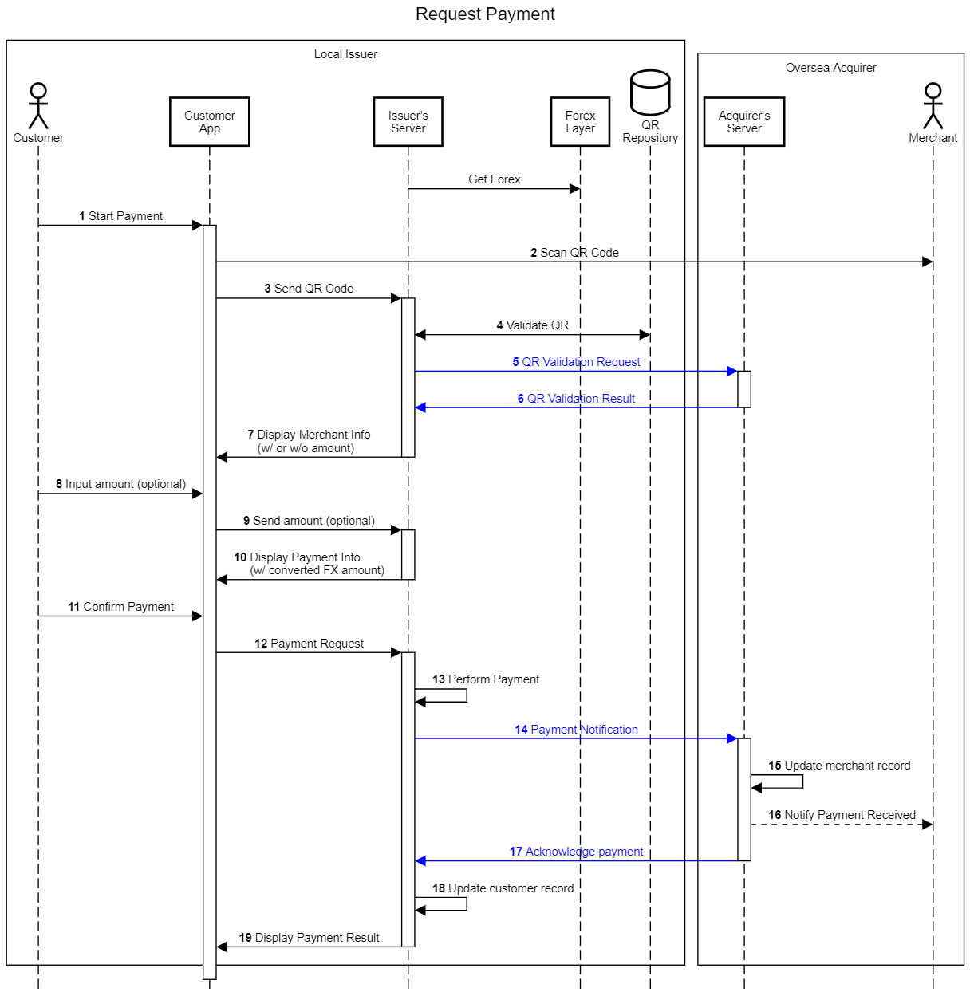
QR Framework Progress

Slide 9
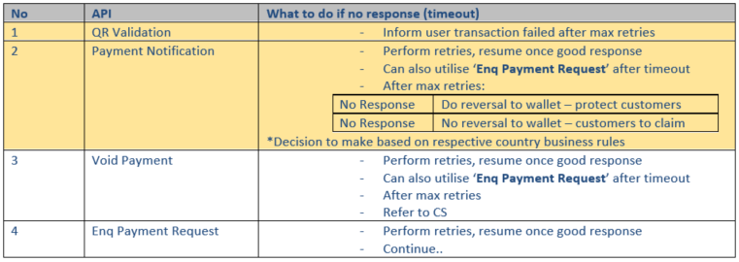
QR Framework Progress
*Mobile timeout should be lesser than the backend timout

Slide 10
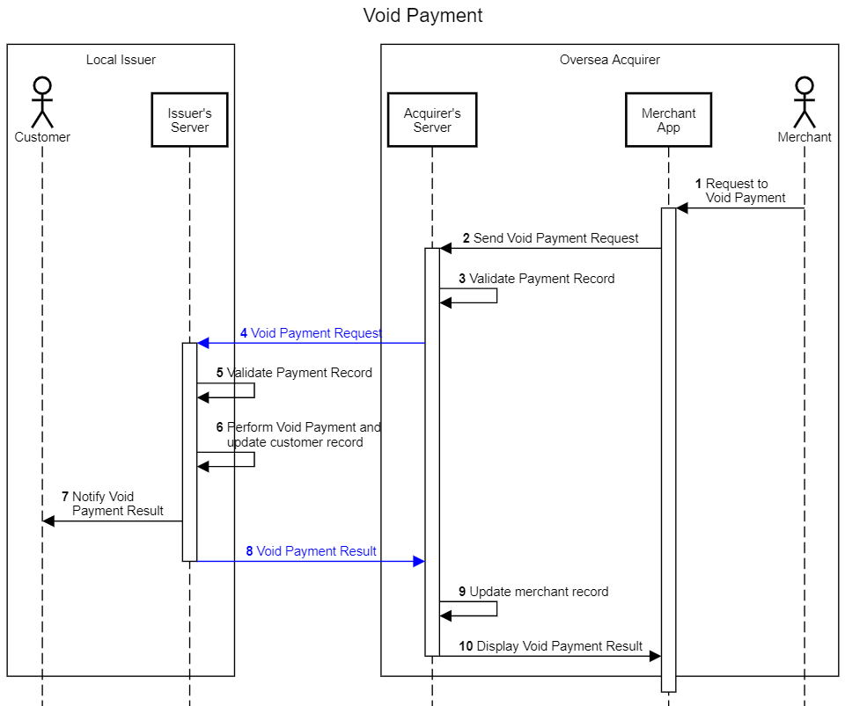
QR Framework Progress

Slide 11
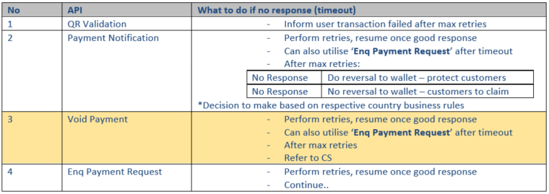
QR Framework Progress
*Mobile timeout should be lesser than the backend timout

Slide 12
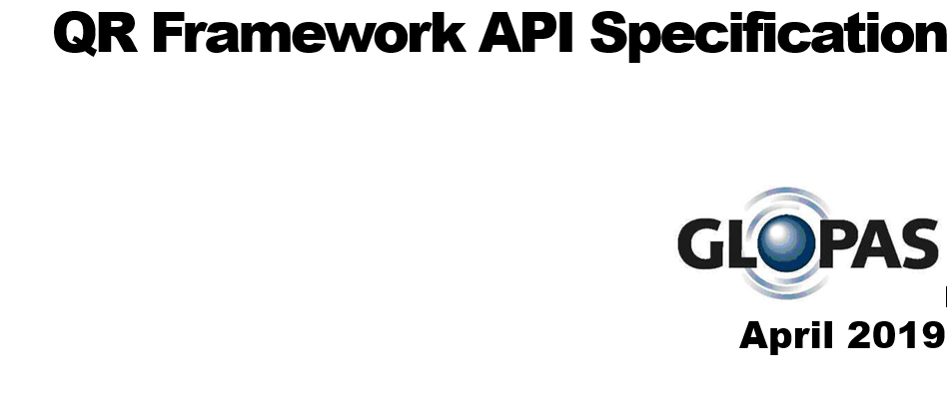
3. Run through spec

Slide 13
XQR Specifications
Specification finalisation and sign-off
Development Work | Q3/4 (July to Oct 2019)
SIT | Q4 (Oct to Nov 2019)
UAT/PAT/Field Trial | Q4 (Dec 2019)

Slide 14
4. Forex layer sharing
(SG & HK)

Slide 15

Thank you

Slide 16
Thank you

