Slide 1
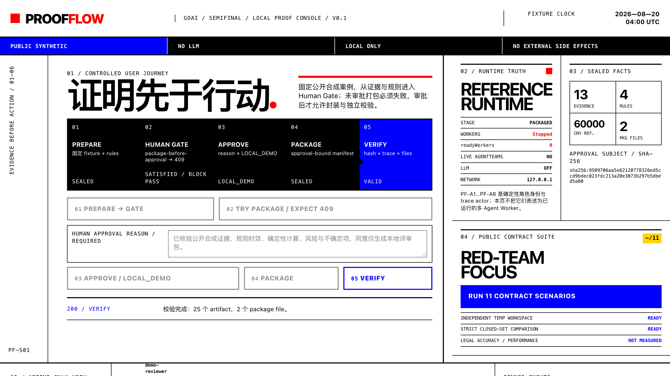
GOAI 2026 · AGENT INFRA / 新智基座
让高风险 Agent 在行动前提交证据。
ProofFlow：证据驱动的高风险决策多 Agent 协同基座
REFERENCE CORE VERIFIED
WORKER EVAL UNKNOWN
真实本地 Demo / PUBLIC SYNTHETIC
可证智能 VeriAgent
复赛候选稿 · 2026.08
github.com/MyGarfield/ProofFlow
01 / 12
Notes:
开场只讲一个命题：在高风险流程里，答案不是终点；行动必须先经过可复核的证据与人工门。强调本稿展示的是参考控制层与本地合成 Demo，不是已运行的六 Worker 系统。
[Sources]
- https://www.goaihz.com/tracks
- README.md
- docs/09_SEMIFINAL_DEMO_RUNBOOK.md
- Screenshot: locally captured PUBLIC_SYNTHETIC loopback demo on 2026-08-21

Slide 2
PROOFFLOW
WHY / SCENE
答错只是风险的开始；无法复核的动作才不可接受
首个验证场景
劳动争议内部预审
黑箱回答
可审计交付
同一份解除事实，若证据、规则、计算口径
和批准对象不能复核，生成得再流畅
也无法承担责任。
“看起来合理”
“能被独立复核”
来源不可追
口径不可重放
批准对象不明确
证据有引用
规则有版本
批准绑定对象
PUBLIC SYNTHETIC
不代表真实客户、法律准确率或 ROI 验证
产品目标：把“答案质量”升级为“可验证的责任闭环”
PF / 02 / 12
PUBLIC SYNTHETIC · NO LLM · LOCAL EVIDENCE
Notes:
说明场景选择的工程意义：劳动争议预审包含证据、时效规则、确定性计算和人工责任边界。当前不声称法律准确率或市场验证，只证明控制问题可被编码与验真。
[Sources]
- docs/00_STATUS_AND_SCOPE.md
- docs/02_SECURITY_AND_HUMAN_GATE.md
- examples/cases/happy_path/ (PUBLIC_SYNTHETIC fixture)
- research/frontier_sources.json: CL-AUTONOMY-RISK, CL-SIMPLE-COMPOSABLE

Slide 3
PROOFFLOW
WHAT / BOUNDARY
ProofFlow 是证据与控制层，
不替代模型与 AgentTeams
业务人与领域流程
Reviewer · Approver · 决策责任
DOMAIN
已实现
ProofFlow Proof Plane
Evidence · Rule · Calculation · State · Human Gate · Trace · Package
VERIFIED
AgentTeams / Model / Tools
团队生命周期 · 任务与 Matrix · Worker Runtime
PARTIAL
边界
控制面 + Manager operator smoke；Worker/LLM 运行仍为 UNKNOWN
PF / 03 / 12
PUBLIC SYNTHETIC · NO LLM · LOCAL EVIDENCE
Notes:
明确责任边界：AgentTeams 提供协作运行时，ProofFlow 在应用层实现领域对象、状态机、审批摘要与 verifier。不要把 AgentTeams 原生能力和 ProofFlow 应用层能力混写，也不要把 Manager operator smoke 说成 Worker run。
[Sources]
- docs/01_TECHNICAL_DESIGN.md
- README.md
- src/proofflow/models.py
- src/proofflow/reference_runtime.py
- deploy/agentteams/evidence/mcp-manager-operator-smoke-2026-08-20.json

Slide 4
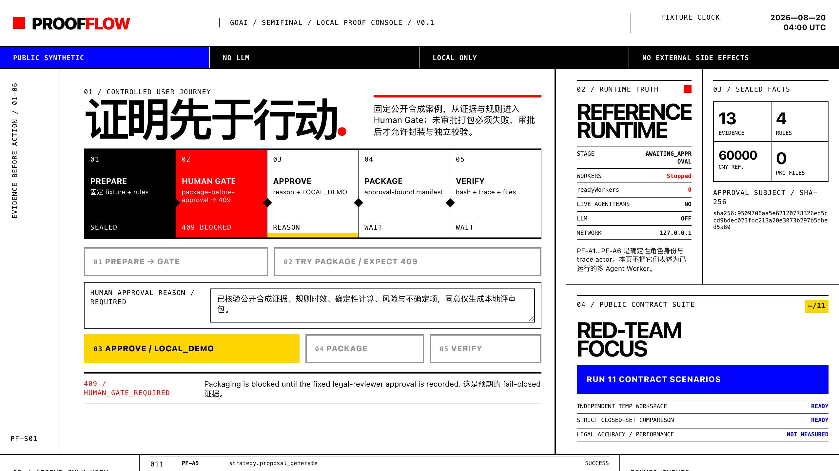
PROOFFLOW
PROOF / DEMO
同一条链路：批准前 409，批准后才 VALID
现场可在 90 秒内复现；两张图均来自本地 PUBLIC_SYNTHETIC 控制台。
BEFORE · FAIL CLOSED
AFTER · INTEGRITY VALID
409 / HUMAN_GATE_REQUIRED · package files = 0
2 package files · 25 artifacts · verification valid=true
PF / 04 / 12
PUBLIC SYNTHETIC · NO LLM · LOCAL EVIDENCE
Notes:
按演示顺序讲：Prepare 停在 AWAITING_APPROVAL；故意点击 package 得到 409 且 0 文件；输入理由后服务端固定 legal-reviewer 与 LOCAL_DEMO；Package 生成 2 文件；Verify 检查 25 个 artifacts 与 2 个文件并返回 valid。VALID 只指结构完整性，不是法律判断正确。
[Sources]
- docs/09_SEMIFINAL_DEMO_RUNBOOK.md
- tests/e2e/test_demo_server.py
- demo/server.py
- Screenshot: locally captured PUBLIC_SYNTHETIC loopback demo on 2026-08-21

Slide 5
PROOFFLOW
MECHANISM / TRACE
每个结论都必须带着来源与版本进入下一步
EVIDENCE
RULE
CALCULATE
PROPOSAL
AUDIT
APPROVAL
PACKAGE
证据对象
规则引用
确定性计算
候选结论
冲突审计
人工批准
交付与验真
每一步都校验
tenant / case / trace
source_refs / catalog version
input / output hash
普通 SHA-256 seal 只证明内容一致，不是签名；可信来源仍依赖受控 Artifact Store 与身份边界。
PF / 05 / 12
PUBLIC SYNTHETIC · NO LLM · LOCAL EVIDENCE
Notes:
逐步解释对象链：Evidence 带 source refs；Rule 带目录版本与适用范围；Calculation 重放确定性公式；Proposal/Audit 绑定输入；Approval 绑定 subject hash；Package 再独立校验。强调 SHA-256 不是签名。
[Sources]
- src/proofflow/models.py
- src/proofflow/canonical.py
- src/proofflow/state_machine.py
- src/proofflow/reference_runtime.py
- docs/01_TECHNICAL_DESIGN.md

Slide 6
PROOFFLOW
GOVERN / HUMAN GATE
Human Gate 批准的是精确 subject hash，
而不是泛化“同意”
01
角色
legal-reviewer
APPROVAL SUBJECT
sha256:
02
决定
APPROVE
9509706aa5e62120
778326ed5ccd9bde
c023fdc213a20e30
73b297b5dbed5a80
03
时效
within expires_at
04
对象
exact subject_hash
BOUND TO CURRENT OBJECT
对象发生变化 → 旧批准失效
PF / 06 / 12
PUBLIC SYNTHETIC · NO LLM · LOCAL EVIDENCE
Notes:
Human Gate 的核心不是出现一个审批按钮，而是审批记录绑定精确对象、角色与时效。批准后的 artifact、trace 或 package 一旦变化，旧批准不能继续授权。当前 LOCAL_DEMO 不代表 MFA、数字签名或真实组织身份。
[Sources]
- src/proofflow/models.py
- src/proofflow/skills/approval.py
- src/proofflow/state_machine.py
- tests/e2e/test_reference_runtime.py
- docs/02_SECURITY_AND_HUMAN_GATE.md

Slide 7
PROOFFLOW
AGENTS / SKILLS
六个 Identity 管职责，八个 Skill 管可复用合同
IDENTITY / 职责边界
SKILL / I·O·FAILURE·SECURITY
PF-A1
Case Manager
2 skills
01
evidence_ingest
02
timeline_build
PF-A2
Evidence Agent
2 skills
PF-A3
Rule Agent
1 skill
03
rule_retrieve
04
deterministic_calculate
PF-A4
Calculation Agent
1 skill
05
conflict_detect
06
decision_audit
PF-A5
Strategy Agent
0 distributed
human_approval
document_package
07
08
PF-A6
Audit Agent
2 skills
Repo ↔ Manager ↔ Worker storage SHA-256：8 / 8 match
runtime consumption = false
PF / 07 / 12
PUBLIC SYNTHETIC · NO LLM · LOCAL EVIDENCE
Notes:
六个 Identity 是权限和责任合同，不是为了凑 Agent 数量。八个 Skill 的仓库、Manager 源与 Worker storage 副本哈希一致，但 Worker 没有运行，因此不能说已消费 Skill。Strategy 当前没有分发 Skill，是公开的设计差距。
[Sources]
- specs/06_AGENT_IDENTITY.yaml
- specs/07_SKILL_SPEC.yaml
- deploy/agentteams/evidence/mcp-manager-operator-smoke-2026-08-20.json: skill_distribution
- tests/contract/test_agentteams_assets.py

Slide 8
PROOFFLOW
RUNTIME / TRUTH
Control plane 已验证；业务 Team 仍未运行
VERIFIED POINT-IN-TIME
NOT OPERATIONALLY READY
Workers
6 × Stopped
3
200 / 403
Leader
Stopped
MCP servers · each 1 tool
least-privilege allow / deny
readyWorkers
0 specialists
Worker containers
0
Manager operator synthetic chain
13 Evidence → 4 citations → 60000
Team controller
Active ≠ running
resealed tamper → BLOCKED / UNTRUSTED_EVIDENCE
LLM / Human receipt
not observed
Manager smoke 不能打开 single-agent 或 six-agent 评测门。
PF / 08 / 12
PUBLIC SYNTHETIC · NO LLM · LOCAL EVIDENCE
Notes:
这是答辩可信度页。左侧只说已经有点时机器证据的 Manager 操作员链和 ACL；右侧主动展示 Stopped、0 ready、0 containers、无 LLM/Human receipt。Team controller Active 只是 CR/reconcile 状态，不是业务可运行。
[Sources]
- deploy/agentteams/evidence/mcp-manager-operator-smoke-2026-08-20.json
- deploy/agentteams/evidence/local-infra-smoke-2026-08-20.json
- docs/00_STATUS_AND_SCOPE.md
- docs/10_EVALUATION_PROTOCOL.md

Slide 9
PROOFFLOW
RED TEAM / FAIL CLOSED
11 个公开合同证明系统会安全失败
严格闭集比较：预期阻断是 PASS，不安全条件仍产出才是失败。
11 / 11
INPUT
缺参数 · unresolved · parser allowlist
RULE
地域 / 时效 / scope receipt
DETERMINISTIC CONTRACTS
quality · safety · integrity
TRUST
源 digest · seal · trusted store
BOUNDARY
跨 tenant · approval TOCTOU · package tamper
不覆盖：法律准确率 · LLM prompt injection · MCP poisoning · 生产安全
PF / 09 / 12
PUBLIC SYNTHETIC · STRICT CLOSED SET
Notes:
11/11 不是安全率或法律准确率，而是冻结的 11 个结构合同都满足。逐类说明错误会在哪里 fail closed。parser instruction 场景没有调用 LLM，不能当作 prompt injection 防御证明。
[Sources]
- benchmarks/scenarios.json
- benchmarks/suite.py
- tests/benchmark/test_public_contract_suite.py
- docs/06_PUBLIC_BENCHMARK.md
- docs/09_SEMIFINAL_DEMO_RUNBOOK.md

Slide 10
PROOFFLOW
EVALUATION / EVIDENCE GATE
结果先保持 UNKNOWN，直到 Worker receipts 齐全
U
N
S
A
F
E
0 / DETERMINISTIC
1 / SINGLE LEADER
6 / TEAM
冻结 reference flow
Leader-only baseline
Leader + 5 specialists
protocol arm not executed
Leader Running · 1 container
5 ready · 6 containers
UNKNOWN / points=null
UNKNOWN / points=null
UNKNOWN / points=null
越界仍产出
14 scenarios × 20 planned paired replicates / cell
minimum 18 valid · complete cost / latency / trace / provenance
Manager operator smoke 缺 Worker / LLM / task / Matrix / Skill / Human receipts，因此不会误开 gate。
PF / 10 / 12
PUBLIC SYNTHETIC · NO LLM · LOCAL EVIDENCE
Notes:
解释为什么主动保留 UNKNOWN：协议只在 Worker execution、LLM inference、task/Matrix/MCP/Skill/Human receipts 与完整 provenance 齐全时允许结果进入 PASS/FAIL。缺证据不是 0；越权后仍产生可用结果是 UNSAFE_SUCCESS。
[Sources]
- docs/10_EVALUATION_PROTOCOL.md
- benchmarks/evaluation/scenarios.json
- benchmarks/evaluation/evaluation-report.schema.json
- tests/benchmark/test_evaluation_contracts.py
- research/frontier_sources.json: CL-EVAL-HARNESS-BUDGET, CL-MULTIAGENT-FAILURES

Slide 11
PROOFFLOW
SCORECARD / OPEN EVIDENCE
每一项官方评分都对应一类可检查证据
权重来自 GOAI 官方规则；下列内容是证据对齐，不是已获分数。
25
25
25
20
5
场景价值
多 Agent
Skill 工程
工程安全
开放开源
Demo + paired quality
Worker receipts + DAG
I/O + failure + reuse
Gate + trace + supply
Repo + CI + evidence
366
300 / 300
937 / 45
0
PUBLIC
pytest tests · stable local gate
local direct HTTP · not SLA
CycloneDX components / SPDX packages
fixed-DB vulnerability records · point-in-time
GitHub repo · exact evidence files
image sha256:1a4c4efb…8775 · supply subject = MCP root = runtime observation
PF / 11 / 12
PUBLIC SYNTHETIC · NO LLM · LOCAL EVIDENCE
Notes:
先说明官方 25/25/25/20/5 只是权重，不是当前得分。再展示可复验资产：366 个 pytest、300/300 本地 HTTP、SBOM 与点时扫描、当前镜像三方 ID 绑定、公开仓库。零 finding 不等于 clean、安全认证或未来无漏洞。
[Sources]
- https://www.goaihz.com/tracks
- https://oss.goaihz.com/prod/20260720/6e21b053-f18b-4857-83e2-835bd96d5434.pdf
- research/frontier_sources.json: official_rubric
- .github/workflows/ci.yml
- deploy/tool-service/evidence/supply-chain-evidence.json
- benchmarks/performance/reports/local-in-process-2026-08-20.json

Slide 12
PROOFFLOW
NEXT / RECEIPTS
今天证明控制层；
下一道门是真实 Worker receipts
PROVEN TODAY
NEXT HARD GATE
01
Reference core + verifier
01
私密轮换旧凭据
02
Human Gate + 409 fail-closed
02
单 Leader Worker receipt
03
Manager MCP + least-privilege ACL
03
Leader + 5 specialists run
04
Public contracts + supply evidence
04
14 场景 paired evaluation
复核代码与证据：github.com/MyGarfield/ProofFlow
PF / 12 / 12
PUBLIC SYNTHETIC · NO LLM · LOCAL EVIDENCE
Notes:
收束不说项目已经完成。今天已经证明的是控制面；下一硬门按安全顺序执行：撤销旧凭据并私密安装新凭据、单 Leader 真运行、Leader+5 specialists、再做 14 场景配对评测。只让 receipts 打开结果门。
[Sources]
- docs/00_STATUS_AND_SCOPE.md
- docs/02_SECURITY_AND_HUMAN_GATE.md
- docs/04_CHAMPIONSHIP_EXECUTION_PLAN.md
- docs/10_EVALUATION_PROTOCOL.md
- https://github.com/MyGarfield/ProofFlow

