Slide 1

AWS CLOUD PRACTITIONER ESSENTIALS
Storage Services & Networking Fundamentals
EC2 • S3 • EBS • EFS • VPC • CIDR
Exam-focused walkthrough of AWS compute, storage, and network addressing

Slide 2
Agenda
1
Identity & Access (IAM)
2
Compute Foundations
Who can do what — users, groups, roles & policies
EC2 — the virtual server at the heart of AWS
3
Storage Family
4
S3 Deep Dive
S3 vs EBS vs EFS — how & where data lives
Storage classes, Versioning, MFA Delete, Object Lock
5
EBS & EFS Deep Dive
6
Modern Databases
Volume types, Snapshots & shared elastic file storage
Aurora & DynamoDB — managed relational and NoSQL
7
Networking
VPC, Subnets, CIDR notation & IP math
2

Slide 3






AWS IAM — Identity & Access Management
Controls WHO can do WHAT to WHICH AWS resources
CORE ENTITIES
Key Principles
Users
Least Privilege: grant only the permissions needed, nothing more.
Deny by default: if no policy explicitly allows an action, it's denied.
Explicit Deny wins: an explicit Deny always overrides an Allow.
An individual identity (person or app) with long-term credentials — username/password or access keys.
Groups
A collection of Users. Attach a policy once to the group; every member inherits the permissions.
Roles
Exam POV
A temporary identity assumed by a user, service, or app — no long-term credentials, just short-lived tokens.
IAM is global — not tied to any one Region.
Root user should never be used day-to-day; lock it down with MFA.
Roles, not keys, are the best practice for EC2 instances and cross-account access — avoid hardcoding access keys.
MFA adds a second verification factor for sensitive actions.
Policies
JSON documents that explicitly Allow or Deny actions on specific resources.
3

Slide 4


Amazon EC2
Elastic Compute Cloud — resizable virtual servers in the cloud
On-Demand Pricing
Pay by the second/hour with no upfront commitment — ideal for unpredictable workloads.
Elasticity
Launch, stop, resize, or terminate instances in minutes as demand changes.
Virtual Machine
Instance Types
Runs your OS + apps on
shared physical hardware,
fully isolated per instance
Families optimized for general purpose, compute, memory, or storage needs.
Security Groups
You choose: vCPUs, RAM, storage,
network performance & instance type
(e.g. t3.micro, m5.large)
Virtual firewall controlling inbound/outbound traffic at the instance level.
4

Slide 5


The AWS Storage Family
Three very different ways to store data — pick based on shape, sharing, and speed
S3
EBS
EFS
Object Storage
Block Storage
File Storage
Flat objects, accessed via HTTP/REST from anywhere. Region-wide, 11 nines durability.
Raw disk blocks attached to ONE EC2 instance, in ONE Availability Zone. Local-drive speed.
Traditional folder hierarchy, mounted by MANY instances at once via NFSv4. Elastic capacity.
Quick rule of thumb: S3 = files for the internet | EBS = hard drive for one server | EFS = shared drive for many servers
 | S3 | EBS | EFS
Structure | Objects (flat) | Raw blocks | File hierarchy
Scope | Whole Region | Single AZ | Whole Region
Attach point | Anywhere (HTTPS) | One EC2 instance | Many EC2 / on-prem
5

Slide 6
Amazon S3 — Simple Storage Service
How & Where
THROUGHPUT & SCALE
Thousands of requests/sec,
scaling into GB/s — automatically
Stored as objects — data + metadata + a unique key. No real folders; “directories” are just name prefixes.
Latency: low double-digit milliseconds (higher than local disk, but global reach)
Replicated across ≥3 AZs automatically within the chosen Region — no manual replication needed.
Accessed over HTTP/HTTPS via REST API, SDKs, CLI, or a unique URL endpoint — from anywhere.
Exam POV: Storage Classes
Standard → frequent access (default)
Standard-IA / One Zone-IA → infrequent, retrieval fee applies
Intelligent-Tiering → auto-moves data to save cost
Glacier (Instant/Flexible/Deep Archive) → cheapest, archival, ms–12hr retrieval
11 nines durability (99.999999999%) and fully serverless — no capacity to provision.
Best for: media uploads, static websites, data lakes, backups & archives.
6

Slide 7



S3 Data Protection: Versioning, MFA Delete & Object Lock
1. Versioning
2. MFA Delete
3. Object Lock (WORM)
Keeps every version of an object with a unique version ID.
Deletes are soft — S3 adds a Delete Marker instead of erasing data; removing the marker restores the file.
You pay for storage of ALL versions kept.
🚨 Once enabled, can only be suspended — never fully disabled.
Pair with Lifecycle Rules to move old versions to Glacier and cut cost.
Requires a valid MFA code to permanently delete a version or suspend Versioning.
🚨 Requires Versioning to be enabled first.
🚨 Can only be enabled by the AWS Root User — not regular IAM admins.
🚨 Configurable only via AWS CLI, not the Console.
Write-Once-Read-Many — blocks deletion/overwrite for a set period or indefinitely.
Governance Mode: special IAM permissions CAN bypass the lock.
Compliance Mode: NO ONE, not even Root, can delete until retention expires.
Legal Hold: indefinite lock removed only by an authorized user.
🚨 Requires Versioning to be enabled.
7

Slide 8
Amazon EBS — Elastic Block Store
A virtual hard drive, plugged directly into one EC2 instance
Raw, unformatted blocks — your OS manages the file system, just like a physical SSD/HDD.
Snapshots
Point-in-time, incremental backups of a volume — stored automatically in S3 (managed by AWS).
Locked to ONE Availability Zone — the drive lives in the same data center as its EC2 instance.
Incremental: first snapshot backs up the full volume; later snapshots only capture changed blocks — saves time & money.
Attached to exactly one EC2 instance at a time (rare Multi-Attach exceptions for io2).
Ultra-low latency: single-digit or sub-millisecond — local-drive speed.
🚨 Move to another AZ/Region:
Snapshot → Copy to new region → Create new volume from it
VOLUME TYPES
gp2/gp3 (SSD) general purpose, default
io1/io2 (SSD) highest performance, mission-critical DBs
st1 / sc1 (HDD) cheap, big-data — can't boot from these
🚨 Encrypt an unencrypted volume:
Snapshot → Copy with "Encrypt" checked → Create new encrypted volume
8

Slide 9

Amazon EFS — Elastic File System
One shared folder, mounted by thousands of servers at once
Auto-elastic capacity
Many instances, one file system
Grows and shrinks automatically as files are added/removed — never pre-provision size.
Region-wide redundancy
Spans multiple AZs automatically within the Region.
Storage classes
Standard + Infrequent Access (EFS-IA) tiers, plus a cheaper EFS One Zone option.
Performance modes
NFSv4
General Purpose (most workloads) vs Max I/O (massive parallel jobs, higher latency).
Mounted simultaneously by tens to thousands of EC2 instances or on-prem servers via the standard NFSv4 protocol.
Throughput modes
Elastic (auto-scales) vs Provisioned (you set a fixed rate).
POSIX permissions
Standard Linux access control — chmod, chown — works as expected.
9

Slide 10


Modern Managed Databases
Amazon Aurora & DynamoDB — relational power and NoSQL scale, fully managed
Amazon Aurora
Amazon DynamoDB
MySQL & PostgreSQL-compatible relational engine
Fully managed key-value & document NoSQL store
Up to 5x faster than standard MySQL and 3x faster than standard PostgreSQL on comparable hardware.
Storage auto-scales in 10GB increments up to 128TB — no manual provisioning.
6 copies of data replicated across 3 Availability Zones automatically for durability.
Aurora Serverless automatically scales compute capacity up/down based on load.
Transactional Type of Database.
Note: Fully Managed but not Serverless
Single-digit millisecond performance at any scale.
Upto 20 Million requests/second, 10 Trillion requests/day
Serverless & fully managed — no servers to provision or patch.
On-Demand or Provisioned capacity modes for read/write throughput.
DAX (DynamoDB Accelerator) adds an in-memory cache for microsecond reads.
Fully Managed NoSQL Key-value database
Note: Serverless + Fully Managed
10

Slide 11


Networking: VPC, Subnets & Private IPs
Your own private, blank-canvas network inside AWS
A CIDR block (e.g. 10.0.0.0/24) is you telling AWS: “Give me a pool of blank, private IPs and put them in a bucket for me.”
Who actually gets assigned these IPs?
EC2 Instances
Databases (RDS)
Load Balancers
NAT Gateways / Endpoints
Every server needs its own private IP to exist on the network.
Needs an IP so app servers can send it queries.
Distributing traffic itself consumes IP addresses.
Internal routing services also use up your pool.
A /28 subnet has only 16 IPs. Try to launch a 17th EC2 instance → AWS blocks IT, not your users. You've simply run out of addresses to assign.
11

Slide 12
Why “Classless”? The History Behind CIDR
CIDR (1993) replaced a rigid, wasteful system of fixed IP “Classes”
BEFORE: Classful Architecture
AFTER: Classless (CIDR)
Class A
16,777,214 IPs — massive networks
Slices the IP pool into custom-sized blocks using slash notation (/22, /23, /24, ...) — no rigid class boundaries.
Class B
65,534 IPs — medium networks
Need exactly 500 IPs?
Use a /23 network → exactly 510 usable IPs.
Almost zero waste.
Class C
254 IPs — small networks
The problem: a company needing 500 IPs had to take an entire Class B (65,534 IPs) — wasting 65,034 of them. No middle ground existed.
In short: CIDR ignores the old Class A/B/C boundaries, letting you cut the network “pie” into whatever slice size you actually need.
12

Slide 13

CIDR Notation — The “Slash” Explained
192.168.1.0
/24
Network portion (fixed) Host bits (free for devices)
32 bits total in an IPv4 address — the number after the slash = bits locked for the network; the rest are free for devices.
The Formula
Remember
Total IPs = 2^(32 − prefix)
Smaller number after the slash = bigger network
(more host bits free).
Larger number after the slash = smaller network
(fewer host bits free).
Max possible IP address is 255.255.255.255 — written as 255.255.255.255/32, a network of exactly one address.
CIDR | Host bits | Total IPs
/24 | 32 − 24 = 8 | 2^8 = 256
/28 | 32 − 28 = 4 | 2^4 = 16
/23 | 32 − 23 = 9 | 2^9 = 512 (510 usable)
/32 | 0 | 1 (a single host — max address 255.255.255.255)
13

Slide 14
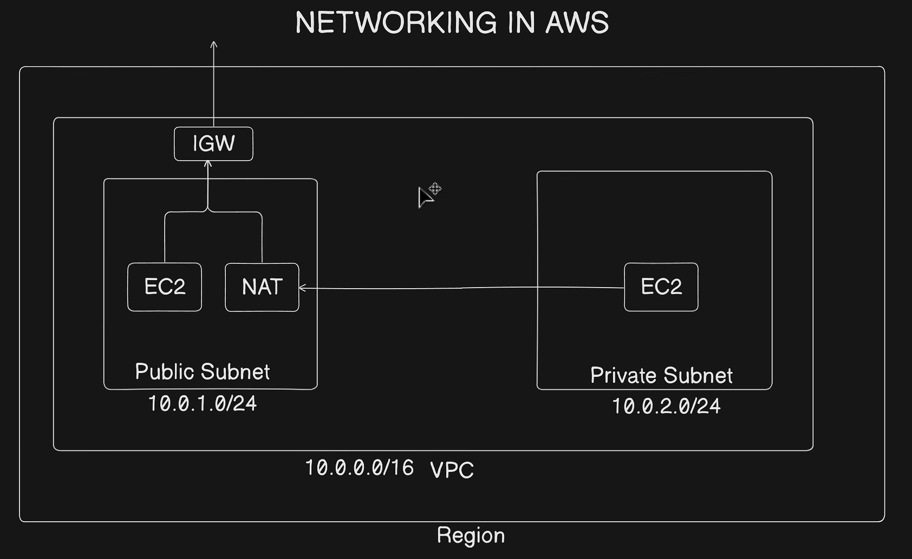
12

Slide 15
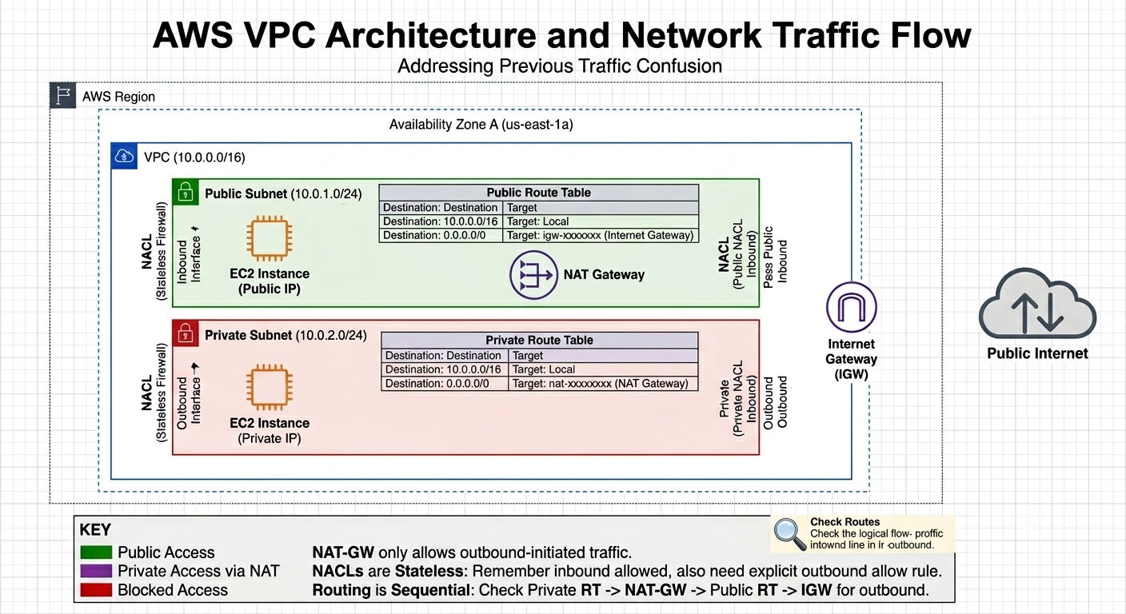
12

Slide 16
Key Takeaways
I
IAM: Controls who can do what. Users, Groups, Roles & Policies — least privilege, deny-by-default.
E
EC2: Resizable virtual servers — the compute building block.
S
S3: Object storage for the internet — durable, region-wide, serverless. Know the storage classes & Versioning/Object Lock rules.
E
EBS: A virtual hard drive for ONE instance in ONE AZ. Snapshots are incremental and live in S3.
E
EFS: A shared, elastic NFS file system mounted by MANY instances across a Region.
A
Aurora & DynamoDB: Aurora = fast, auto-scaling managed relational DB. DynamoDB = serverless, single-digit-ms NoSQL at any scale.
V
VPC & CIDR: Your private IP “bucket.” Smaller prefix (e.g. /24) = more IPs; classless design lets you size networks precisely instead of wasting addresses.

