Slide 1
Ordination
Nelson Mok
19/11/28

Slide 2
Overview
Study background
Brief Methodology
Types of Ordination
Eigenvalues & Eigenvectors (partial)
Results
Other Applications & Limitations
Summary
Future Directions
Eigenvalues & Eigenvectors (Extra slides – supplementary)

Slide 3
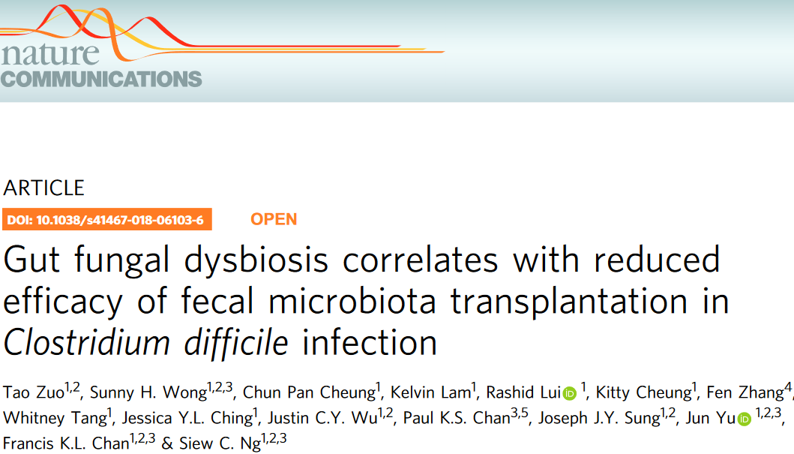
Study Background

Slide 4
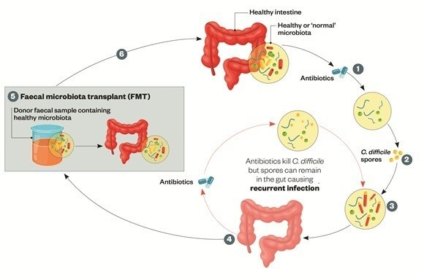
Study Background
Explored fungal community (mycobiota) in patients with recurrent Clostridium Difficile infection (CDI)
Before and after fecal microbiota transplants (FMT)
Sequenced fungal internal transcribed spacer 2 (ITS2) region
Results
CDI patients – low fungal diversity
Candida albicans = decreased transplant efficacy
Cured – gradually acquired donor community
Importance
See if control patients fungal community matches cured CDI cases
Suggests possible fungal role in CDI remediation
Notes:
CDI = inflammation of large intestine -> diarrhea, fevers, pains
1

Slide 5
Is the mycobiota between cured patients & matched donors similar?

Slide 6
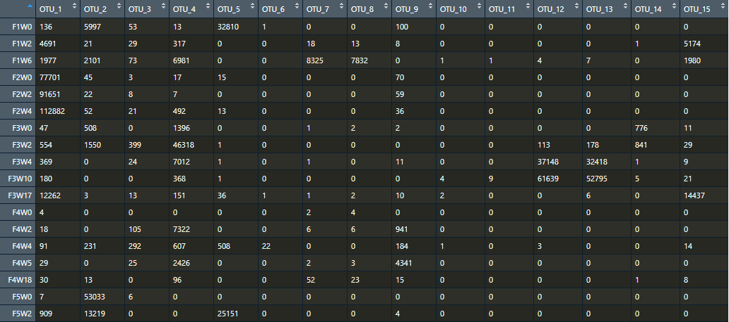
Brief Methodology
Download sequencing files & metadata
Analyze sequencing files via clustering & generating a counts table
Used less OTU scripts and sdm pipeline (LotuS)
“Organisms”
Samples

Slide 7
Brief Methodology
Download sequencing files & metadata
Analyze sequencing files via clustering & generating a counts table
Used less OTU scripts and sdm pipeline (LotuS)
Interpret metadata & associate to counts table
Data wrangle
Perform ordination

Slide 8
Ordination analysis

Slide 9
Types of Ordination
Ordination – Finding ordered relationships by positioning points in a reduced the number of dimensions
Counts table is multivariate data (recall CH7)
My focus
Method | Distance Measure
Principal component analysis (PCA) | Euclidean
Principal coordinates analysis (PCoA/PCO) = Metric Multidimensional Scaling (MDS) | Any
Nonmetric Multidimensional Scaling (NMDS) | Any
Notes:
1

Slide 10
Eigenvalues & Eigenvectors
A familiar example – PCA
Eigen decomposition or singular value decomposition (SVD)
Toy example of a counts table
 | Species1 (X) | Species2 (Y)
Sample1 (disease) | 2 | 1
Sample2 (disease) | 6 | 7
Sample3 (healthy) | 8 | 5
Sample4 (healthy) | 4 | 3
Matrix A =
(m rows) x (n columns) = 4 x 2
Not a squared matrix!

Slide 11
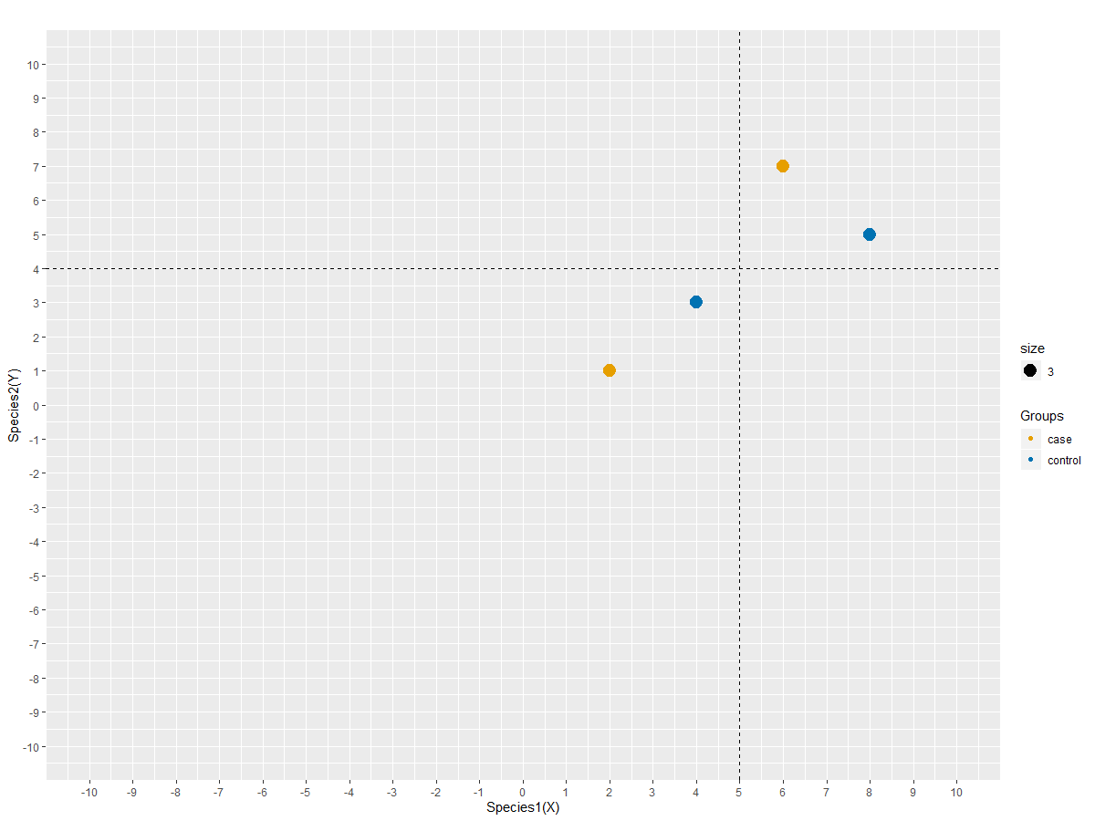
Eigenvalues & Eigenvectors
 | Species1 (X) | Species2 (Y)
Sample1 (disease) | 2 | 1
Sample2 (disease) | 6 | 7
Sample3 (healthy) | 8 | 5
Sample4 (healthy) | 4 | 3
Notes:
1

Slide 12
Eigenvalues & Eigenvectors
Step 1: Scaling
Dividing by column standard deviation (Standardizing)
When: quantities measured in different units
Subtracting by column mean (Centering)
When: data points show between axis heterogeneity
Does not affect outcome (positions maintained)
 | Species1 (X) | Species2 (Y)
Sample1 (disease) | 2 | 1
Sample2 (disease) | 6 | 7
Sample3 (healthy) | 8 | 5
Sample4 (healthy) | 4 | 3
Mean: | 5 | 4
Matrix A =
Notes:
1

Slide 13

Eigenvalues & Eigenvectors
Step 1: Scaling
Dividing by column standard deviation (Standardizing)
When: quantities measured in different units
Subtracting by column mean (Centering)
When: data points show between axis heterogeneity
Does not affect outcome (positions maintained)
 | Species1 (X) | Species2 (Y)
Sample1 (disease) | 2 | 1
Sample2 (disease) | 6 | 7
Sample3 (healthy) | 8 | 5
Sample4 (healthy) | 4 | 3
Mean: | 5 | 4
 | Species1 (X) | Species2 (Y)
Sample1 (disease) | 2-5 | 1-4
Sample2 (disease) | 6-5 | 7-4
Sample3 (healthy) | 8-5 | 5-4
Sample4 (healthy) | 4-5 | 3-4
Mean: | 5 | 4
Matrix A =
= Matrix

Slide 14
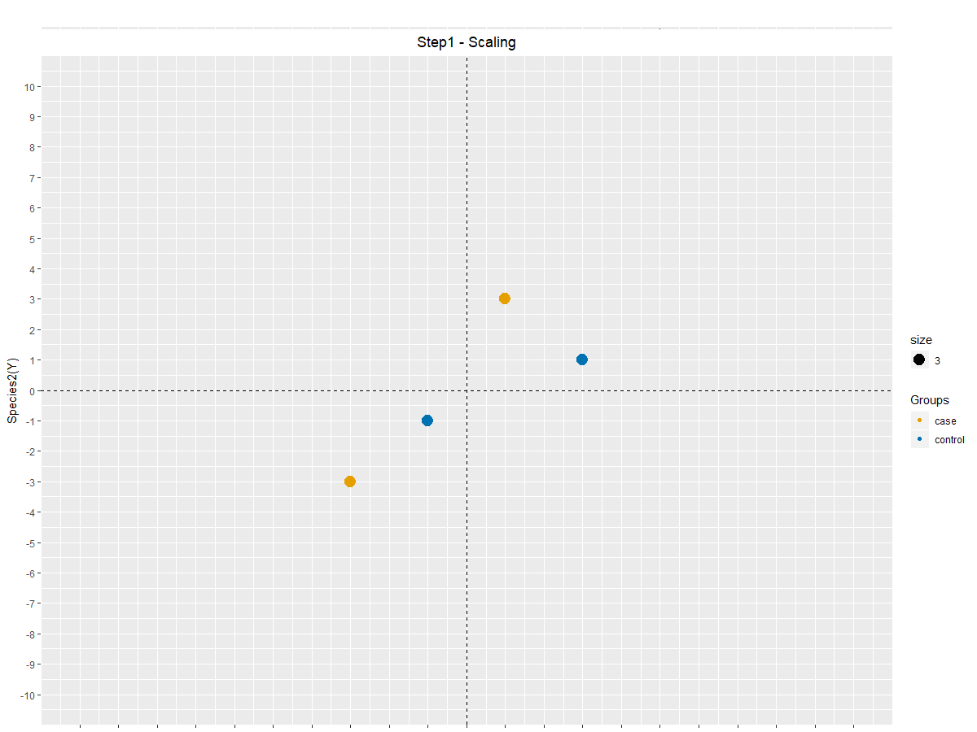

Eigenvalues & Eigenvectors
Step 1: Scaling
scale(matrix, center=T, scale=F)
 | Species1 (X) | Species2 (Y)
Sample1 (disease) | -3 | -3
Sample2 (disease) | 1 | 3
Sample3 (healthy) | 3 | 1
Sample4 (healthy) | -1 | -1
Matrix =
Notes:
1

Slide 15
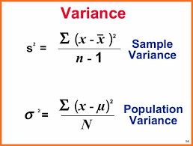
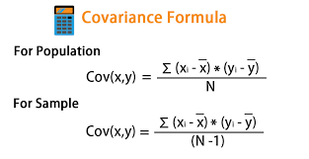

Eigenvalues & Eigenvectors
Step 2: Generate a squared matrix
Correlation matrix
When: alike scaling when observations are heterogenous (don’t have same units)
Covariance matrix
When: observations are homogenous (have the same units)
Notes:
1

Slide 16
Notes on Ordination
PCoA = MDS
Uses a distance matrix based upon specified distance measure
Transforms distance matrix into a matrix where eigenvalues & vectors are calculated
n.b. using MDS + Euclidean distance on a matrix will result in the same plot as PCA
This is because the method are highly similar
Preserves distance relationships between points
NMDS
Uses a distance matrix
Iterative process, alike Expectation-maximization algorithm which eventually converges
Want to find the lowest “Stress” value -> goodness of fit
Starting point matters
Tries to preserve distance relationships but emprises on clustering similar points away from dissimilar points (preserves ordering relationships)

Slide 17
Results

Slide 18
Results
16 CDI patients (CDI) matched with 16 healthy donors (Control)
CDI1-9 matched with Control1-9 = cured
CDI10-16 matched with Controls10-16 = Reoccurrence of CDI
Patient | Recurrence Period
FMT10 | Recurrence at week 19 (ND)
FMT11 | Recurrence at week 5 (ND)
FMT12 | Recurrence at week 28 (ND)
FMT13 | Recurrence at week 2
FMT14 | Recurrence at week 2
FMT15 | Recurrence at week 4
FMT16 | Recurrence at week 4
ND – No data

Slide 19
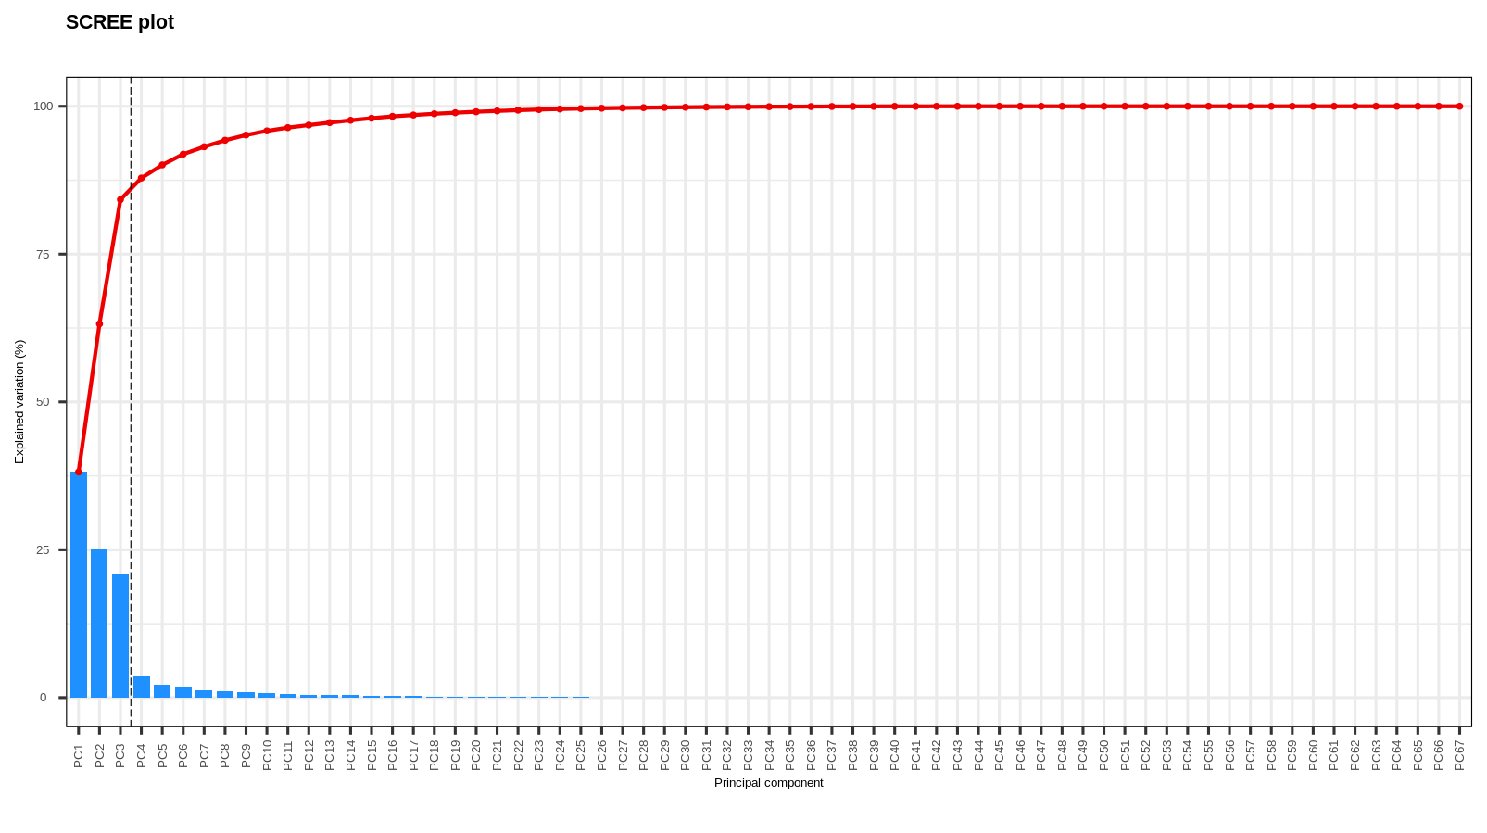
Results
PCA analysis (PCAtools::screeplot())

Slide 20
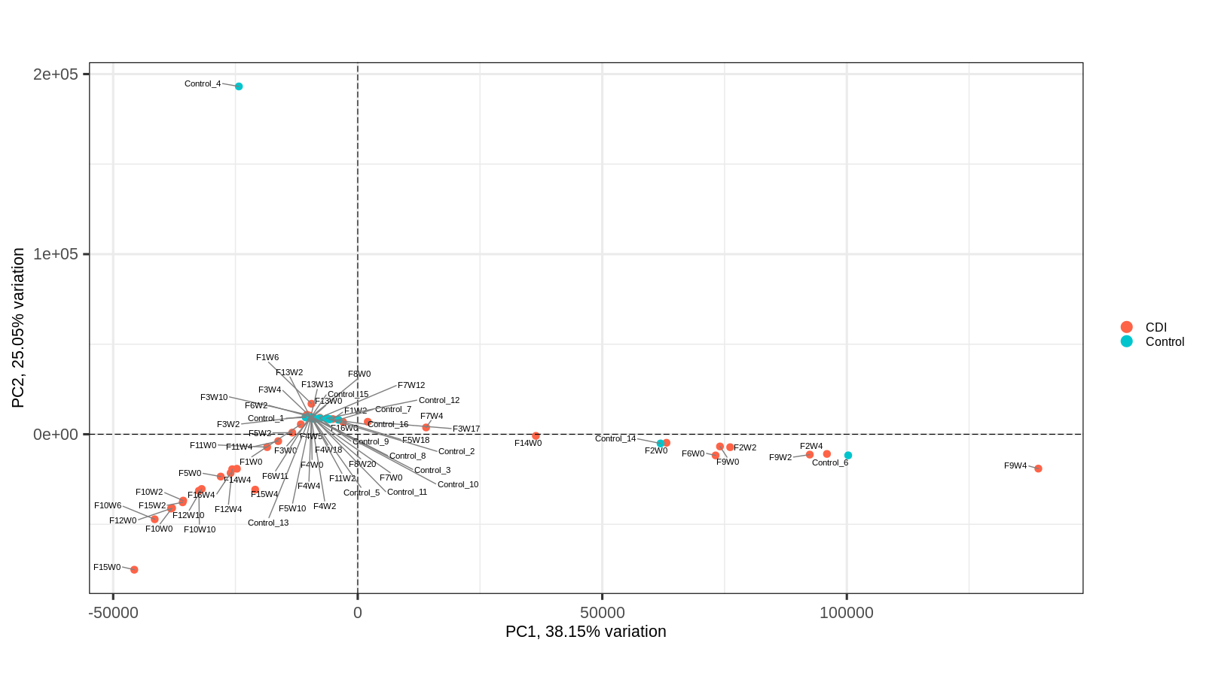
Results
PCA analysis (PCAtools::biplot())

Slide 21
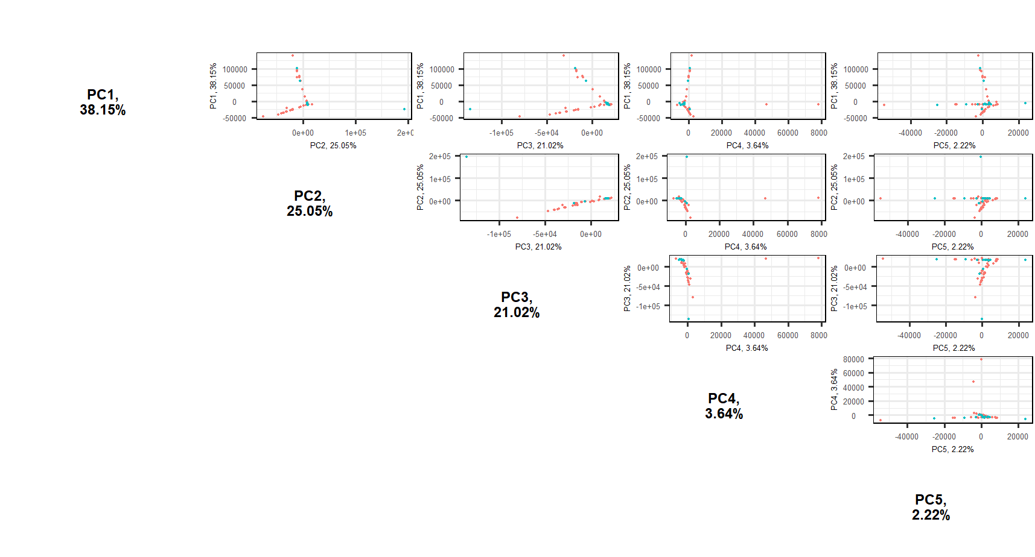
Results
PCA analysis (PCAtools::pairsplot())

Slide 22
Results
PCA analysis (PCAtools::pairsplot())
38+25+21 = 84% of the variance

Slide 23
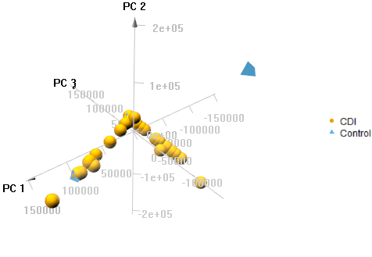
Results
PCA analysis (pca3d::pca3d())

Slide 24
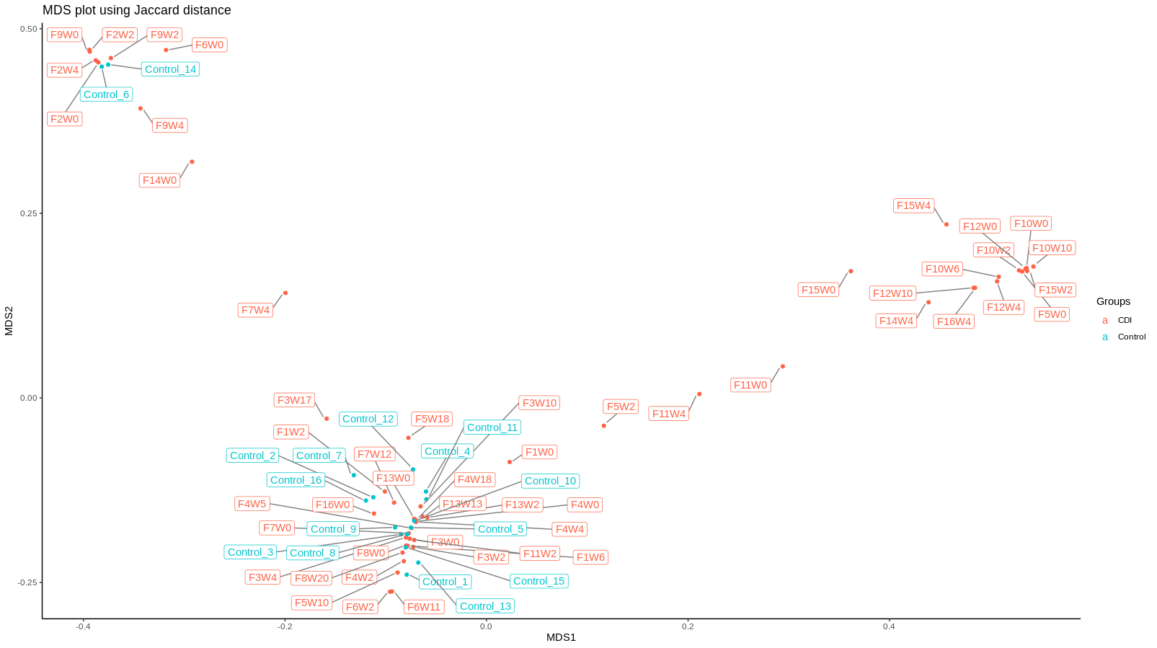
Results
PCoA/MDS analysis (vegdist(method=“jaccard”) & cmdscale())

Slide 25
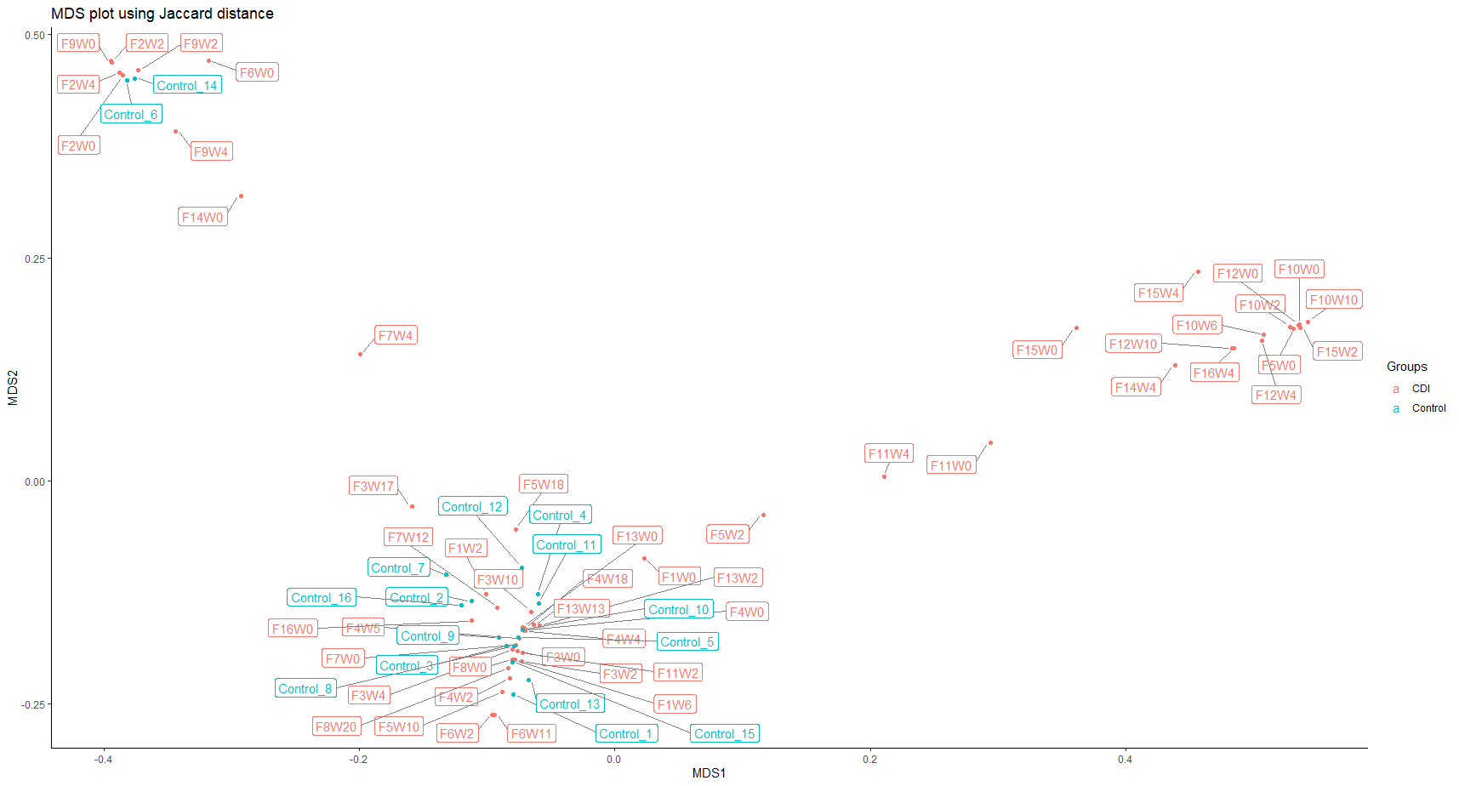
Results
PCoA/MDS analysis (vegdist(distance=“jaccard”) & cmdscale())
These should be recurrence CDI

Slide 26
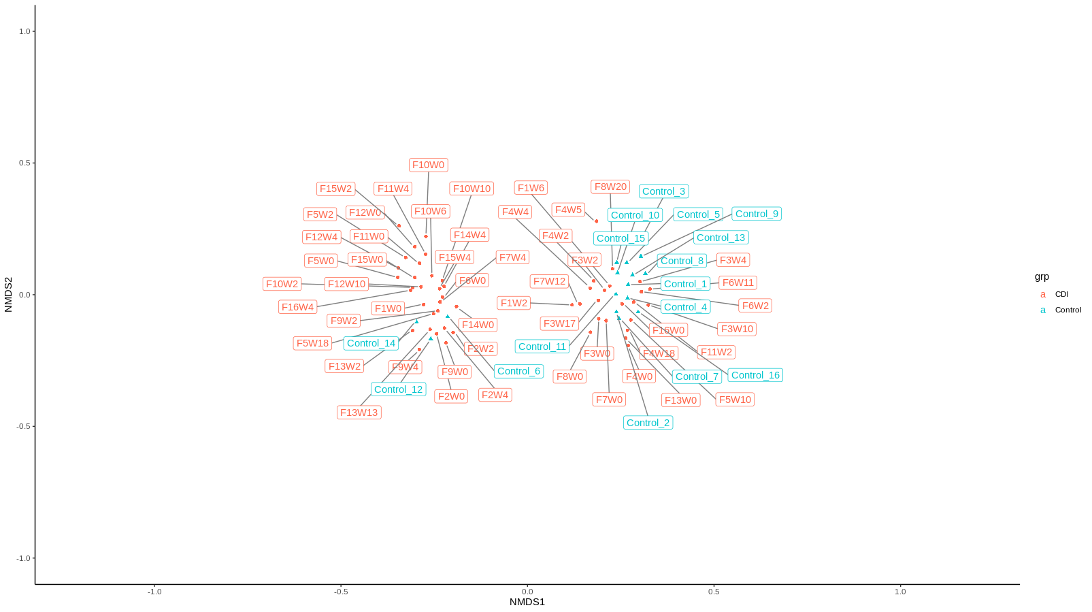
Results
NMDS analysis (vegan::metaMDS(method=“jaccard”))

Slide 27
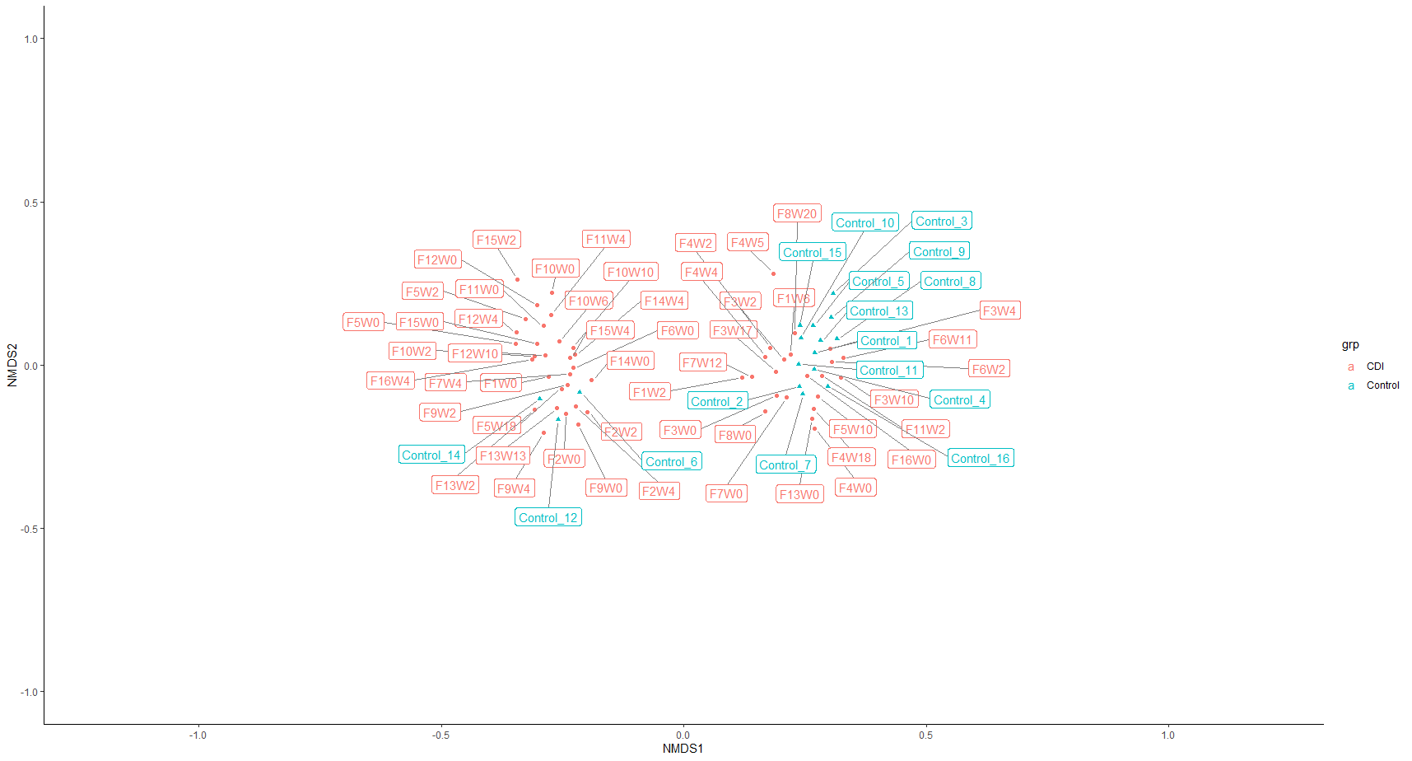
Results
NMDS analysis (vegan::metaMDS(method=“jaccard”))

Slide 28
Other Applications & Limitations
Other Applications
Can be used for multivariate data sets
Experiments in neuroscience, photometry, etc.
Image compression
Facial recognition
Notes:
Complex relationships
1

Slide 29
Other Applications & Limitations
Limitations
PCA
PCA invented for data with normal distributions
Sensitive to outliers
#observations has to be higher than #variables
Quantitative data only
Doesn’t work well for data with many zeros (mycobiota)
Assumes linear correlation between variables
Horseshoe effect (non-linearity = parabola shaped outcome)
MDS & NMDS
Distance matrix matters to determine grouping
Finding the best distance measure is an art
NMDS iterations may never converge for certain datasets using certain distance measure
Notes:
Complex relationships
1

Slide 30
Summary
PCA uses Euclidean distance method
Doesn’t work great for this set of data
MDS can use any distance method
Chose Jaccard
Slightly better results than PCA
NMDS can use any distance method
Chose Jaccard
Drastically better results versus PCA or MDS

Slide 31
Future Directions
Investigate distance methods
Dive deep into NMDS
Explore other ordination methodology
Find alternative methods for visualizing experimental data with many zeros

Slide 32
Eigenvalues & Eigenvectors
A familiar example – PCA
Eigen decomposition or singular value decomposition (SVD)
Toy example of a counts table
 | Species1 (X) | Species2 (Y)
Sample1 (disease) | 2 | 1
Sample2 (disease) | 6 | 7
Sample3 (healthy) | 8 | 5
Sample4 (healthy) | 4 | 3
Matrix A =
(m rows) x (n columns) = 4 x 2
Not a squared matrix!

Slide 33
Eigenvalues & Eigenvectors
 | Species1 (X) | Species2 (Y)
Sample1 (disease) | 2 | 1
Sample2 (disease) | 6 | 7
Sample3 (healthy) | 8 | 5
Sample4 (healthy) | 4 | 3
Notes:
1

Slide 34
Eigenvalues & Eigenvectors
Step 1: Scaling
Dividing by column standard deviation (Standardizing)
When: quantities measured in different units
Subtracting by column mean (Centering)
When: data points show between axis heterogeneity
Does not affect outcome (positions maintained)
 | Species1 (X) | Species2 (Y)
Sample1 (disease) | 2 | 1
Sample2 (disease) | 6 | 7
Sample3 (healthy) | 8 | 5
Sample4 (healthy) | 4 | 3
Mean: | 5 | 4
Matrix A =
Notes:
1

Slide 35
Eigenvalues & Eigenvectors
Step 1: Scaling
Dividing by column standard deviation (Standardizing)
When: quantities measured in different units
Subtracting by column mean (Centering)
When: data points show between axis heterogeneity
Does not affect outcome (positions maintained)
 | Species1 (X) | Species2 (Y)
Sample1 (disease) | 2 | 1
Sample2 (disease) | 6 | 7
Sample3 (healthy) | 8 | 5
Sample4 (healthy) | 4 | 3
Mean: | 5 | 4
 | Species1 (X) | Species2 (Y)
Sample1 (disease) | 2-5 | 1-4
Sample2 (disease) | 6-5 | 7-4
Sample3 (healthy) | 8-5 | 5-4
Sample4 (healthy) | 4-5 | 3-4
Mean: | 5 | 4
Matrix A =
= Matrix

Slide 36
Eigenvalues & Eigenvectors
Step 1: Scaling
scale(matrix, center=T, scale=F)
 | Species1 (X) | Species2 (Y)
Sample1 (disease) | -3 | -3
Sample2 (disease) | 1 | 3
Sample3 (healthy) | 3 | 1
Sample4 (healthy) | -1 | -1
Matrix =
Notes:
1

Slide 37
Eigenvalues & Eigenvectors
Step 2: Generate a squared matrix
Correlation matrix
When: alike scaling when observations are heterogenous (don’t have same units)
Covariance matrix
When: observations are homogenous (have the same units)
Notes:
1

Slide 38

Eigenvalues & Eigenvectors
Step 2: Generate a squared matrix
Correlation matrix
When: alike scaling when observations are heterogenous (don’t have same units)
Covariance matrix
When: observations are homogenous (have the same units)
 | Species1 (X) | Species2 (Y)
Species1 (X) | (X,X) | (X,Y)
Species2 (Y) | (Y,X) | (Y,Y)
Cov( )=
Notes:
1

Slide 39
Eigenvalues & Eigenvectors
Step 2: Generate a squared matrix
Correlation matrix
When: alike scaling when observations are heterogenous (don’t have same units)
Covariance matrix
When: observations are homogenous (have the same units)
 | Species1 (X) | Species2 (Y)
Species1 (X) | (X,X) | (X,Y)
Species2 (Y) | (Y,X) | (Y,Y)
Cov( )=
Notes:
1

Slide 40


Eigenvalues & Eigenvectors
Step 2: Generate a squared matrix
stats::cov(matrix)
 | Species1 (X) | Species2 (Y)
Sample1 (disease) | -3 | -3
Sample2 (disease) | 1 | 3
Sample3 (healthy) | 3 | 1
Sample4 (healthy) | -1 | -1
 | Species1 (X) | Species2 (Y)
Species1 (X) | 6.67 | 5.33
Species2 (Y) | 5.33 | 6.67
Matrix =
Cov( )=
(m rows) x (n columns) = 2 x 2
A squared matrix!
Notes:
1

Slide 41
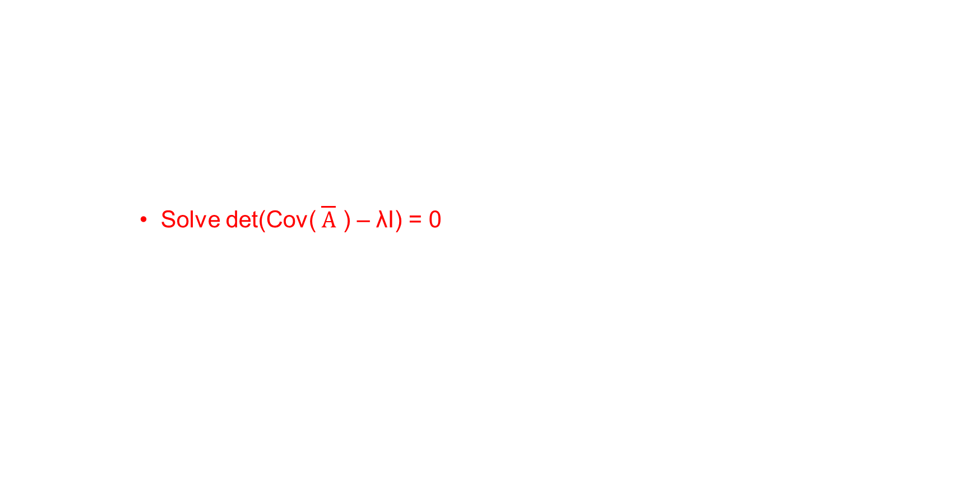
Eigenvalues & Eigenvectors
Step 3: Solve for eigenvalues & eigenvectors
Formula: Cov( )x = λx
Where λ is the eigenvalue and x is the associated eigenvector
Solving for eigenvalues
Cov( )x – λx = 0
So x(Cov( ) – λ) = 0
Solve det(Cov( ) – λI) = 0
Notes:
1

Slide 42

Eigenvalues & Eigenvectors
Step 3: Solve for eigenvalues & eigenvectors
Formula: Cov( )x = λx
Where λ is the eigenvalue and x is the associated eigenvector
Solving for eigenvalues
Cov( )x – λx = 0
So x(Cov( ) – λ) = 0
Solve det(Cov( ) – λI) = 0
(
 | Species1 (X) | Species2 (Y)
Species1 (X) | 6.67 | 5.33
Species2 (Y) | 5.33 | 6.67
 | Species1 (X) | Species2 (Y)
Species1 (X) | 1 | 0
Species2 (Y) | 0 | 1
)
Cov( )=
- λ
= 0
det
Notes:
1

Slide 43
Eigenvalues & Eigenvectors
Step 3: Solve for eigenvalues & eigenvectors
Formula: Cov( )x = λx
Where λ is the eigenvalue and x is the associated eigenvector
Solving for eigenvalues
Cov( )x – λx = 0
So x(Cov( ) – λ) = 0
Solve det(Cov( ) – λI) = 0
(
 | Species1 (X) | Species2 (Y)
Species1 (X) | 6.67 | 5.33
Species2 (Y) | 5.33 | 6.67
 | Species1 (X) | Species2 (Y)
Species1 (X) | 1 | 0
Species2 (Y) | 0 | 1
)
Cov( )=
- λ
= 0
det
Notes:
1

Slide 44
Eigenvalues & Eigenvectors
Step 3: Solve for eigenvalues & eigenvectors
Formula: Cov( )x = λx
Where λ is the eigenvalue and x is the associated eigenvector
Solving for eigenvalues
Cov( )x – λx = 0
So x(Cov( ) – λ) = 0
Solve det(Cov( ) – λI) = 0
(
 | Species1 (X) | Species2 (Y)
Species1 (X) | 6.67 | 5.33
Species2 (Y) | 5.33 | 6.67
 | Species1 (X) | Species2 (Y)
Species1 (X) | λ | 0
Species2 (Y) | 0 | λ
)
Cov( )=
-
= 0
det
Notes:
1

Slide 45
Eigenvalues & Eigenvectors
Step 3: Solve for eigenvalues & eigenvectors
Solving for eigenvalues
P <- pracma::charpoly(covmatrix, info=T)$cp
PP <- rev(P)
PPP <- polynom::polynomial(PP) #Converts by constant first, lowest exponent to highest
(
)
 | Species1 (X) | Species2 (Y)
Species1 (X) | 6.67-λ
Species2 (Y) |  | 6.67-λ
det
= 0
(6.67-λ) x (6.67-λ)
Notes:
1

Slide 46
Eigenvalues & Eigenvectors
Step 3: Solve for eigenvalues & eigenvectors
Solving for eigenvalues
P <- pracma::charpoly(covmatrix, info=T)$cp
PP <- rev(P)
PPP <- polynom::polynomial(PP) #Converts by constant first, lowest exponent to highest
(
)
 | Species1 (X) | Species2 (Y)
Species1 (X) |  | 5.33
Species2 (Y) | 5.33
det
= 0
(5.33 x 5.33)
Notes:
1

Slide 47
Eigenvalues & Eigenvectors
Step 3: Solve for eigenvalues & eigenvectors
Solving for eigenvalues
P <- pracma::charpoly(covmatrix, info=T)$cp
PP <- rev(P) # Reverses the calculated characteristic polynomial
PPP <- polynom::polynomial(PP) #Converts by constant first, lowest exponent to highest
solve(PPP) # Solves for eigenvalues from characteristic polynomial
[(6.67-λ)(6.67-λ) - (5.33 x 5.33)]
16 - 13.33333λ + λ²
λ = 12 & 1.33
Eigenvalues (AKA PC1 & PC2)
Notes:
1

Slide 48
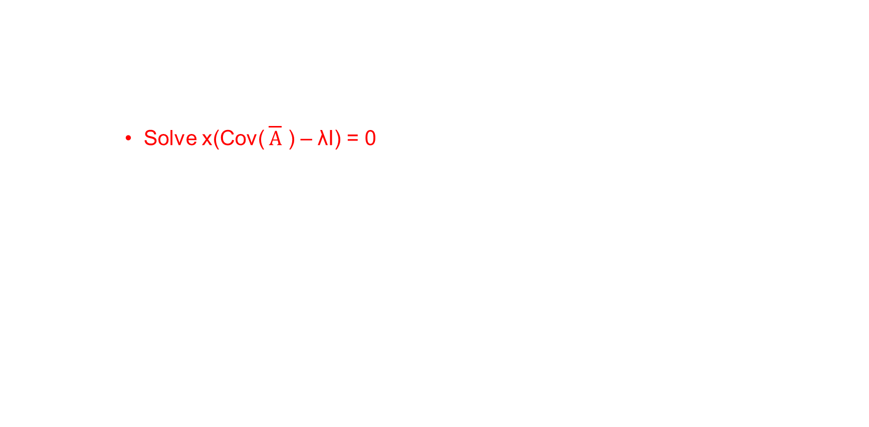
Eigenvalues & Eigenvectors
Step 3: Solve for eigenvalues & eigenvectors
Solving for eigenvectors
Cov( )x – λx = 0
So x(Cov( ) – λ) = 0
Solve x(Cov( ) – λI) = 0
Notes:
1

Slide 49
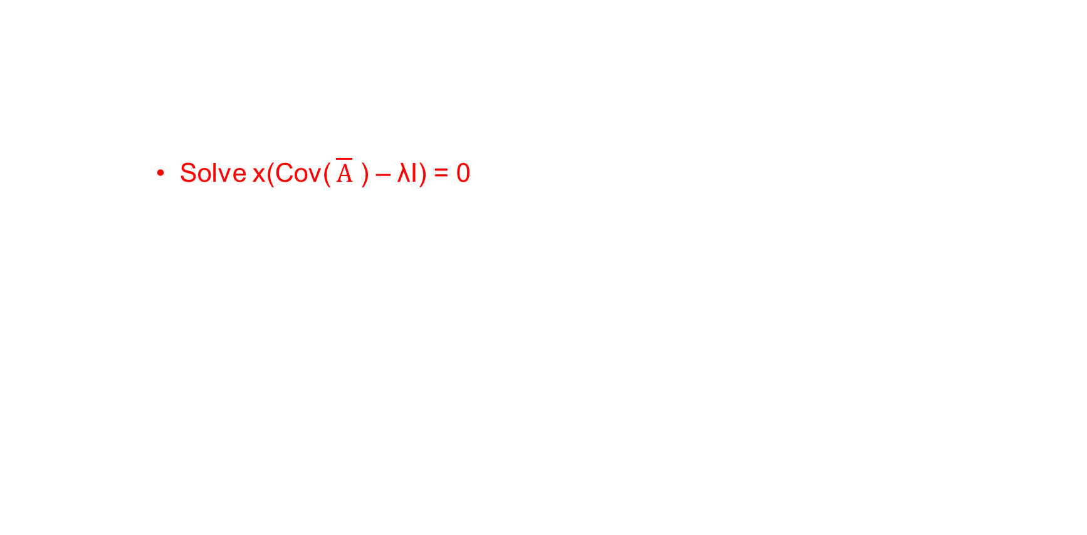
Eigenvalues & Eigenvectors
Step 3: Solve for eigenvalues & eigenvectors
Solving for eigenvectors
Cov( )x – λx = 0
So x(Cov( ) – λ) = 0
Solve x(Cov( ) – λI) = 0
When λ = 12
(
 | Species1 (X) | Species2 (Y)
Species1 (X) | 6.67 | 5.33
Species2 (Y) | 5.33 | 6.67
 | Species1 (X) | Species2 (Y)
Species1 (X) | 1 | 0
Species2 (Y) | 0 | 1
)
x₁
x₂
Cov( )=
- 12
= 0
Notes:
1

Slide 50

Eigenvalues & Eigenvectors
Step 3: Solve for eigenvalues & eigenvectors
Solving for eigenvectors
When λ = 12
(
 | Species1 (X) | Species2 (Y)
Species1 (X) | 6.67-12 | 5.33-0
Species2 (Y) | 5.33-0 | 6.67-12
)
x₁
x₂
Cov( )=
= 0
Notes:
1

Slide 51
Eigenvalues & Eigenvectors
Step 3: Solve for eigenvalues & eigenvectors
Solving for eigenvectors
When λ = 12
(
)
 | Species1 (X) | Species2 (Y)
Species1 (X) | -5.33 | 5.33
Species2 (Y) | 5.33 | -5.33
x₁
x₂
= 0
Matrix multiplication -> Row x Column
Notes:
1

Slide 52
Eigenvalues & Eigenvectors
Step 3: Solve for eigenvalues & eigenvectors
Solving for eigenvectors
When λ = 12
(
)
 | Species1 (X) | Species2 (Y)
Species1 (X) | -5.33 | 5.33
Species2 (Y)
x₁
x₂
= 0
Matrix multiplication -> Row x Column
-5.33x₁+5.33x₂ = 0
Notes:
1

Slide 53
Eigenvalues & Eigenvectors
Step 3: Solve for eigenvalues & eigenvectors
Solving for eigenvectors
When λ = 12
(
)
 | Species1 (X) | Species2 (Y)
Species1 (X)
Species2 (Y) | 5.33 | -5.33
x₁
x₂
= 0
Matrix multiplication -> Row x Column
5.33x₁-5.33x₂ = 0
Notes:
1

Slide 54
Eigenvalues & Eigenvectors
Step 3: Solve for eigenvalues & eigenvectors
Solving for eigenvectors
When λ = 12
x₁
x₂
Eqn1: -5.33x₁+5.33x₂ = 0
Eqn2: 5.33x₁-5.33x₂ = 0
Notes:
1

Slide 55
Eigenvalues & Eigenvectors
Step 3: Solve for eigenvalues & eigenvectors
Solving for eigenvectors
When λ = 12
x₁
x₂
Eqn1: -5.33x₁+5.33x₂ = 0
Let x₂ = 1
-5.33x₁+5.33(1) = 0
-5.33x₁= -5.33
x₁ = 1
Eqn2: 5.33x₁-5.33x₂ = 0
5.33(1)-5.33x₂ = 0
-5.33x₂ = 5.33
x₂ = 1
Notes:
1

Slide 56
Eigenvalues & Eigenvectors
Step 3: Solve for eigenvalues & eigenvectors
Solving for eigenvectors
When λ = 12
x₁
x₂
Eqn1: -5.33x₁+5.33x₂ = 0
Let x₂ = 1
-5.33x₁+5.33(1) = 0
-5.33x₁= -5.33
x₁ = 1
Eqn2: 5.33x₁-5.33x₂ = 0
5.33(1)-5.33x₂ = 0
-5.33x₂ = 5.33
x₂ = 1
1
1
The eigenvector(x) associated with eigenvalue(λ) = 12
Notes:
1

Slide 57
Eigenvalues & Eigenvectors
Step 3: Solve for eigenvalues & eigenvectors
Solving for eigenvectors
When λ = 12
Need to normalize!
Eqn: (x₁)² + (x₂)² = 1²
Notes:
1

Slide 58
Eigenvalues & Eigenvectors
Step 3: Solve for eigenvalues & eigenvectors
Solving for eigenvectors
When λ = 12
Need to normalize!
Eqn: (x)² + (x)² = 1²
(1x)² + (1x)² = 1
1²x²+1²x² = 1
x²+x² = 1
2x² = 1
1
1
Notes:
1

Slide 59
Eigenvalues & Eigenvectors
Step 3: Solve for eigenvalues & eigenvectors
Solving for eigenvectors
When λ = 12
Need to normalize!
Eqn: (x)² + (x)² = 1²
(1x)² + (1x)² = 1
1²x²+1²x² = 1
x²+x² = 1
2x² = 1
1
1
Divide by square root of the coefficient (i.e √2)
Notes:
1

Slide 60
Eigenvalues & Eigenvectors
Step 3: Solve for eigenvalues & eigenvectors
Solving for eigenvectors
When λ = 12
Need to normalize!
Eqn: (x)² + (x)² = 1²
(1x)² + (1x)² = 1
1²x²+1²x² = 1
x²+x² = 1
2x² = 1
1
1
1/√2
1/√2
0.707
0.707
Divide by square root of the coefficient (i.e √2)
Notes:
1

Slide 61
Eigenvalues & Eigenvectors
Step 3: Solve for eigenvalues & eigenvectors
Solving for eigenvectors
When λ = 12
Need to normalize!
Eqn: (x)² + (x)² = 1²
(1x)² + (1x)² = 1
1²x²+1²x² = 1
x²+x² = 1
2x² = 1
1
1
1/√2
1/√2
0.707
0.707
The normalized Eigenvector (AKA loadings for PC1)
Divide by square root of the coefficient (i.e √2)
Notes:
1

Slide 62
Eigenvalues & Eigenvectors
Step 3: Solve for eigenvalues & eigenvectors
Solving for eigenvectors
Now do the same when λ = 1.33….
-7.07
0.707
The normalized Eigenvector (AKA loadings for PC2)
Notes:
1

Slide 63
Eigenvalues & Eigenvectors
Step 4: Determine which PCs to plot
How much variation does each PC (λ) account for?
Formula: [λ/total(λ)] x 100
Ex) λ=12 (PC1) & 1.33 (PC2)
(12/(12+1.33) x 100 = 90% variance accounted by PC1
This is visualized on a screeplot!
Notes:
1

Slide 64
Eigenvalues & Eigenvectors
Step 4: Determine which PCs to plot
How much variation does each PC (λ) account for?
Formula: [λ/total(λ)] x 100
Ex) λ=12 (PC1) & 1.33 (PC2)
(12/(12+1.33) x 100 = 90% variance accounted by PC1
This is visualized on a screeplot!
If there is more than 2 PCs, choose the ones covering most of the variance
Notes:
1

Slide 65

Eigenvalues & Eigenvectors
Step 5: Transform data into new coordinates on PC#
Formula: x loading
Notes:
1

Slide 66


Eigenvalues & Eigenvectors
Step 5: Transform data into new coordinates on PC#
Formula: x loadings = new coordinates
 | PC1 | PC2
Sample1 (disease) | -4.24
Sample2 (disease) | 2.83
Sample3 (healthy) | 2.83
Sample4 (healthy) | -4.24
 | Species1 (X) | Species2 (Y)
Sample1 (disease) | -3 | -3
Sample2 (disease) | 1 | 3
Sample3 (healthy) | 3 | 1
Sample4 (healthy) | -1 | -1
λ (PC1) = 12
Loadings
Matrix =
%*%
0.707
0.707
=
Matrix multiplication in R
(In this case dot product by pen & paper (not shown))
Notes:
1

Slide 67
Eigenvalues & Eigenvectors
Step 5: Transform data into new coordinates on PC#
Formula: x loadings = new coordinates
 | PC1 | PC2
Sample1 (disease) | -4.24 | 0
Sample2 (disease) | 2.83 | 1.41
Sample3 (healthy) | 2.83 | -1.41
Sample4 (healthy) | -4.24 | 0
 | Species1 (X) | Species2 (Y)
Sample1 (disease) | -3 | -3
Sample2 (disease) | 1 | 3
Sample3 (healthy) | 3 | 1
Sample4 (healthy) | -1 | -1
λ (PC2) = 1.33
Loadings
Matrix =
%*%
-7.07
0.707
=
Notes:
1

Slide 68
Eigenvalues & Eigenvectors
Step 6: Skip everything and calculate using R
eigen(matrix) # Gives eigenvalues and eigenvectors
princomp(matrix, cor=F) # Calculates sdev, loadings, and coordinates (scores) using eigendecomposition
Note: Don’t use this – calculates covariance matrix using population formula
“Note that the default calculation uses divisor N for the covariance matrix.”
prcomp(matrix, scale=F, center=T) # Calculates sdev, loadings (rotation), and coordinates (x) using SVD
This is the preferred PCA calculation method
Notes:
1

Slide 69
Eigenvalues & Eigenvectors
Step 6: Skip everything and calculate using R
eigen(matrix) # Gives eigenvalues and eigenvectors
princomp(matrix, cor=F) # Calculates sdev, loadings, and coordinates (scores) using eigendecomposition
Note: Don’t use this – calculates covariance matrix using population formula
“Note that the default calculation uses divisor N for the covariance matrix.”
prcomp(matrix, scale=F, center=T) # Calculates sdev, loadings (rotation), and coordinates (x) using SVD
This is the preferred PCA calculation method
n.b. to find eigenvalues calculated by princomp() or prcomp() just square the sdev values
Notes:
<number>

Slide 70
