Slide 1

Ratings-Prediction-Project
Table of Contents
Serial Number | Topic
1 | INTRODUCTION
2 | ANALYTICAL PROBLEM FRAMING
3 | MODEL/S DEVELOPMENT AND EVALUATION
4 | CONCLUSION

Slide 2
INTRODUCTION
Business Problem Framing
In this problem a client of the company is having a website who wants to add new feature to his website that the reviewer will have to add stars(rating) as well as the review. The rating will be out of 5 stars and it has only 5 options available 1 star, 2 stars, 3 stars, 4 stars and 5 stars.
Conceptual Background of the Domain Problem
Concept wise the problem of review and rating is very crucial for an e-commerce company to increase its sales thus increasing revenue. So, to solve this problem of prediction of rating according to reviews can be solved by machine learning using NLP and help the companies to increase their business.

Slide 3
Review of Literature
Various articles and reports from website like Kaggle, analyticsvidhya, medium and towardsdatascience have been used for reference and various techniques in text-pre-processing, data visualization and machine learning model building have been used from these websites.
Motivation for the Problem Undertaken
Objective to build this machine learning model is to have a hands on the model building techniques along with new facing new challenges while solving various anomalies in the dataset. And solving issues encountered during the machine learning building model. Since the number of records is quite high so computation takes a lot of time along with careful selection of features during feature engineering also posed some challenges.

Slide 4
ANALYTICAL PROBLEM FRAMING
Mathematical/ Analytical Modeling of the Problem
Linear Algebra and Calculus concepts are used in the machine learning models. Since various Regressor Algorithms have been used in the Machine Learning Models, mathematics is working behind them. Calculation of evaluation metrics also involved mathematical concepts like algebraic summation.
Data Sources and their formats
Dataset that is used is having csv format of file and that is webscrapped from various sources like e-commerce websites amazon, flipkart etc.

Slide 5
Text Pre-processing Done
In the text pre-processing and cleaning. Data have been checked for datatype and then various techniques have been used to clean the data like stopword removal, punctuation removal, lowercase, removal of frequent words, removal of rare words, Lemmatization, Emoji’s removal, URL removal, HTML tags removal.
Data Inputs- Logic- Output Relationships
There are no data inputs-logic-output relationships found in the dataset.

Slide 6
Set of assumptions (if any) related to the problem
No assumption taken during model building.
Hardware and Software Requirements and Tools Used
In the hardware a laptop has been used along with an optical mouse. In software excel, Python Jupyter notebook, have been used. Various libraries, methods and application of that method/function have been used. Libraries like sklearn, NumPy, Pandas, Seaborn, scipy.stats are used.

Slide 7
MODEL/S DEVELOPMENT AND EVALUATION
Identification of possible problem-solving approaches (methods)
Problem solving approach includes text cleaning using various methods like stopword removal, punctuation marks removal, url removal, html tags removal, most frequent words removal, rare words removal, emoji’s removal etc. Before that the average count of words for each class was calculated and visualization was done using seaborn plot.
Testing of Identified Approaches (Algorithms)
Algorithms used in the training and testing are : RandomForestClassifier, SupportVectorClassifier, GradientBoostingClassifier, DecisionTreeClassifier, NaivesBayesClassifier, KNeighborsClassifier have been used.

Slide 8
Run and Evaluate selected models
RandomForestClassifier is the first algorithm used for the classification which is a type of ensemble technique which is generated using a random selection of attributes at each node to determine the split. During classification each tree votes and the most popular class is returned. It is comparable to adaboost in accuracy but more robust to errors and outliers.
The second algorithm that has been used is Support Vector Classifier. This algorithm is used for both categorical and continuous type of data. It constructs a hyperplane in multidimensional manner in an iterative manner, which is used to minimize the error. The core idea of the SVM is to create a hyperplane that best divides the dataset into classes. A hyperplane is a decision plane which separates between a set of objects having different class memberships.
The third algorithm that has been used is DecisionTreeClassifier.This algorithm is using the concept of reducing the impurity from the sample. ‘Entropy’ and ‘Gini index/Gini impurity’ are used for measuring impurity in a sample. Entropy is the amount of information needed to accurately describe some sample. If the sample is homogeneous then entropy is 0 if maximum then it is 1.

Slide 9
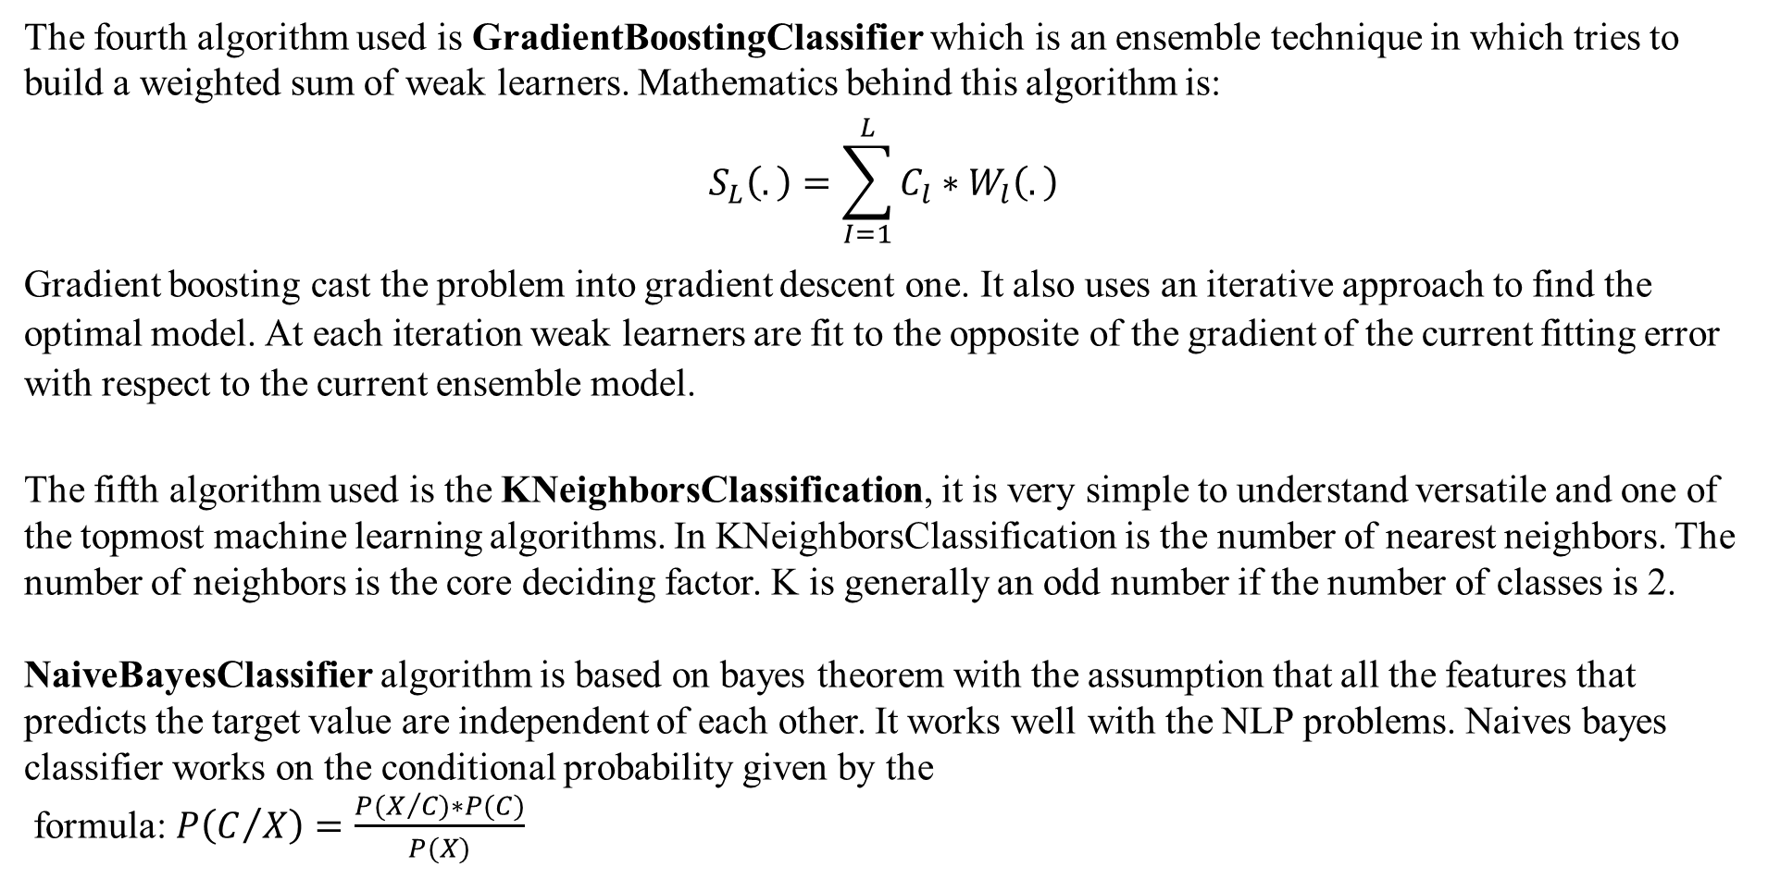
The fourth algorithm used is GradientBoostingClassifier which is an ensemble technique in which tries to build a weighted sum of weak learners. Mathematics behind this algorithm is:
$$S_{L}\left(.\right)=\sum_{I=1}^{L}{C_{l}∗W_{l}\left(.\right)}$$
Gradient boosting cast the problem into gradient descent one. It also uses an iterative approach to find the optimal model. At each iteration weak learners are fit to the opposite of the gradient of the current fitting error with respect to the current ensemble model.
The fifth algorithm used is the KNeighborsClassification, it is very simple to understand versatile and one of the topmost machine learning algorithms. In KNeighborsClassification is the number of nearest neighbors. The number of neighbors is the core deciding factor. K is generally an odd number if the number of classes is 2.
NaiveBayesClassifier algorithm is based on bayes theorem with the assumption that all the features that predicts the target value are independent of each other. It works well with the NLP problems. Naives bayes classifier works on the conditional probability given by the
formula: $P\left(C/X\right)=\frac{P(X/{C)∗P(C})}{P(X)}$

Slide 10
Key Metric for success in solving problem under consideration
Key Metrics for success in solving problem under consideration includes accuracy_score, classification_report and confusion_matrix.
Visualizations
Visualization plots that have been used in the project includes histplots for visualizing the Ratings of various parameters for char_count, word_count. To see the see the average word_count and average char_count for various ratings from Rating 1,2,3,4,5 plots at different Rating have been found.
Interpretation of the Results
From the visualization we can say that the average wordcount for rating 3 is least whereas highest for rating 1. Average character count for Rating 3 is found to be minimum and Rating 1 is found to be maximum. For Rating1 average wordcount histogram suggests that maximum value of Average wordcount lies between 0-50 and same trend is followed by all the Ratings except Rating4 and Rating 5 where Average wordcount lies between 0-100.

Slide 11
CONCLUSION
Key Findings and Conclusions of the Study
From the complete project we came to know that starting from importing the dataset and to the end various techniques have been used from text visualization to using various text pre-processing techniques like stopwords removal, punctuation removal, lowercase, removal of frequent words, removal of rare words, lemmatization, emoji’s removal, URL removal, html tags removal. Then feature engineering techniques like count-vectors, TF-IDF vectors, NLP based features like ‘char_count’,’word_count’,’word_density’, ‘punctuation_count’,’title_word_count’,’upper_case_word_count’ have been used for various machine learning models and various key_metrics have been found like accuracy, classification_report and confusion_matrix.
Learning Outcomes of the Study in respect of Data Science
Learnings includes deep analysis of the text data. In text data visualization of word_count, char_count and their mean value has been used which plays an important role in visualizing the mean word_count and mean char_count. And in the text-pre-processing various techniques like stopwords removal, punctuation removal, frequent words removal, rare words removal, URL removal, html tags removal has been done to clean the text data.

Slide 12
Limitations of this work and Scope for Future Work
Limitations of this work is that more robust model can be build using some more advanced techniques in machine learning model building. Exhaustive EDA can also improve the accuracy of the model using some more techniques for the EDA analysis. Solution of the problem of less accuracy can be done using improved Feature Engineering techniques. Data scraping can also be improved using some more advanced tools.

