Slide 1
Modelling Approach
Churn Prediction

Slide 2
CHURN PREDICTION
PROBLEM : CHURN PREDICTION EVERY 2 MONTHS

Slide 3
CHURN PREDICTION
CUSTOMER SINGLE VIEW version 1
CUSTOMER CODE | CUST000099978
LAST WEEK | 200805
LAST DATE | 2008-03-27
TOTAL COME | 116
TOTAL SPEND | 737.99
MOST CUSTOMER SENSITIVE | MM
MOST BASKET SIZE | L
MOST BASKET TYPE | FULLSHOP
MOST BASKET DOMAIN | FRESH
MOST STORE FORMAT | MS
CHURN | 0

Slide 4
CHURN PREDICTION
LABELING
Train Data
Test Data

Slide 5
CHURN PREDICTION
Make Model
Train data : 67665 rows
Train : 67 %
Test : 33 %
High Score:
Decision tree

Slide 6
CHURN PREDICTION
Make Model
NOT WORK !!!

Slide 7
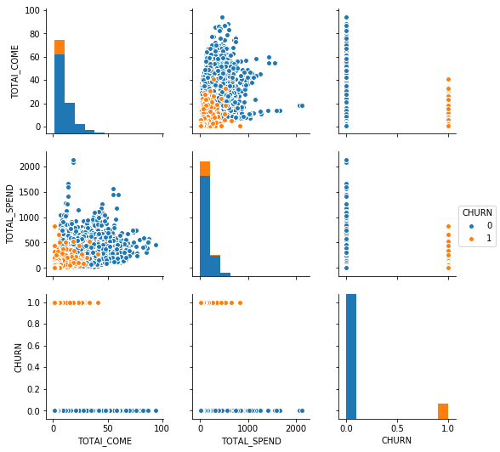
CHURN PREDICTION
Visualization

Slide 8
CHURN PREDICTION
Make New Feature : Cumulative CHURN
Train Data
Test Data

Slide 9
CHURN PREDICTION
CUSTOMER SINGLE VIEW version 2
CUSTOMER CODE | CUST000099978
LAST WEEK | 200805
LAST DATE | 2008-03-27
TOTAL COME | 116
TOTAL SPEND | 737.99
MOST CUSTOMER SENSITIVE | MM
MOST BASKET SIZE | L
MOST BASKET TYPE | FULLSHOP
MOST BASKET DOMAIN | FRESH
MOST STORE FORMAT | MS
TOTAL CHURN | 0
CHURN | 0

Slide 10
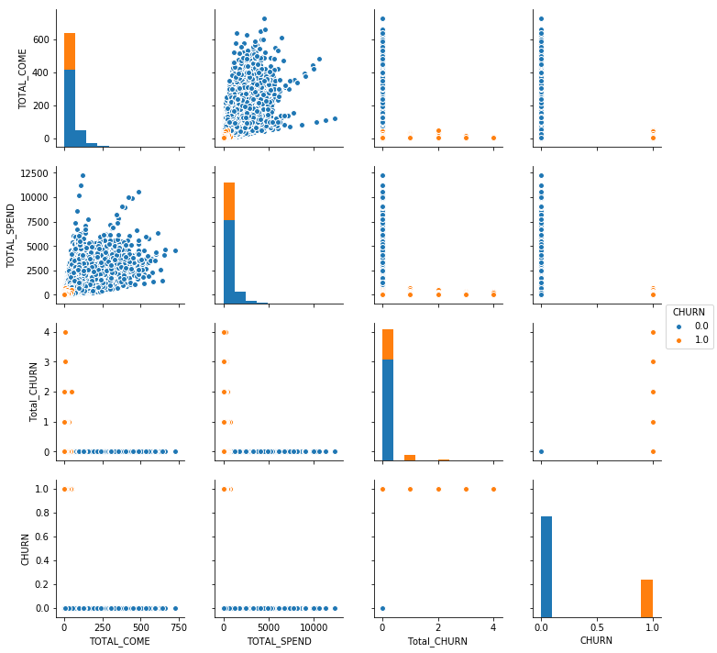
CHURN PREDICTION
Visualization

Slide 11
CHURN PREDICTION
Make New Model
Train data : 84556 rows
Train : 67 %
Test : 33 %
High Score:
Logisitic Regression

Slide 12
Thank You

