Slide 1
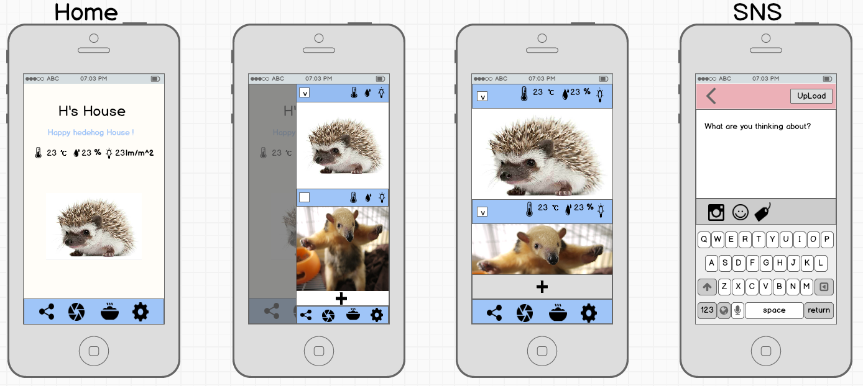
gray2 (666666)
D96277, 투명도(50)
fffdf8
gray2 (666666)
gray4 (cccccc)
blue2 (9fc5f8)
gray4 (cccccc)
UI design has been changed slightly. This document is only used to determine the color, please.

Slide 2
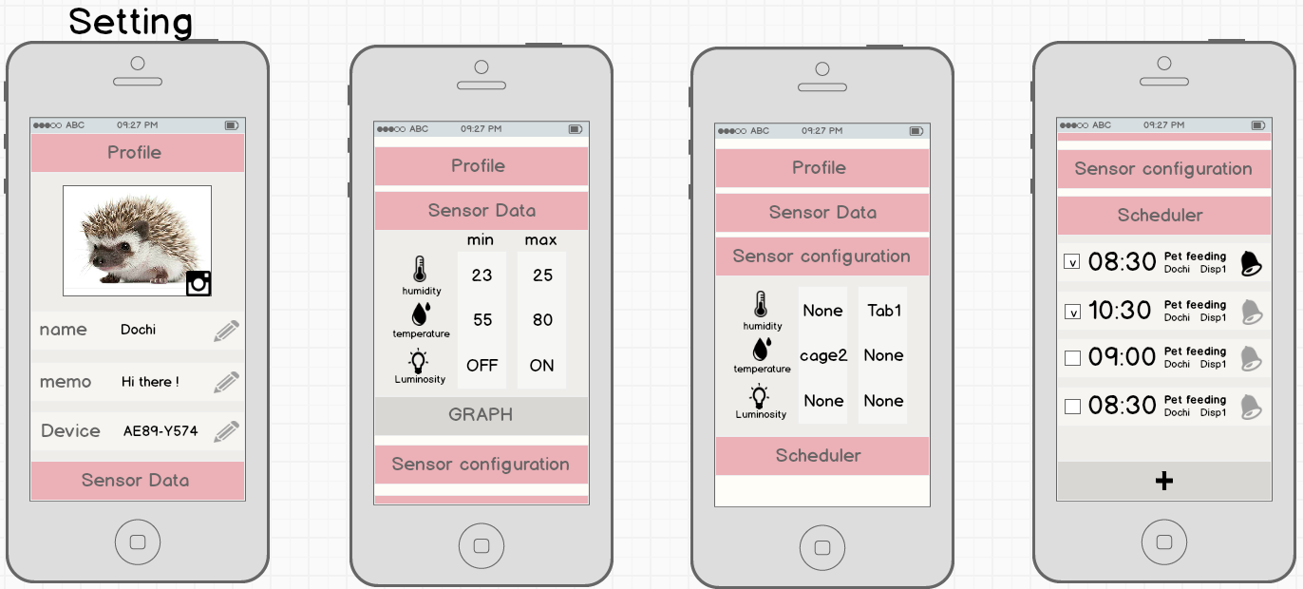
gray2 (666666)
gray5 (dddddd), Opacity(50%)
fffdf8
gray4 (cccccc)
fffdf8
gray4 (cccccc)
UI design has been changed slightly. This document is only used to determine the color, please.

Slide 3
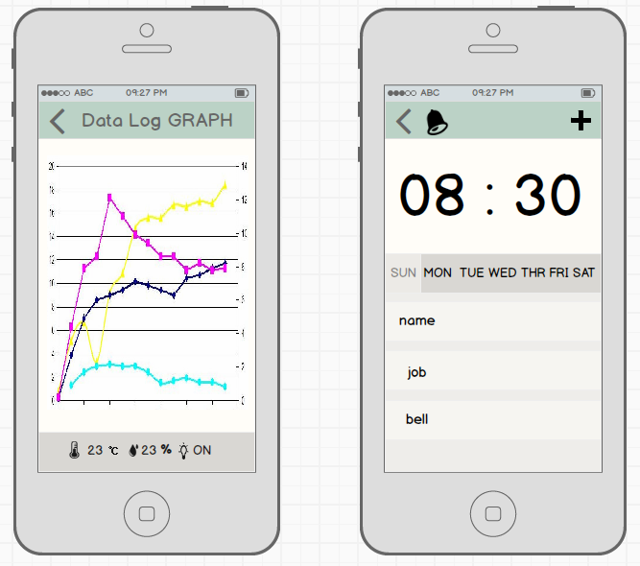
gray2 (666666)
fffdf8
76a694
fffdf8
Fffdf8, Opacity(50)
gray4 (cccccc)
gray5 (dddddd), Opacity(50%)
UI design has been changed slightly. This document is only used to determine the color, please.

