Slide 1
Social media usage throughout the world By: Andrew Amato, Christina Gabriel, Gerardo Lopez Rodriguez, and Steven Schiffner

Slide 2
Questions to be answered
Does social media usage correlate with a population’s wealth or age?
Does this relationship change when looking at specific platforms?
Historically, how closely related is social media penetration with internet penetration?
Do countries with high rates of social media usage tend to produce more top influencers?

Slide 3
Section 1 Social media usage vs. gdp and median age By christina gabriel

Slide 4
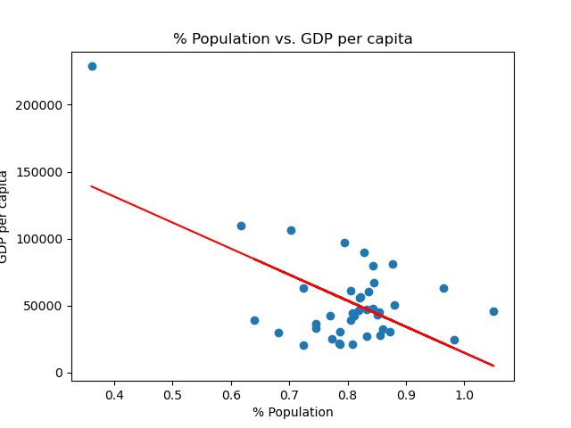
Social media usage vs. GDP Per Capita
Correlation: Negative Relationship

Slide 5
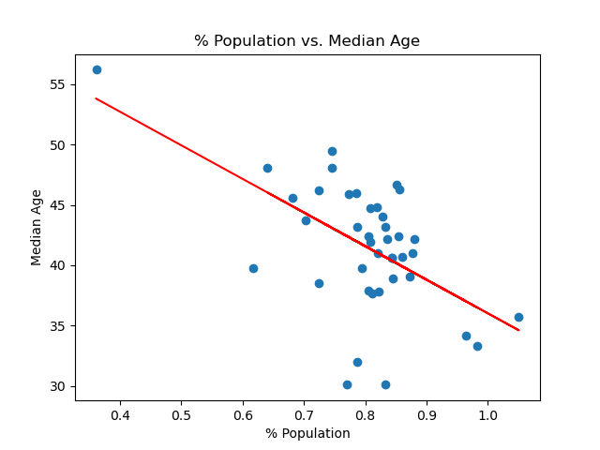
Social media usage vs. Median age
Correlation: Negative Relationship

Slide 6
Section 2 Narrowing our analysis to facebook and tiktok By Steven Schiffner

Slide 7
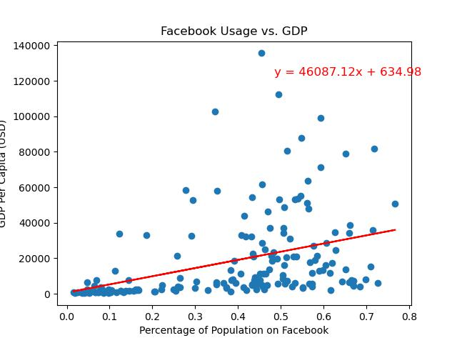
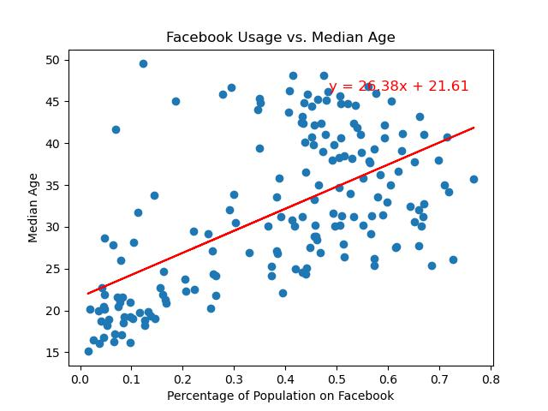
Initial analysis on facebook Upon producing charts for facebook usage vs. both gdp per capita and median age, we see a slight relationship between the two sets of data. However, there do appear to be some outliers in the bottom left corner…

Slide 8
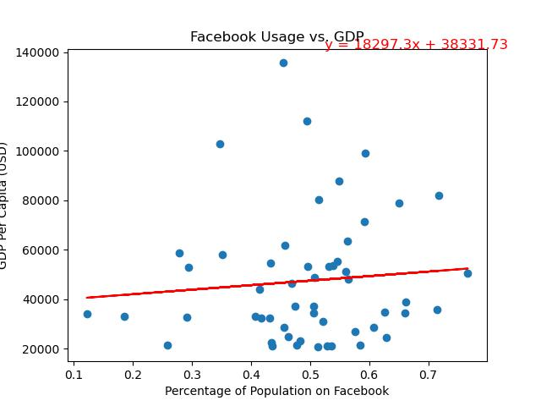
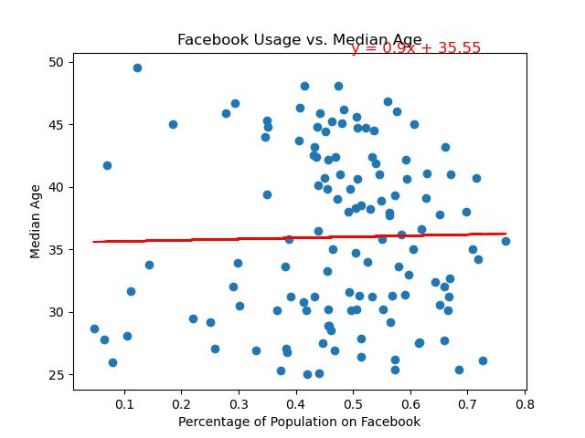
Restricting the dataset Upon narrowing the set of countries we are looking at to those with a gdp per capita over 20,000 Usd or a median age of at least 25, we see a clear lack of correlation in the data

Slide 9
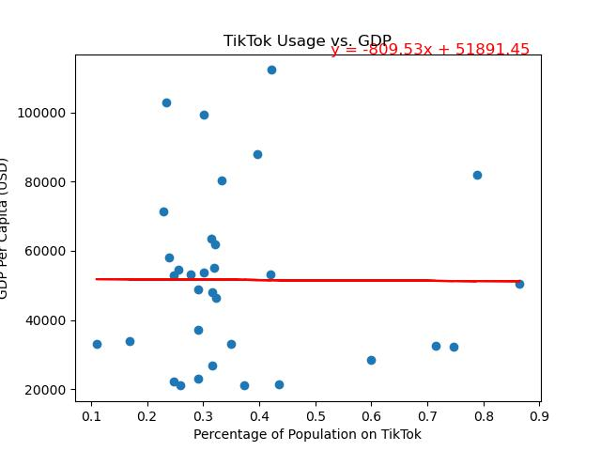
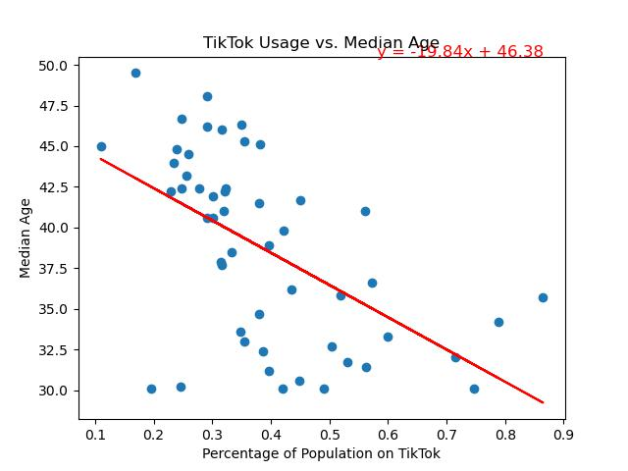
Tiktok analysis Upon giving a similar treatment to our tiktok data, but with a slightly higher age restriction of 30 or higher to account for the shape of the data, we see a clear downwards trend in usage vs median age (but not vs gdp).

Slide 10
Section 3 Internet penetration vs. Social media penetration By Gerardo lopez rodriguez

Slide 11
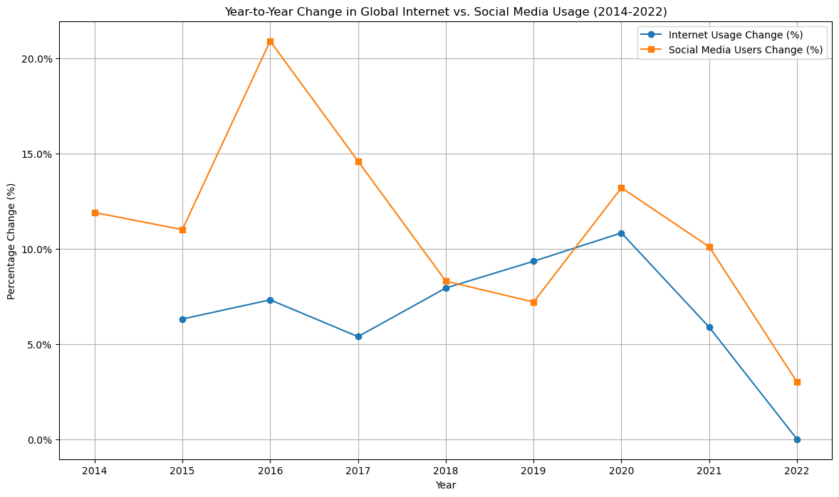
Internet penetration vs. Social media penetration
Graph depicts year to year percentage change global internet usage and social media usage, 2014-2022
Social Media saw significant spike in growth in 2016 by ( 20.9) with a gradual decline of 3.0%
Internet usage growth peak in 2020 by 10.83% and then stabilized

Slide 12
Internet penetration vs. Social media penetration
The peak in social media growth in 2016 could be attributed global events, technological advancements and online engagement.
The spike internet usage in 2020 is likely linked to the global COVID-19 Pandemic which necessitated remote work, learning and socialization.
Internet and social media penetration are closely related but saturation levels are influence by a mix set of factors.
(Cultural, Technological, economical, among others.)
The line plot data illustrates this information.

Slide 13
Section 4 Comparing social media usage with origin of top influencers and suicide Rate By Andrew Amato

Slide 14
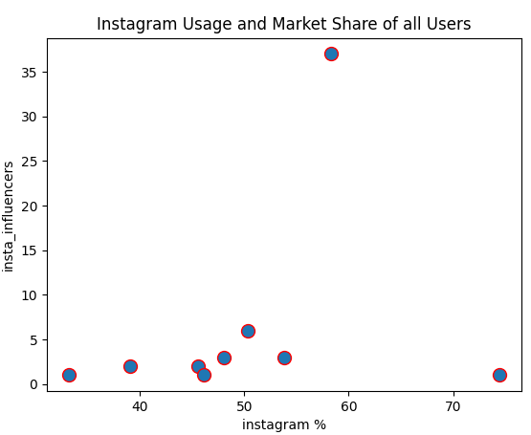
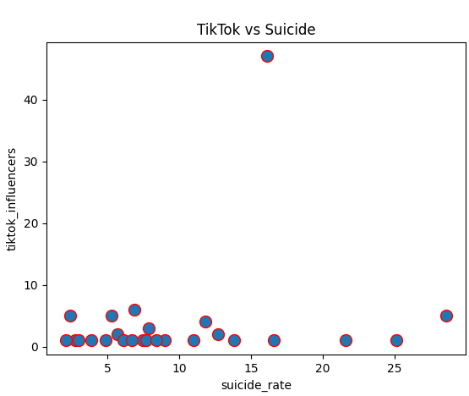
Social Media Usage vs Popular Influencers and Suicide Rate
No relationship between social media users and number of influencers or suicide rate across platform type

Slide 15
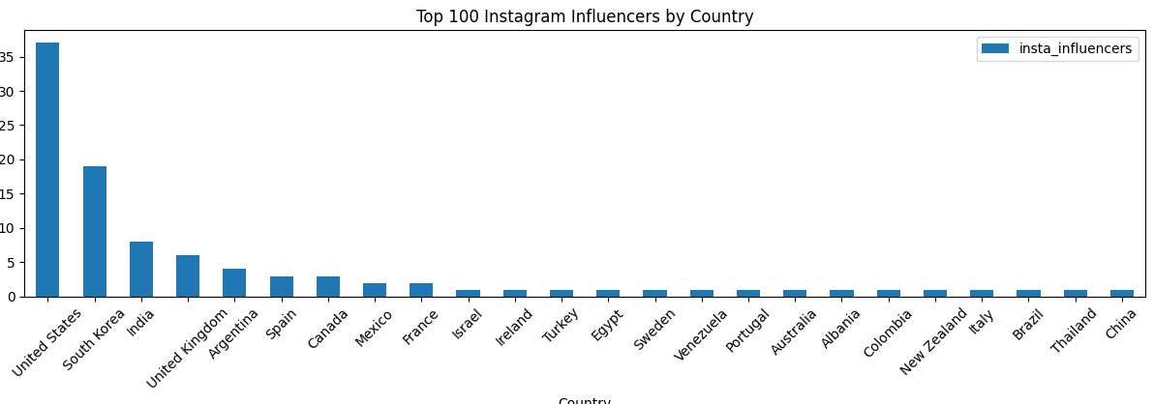
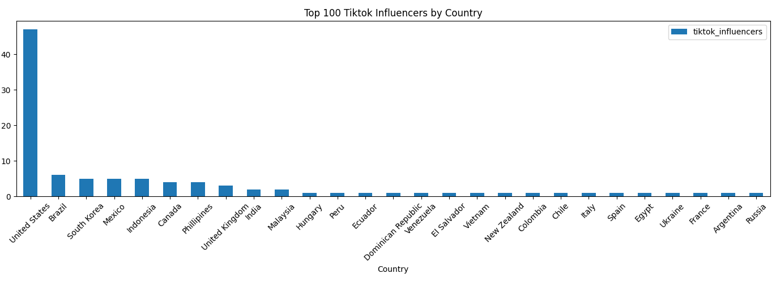
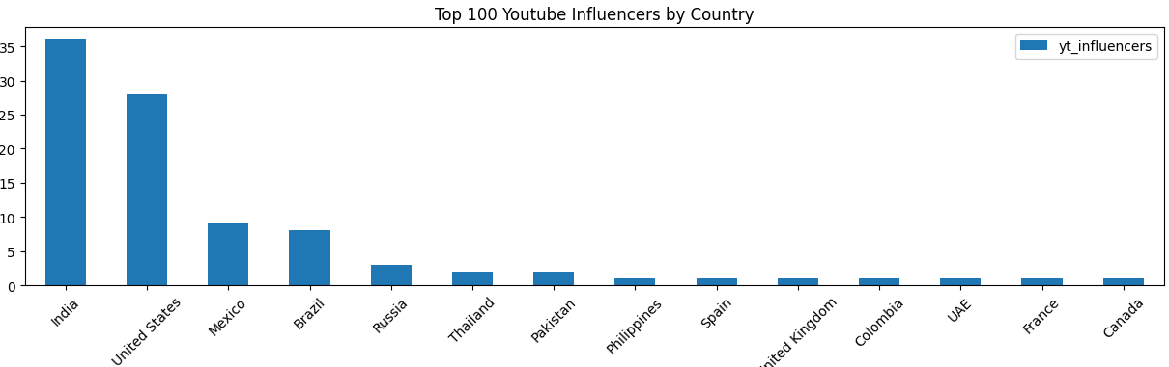
popular influencers
There is an interesting distribution for Instagram and Youtube influencers. For YT, most channels come from India and for Insta, the second most come from SK, TikTok was more dispersed amongst countries. There was also no relationship between the amount of of top content creators and the most used social media type in a country.

