Slide 1





HANGMAN GAME
Mentor: Vo Hong Khanh
Group 4:
Pham Hai Dang(Leader) - CE170348
Do Dang Khoa - CE170883
Nguyen Minh Khoi - CE171346
Nguyen Thi Tra My - CE170699
Nguyễn Tan An - CE140485

Slide 2

I. Introduction
II. Game rules
III. Frames interface
IV. Demo
V. Q&A
3
5
7
13
14
Table of content

Slide 3

I. Introduction

Slide 4

- Hangman is a pen and paper game that guesses words based on the number of characters in the word. - Usually, this game consists of two players with the simple means of a pen and a blank sheet of paper. - Other names: "Gallows", "The Game of Hangin" or "Hanger". - Today, use: entertainment, development of thinking, memorizing English vocabulary. | - Hangman is a pen and paper game that guesses words based on the number of characters in the word. - Usually, this game consists of two players with the simple means of a pen and a blank sheet of paper. - Other names: "Gallows", "The Game of Hangin" or "Hanger". - Today, use: entertainment, development of thinking, memorizing English vocabulary.
I. Introduction

Slide 5
II. Game rules

Slide 6
-At the start, the game will show you the length of the word to guess and a topic related to that word. -String * is the word you need to guess. -The small keyword at the bottom of the "gallows" is a "hint" for you. -For each correct guess, you will get 200 points. -20 points will be deducted for each wrong guess and the "hangman" will draw 1 more line. -Guess the correct keyword before the "hangman" finished, you will go to the next keyword and the "hangman" will be redrawn from the beginning. | -At the start, the game will show you the length of the word to guess and a topic related to that word. -String * is the word you need to guess. -The small keyword at the bottom of the "gallows" is a "hint" for you. -For each correct guess, you will get 200 points. -20 points will be deducted for each wrong guess and the "hangman" will draw 1 more line. -Guess the correct keyword before the "hangman" finished, you will go to the next keyword and the "hangman" will be redrawn from the beginning.
II. Game rules

Slide 7
II. Frames interface

Slide 8
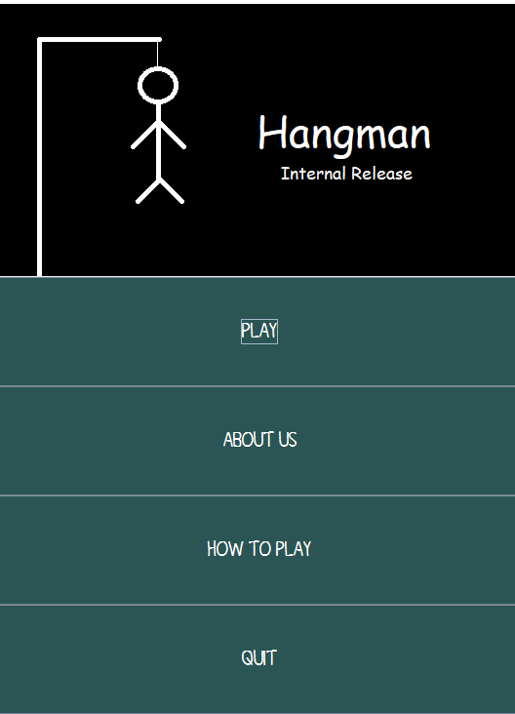
III. Frames interface
The game's MENU interface

Slide 9
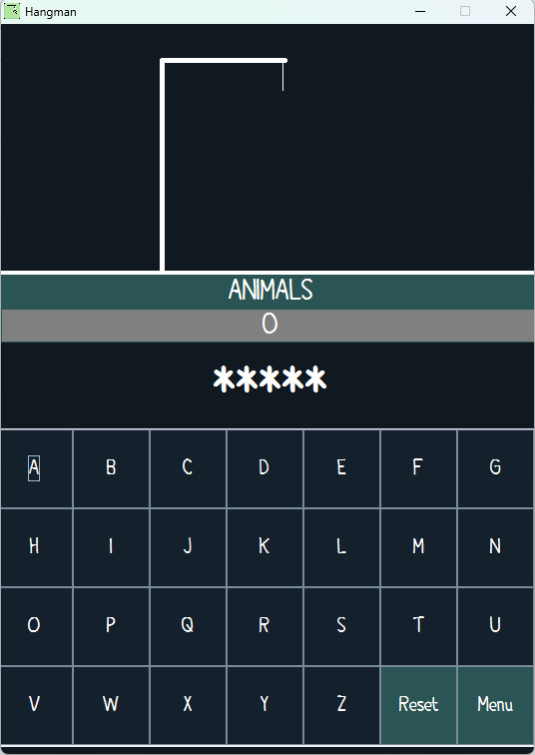
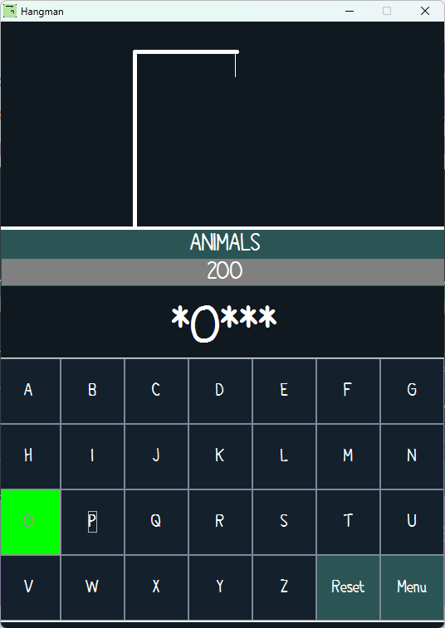
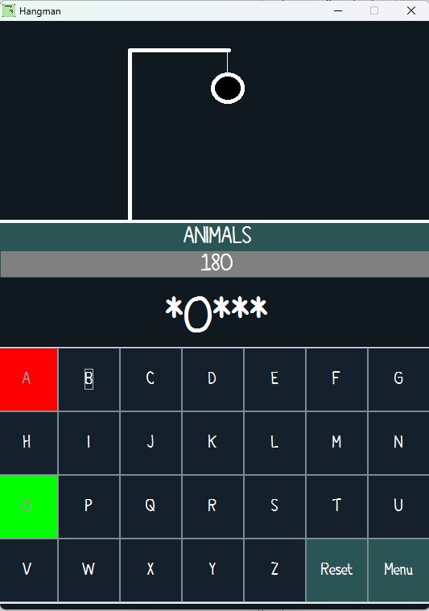
III. Frames interface
The game's PLAY interface
Start
Correct Guess
+200points
Incorrect Guess
-20points

Slide 10

III. Frames interface
The game's ABOUT US interface

Slide 11
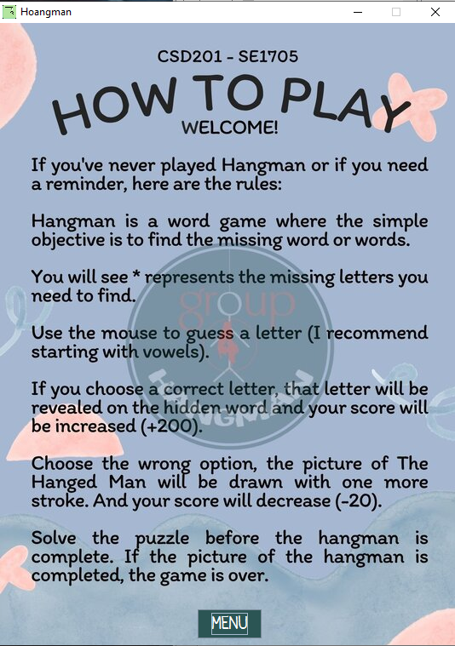
III. Frames interface
The game's HOW TO PLAY interface

Slide 12

III. Frames interface
The game's QUIT interface

Slide 13
IV. Demo

Slide 14
V. Q&A

Slide 15
Thanks for your following!

