Slide 1
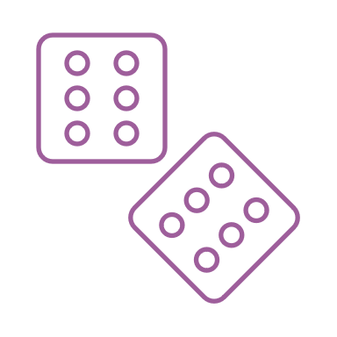
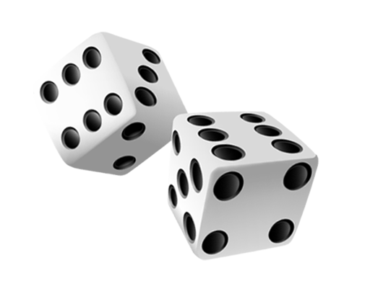
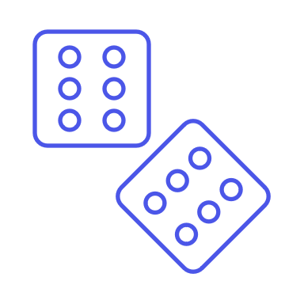
Dice Roll Simulator
Roll a randomly generated number on A set of dice!
Project Coder: Logan Rivera
https://github.com/MyNameIsLogan/Dice-roll-simulator

