Slide 2
Imagine Cup Junior Submission: Submitting institution/school: Independent (KOSEN King Mongkut's Institute of Technology Ladkrabang), Thailand Student team name: The R The idea in a sentence: AI translation for deaf people Number of team members: 2 Age range of team members: 14 AI for Good initiative (select one from: Accessibility/Earth/Cultural Heritage/Humanitarian Action/Health): Accessibility Team video link: https://cloud.thaddev.com/s/TCs9EyxqZB6zekC

Slide 3
The Problem
According to the World Health Organization (WHO) in 2021, there are over 466 million people worldwide (>5% of the global population) with disabling hearing loss.
Among the countries with the highest population with deafness hearing loss include China, India, the US, Brazil, and Pakistan. All of them having over a million people with hearing disabilities. Some, such as China, have as much as 80 million. And these people are unable to communicate effectively with others.
Deaf people often face communication barriers in their daily lives, which usually leads to social isolation and limited access to education and employment opportunities.
Sign languages are the primary means of communication for many deaf individuals.
However, most regular people that do not directly interact with the deaf do not understand sign language or are not fluent at it.
Sign language also may not be interpreted properly or sometimes lack features with give them proper context.

Slide 4
Your AI Concept
The AI, DeafTranslate is an AI that uses Computer vision to be able to interpret sign language
of all types and is able to translate these gestures back to the user’s native language whilst
being able to retain context either from the surroundings, or other cues like facial expressions.
The main way to use the AI is by using a mobile app, which feeds raw image data from the camera
to the AI. The AI then uses Object detection and tracking to detect whenever a person is doing sign
language with their hands and then tracks their hand movement to determine which hand gesture
they will perform and then translate to the user’s preferred language.
The AI can support multiple sign languages and cross translate to multiple spoken languages, and
vice versa. For communicating back to the disabled person the AI uses Natural Language Processing
to translate back if they’re communicating in a different language, and then generates either text to
Present to the other party, or hand sign instructions for the user to perform.

Slide 5
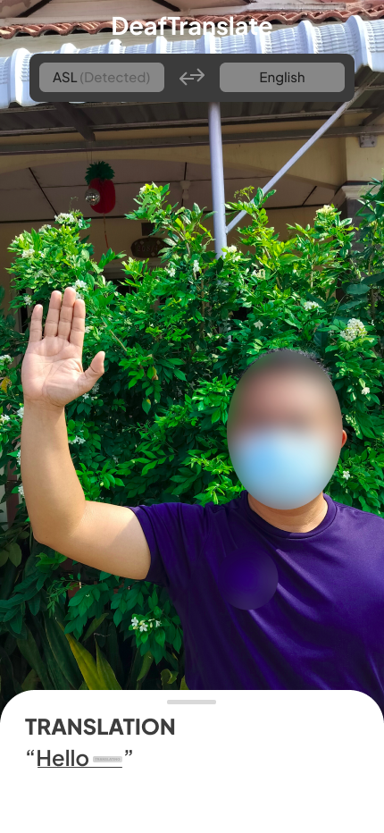
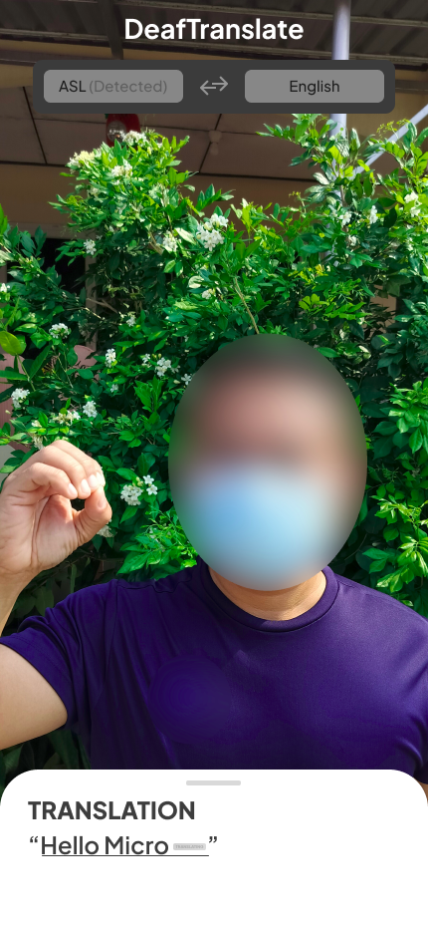
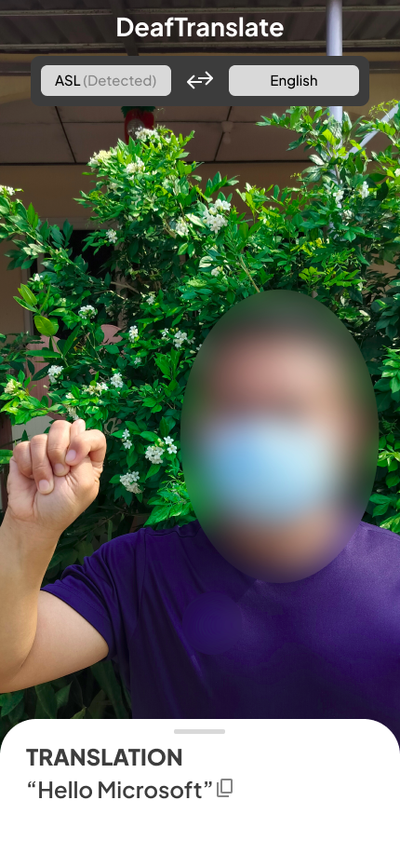
DeafTranslate
DeafTranslate’s mobile app frontend uses an Object detection AI that will be trained using Azure Custom Vision and is bundled locally to detect and recognize multiple sign languages automatically but can also be manually selected for more accurate translations. Once it recognizes a sign, it then tracks the hand movement to provide follow-up translations. It finalizes the translation by using Azure’s Cognitive Service for Language to process the raw translation and fix grammar, sentence structure, and language features to produce a full featured translation.

Slide 6
DeafTranslate
DeafTranslate AI Operation Chart (Sign → Written Language)
Raw Camera Input
Custom Object Detection Model Trained from Custom Vision
Object Tracking for further translations
Raw Translated Text
Azure Cognitive Services for Language
Fully Translated Text

Slide 7
DeafTranslate
DeafTranslate AI Operation Chart (Written → Sign Language)
Input text
Varient of Sign language
Image Generator
Signing graphical guide

Slide 8
Use of Artificial Intelligence
DeafTranslate uses:
- Custom Trained Azure Custom Vision Object Detection model to identify sign language
- Same for Object Tracking and adding additional gestures to the translation
- Raw Translation sent to Azure Cognitive Services for Language for further refining and translation to other Written Languages
- Azure Image generation for generating Sign gestures.
Impact
As a result, DeafTranslate can enable far easier communication with people with hearing disabilities and as such, allow them to improve socializing, getting proper education, and getting the proper training and better employment. It also increases the overall productiveness of disabled people due to the communication barrier being removed. It also allows for ese of collaboration and day-to-day communication as additional preparation to incorporate a disabled workforce is now mostly not required.

Slide 9
Ethics
We believe that our AI is fair, transparent, and is able to be trusted to provide accurate translations with no ethical bias.
Cybersecurity
DeafTranslate, by it’s nature, does not do anything to tamper or even interact with the outside system except for the usage of the camera. The AI will mostly be able to work offline, not connecting to internet unless there is an update to the AI available.

Slide 10
Sources
World Health Organization. (2021). Deafness and hearing loss. https://www.who.int/news-room/fact-sheets/detail/deafness-and-hearing-loss
World Federation of the Deaf. (2021). About us. https://wfdeaf.org/about-us/
National Institute on Deafness and Other Communication Disorders. (2021). Quick Statistics About Hearing. https://www.nidcd.nih.gov/health/statistics/quick-statistics-hearing
Instituto Brasileiro de Geografia e Estatística. (2019). Pesquisa Nacional de Saúde 2019.
Pakistan Association of the Deaf. (2018). Deaf People in Pakistan: A Statistical Profile.

