Slide 1

City of Windsor Website Application
Group 11

Slide 2

City of Windsor Website Application
Business Case / Vision
How can we help new homeowners find a suitable neighborhood in the City of Windsor?
Vision: Create a user-friendly website for data access and community engagement.
Group 11

Slide 3
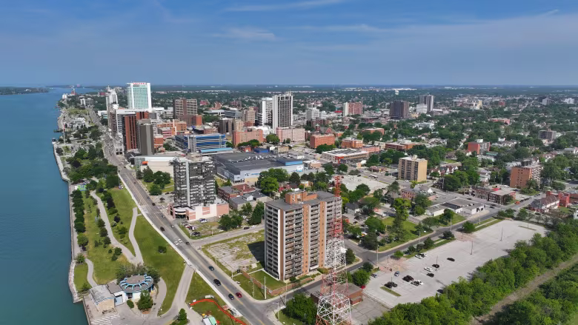
Business Case / Vision
Vision: Create a user-friendly website for data access and community engagement.
Problem Requirements/Scope & Risks
Scope: User account creation and management, dataset upload and approval workflow.
Risks: Data integrity, user authentication, and authorization challenges.
How can we help new homeowners find a suitable neighborhood in the City of Windsor?

Slide 4

Problem Requirements/Scope & Risks
Risks: Data integrity, user authentication, and authorization challenges.
Proposed Solution
Key Features:
Guest access to data catalogs
User account creation and login
Role-based access (Contributor and Admin)
Dataset upload and approval process
Scope: User account creation and management, dataset upload and approval workflow.

Slide 5

Proposed Solution
Utilization of Open Data Set
Data Source: City of Windsor's open datasets.
Data Usage: Enhancing user experience by providing accessible and downloadable data.
Key Features:
Guest access to data catalogs
User account creation and login
Role-based access (Contributor and Admin)
Dataset upload and approval process

Slide 6

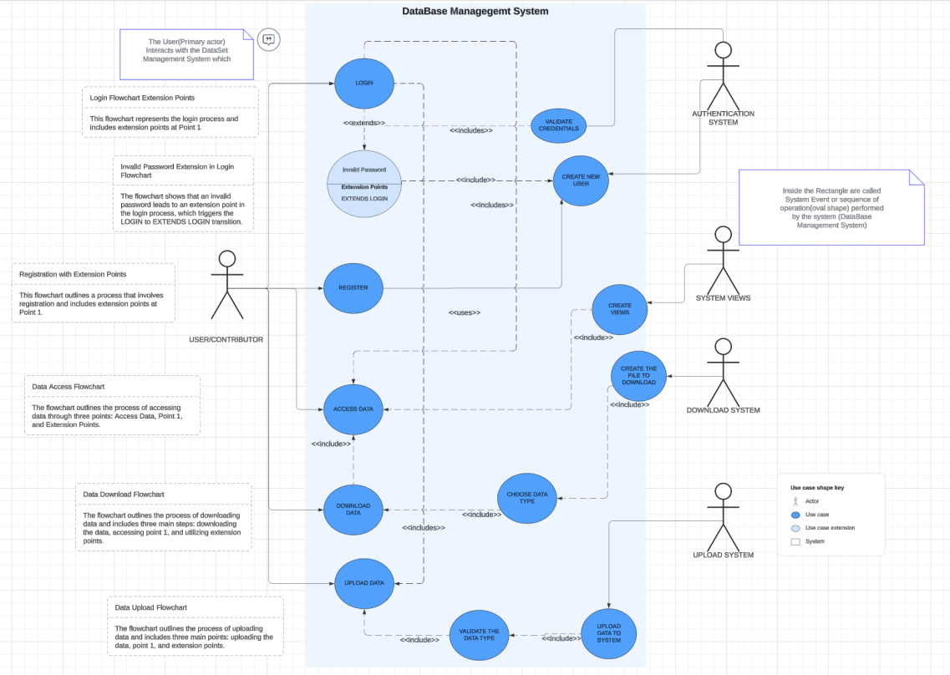
Utilization of Open Data Set
Application Design / Architecture
UML Diagrams:
Use Case Diagram: Show interaction between users (guests, contributors, admins) and the system.
Architecture:
Backend: Java for server-side logic, MySQL for database.
Frontend: Java GUI for the user interface.
Data Source: City of Windsor's open datasets.
Data Usage: Enhancing user experience by providing accessible and downloadable data.

Slide 7

Architecture:
Backend: Java for server-side logic, MySQL for database.
Frontend: Java GUI for the user interface.
Object-Oriented Design Pattern
Design Pattern:
Pattern 1: Indirection
Pattern 2: Polymorphism
Pattern 3: Pure Fabrication
Class: AuthService
Role: Manages user authentication.
Benefit: Allows changes in authentication logic without affecting other parts of the system.
Interface: DatabaseConnection
Role: Defines a common interface for different database connections.
Benefit: Facilitates the use of different database connections interchangeably.
Application Design / Architecture
Class: DownloadManager
Role: Manages file downloads.
Benefit: Improves separation of concerns and reusability.
Improvement: Enhances code maintainability and scalability.
UML Diagrams:
Use Case Diagram: Show interaction between users (guests, contributors, admins) and the system.
Class Diagram: Depict classes like User, Dataset, Admin, Contributor.

Slide 8

Improvement: Enhances code maintainability and scalability.
Interface: DatabaseConnection
Role: Defines a common interface for different database connections.
Benefit: Facilitates the use of different database connections interchangeably.
Team Management & Tools
Class: AuthService
Role: Manages user authentication.
Benefit: Allows changes in authentication logic without affecting other parts of the system.
Software Used:
Team management software for collaboration.
Code repository: GitLab.
Documentation and testing tools: Javadoc, JUnit.
Workflow: Agile methodology for iterative development.
Object-Oriented Design Pattern
Design Pattern:
Class: DownloadManager
Role: Manages file downloads.
Benefit: Improves separation of concerns and reusability.

Slide 9
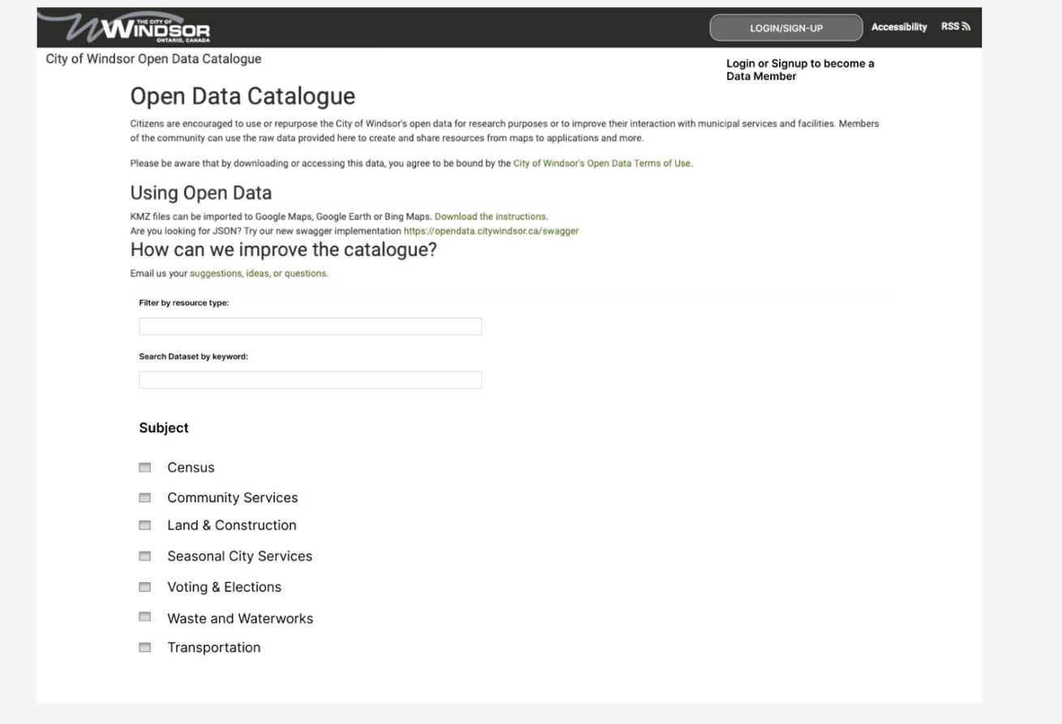
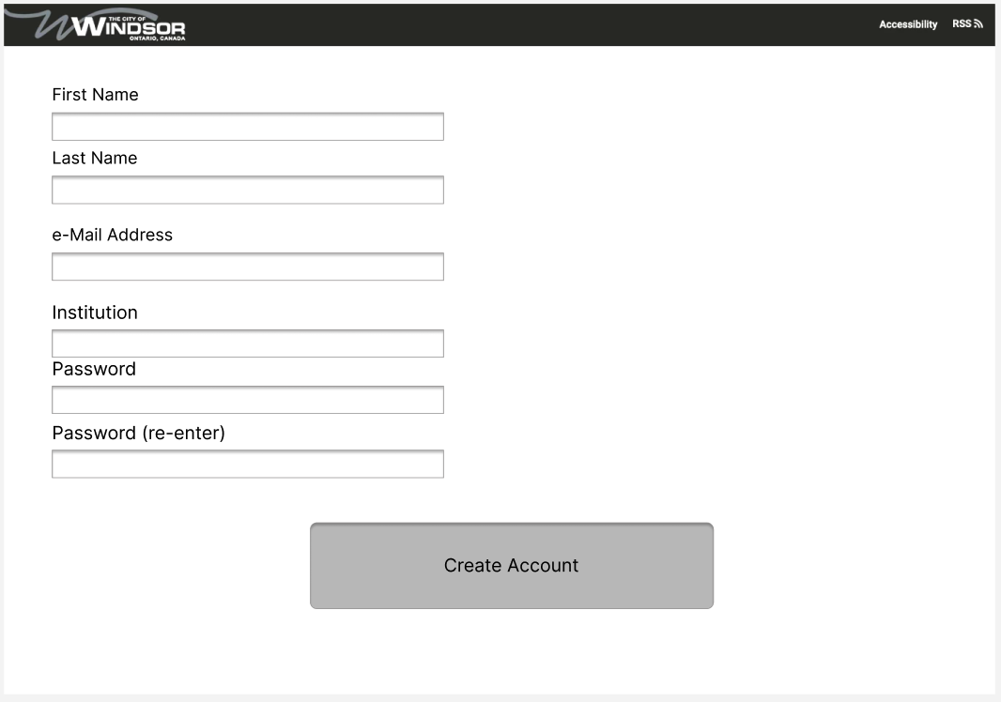
Improvement: Enhances code maintainability and scalability.
Team Management & Tools
Prototype Concept
Workflow: Agile methodology for iterative development.
Main Dashboard
Create Account Page
Software Used:
Team management software for collaboration.
Code repository: GitLab.
Documentation and testing tools: Javadoc, JUnit.

Slide 10
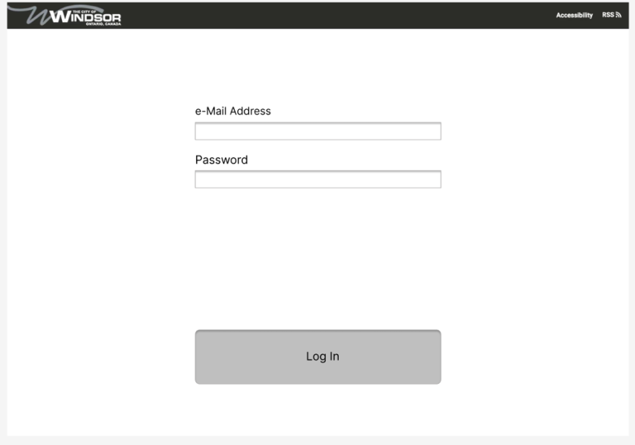
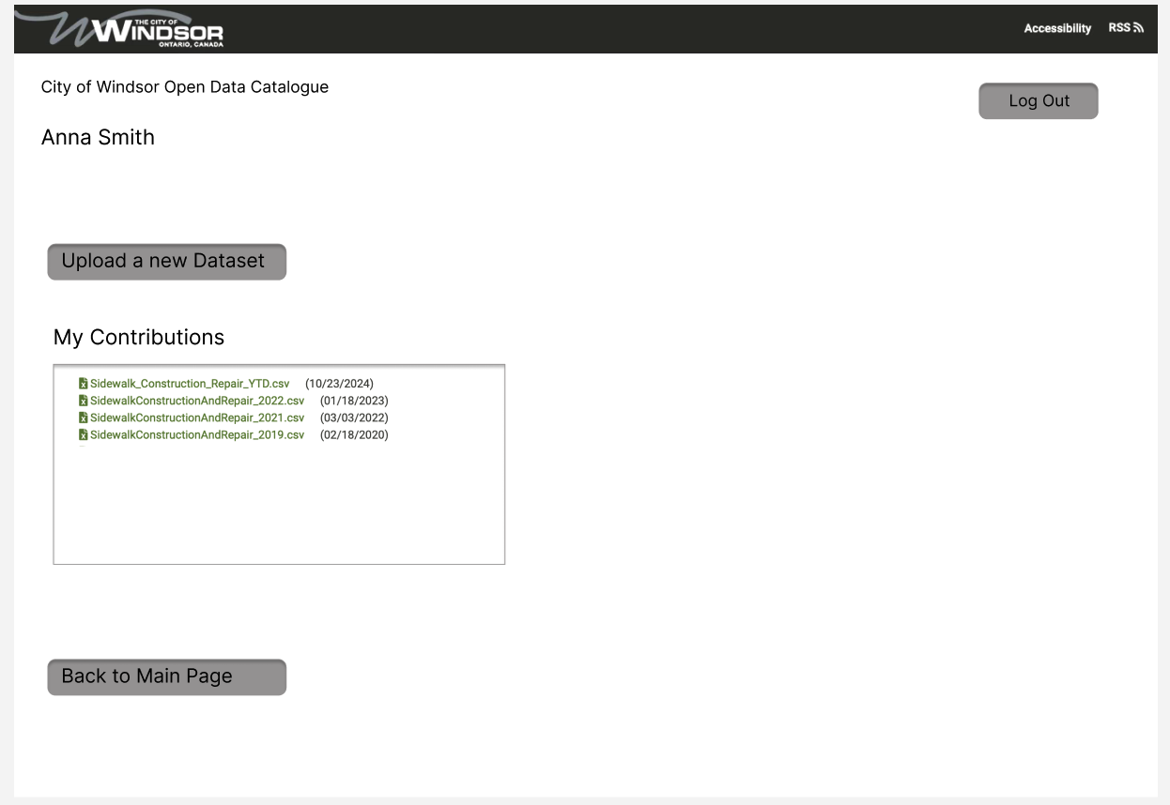
Prototype Concept
Workflow: Agile methodology for iterative development.
Login Page
Contributor Page on Login

Slide 11
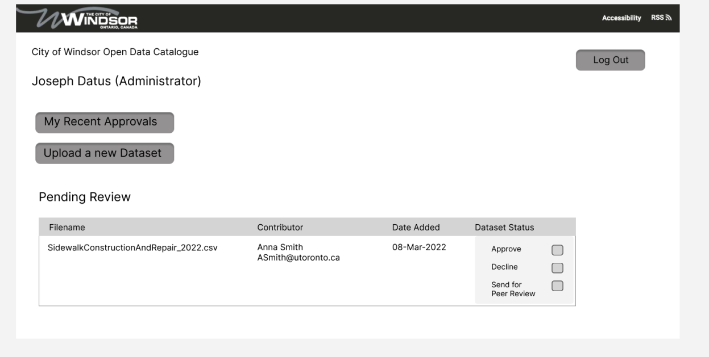
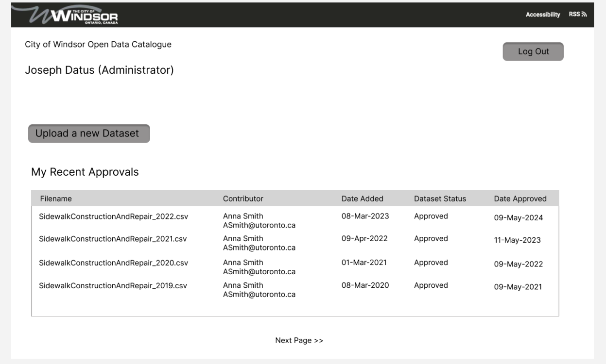

Prototype Concept
Workflow: Agile methodology for iterative development.
Admin Page on Upload and Data Approval
Admin Page About Recent Approval

Slide 12
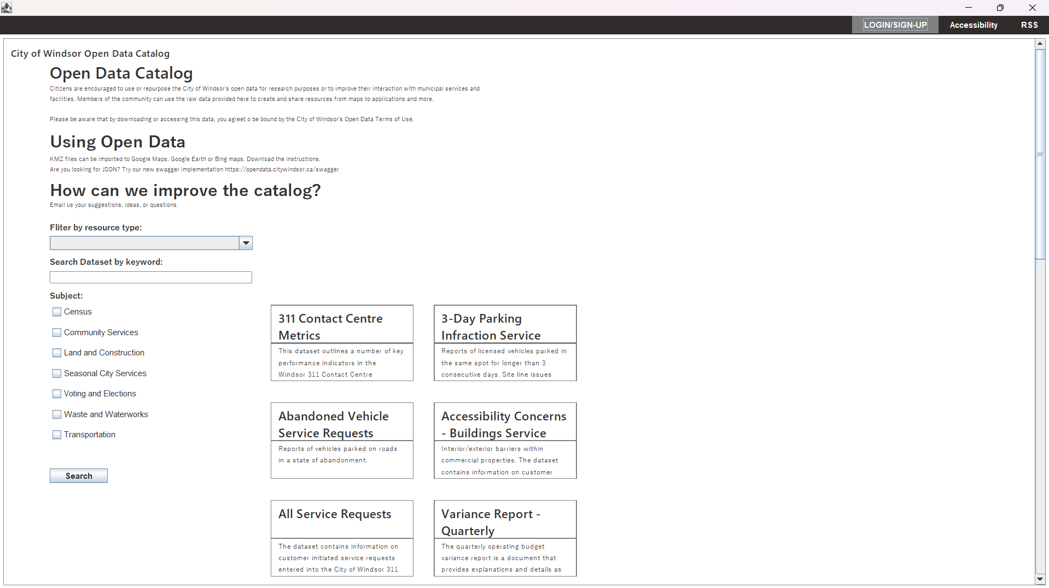
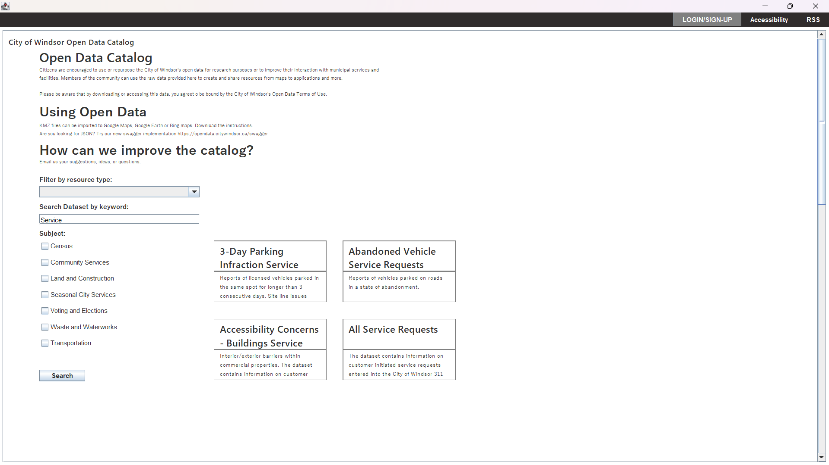
Prototype Concept
Sample Run/Screenshots
Main Dashboard
Filtered Main Dashboard

Slide 13
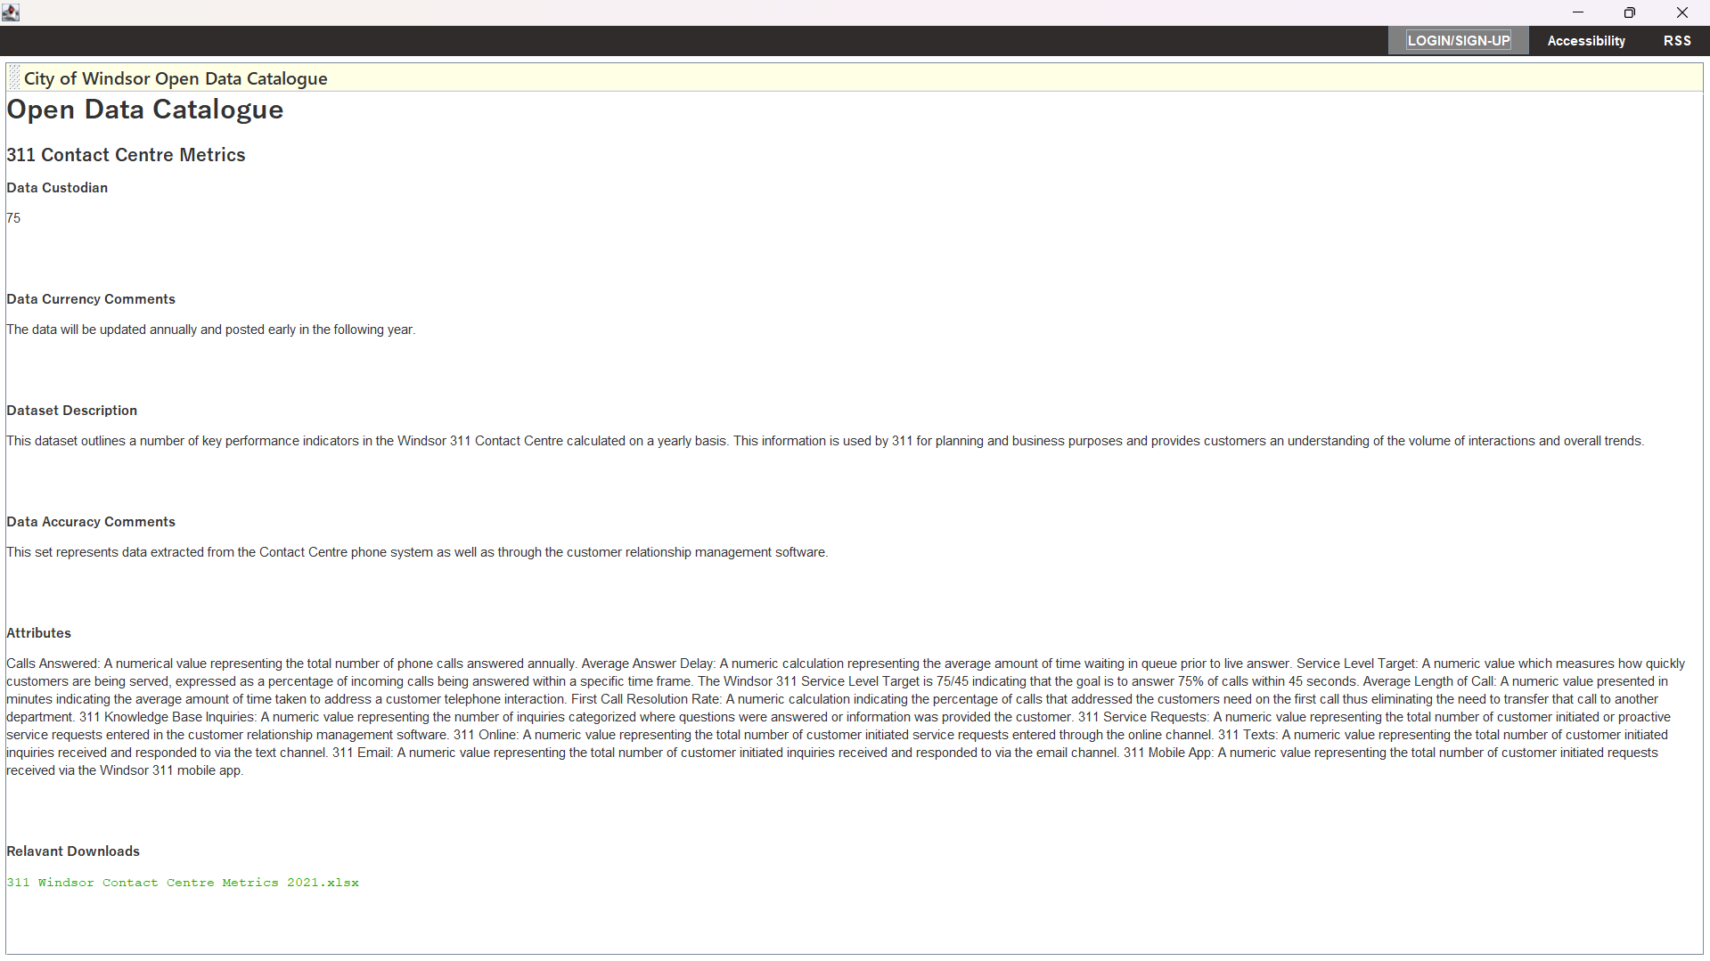
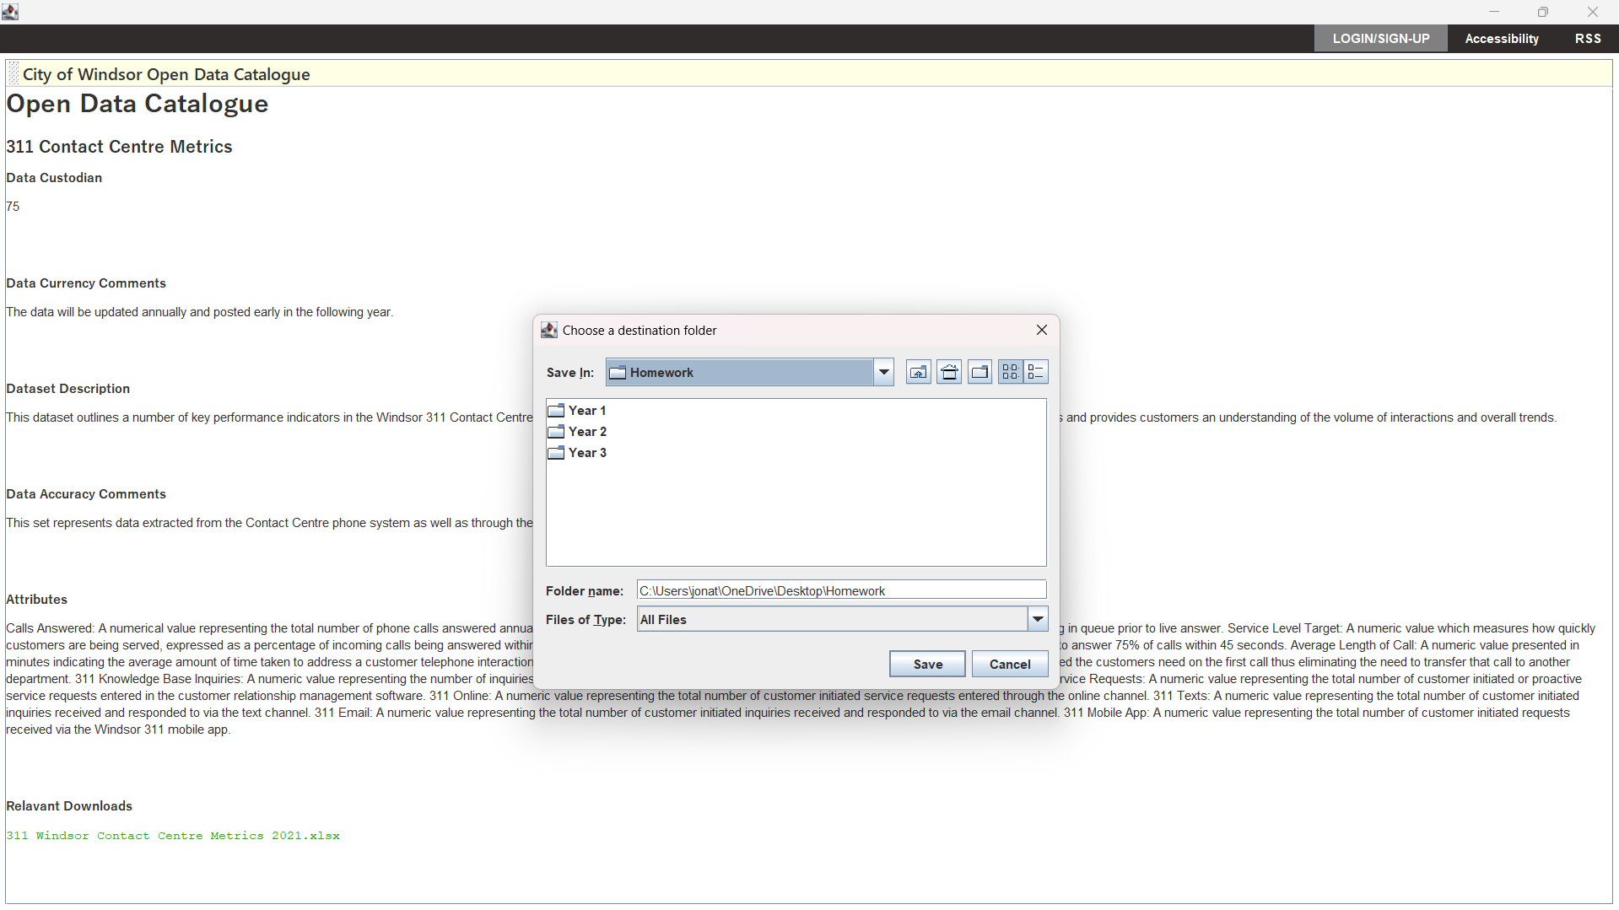
Sample Run/Screenshots
Catalogue Entry
Catalogue Entry Download Prompt

Slide 14
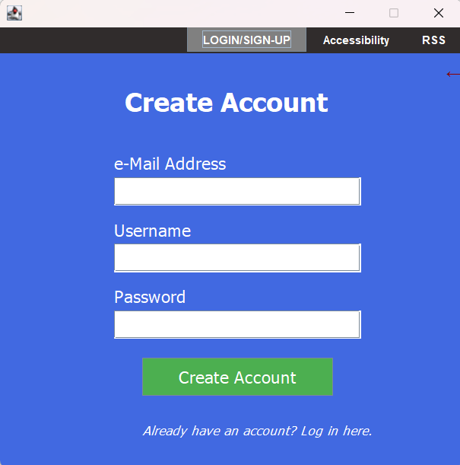
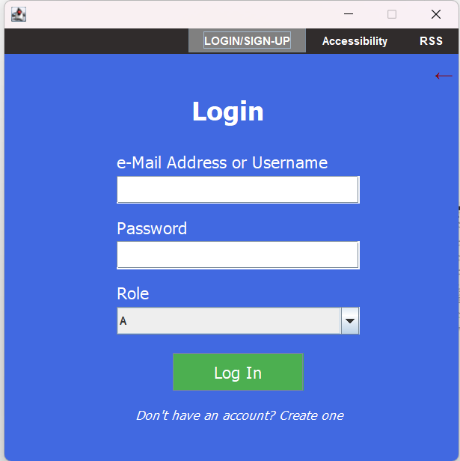
Sample Run/Screenshots
Create Account
Login page

Slide 15
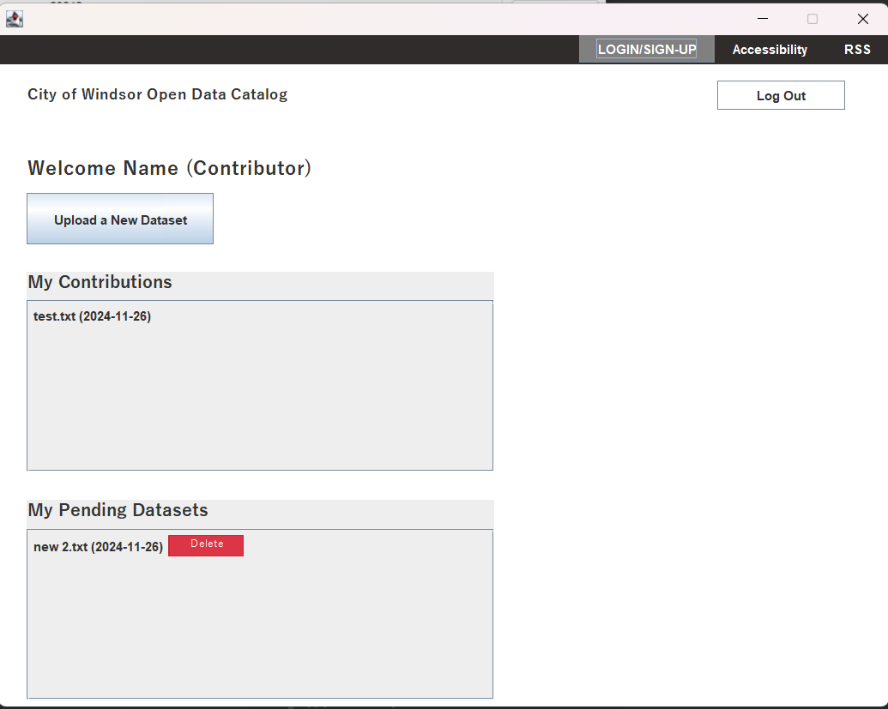
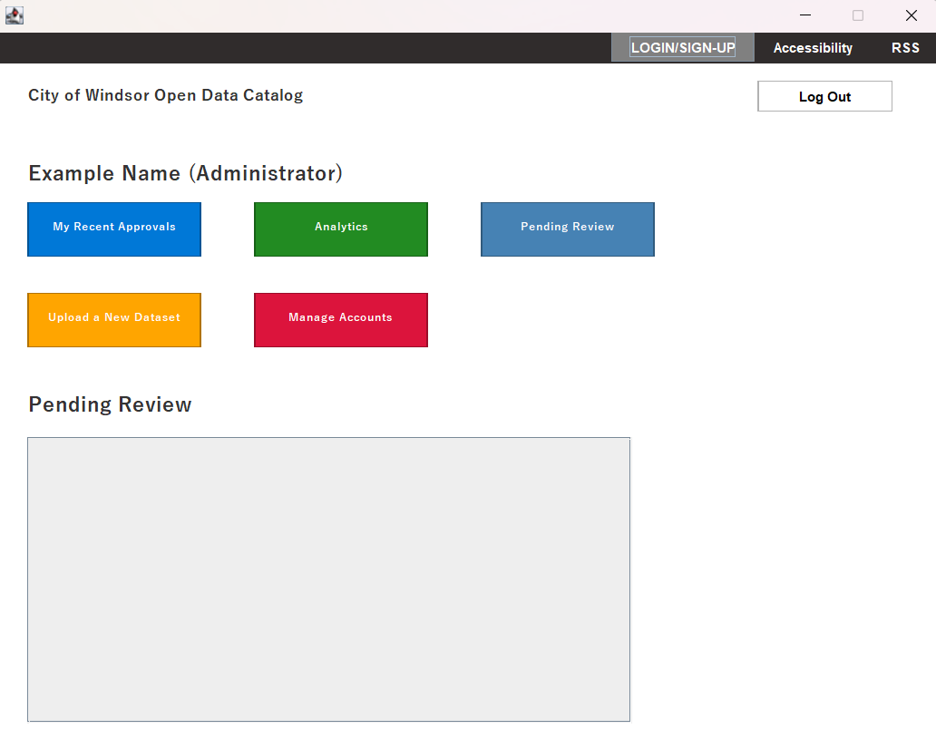
Sample Run/Screenshots
Contributor Dashboard
Admin Dashboard

Slide 16
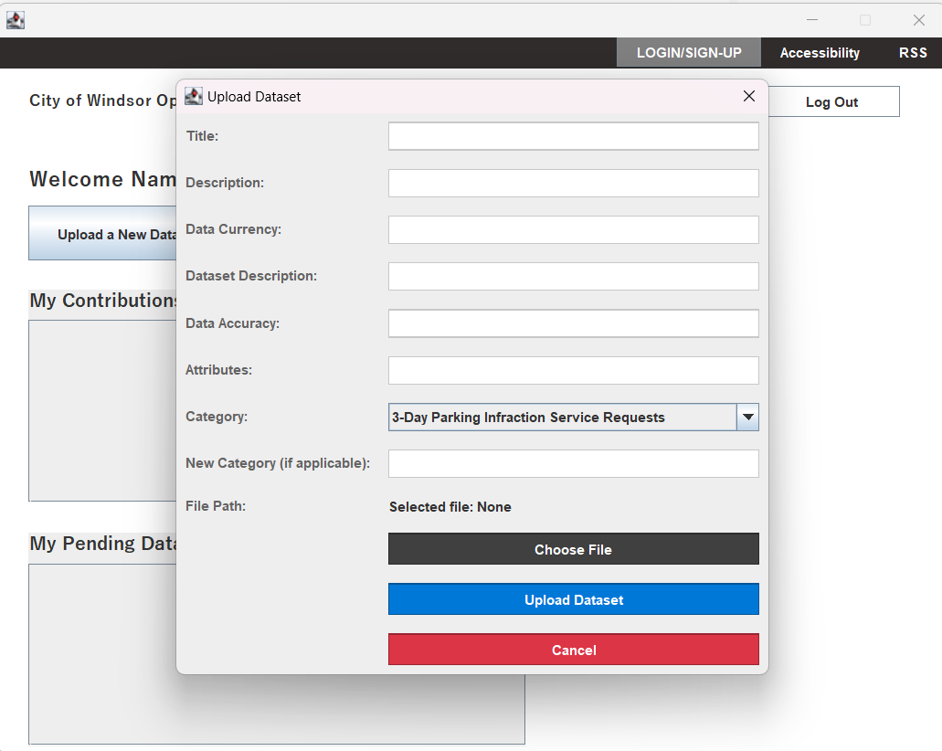
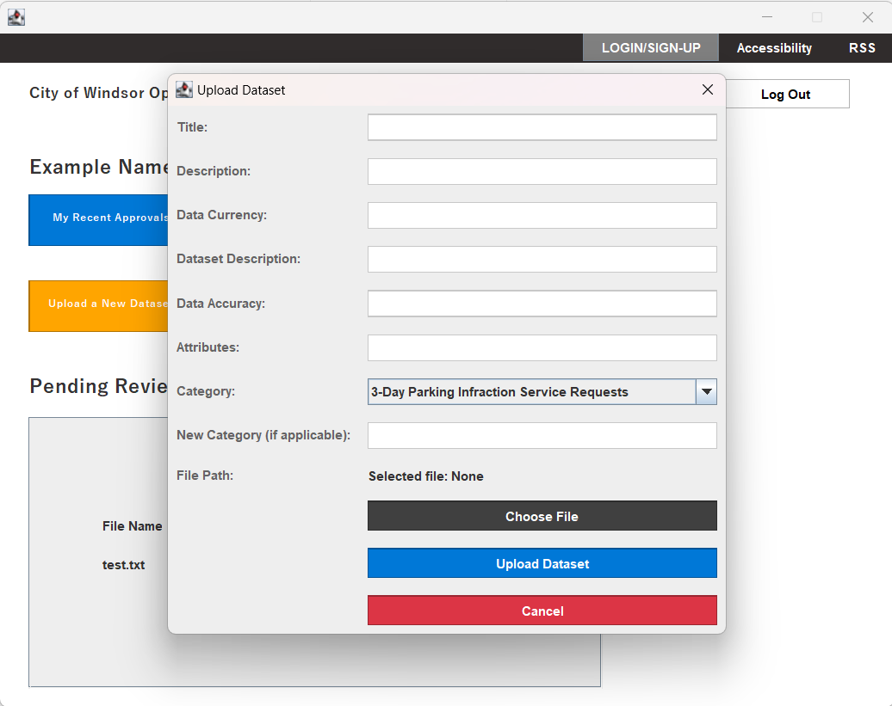
Sample Run/Screenshots
Contributor Upload Dashboard
Admin Upload Dashboard

Slide 17
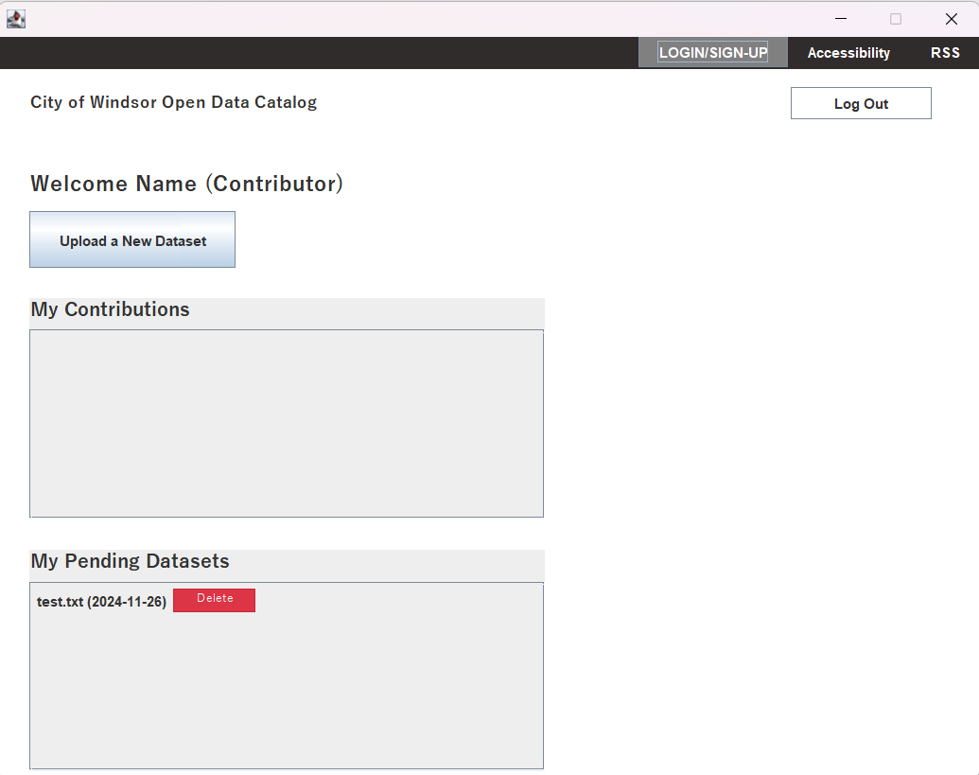
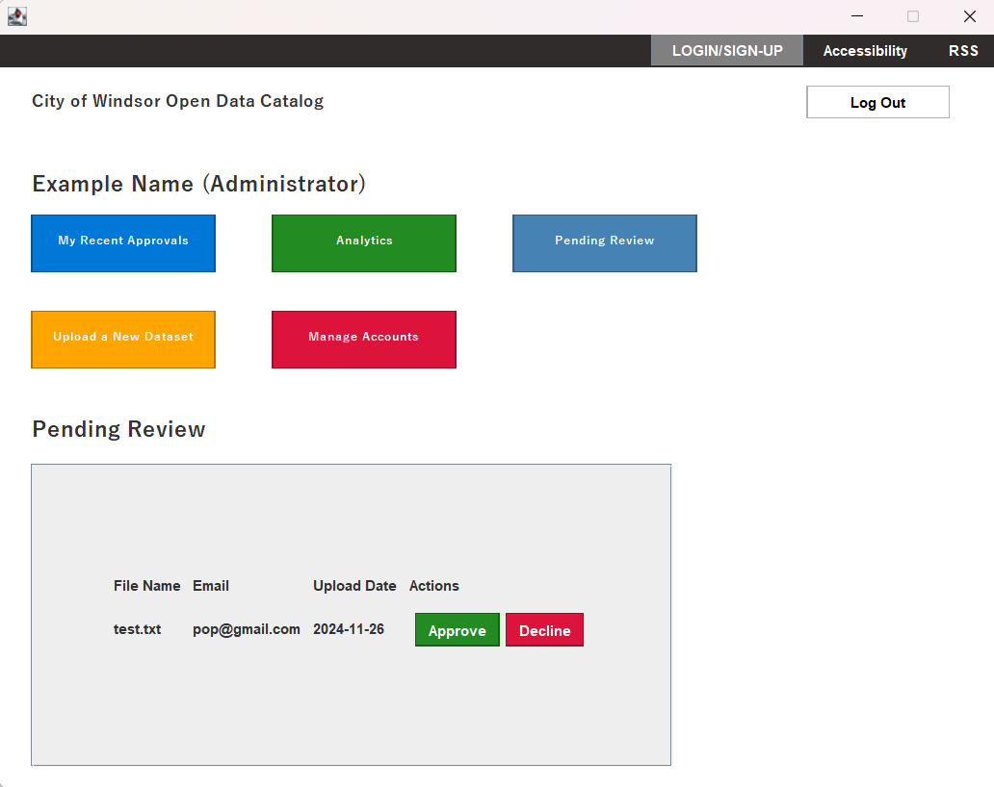
Sample Run/Screenshots
Contributor Pending Dashboard
Admin Pending Approval

Slide 18
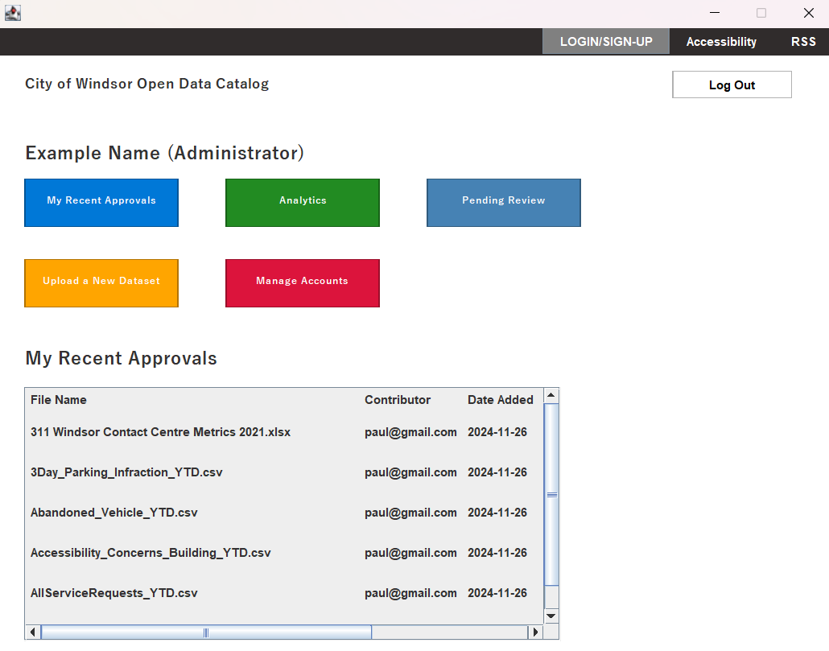
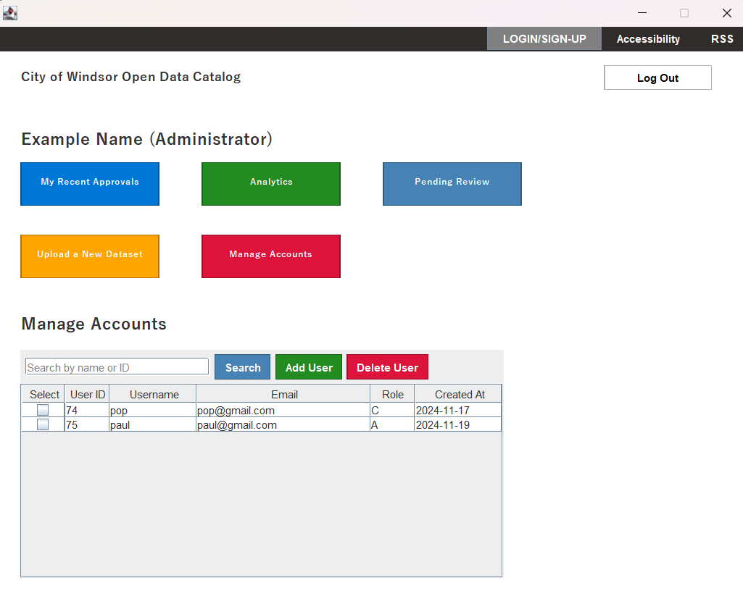

Sample Run/Screenshots
Admin Recent Approvals
Admin Manage Accounts

Slide 19
Sample Run/Screenshots
Summary & Next Iteration Plan
Summary: Recap the development phases and functionalities implemented.
Next Steps: Future enhancements like improving UI/UX, adding more datasets, and implementing additional features.

