Slide 1
MyScriptJS
Scope statement
MyScript Company Confidential

Slide 2
MyScriptJS – PURPOSE
Ease access to MyScript Cloud.
Increase ISV's developement speed drastically.
Provide High visibility for Web ISV (github, CDN,...)
Leverage web community's interest.

Slide 3
MyScriptJS – HOW 1/2
Javascript library.
Simple components (rebrandable canvas, result box, toolbars,...).
Rich components (Single Char, Math, …) based on Simple components.
Free lib (business based on MyScript Cloud)

Slide 4
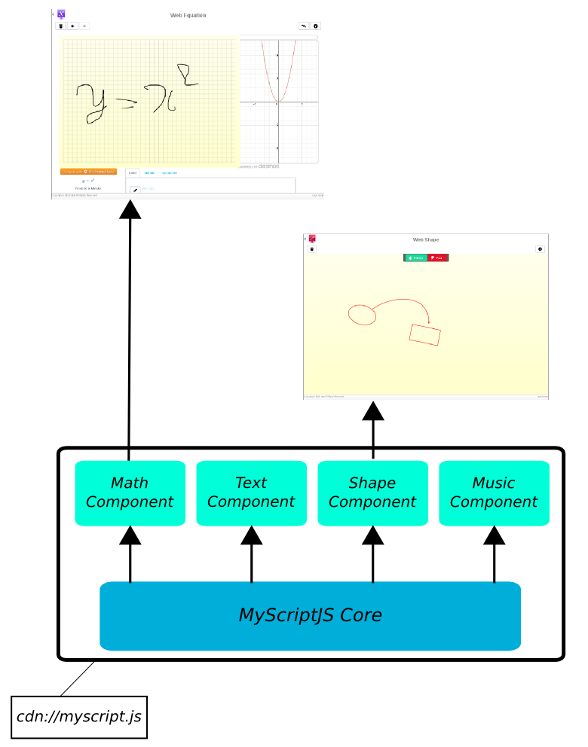
MyScriptJS – HOW 2/2

Slide 5
MyScriptJS – Technical Aspects 1/2
Based on Polymer JS framework (web components)
MyScriptJS:
  Core library (communication, ...).
MyScriptJS-components:
  Polymer elements (fontification, rendering, …)
  UI components (canvas, textbox, ...)

Slide 6
MyScriptJS – Technical Aspects 2/2
Provides UI components (high level).
Provides Service components (medium/low level).
Implements and simplify MyScript Cloud API recognition.

Slide 7
MyScriptJS – MyScriptJS 1.0
Architecture foundations
Goal: Ink Canvas
Iterate with equation webdemo in mind.

