Slide 1
Redis environment setup
Li, Xuepeng
Aug 8, 2022

Slide 2
Data WinClient-Brower Flow
Topic Group 1
Topic Group 2
WinClient1
WinClient2
AMS
AMS
Server 1
Server 2
Server 3
Server 4
DC Service 1
DC Service 2
DC Service 3(backup 1)
DC Service 4(backup 2)
Master
Sentinel 1
Slave1
Sentinel 2
Slave2
Sentinel 3
Slave3
Sentinel 4
SignalR Services
SignalR Services
SignalR Services
SignalR Services
Browser1
Browser2

Slide 3
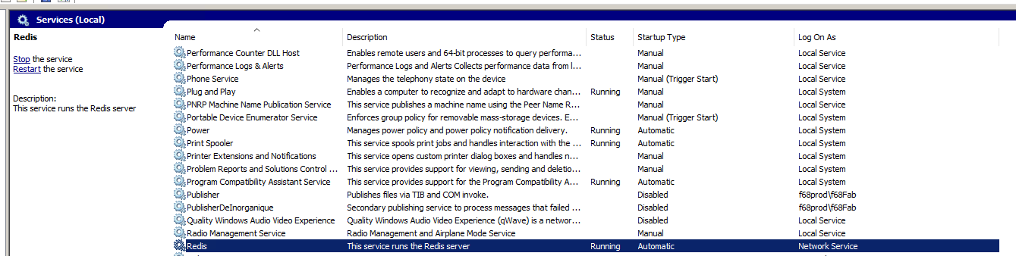
Install Redis
Copy dependences folder to server that we need setup Redis.
Find and install Redis-x64-5.0.14.1.msi(all options are default).
We can find the Redis service is running if we install successfully.
Actually, we can use the Redis installed by default, but to distinguish it from other systems on this server in the future, we’d better configure an independent environment. See the following configuration for details.

Slide 4
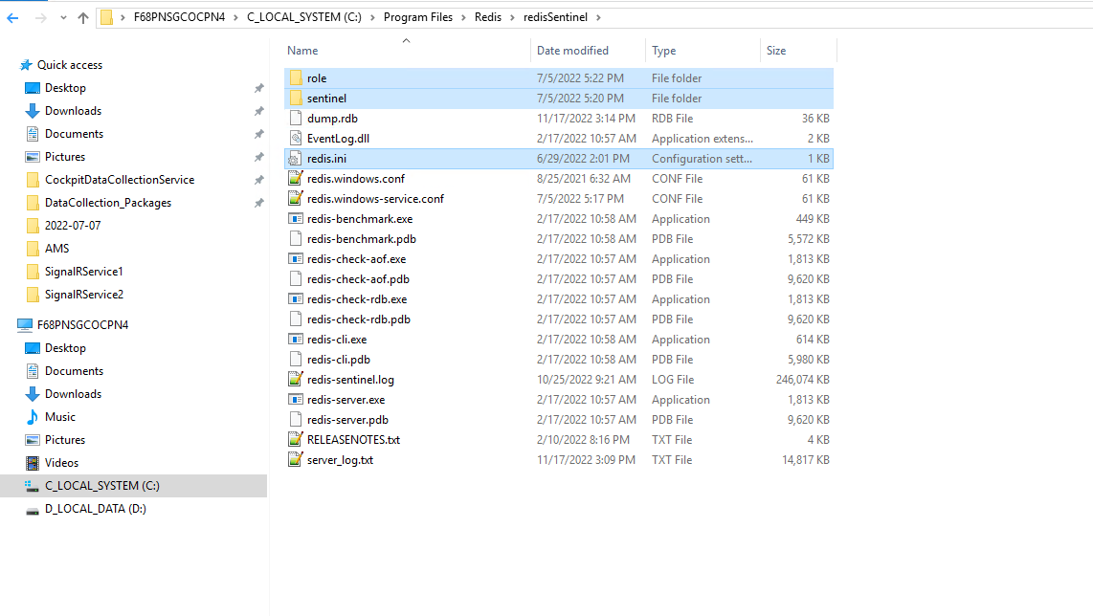
Prepare env and conf
Create a new folder named redisSentinel(customized) under any folder we want(C:\Program Files\Redis\ redisSentinel)
Copy everything in the config folder(we can find it in the dependences folder) to the redisSentinel folder
Navigate to redis installation path(C:\Program Files\Redis)
Copy all files in the installation path to redisSentinel folder
Determine the number of master slave and sentinel and repeat the above steps

Slide 5
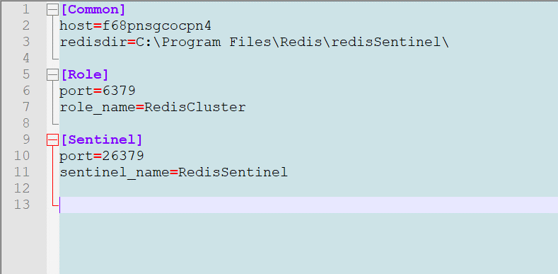
Prepare env and conf
Redis ini
<role_name> field used as master or slave service name
<sentinel_name> field used as sentinel service name
Other fields are used to confirm whether the service is
running normally.

Slide 6
Prepare env and conf
Master-slave conf
Determine which server is the master
Edit the file named redis.windows.conf under the redisSentinel/role folder
For master
# bind IP # followed by one or more IP addresses
# port 6379 # default 6379, we should stop other Redis started with 6379 on the same server if we use 6379
# masterauth <master-password> # use to connect to master for slave
# requirepass <password> # connection password, we’d better set same password with the masterauth
# logfile “the log file name”
# dir ./ # Note that you must specify a directory here, not a file name.
bind 127.0.0.1
port 6379
masterauth 123456
requirepass 123456
logfile “redis_server_log.txt"
dir "C:\\Program Files\\Redis\\redisSentinel"
For slave
One more setting item than master
# replicaof <masterip> <masterport>

Slide 7
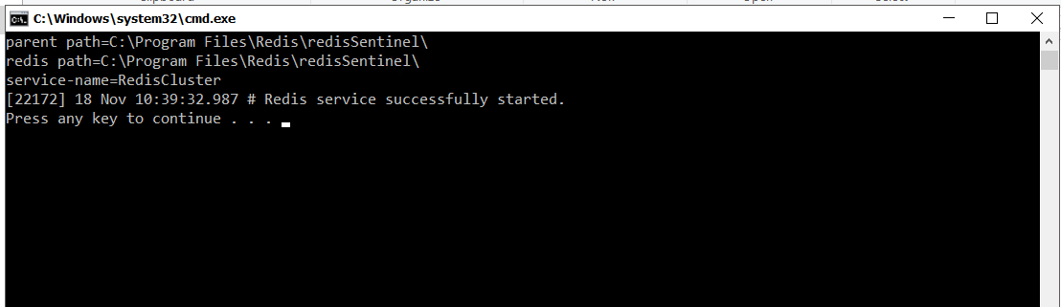
Prepare env and conf
Master-slave install
Navigate to redisSentinel/role folder
Install and run as a windows service
Run install.bat in the command window or double click, will find the service named RedisCluster(configured in redisSentinel/redis.ini) running.
We should make sure that the master starts first.

Slide 8

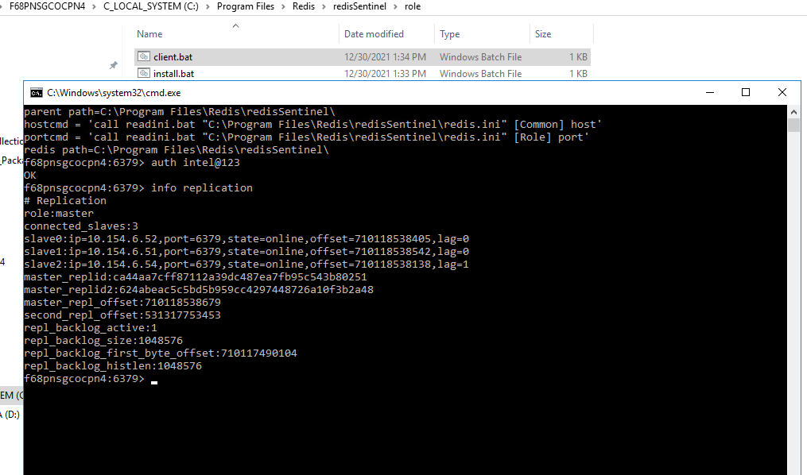
Prepare env and conf
Master-slave check
Run client.bat in the command window or double click.
Run command auth < requirepass> (e.g. auth 123456)
Run command info replication
If we see something like the below, it means that the installation is OK.

Slide 9
Prepare env and conf
Sentinel conf
Edit the file named sentinel.conf under the redisSentinel/role folder
# bind IP
# port 26379
# sentinel auth-pass <master-name> <password>
# sentinel monitor <master-name> <ip> <redis-port> <quorum>
# logfile “the log file name”
# dir ./
bind 127.0.0.1
port 26379
sentinel auth-pass mymaster 123456(the password configured in master/slave conf)
sentinel monitor mymaster 127.0.0.1 6379 2
logfile "redis-sentinel.log"
dir "C:\\Program Files\\Redis\\redisSentinel“
sentinel myid
We must find and delete it, and it will be automatically created again when starting sentinel service. Otherwise, the sentinel will not be found.

Slide 10
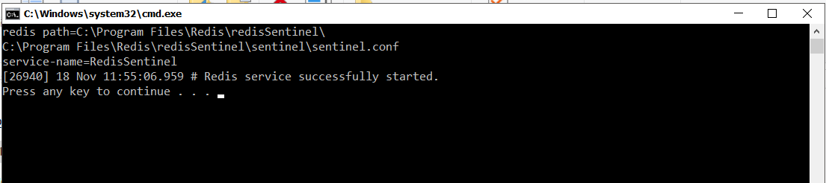
Prepare env and conf
Sentinel install
Navigate to redisSentinel/sentinel folder
Install and run as a windows service
Run install.bat in the command window or double click, will find the service named RedisSentinel(configured in redisSentinel/redis.ini) running.

Slide 11
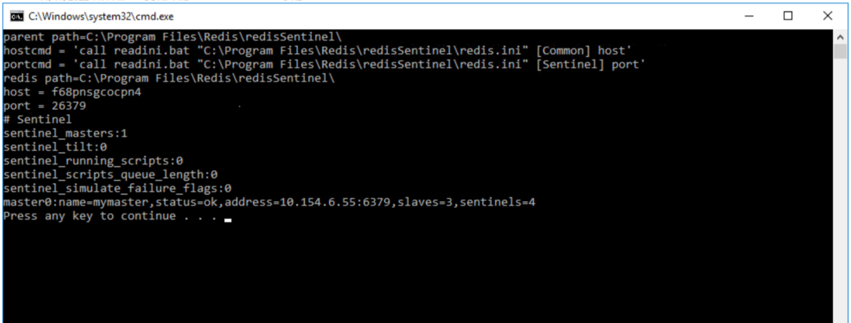
Prepare env and conf
Sentinel check
Run client.bat in the command window or double click.
If we see something like the below, it means that the installation is OK.

Slide 12
Thanks!

