Slide 1

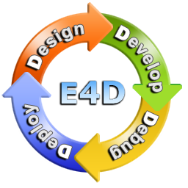
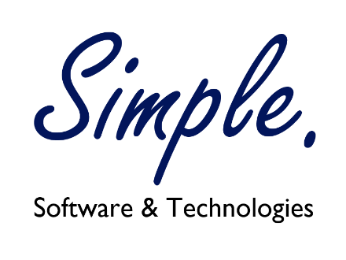

Windows Azure Platform
Yair Cohen
CEO Simple. Software & Technologies site: simpl.co.il

Slide 2
Agenda
Overview of cloud computing
Comparison – IaaS, PaaS, SaaS, MBaaS
Azure Overview
Storage – Tables, Queues, Blobs
SQL Azure – Database in the cloud
Websites – PaaS for websites
Cloud Services – PaaS for cloud applications
Mobile Services – Mobile Backend as a Service

Slide 3
Cloud Computing

Slide 4
Video
The LowS
http://www.youtube.com/watch?v=rRQLWjYxXvg&list=TL77Of8WZz1hGv7J_pDwo3LQV-dTlqqElL

Slide 5
Power –Generators to Utility
Generators
Each Amper is very expensive.
Every factory requires new infrastructure.
Unreliable by definition
Limited availability
Not in the core business
Utilities
Scalable – use as much as you like
Wide spread infrastructure allow expanision
Multiple Generators, Multiple sites – much more reliable
Resources shared across companies
New use cases – who needs vacume cleaner?

Slide 6
Cloud – Mainframe to PC and Back ?
Mainframe
Companies built full infrastructure to get computer resources to branches
Very limited resources – network, storage, computation
Not in the core business
Compromises – Missiles? Here? No way…
Resources shared across companies
NC – failed
PC
Limited Resources (Compute, Storage, Network etc.)
Deployment
IT Resource hog
Unmanaged (even if you have IT…)

Slide 7
Cloud – Mainframe to PC and Back ?
Web
Solves the scalability, deployment
Still very fragmented
Very limited, untrusted
Scalability issues started the movement to cloud
Mobile
Like a pc on your hands
One of the major triggers for Cloud Computing
X3 Devices vs. PC
Very accessible - X10+ Actions vs. PC
Internet of Things
Billions devices to come and get you …

Slide 8
Cloud – Mainframe to PC and Back ?
Cloud
Smart hybrid between Web and PC (or any device)
Treat each “problem” differently
Special solutions for Storage layer
Special solutions for Network layer
Special solutions for Compute layer
Scalability
You are not bound to your physical space or resources
Grow and Shrink as your wish
Availability are main benefits
The servers & OS built to support this scenario
Most business don’t need true 24/7 availability all time.
Reliability/Durability
Redundancy of resources (multi networks, multi power plugs, etc.)

Slide 9
IaaS, PaaS, SaaS, MBaaS, *aaS

Slide 10
Cloud - Definitions
Storage, Network, Compute
Virtualization of File System, Network and CPU
IaaS – Infrastructure as a Service
Virtualize the machine on the OS level – like VM on premise.
Paas – Platform as a Service [Recommended]
Virtualize the runtime of the application
You care about your application only.
MBaaS – Mobile Backend as a Service
Let you focus on the client only (not only mobile)
Provides services for storage, authentication, notifications, etc.
SaaS – Software as a Service
This is what you should build based on those services.

Slide 11
Cloud - Benefits
 | On Premise | IaaS | PaaS | MBaaS |  | SaaS
Applications
Runtime
Database
Operating System
Virtualization
Server
Storage
Networking
Requires Management
Managed by Provider

Slide 12
Software
Acquisition cost: 10%
Hardware
network
IT labor
management tools
Operation cost: 90%
support
power/cooling
maintenance
security
disaster recovery
facilities
backup
Source: IDC

Slide 13
Windows Azure

Slide 14
Azure – Cloud OS
Storage, Network, Compute
Virtualization of File System, Network and CPU
IaaS – Infrastructure as a Service
Virtualize the machine on the OS level – like VM on premise.
Paas – Platform as a Service [Recommended]
Virtualize the runtime of the application
You care about your application only.
MBaaS – Mobile Backend as a Service
Let you focus on the client only (not only mobile)
Provides services for storage, authentication, notifications, etc.
SaaS – Software as a Service
This is what you should build based on those services.

Slide 15
Building Blocks

Slide 16
Storage – Build to fail
Update Domain / Fault Domain
Another data center (500 Miles away)
Geo-Replication

Slide 17
Datacenter Network Architecture
DLA Architecture (Old)
Quantum10 Architecture (New)
DC Router
DC Routers
DCR
DCR
Access Routers
Aggregation + LB
BL
BL
BL
AGG
AGG
AGG
AGG
AGG
AGG
BL
LB
LB
LB
LB
LB
LB
LB
LB
LB
LB
LB
LB
20Racks
20Racks
20Racks
20Racks
Spine
Spine
…
Spine
Spine
40 Nodes
TOR
40 Nodes
TOR
40 Nodes
TOR
40 Nodes
TOR
40 Nodes
TOR
40 Nodes
TOR
40 Nodes
TOR
40 Nodes
TOR
40 Nodes
TOR
40 Nodes
TOR
40 Nodes
TOR
40 Nodes
TOR
40 Nodes
TOR
40 Nodes
TOR
40 Nodes
Digi
Digi
Digi
Digi
Digi
Digi
Digi
Digi
Digi
Digi
Digi
TOR
…
Digi
Digi
…
Digi
Digi
…
…
…
…
APC
APC
APC
APC
APC
APC
APC
APC
APC
APC
APC
APC
APC
APC
APC
…
120 Gbs
TOR
TOR
TOR
TOR
30,000 Gbps

Slide 18
Compute
Business Portal
Developer Portal
User Code
REST
Service Management Service
Runtime API
…
…
VM Setup
VS Tools
Storage Cluster
Compute Cluster
…
Cloud VM
WA SDK
REST
Desktop
MSFT Datacenters

Slide 19
SQL Azure

Slide 20
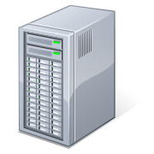
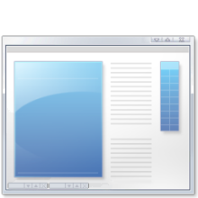
SQL Azure Database: An Illustration
SQL Azure Database
YOUR APP
TDS

Slide 21
Database Replicas
!
Single Database
Multiple Replicas
Replica 1
Single Primary
Replica 2
DB
Replica 3
Replica 4

Slide 22
SQL Azure Compatibility
Currently Supported
Not Currently Supported
Tables, indexes and views
Stored Procedures
Triggers
Constraints
Table variables, session temp tables (#t)
Spatial types, HierarchyId
Data Types
Sparse Columns, Filestream
Partitions
Filegroups
Full-text indexes
SQL-CLR

Slide 23
Demo

Slide 24
Cloud Services

Slide 25
Application Technical Requirements
Hardware
Software
Customers (should) Require:
Network failures
Disk failures
Power
Cooling
Physical Security
Fire
Earthquaqe
IT Operational Team
Management Applications
Provisioning
Large Rooms
Etc
Etc
Etc
Etc
…
Customers (should) Require:
Scalability
Can your app Grow?
Availability
Evolution of information age
Security
How my data is secured?
Seamless Updates
Add features, fix bugs, but why I need to wait????
Performance
2 seconds? Your app is too slow…
Backups
Ooooops… I deleted that row and….
?
Covered by Azure Data Centers

Slide 26
Welcome to Azure Cloud Services
Supports Virtual Network
.Net Full Stack
Update Domains
Fault Domains
Staged Deployment
Automated
Management insturmentations
Reliability – builds on Azure Storage/Networking
Scalability – as easy as slider, or better Scheduled/Rules

Slide 27
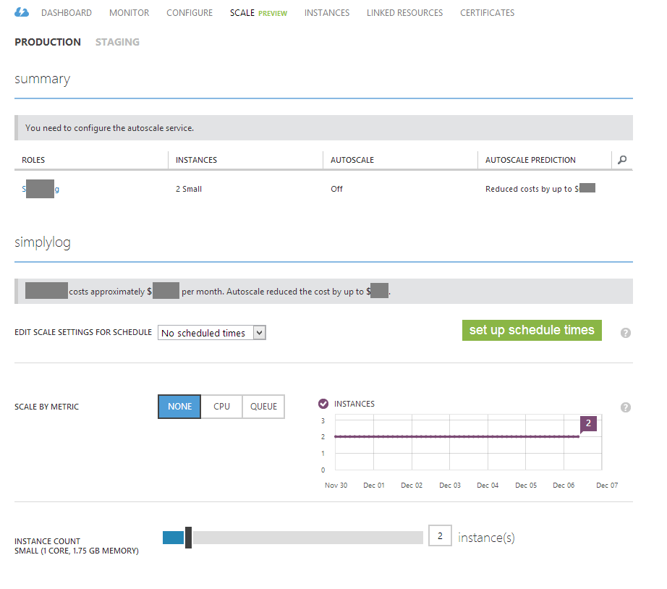
Scaling

Slide 28
Cloud Architecture
API Frontend
Web Frontend
Async
Sync/Async
Logging
Management
Load Balancer
Security
Application Layer - Services
Async - ServiceBus
Load Balancer
Database
Files Storage
Backend Processing

Slide 29
Windows Azure Service Architecture
The Internet
The Internet via TCP or HTTP
LB
LB
LB
Web Site
(ASPX, ASMX, WCF)
Queues
Web Site
(ASPX, ASMX, WCF)
Storage
Worker Service
Web Role
IIS as Host
Worker Service
Worker Role
Managed Interface Call
Tables
Blobs
Windows Azure Data Center

Slide 30
Roles and Instances
Roles are defined in a Service Model
May define one or more Roles per Service
A role definition specifies
VM size
Communication Endpoints
Local storage resources
Etc…
At runtime each Role will execute on one or more instances (up to 20 per subscription)
A role instance is a set of code, configuration, and local data, deployed in a dedicated VM

Slide 31


Worker Role Patterns
Queue Polling Worker
Poll and Pop Messages within while(true) loop
E.g. Map/Reduce pattern, background image processing
Listening Worker Role
Create TcpListener or WCF Service Host
E.g. Run a .NET SMTP server or WCF Service
External Process Worker Role
OnStart or Run method executes Process.Start()
E.g. Run a database server, web server, distributed cache

Slide 32

Web Role
All features of a worker role + IIS
ASP.NET 3.5 SP1 or 4.0 – 64bit
IIS7 Hostable Web Core
Hosts
Webforms or MVC
FastCGI applications (e.g. PHP)
Http(s)
Web/Worker Hybrid
Can optionally implement RoleEntryPoint

Slide 33
Local Storage
Role instances have available disk storage
Use LocalStorage element in service definition
Name
CleanOnRoleRecycle
Size
Persistent but not guaranteed durable Good for cached resources
Windows Azure Storage Drives provide guaranteed durable storage

Slide 34
Local Storage
Define in Config
<LocalResources>
<LocalStorage name=“myLocalDisk" sizeInMB="10" cleanOnRoleRecycle="false" />
</LocalResources>
Use in Code
string rootPath = RoleEnvironment.GetLocalResource[“myLocalDisk”]
.RootPath;
DirectoryInfo di = new DirectoryInfo(rootPath);
foreach(di.EnumerateFiles())
….

Slide 35
Deployment
Automated deployment to Staging Environment
Takes time… (minutes)
Testing
3. VIP Swap:
Uses Staging and Production environments.
Allows to quickly swap environments.
Production: v1 ➔ Staging: v2, after swap then Production: v2 ⬅ Staging: v1.
Can Fast Rollback by swapping from Production to Staging
4. In-Place Upgrade (not recommended)
Performs a rolling upgrade on live service.
Entire service or a single role
Manual or Automatic across update domains
Cannot change Service Model

Slide 36
Fault Domains and Availability Sets
Avoid single points of physical failures
Unit of failure based on data center topology
E.g. top-of-rack switch on a rack of machines
Windows Azure considers fault domains when allocating service roles
At least 2 fault domains per service
Will try and spread roles out across more
Availability SLA: 99.95%
Front-End-1
Web
Front-End-1
Front-End-2
Middle Tier-1
App
Middle Tier-1
Middle Tier-2
App
Middle Tier-3
Fault Domain 1
Fault Domain 2
Fault Domain 3

Slide 37
Challenges
Stateless Role Instances
Session state
Local storage
AJAX requests may callback different instance
Non-Admin Rights
Cannot easily register COM components
Registration free COM http://tinyurl.com/Reg-Free-COM

Slide 38
Demo

Slide 39
Service Bus

Slide 40
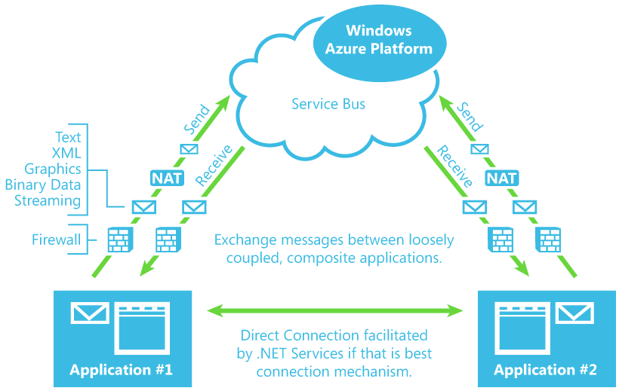

Slide 41
Mobile Services

Slide 42
Video
Azure Data Centers
http://www.youtube.com/watch?v=JJ44hEr5DFE

Slide 43
WebSites

Slide 44



Azure Web Sites – what you manage
Windows Azure
Your Datacenter
Applications
Virtual Machines
Cloud Services
Web Sites
Data
Applications
Applications
Applications
Firewall
Data
Data
Data
Network
Firewall Rules
Firewall Rules
O/S
Virtual Network
Virtual Network
Virtualization
O/S
Hardware
Focus on the Application

Slide 45

Windows Azure Web Sites
powerful web sites in seconds
start simple
code smart
go live
start free, scale up and out as you go, friction-free and without the headaches
with classic asp, asp.net, php or node.js, develop on Windows, OSX or Linux
deploy live in seconds, easily monitor performance, rapidly diagnose and fix issues

Slide 46
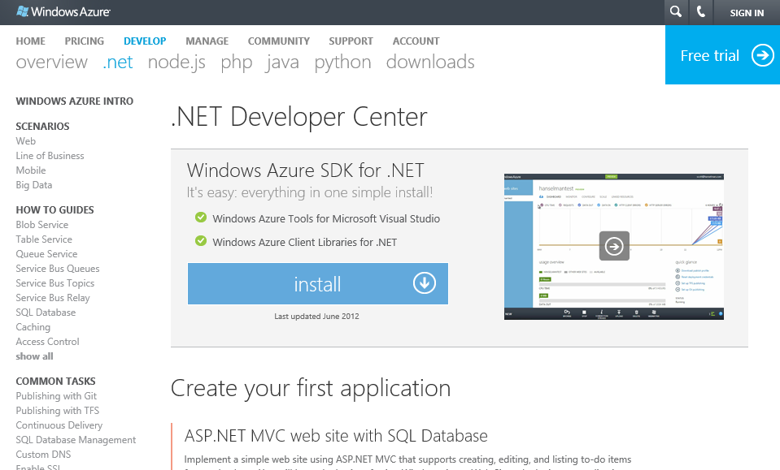
Azure Web Sites – Simple Management

Slide 47
Demo

Slide 48
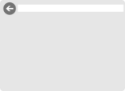

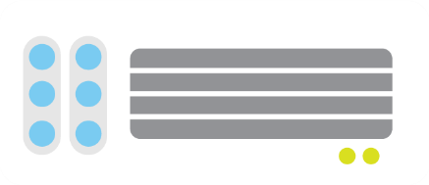

web sites
shared
reserved
1
shared
Shared instanceS
:-)

Slide 49
web sites
shared
reserved
2
shared
Shared instanceS
:-)
:-)

Slide 50
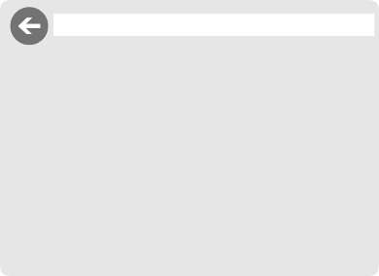
web sites
shared
reserved
1
reserved
Shared instanceS
RESERVED instance
:-)
:-)
:-)

Slide 51
web sites
shared
reserved
2
reserved
RESERVED instance
RESERVED instance
:-)
:-)

Slide 52


web sites
shared
reserved
2
reserved
RESERVED instance
RESERVED instance
:-)
:-)
:-)
:-)
:-)
:-)
:-)
:-)

Slide 53




Supported Web Frameworks
more coming soon…

