Slide 1
PhoneGap
Developing native Apps with html5

Slide 2
Overview
Native
Pros:
Faster runtime performance
Can handle graphics and games interactions very well
“fit in the neighborhood”
Cons:
Requires specialized skill for each platform
Very complex UI methaphors
Adjustments must be made for multiple screen sizes
Smaller support community
Testing multiplies by platform

Slide 3
Overview
HTML5
Pros:
Harness existing skills (HTML5, JavaScript, CSS
Develop and test once for multiple platform
Easily support multiple screen sizes
“Good Enough” performance for most business applications
Can share code even with standard web applications
Use existing tools
Cons:
Slower than native
Requires disciplined and methodical approach
Cannot access device features (camera, Bluetooth, etc.)
“Zero-trust”
Browser compatibility (minor issue these days)

Slide 4
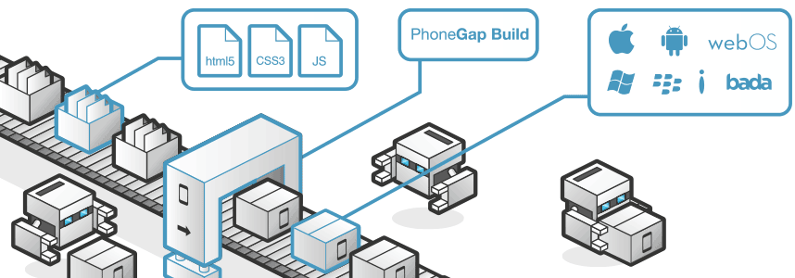
Introducing PhoneGap
A Native Platform for HTML5 Applications.

Slide 5
PhoneGap - Overview
Comprised of 4 main parts:
* A library/sourcecode (has separate for each platform) that compiles to platform-specific package that serve as the “Main View” (most of times, can be any other view).
* Packaged folder (as content) ‘www’ for HTML5/JS/CSS content files
* Plugins (as libraries) that will be packaged along (most of times including js “bridge” file inside www folder)
* Extensive API that “bridges” between Native features and JS api which provide access to Camera, Accelerometer, files and etc.

Slide 6
PhoneGap - Build
Local:
- downloading the Source/libs of Phonegap / plugins for each platform
- creating new project (phonegpa have nodejs npm plugin to aid with this)
- building and packaging.
- Should be automated.
- Easier for debugging specific issue
Adobe Build Service
- Automated
- Just upload the content files (HTML/JS/CSS) or git push to build to any desired platform.
- Very convenient, smooth cross-platform testing cycle (2-5 mins at most)

Slide 7
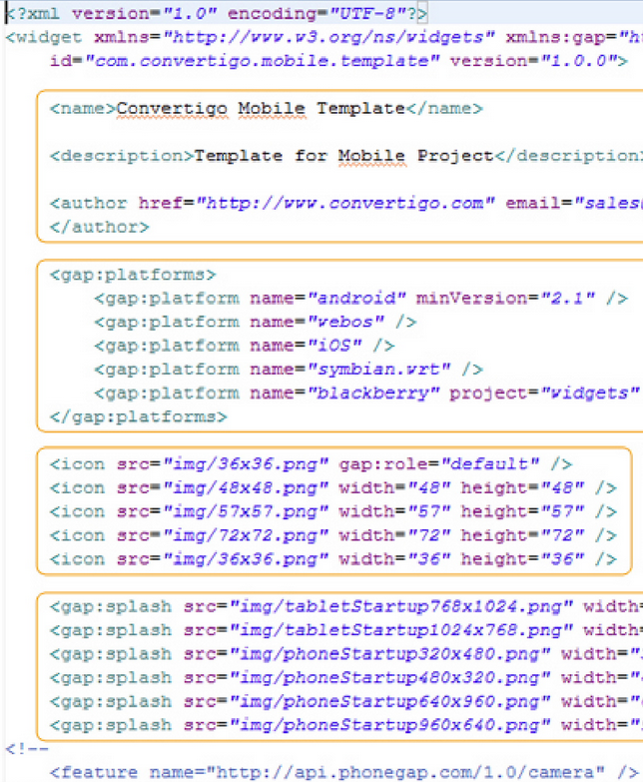
PhoneGap – config.xml
- Controls “manifest” of the application
Name, id
Icons
Splash
Plugins registration
Preferences
- PhoneGap Build uses it to construct the app entirely.

Slide 8
PhoneGap - Plugins
3 steps:
Get the plugin, integrate into the app (JAR/OBjectiveC lib, etc.)
Add script and reference for the JS api (for example: barcodescanner.js)
Register in config.xml
Plugins are packaged with the application, no additional download for the user
Developing plugins
Needs to create the plugin itself, for each supported platform
Need to package it as Lib / JAR
Add JS file that provides usable API that bridges between the JS and the exported API of the plugin
Optionally submit to Phonegap Build in order to be able to include it in builds (open to all).
Best Practices:
Only develop plugin if you MUST, it is complicated, tedious and time consuming (many moving parts, returning to the main issue at the first place for not developing native)
Search for existing plugins, and strive to use Cross-Platform plugins as much as possible (even compromising on features.

Slide 9
PhoneGap - API
Using APIs
Include reference to phonegap.js (in local build, it can be any name/version)
On Device Ready event must be called before using api.
document.addEventListener("deviceready", yourCallbackFunction, false);
yourCallbackFunction – here you can put init code / code that calls phonegap api.
“Async” nature
Most APIs working with callbacks you provide (some of them async but others are sync)
HTML5 “interface” Compatibility
PhoneGap will favor HTML5 features by host browser.
PhoneGap will try to use HTML5 standards or drafts like API (even if it does not implemented in the browser) as close as it can so porting to HTML5 should be more fluent
Compatiblity – some APIs are not available on certain platforms, use Docs to find out.
Best Practices
Always wrap phonegap API with your own “service” or façade, there will be changes.
OnDeviceReady is async and your html will probably load faster (should be…) so don’t assume anything.

Slide 10
PhoneGap – Camera API
Camera API expose functionality for working with Camera
Taking pictures/video
Loading pictures from library
Storing to library
navigator.camera.getPicture( function(picture){
$(“img”).attr(“src”, picture);
}, function(error){
console.log(error);
}, {
destinationType: Camera.DestinationType.FILE_URI,
sourceType: Camera.PictureSourceType.CAMERA
});

Slide 11
PhoneGap – File API
Expose functionality for dealing with files:
Read, Write
Transfer
Traverse, read metadata etc.
Should call requestFileSystem before
function win(file) {
var reader = new FileReader();
reader.onloadend = function (evt) {
console.log("read success");
console.log(evt.target.result);
};
reader.readAsText(file);
};
var fail = function (error) {
console.log(error.code);
};
entry.file(win, fail);

Slide 12
PhoneGap – File API
File Transfer:
var options = new FileUploadOptions();
options.fileKey = "file";
options.fileName = fileURI.substr(fileURI.lastIndexOf('/') + 1);
options.mimeType = "text/plain";
var params = {};
params.value1 = "test";
params.value2 = "param";
options.params = params;
var ft = new FileTransfer();
ft.upload(fileURI, encodeURI("http://some.server.com/upload.php"), win, fail, options);

Slide 13
PhoneGap
Thank You
Yair Cohen
Yair.c@e4d.co.il

