Slide 1
SEAC 2026 WORKSHOP
Circular Statistics in
Archaeoastronomy and
Ethnoastronomy Using R
RStudio · circular package · transparent curvigrams · reproducible outputs
Sunday 16:00–20:00 | Zlatko J. Kovačić

Slide 2
START HERE
This is a methods workshop supported by R
Not an R programming course. You will run prepared scripts, change only marked parameters and interpret the result.
1
Identify
the question
2
Run a
validated block
3
Change one
safe parameter
4
Interpret
the output
5
Export
and report
Rule for today: do not ask “what code should I write?”
Ask “what does this output let me conclude?”
Opening and workflow
2

Slide 3
16:00–20:00
Four-hour roadmap
16:00–16:50
From ordinary statistics to circular data
16:50–17:50
Circular description and inference in R
17:50–18:10
Break
18:10–19:15
Measurement uncertainty and curvigrams
19:15–20:00
Robustness, AI assistance and Curvigram Explorer
Core live work: Dataset 1 + Dataset 2. Dataset 3 is optional or take-home if time is tight.
Opening and workflow
3

Slide 4
PRACTICAL SETUP
RStudio: the only interface you need today
Open the project file first:
SEAC2026_Circular_Statistics.Rproj
Run selected line(s): Ctrl + Enter
Source
Console
Never solve file-path problems with:
setwd("C:/my/personal/path")
read and run scripts
results and errors
Plots
Files
find outputs
graphs appear here
If a file is not found, first check that the .Rproj is open.
Opening and workflow
4
Notes:
The goal is not to learn every part of RStudio today. We will use only the parts needed to run prepared code, inspect results, and save outputs. If an error occurs, first check whether the project file is open and whether the expected data file is in the project folder.

Slide 5
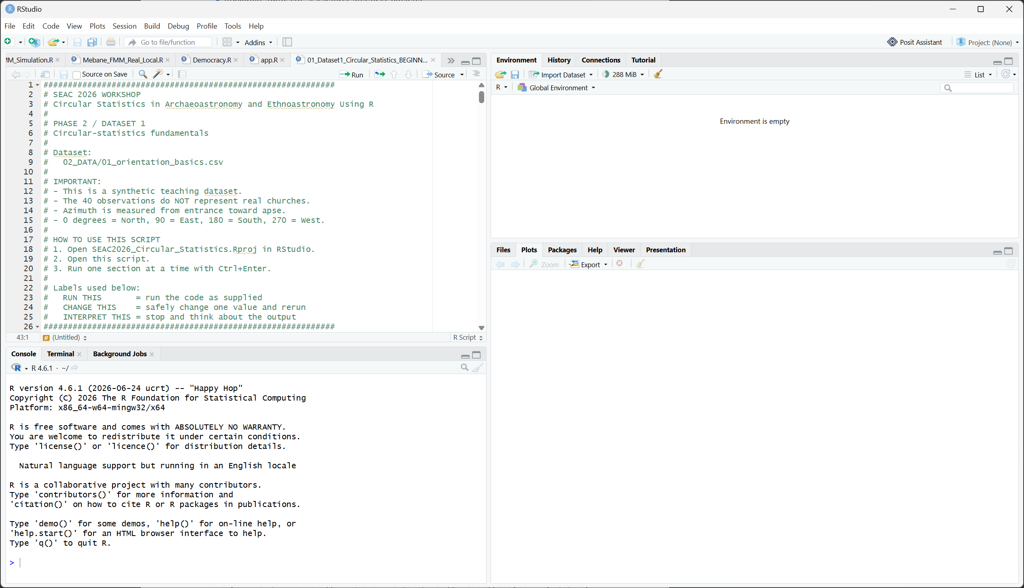
PRACTICAL SETUP
RStudio panes you will use
Source
Data info
Console
Files & Plots
Opening and workflow
5

Slide 6
HOW TO WORK
The three labels in every script
RUN THIS
Execute the block as supplied. Do not rewrite it.
CHANGE THIS
A safe parameter for guided experimentation.
INTERPRET THIS
Stop and explain the result in research language.
A good workshop answer is usually a sentence about evidence and limits, not another line of code.
Opening and workflow
6
Notes:
The three labels are a safety mechanism. They tell participants when to execute code, when it is methodologically safe to change a parameter, and when they should stop coding and describe what the output means.

Slide 7
01
Circular data: the minimum vocabulary
Why ordinary statistics can fail when the variable lives on a circle.
7

Slide 8
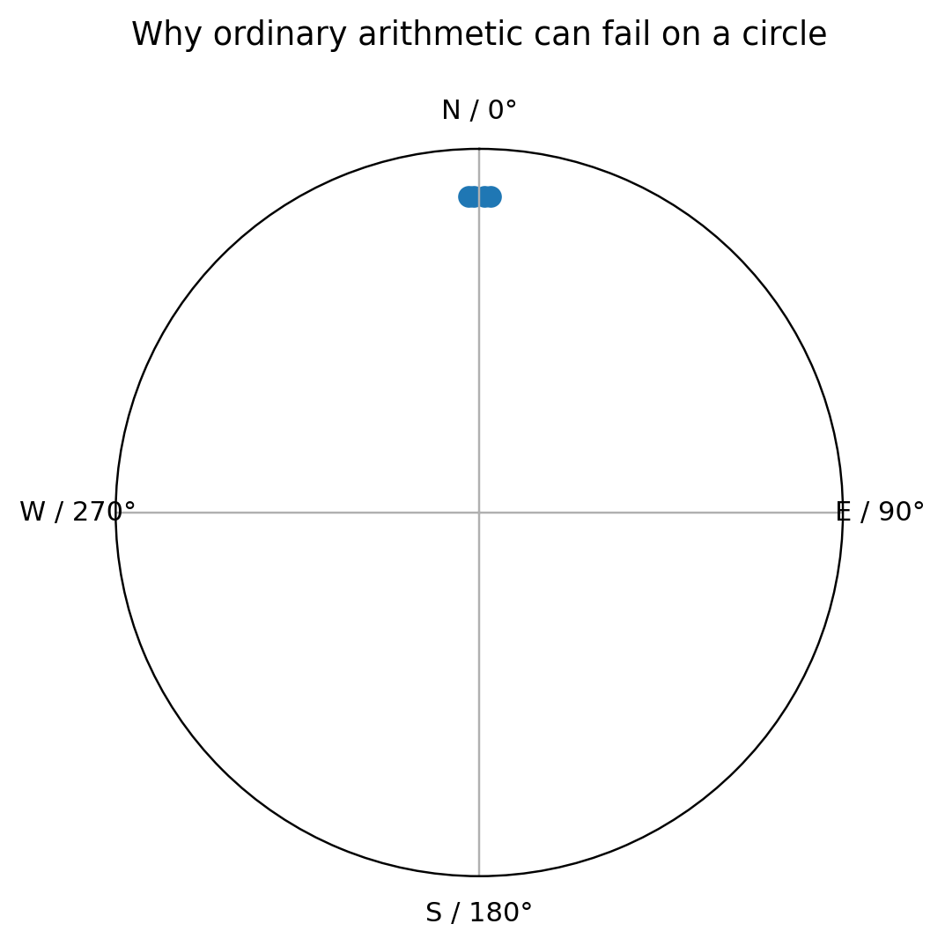
LINEAR VERSUS CIRCULAR
359° and 1° are neighbours
The ordinary arithmetic mean of:
358°, 359°, 1°, 2°
is 180° — pointing South.
But all observations cluster around North. The circular mean respects the joined 0/360 boundary.
Circular statistics encode the geometry of the variable.
Circular-statistics fundamentals
8
Notes:
The key idea is that angles are positions on a circle, not ordinary numbers on an open line. The values 359° and 1° are only two degrees apart, even though their arithmetic difference appears to be 358°. Circular methods preserve this neighbourhood relationship.

Slide 9
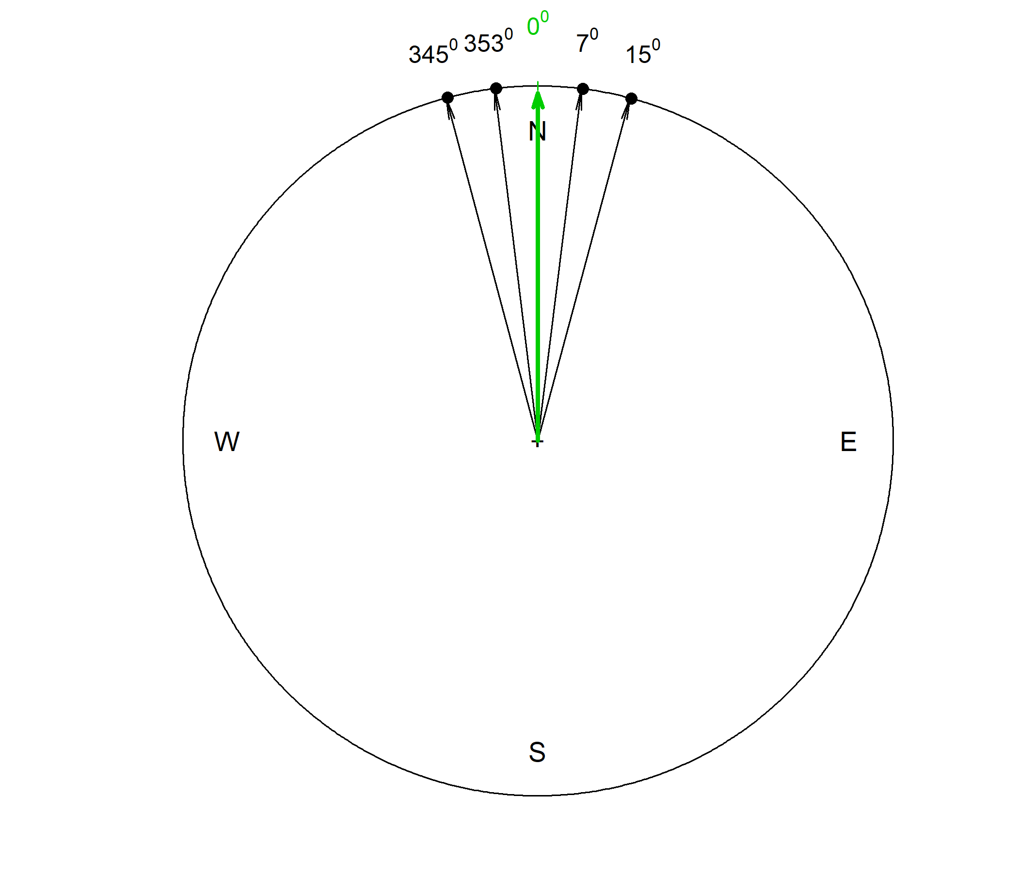
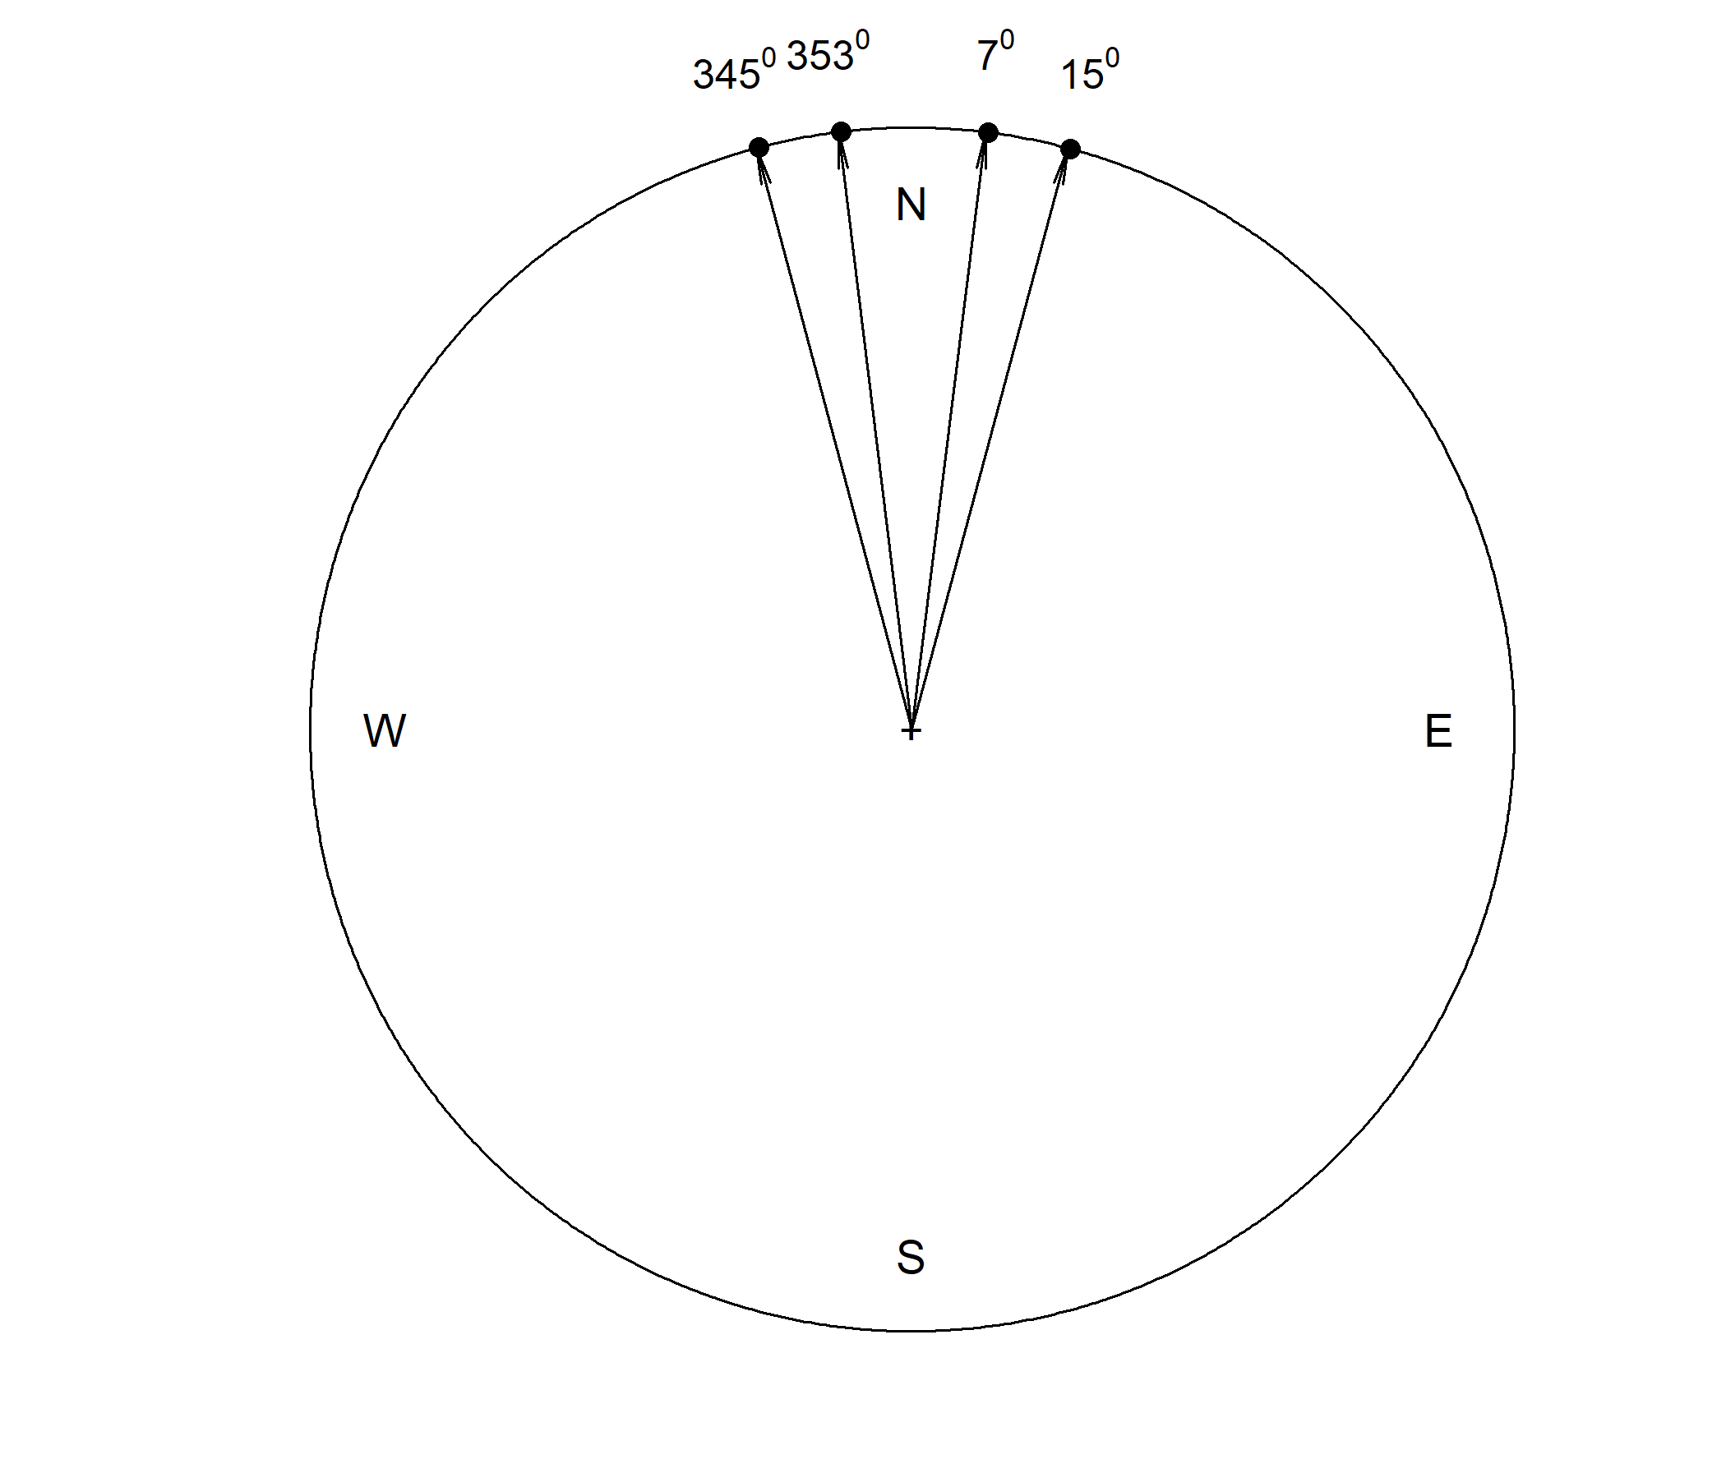
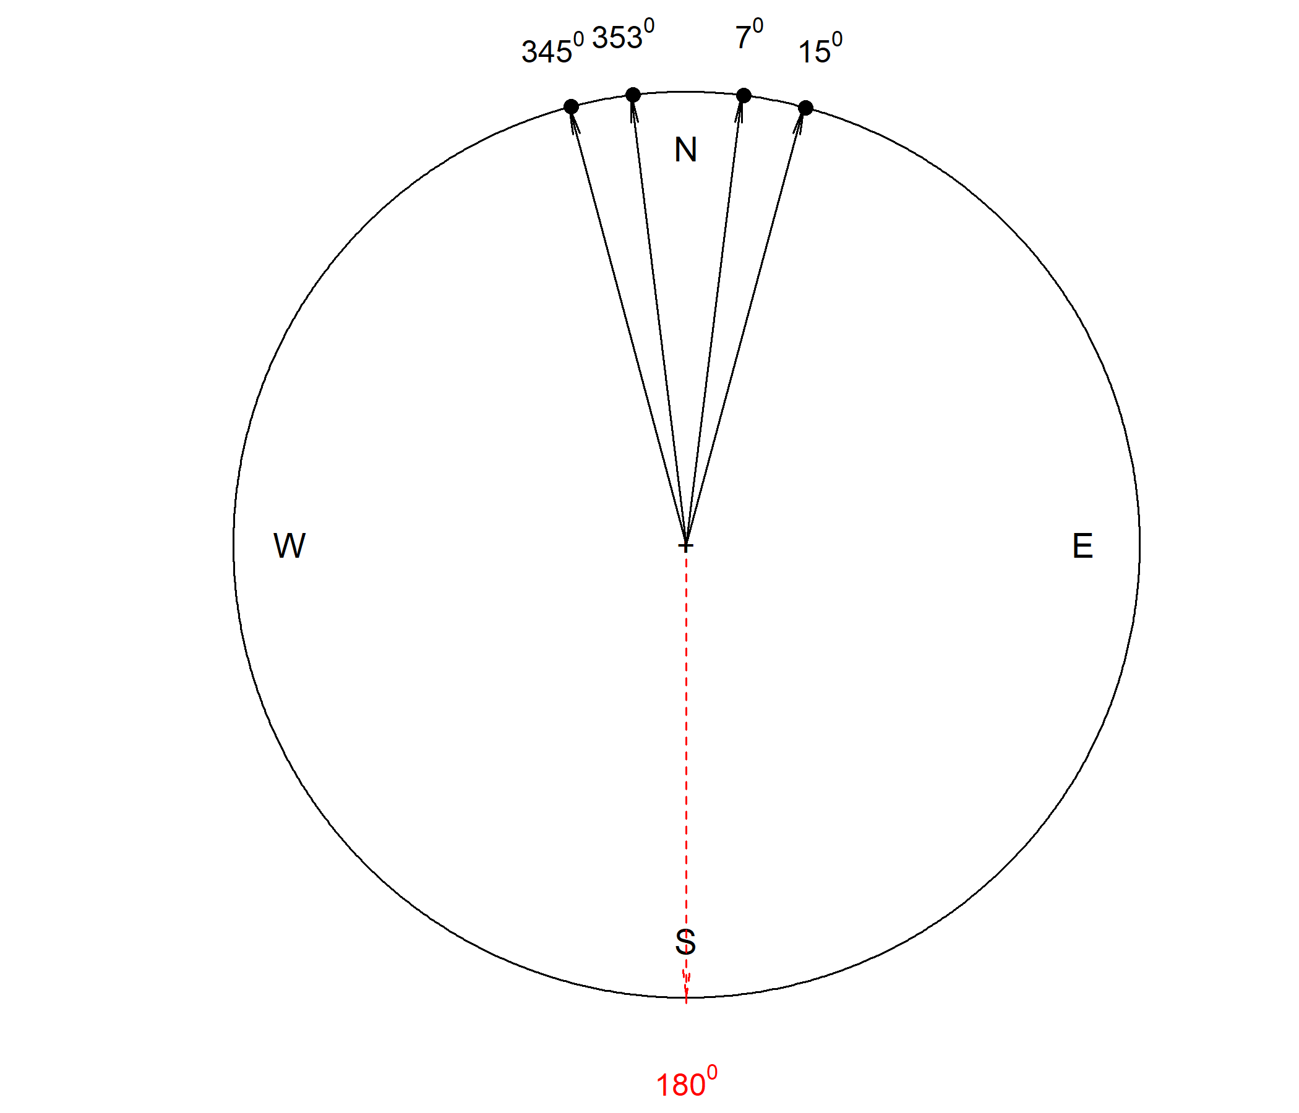
LINEAR VERSUS CIRCULAR
Four observations near North
The circular mean follows the cluster.
Arithmetic average fails here.
Circular-statistics fundamentals
9

Slide 10
FIRST METHODOLOGICAL FORK
Directional data are not the same as axial data
Directional
Axial
A meaningful arrow
entrance → apse
90° ≠ 270°
No meaningful arrow
axis only
20° = 200°
For Dataset 1, we define church orientation as entrance → apse, so it is directional.
Circular-statistics fundamentals
10
Notes:
Before choosing a statistical method, decide whether the direction of the arrow has substantive meaning. If reversing the arrow changes the meaning, the data are directional. If only the underlying line or axis matters, the data are axial and require a different treatment. This treatment is explained in my book (a copy of the book is available with the workshop materials).

Slide 11
GEOGRAPHIC DIRECTIONS
The workshop azimuth convention
circular(azimuth_deg,
units = "degrees",
template = "geographics",
modulo = "2pi")
0°
North
90°
East
270°
West
circular(x, type = c("angles", "directions"),
units = c("radians", "degrees", "hours"),
template = c("none", "geographics", "clock12", "clock24"),
modulo = c("asis", "2pi", "pi"),
zero = 0, rotation = c("counter", "clock"), names)
180°
South
Angles increase clockwise. This matches normal geographic azimuths.
Circular-statistics fundamentals
11
Notes:
The geographic convention matters because different software and disciplines sometimes use different angular conventions. In this workshop we use geographic azimuth: North is zero degrees and angles increase clockwise.

Slide 12
STATISTICAL WORKFLOW
Plot first, test second
Before a p-value, ask what kind of circular pattern you are seeing.
unimodal
bimodal
multimodal
almost uniform
few isolated observations
near 0/360 boundary
rose.diag(az, bins = 18, radii.scale = "sqrt")
If a visual feature exists only under one convenient display choice, be cautious.
Circular-statistics fundamentals
12
Notes:
The plot-first rule is a diagnostic rule. The same p-value can be misleading if the visual pattern is bimodal, multimodal, near-uniform, or dominated by a few outlying observations.

Slide 13
DESCRIPTIVE STATISTICS
Mean direction: average arrows, not average numbers
Conceptually: put one unit arrow at each direction, add the arrows, then read the direction of the resultant.
mean_direction_deg <- as.numeric(mean(az)) %% 360
Caution: A single mean can be misleading for bimodal or multimodal data.
Circular-statistics fundamentals
13

Slide 14
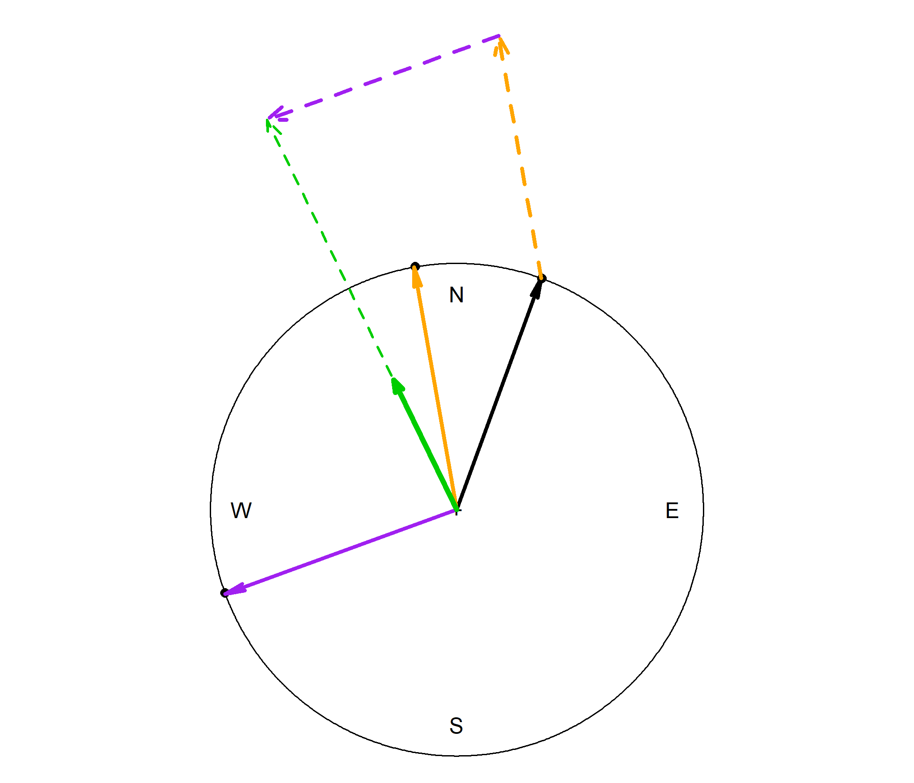
MEAN DIRECTION
Average the arrows, not the numbers
Add arrows → resultant vector
Each observation becomes a unit arrow
Read the resultant angle as the mean direction
Takeaway: direction is averaged geometrically.
Circular-statistics fundamentals
14

Slide 15
R-BAR, VARIANCE, SD
How concentrated are the directions?
R-bar
rho.circular(az)
near 1 = strong net concentration
Circular variance
1 - Rbar
near 0 = strong concentration
Circular SD
sd(az) × 180 / π
angular spread; convert radians → degrees
Do not use arbitrary universal cut-offs. Interpret concentration in context.
Circular-statistics fundamentals
15
Notes:
R-bar measures the length of the average resultant vector. It is large when the observations point in a similar direction and small when they cancel one another. Circular variance is simply 1-bar R, so the two measures describe concentration from opposite perspectives.

Slide 16
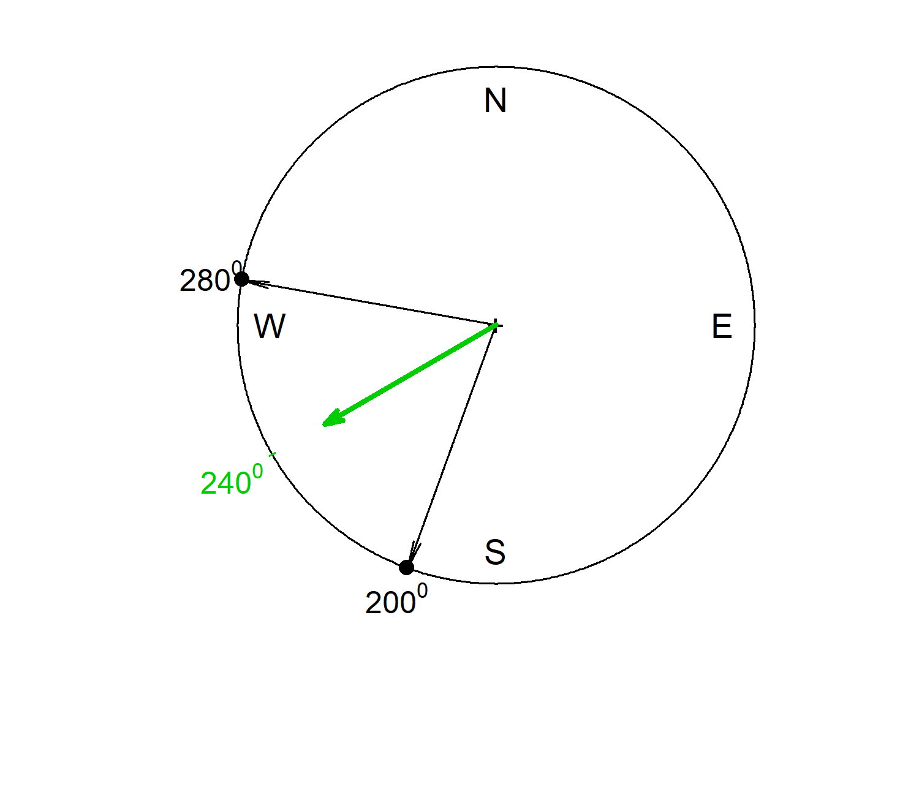
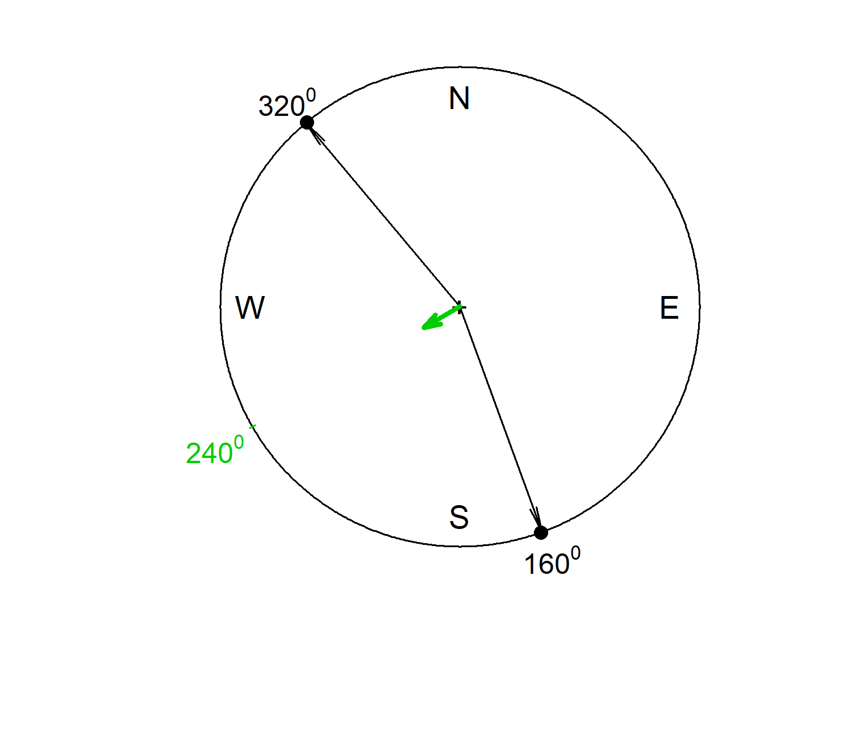
R-BAR, VARIANCE AND SD
Same mean direction, different concentration
Small variance
Large variance
larger R-bar · smaller circular variance · smaller circular SD
smaller R-bar · larger circular variance · larger circular SD
Circular-statistics fundamentals
16

Slide 17
CIRCULAR INFERENCE
Rayleigh test: useful, but not universal
Decision rule before using Rayleigh
H₀: directions are uniformly distributed around the circle.
Plot the data
H₁: a unimodal preferred direction exists.
Is the pattern approximately unimodal?
Yes
No
rayleigh_result <- rayleigh.test(az)
rayleigh_z <- n * Rbar^2
Rayleigh test may be informative
Inspect groups, modes or other methods
A non-significant p-value does not prove uniformity.
Circular-statistics fundamentals
17
Notes:
Rayleigh’s test is most useful when we have a plausible unimodal concentration around one preferred direction. It is not a general-purpose test for every non-uniform circular distribution. Always inspect the plot before interpreting the p-value.
Use the decision diagram before showing the code. Rayleigh is most informative for an approximately unimodal preferred direction. When the plot suggests multiple modes or subgroups, inspect that structure first.

Slide 18
02
Dataset 1: circular-statistics fundamentals
Synthetic Orthodox-church orientations: from rose diagram to Rayleigh reporting.
18

Slide 19
GUIDED EXERCISE
Dataset 1: church orientations
40 synthetic Orthodox churches. Direction is defined as:
Variables you use:
site_id
azimuth_deg
uncertainty_deg
period
setting
entrance → apse
The data are plausible, but fictional. Do not interpret them as real measurements.
Circular-statistics fundamentals
19

Slide 20
EXPECTED RESULTS
Dataset 1: what you should obtain
98.49°
Circular mean
0.941
R-bar
0.059
Circular variance
19.96°
Circular SD
35.43
Rayleigh z
< .001
Rayleigh p
The statistical pattern is clear: a strong non-uniform easterly/east-southeasterly concentration.
Circular-statistics fundamentals
20

Slide 21
MANUSCRIPT LANGUAGE
Reporting the result without overclaiming
The distribution of church orientations was significantly non-uniform, Rayleigh’s z = 35.43, p < .001. The mean direction was 98.49° (R-bar = .941, n = 40).
Then add an archaeological qualification:
The pattern is consistent with a strong directional preference, but interpretation requires chronology, building constraints, horizon context and cultural evidence.
Good statistical reporting separates:
observed pattern ≠ intentional astronomical target
Circular-statistics fundamentals
21

Slide 22
MODEL INTUITION
Optional extension: von Mises in one minute
Think “circular bell-shaped model”.
μ
central direction
κ
concentration around μ
fit <- mle.vonmises(az)
fit$mu
fit$kappa
A single von Mises model is not appropriate for every distribution. Plot first.
Circular-statistics fundamentals
22
Notes:
The von Mises distribution is often introduced as the circular analogue of a normal distribution. The parameter mu represents the central direction, while kappa controls concentration. A high value of kappa produces a narrow distribution; a low value produces a broad one.

Slide 23
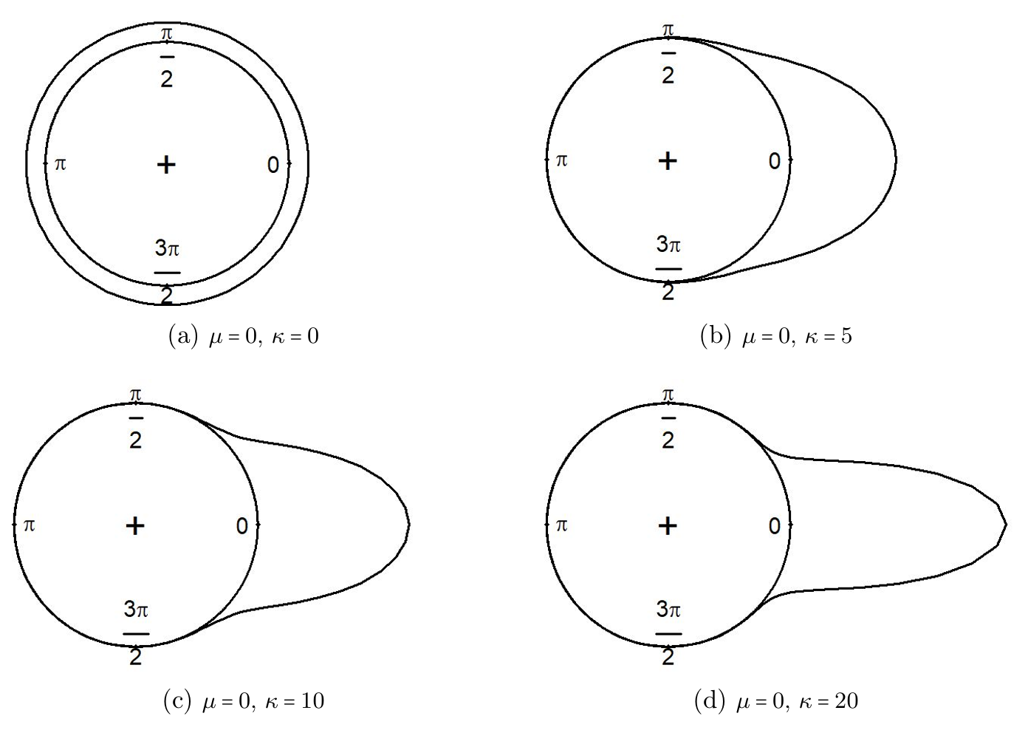
VON MISES INTUITION
Kappa controls concentration around μ
Zero κ is uniform; higher κ produces a narrower, taller distribution.
μ tells us where the distribution is centred; κ tells us how tightly it is concentrated.
Circular-statistics fundamentals
23

Slide 24
03
Curvigrams and sensitivity analysis
From reported uncertainty to a transparent curve, then from curve to defensible interpretation.
24

Slide 25
DECLINATION EXERCISE
From field measurement to curvigram
Dataset 2 starts with astronomical declination already calculated.
declination_deg
uncertainty_deg
We treat declination as linear over the analysed range, so the lesson can focus on smoothing and uncertainty.
uncertainty_deg = reported ± measurement uncertainty; not automatically one standard deviation.
Curvigrams and sensitivity analysis
25

Slide 26
ONE SENTENCE
What is a curvigram?
One measurement becomes one uncertainty-shaped contribution; the dataset becomes a curve.
1
Individual measurement
2
Measurement + uncertainty
3
Kernel contribution
4
Summed + area-normalised curve
reported value
± measurement uncertainty
kernel around value
compare features after sensitivity checks
Takeaway: a curvigram is a transparent smoothing-and-uncertainty display, not direct proof of intention.
Curvigrams and sensitivity analysis
26
Notes:
A curvigram does not treat every reported measurement as exact. Each observation contributes a smooth, uncertainty-shaped function, and the contributions are then combined. The resulting curve is descriptive and should be interpreted together with the uncertainty assumptions and sensitivity analysis.
Walk through the four panels slowly. One value becomes an uncertainty interval, the interval becomes a kernel contribution, and the sum of all contributions becomes the curvigram. The curve is descriptive and depends on kernel, bandwidth and normalization choices.

Slide 27
EPANECHNIKOV / GAUSSIAN
Kernel shape: compact versus smooth tails
Practical meaning:
Epanechnikov:
K(u) = 0.75 × (1 − u²), |u| ≤ 1
K(u) = 0 otherwise
Epanechnikov has finite support: outside the bandwidth window, the observation contributes nothing.
Gaussian:
K(u) = exp(−u² / 2) / √(2π)
Gaussian has tails: contribution fades but never becomes exactly zero.
Kernel choice is a method decision, not graph decoration.
Curvigrams and sensitivity analysis
27

Slide 28
SMOOTHING PARAMETER
Bandwidth: where uncertainty enters the curve
h_i = multiplier × uncertainty_i
multiplier 1
multiplier 2
multiplier 3
sharper
more detail
baseline
teaching setting
smoother
less detail
Multiplier 2 is a baseline for sensitivity analysis, not a universal optimum.
Curvigrams and sensitivity analysis
28

Slide 29
WHAT THE Y-AXIS MEANS
Vertical scale: area-normalised density
After summing all kernel contributions, we divide by the numerical area under the displayed curve.
area = ∫ S(x) dx
f(x) = S(x) / area
Result: the displayed curve has total area = 1.
This makes curves easier to compare across specifications and datasets of different sizes.
Curvigrams and sensitivity analysis
29

Slide 30
CURVIGRAM EXERCISE
Dataset 2: frozen baseline specification
Variable
declination_deg
Geometry
linear
Kernel
Epanechnikov
Bandwidth
2 × uncertainty_deg
Scaling
area = 1
Range / step
−45° to +45° / 0.05°
All sensitivity comparisons start from this baseline.
Curvigrams and sensitivity analysis
30
Notes:
This slide freezes the baseline. Emphasise that a baseline is not a claim of optimality; it is a reproducible starting point from which sensitivity analysis can proceed.

Slide 31
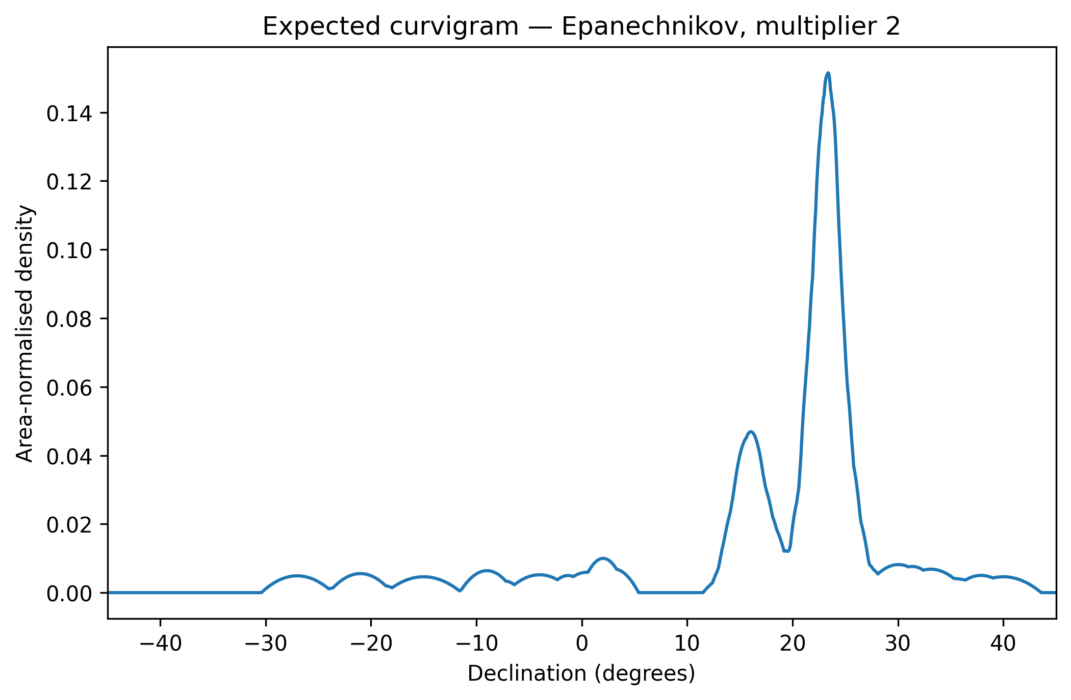
DATASET 2
Baseline curvigram: the first view
Start by asking:
• Where is the dominant feature?
• Is there a smaller shoulder/peak?
• Which small bumps deserve caution?
Do not attach an astronomical target before sensitivity checks and archaeological context.
Curvigrams and sensitivity analysis
31

Slide 32
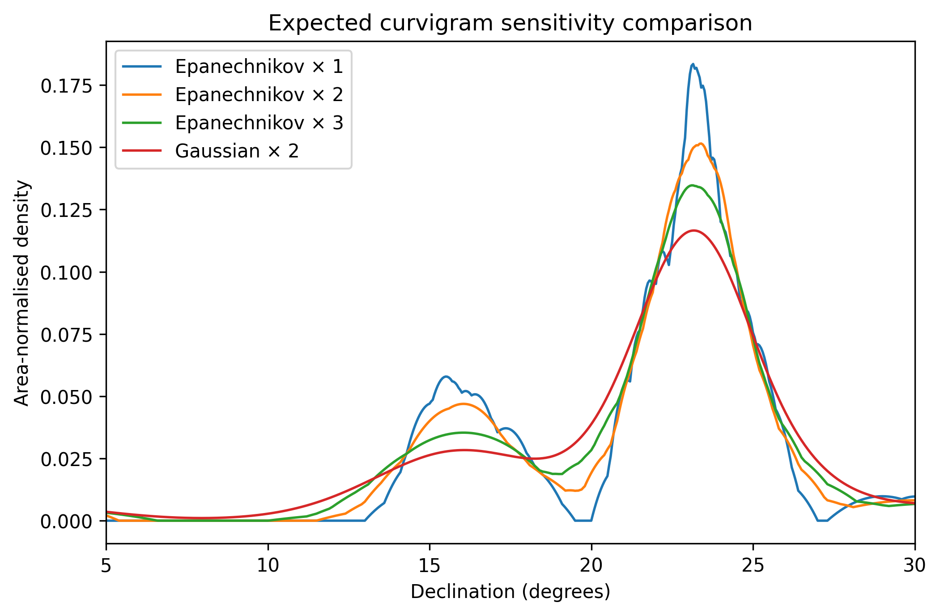
DATASET 2
Sensitivity analysis: compare reasonable choices
Epanechnikov × 1
Epanechnikov × 2
Epanechnikov × 3
Gaussian × 2
The dominant peak stays near +23°. The smaller +16° feature becomes less distinct.
Curvigrams and sensitivity analysis
32
Notes:
The purpose of sensitivity analysis is not to search for the most attractive graph. It is to determine which features remain visible under reasonable analytical choices. A feature that persists across kernels and bandwidths deserves more confidence than one that appears only under a single specification.

Slide 33
HOW TO INTERPRET
Robust feature versus smoothing-sensitive feature
Robust
Smoothing-sensitive
Visible under several reasonable specifications; location remains substantively stable.
Clear under light smoothing but becomes a shoulder, flattens or merges under broader smoothing.
Sensitivity analysis is descriptive robustness checking — not a formal significance test.
Curvigrams and sensitivity analysis
33

Slide 34
MINIMUM REPORTING STANDARD
Report enough detail to reproduce the curve
coordinate
geometry
kernel
bandwidth rule
uncertainty meaning
multiplier
scaling
range / step
sensitivity cases
A good methods paragraph is a reproducibility checklist.
Curvigrams and sensitivity analysis
34

Slide 35
REPRODUCIBLE OUTPUT
Export results for a report or manuscript
PNG
CSV
DOCX
300 / 600 dpi figures
calculated curves
formatted tables + text
ggsave(..., device = ragg::agg_png, dpi = 600)
read_docx() + flextable()
Curvigrams and sensitivity analysis
35

Slide 36
04
Comparison, AI assistance and takeaways
A final warning about pooled data, then tools for working independently after the workshop.
36

Slide 37
OPTIONAL / TAKE-HOME
Dataset 3: when pooling hides structure
N
Pooled sample:
R-bar = 0.007
Rayleigh p = .998
W
E
But the rose diagram is visibly bimodal — not genuinely uniform.
S
The problem is vector cancellation from two opposite traditions.
Pooled rose diagram
two opposite modes
Visual diagnosis: bimodal, not uniform.
Comparison, AI and takeaways
37
Notes:
The simplified rose diagram removes polar-grid decoration and focuses on the substantive message: the pooled distribution has two opposite modes, so the non-significant Rayleigh result should not be read as proof of uniformity.

Slide 38
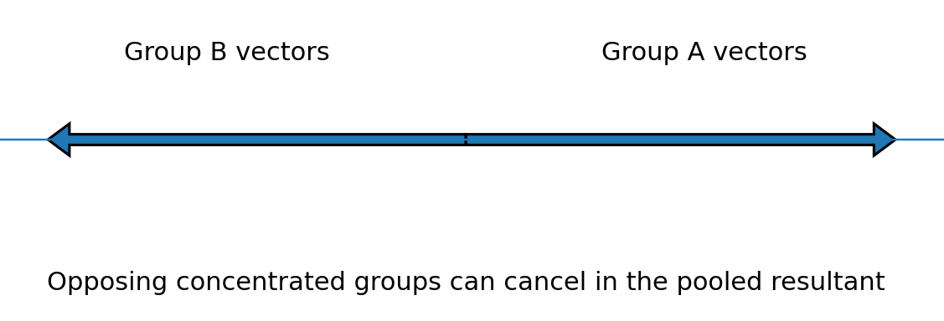
WHY RAYLEIGH CAN MISLEAD
Vector cancellation: two strong patterns can sum to almost zero
A non-significant Rayleigh test does not prove uniformity when the distribution is bimodal.
Always inspect the plot and the grouping structure before interpreting a test.
Comparison, AI and takeaways
38
Notes:
Opposing groups can cancel in the pooled resultant even when each subgroup is strongly concentrated. This is why a low R-bar or non-significant Rayleigh test in the pooled sample may conceal meaningful structure. Grouping and provenance are part of the analysis, not merely descriptive background.

Slide 39
SUBGROUP STRUCTURE
Separate the traditions before interpreting the test
N
N
N
W
E
W
E
W
E
S
S
S
Morning
Evening
Pooled
R-bar .992
R-bar .988
R-bar .007
Provenance and grouping can matter more than another p-value.
Comparison, AI and takeaways
39
Notes:
The subgroup rose diagrams show why provenance matters. Each subgroup is strongly concentrated, but the pooled resultant is almost zero because the two traditions point in opposite directions.

Slide 40
DECISION AID
Cookbook: which method should I use?
Typical direction?
circular mean
Concentration?
R-bar / circular variance
Unimodal non-uniformity?
Rayleigh test + plot
Uncertain declinations?
curvigram + sensitivity
Two traditions?
plot and summarise separately
Methods answer research questions. They do not replace archaeological reasoning.
Comparison, AI and takeaways
40
Notes:
The decision aid is a bridge from workshop examples to participant projects. Start with the research question, then choose the description or method that answers it; do not choose a method simply because it is available.

Slide 41
15-MINUTE DEMONSTRATION
AI as an R assistant: useful, but bounded
Use AI to adapt validated code — not to silently invent a new method.
Good use
change labels, font size, output file name
Good use
diagnose an exact error message
Good use
adapt column names in your CSV
Bad use
change kernel/bandwidth/test without noticing
Comparison, AI and takeaways
41

Slide 42
COPY, PASTE, CONSTRAIN
A safe AI prompt template
Here is my working R code and the exact error.
Explain the error to a non-programmer.
Make the smallest correction.
Do not change the statistical method, kernel, bandwidth,
normalisation, test or filtering.
AI may modify syntax. It must not silently modify methodology.
Before using an AI-edited script, compare the method settings against your original reporting checklist.
Comparison, AI and takeaways
42

Slide 43

AFTER THE WORKSHOP
Participant gift: Curvigram Explorer
A Shiny app for your own CSV data: upload, choose kernel and bandwidth, inspect sensitivity, export PNG/CSV/DOCX.
Live app link: https://bit.ly/curvigram-explorer
GiHub: https://github.com/MyStatisticalConsultant/curvigram-explorer
Use it after you understand what the parameters mean.
Comparison, AI and takeaways
43
Notes:
Reveal the app only after participants have seen the transparent calculation in R. The app is useful because they now understand what kernel, bandwidth, uncertainty and sensitivity mean.

Slide 44
TAKE-HOME PRACTICE
After the workshop: your reproducible workflow
1
Start with a clear research question
2
Check data type: linear, circular, directional or axial
3
Plot before testing
4
Run the appropriate script or app workflow
5
Do sensitivity checks
6
Export graph, table and method notes
Comparison, AI and takeaways
44

Slide 45
FINAL CAUTION
What not to claim
“The peak proves intentional astronomical alignment.”
Prefer:
“The analysis identifies a robust concentration near X°. Any astronomical interpretation requires independent archaeological and contextual support.”
Statistics strengthens interpretation by making assumptions visible, not by replacing interpretation.
Comparison, AI and takeaways
45
Notes:
Statistical evidence can identify a concentration, but it cannot by itself establish intention, astronomical knowledge, or cultural meaning. Those claims require independent archaeological, historical, environmental, and contextual evidence.

Slide 46
CLOSE
Final take-home messages
•
Circular data require circular geometry.
•
Plot first; test second.
•
Rayleigh is useful for unimodal concentration, not every pattern.
•
Curvigram peaks must survive sensitivity checks before serious interpretation.
•
Export and report every analytical choice.
Comparison, AI and takeaways
46

Slide 47
Questions and discussion
Bring your own orientation problem: what is the variable, what is the geometry, and what would count as a defensible conclusion?
SEAC 2026 Workshop | Zlatko J. Kovačić
Comparison, AI and takeaways
47

