Slide 1
MongoDB for Beginners
Updated March 2015

Slide 2
Version Log (hidden in ‘slide show’ mode)
Version | Changes | Author
001 | Created | Atanu Bir
002 | Applied 2015 Template, NGL principles, re-structured learning journey | (L&C Design Team)

Slide 3
Facilitator Name, Role
Name
Enter Name
Profile Pic
Role
Enter Role
Fun Photo
Office
<Enter location>
Unit
FS GBU
… at Work
Personal People Goals this year | …
Technology Areas of passion | Performance Differentiation Talent Review Strategy
Relevant Orgs/ Affiliations | NHRD, CII, NASSCOM
Areas of Expertise | HR Strategy Team Building Performance/Talent Management Employee Engagement & Relations
What qualities powered my success | - 4Ps : Passion, Positive, Purpose, People .
Challenges on the way up | Silo Working Lack of end to end ownership
Years with Capgemini | < Two
Before Capgemini | Reliance Industries Limited
… at Play
Hometown | Bangalore
Hobbies | Badminton Adventure travel
Dream Travel Destination | New Zealand - Adventure Travel
A few favorites… | My family My Mentor Einstein Any woman with a difference
Quote I live by | - Life is 10% what you make and 90% what you take
Little Known Fact | Tears roll down when I see emotional scenes … at times ☹
Preferred Comms Channels | Vijaya.g@capgemini.com
Fun Photo
Fun Photo
Fun Photo
Notes:
Speaker: Panelist/Facilitator. Alternate intro. Helps to make connections with the class.

Slide 4
Ground Rules for Onsite Classrooms
Everyone participates
Respect individual opinions and diversities
Be open and honest
Give headlines, be concise
One speaker at a time
Make language a non-issue
Stick to time contracts
Seek first to understand, and then to be understood
Clean desk / room policy
No mobile phone, no computer
Clients & Leadership are often here, please remember that
Maintain a spirit of fun and enthusiasm
Notes:
Best to print on an A3 sheet and display in class. The idea is to co-create, to connect to learn, to do-learn-do (knowing is not enough, the real purpose is to apply what we learn on the job). It would also be great to have the class share their learning with their teams. You are the facilitator, you will help all share knowledge and learn new concepts or skills, there will be no lectures, everyone is a teacher.

Slide 5

Ground Rules for Virtual Classrooms
Everyone participates (respond to whiteboards, polls, surveys, quizzes, chat boxes, ask questions, share experiences and opinions).
We will respect individual opinions and diversities.
We’ll be open and honest.
We’ll give headlines, be concise.
One speaker at a time.
We’ll stick to time contracts.
Don’t get distracted by emails.
Hang up if you need to attend to an urgent phone call, we will all be on hold if you try to juggle calls!!
We’ll maintain a spirit of fun and enthusiasm.
Notes:
Show this slide and hide the one for onsite classrooms, if this is a virtual session.

Slide 6
Module at a glance
Target Audience: | Consultant, Sr. Consultant and Lead Consultant
Course Level: | Beginner
Duration (in hours): | 16
Pre-requisites, if any: | Database Knowledge
Post-requisites, if any: | Submit Session Feedback, Complete follow-up sessions
Relevant Certifications: | MongoDB Certified Developer Associated Level
Practice: | TDI / Insights and Data

Slide 7
Agenda
1
Philosophy & Features
2
Data Modeling
3
CRUD (Create, Read, Update and Delete)
4
Indexing
5
GridFS
8
Sharding
7
Replication
6
Aggregation
Note: Few contents are from MongoDB tutorial document

Slide 8

Introductions for Face-to-Face Classroom
In teams of 2, please spend 2 minutes on getting to know your neighbor’s:
Name
Account/Project
Favorite DBA dream
What they want to take-away from the class today
Notes:
Have the class pair up and complete the exercise in exactly 2 mins. Then, have them introduce their neighbor. If there are an odd no. of participants, the facilitator pairs up with the odd participant. Explain this is a good way to get to know others and their interests (beyond work time) and ensures we listen better to what they have to say through the class. Also, shows others they are valued.
Time on clock: 5 minutes past start time

Slide 9
Introductions for Virtual Classroom: Poll 1
What is your level of knowledge/skill wrt MongoDB?
Baseline, that’s why I’m here
Progressing, need to learn more
Master!
Mongo-what?? My Staffing Manager insisted I attend…
Proficient, want to prepare to facilitate
Notes:
Have the class pair up and complete the exercise in exactly 2 mins. Then, have them introduce their neighbor. If there are an odd no. of participants, the facilitator pairs up with the odd participant. Explain this is a good way to get to know others and their interests (beyond work time) and ensures we listen better to what they have to say through the class. Also, shows others they are valued.
Time on clock: 5 minutes past start time

Slide 10
Objectives
Business Objectives/Purpose
<Please elaborate why we want to invest in MongoDB training, what are the business drivers and benefits of training employees in MongoDB..>
<What will learners be able to ‘do’ (not just LEARN)
Performance Objectives/Products
At the end of this session, we will be able to:
Notes:
Time on clock: 6 minutes past start time.
After you’ve shared objectives, please ask the class to share their goals, if they have anything in addition to those mentioned on the slide.
Important: Have the Operations Team send out slide 5-8 with the invite. You will save a lot of time in class otherwise spent in going through the works.

Slide 11
Process (Face-to-Face Classroom)
A facilitated class
Examples and exercises
Energizers and games
Hand-outs and references to use on the job and to refresh our learning
A participant feedback form to understand what went well, what could be better
Project/supervisor feedback after 90 days to assess how you applied your learning on the job
Notes:
Time on clock: 8 minutes past start time

Slide 12
Process (Virtual Classroom)
A virtually facilitated class
Examples and exercises
Whiteboards and polls
Hand-outs and references to use on the job and to refresh our learning
A participant feedback form to understand what went well, what could be better
Project/supervisor feedback after 90 days to assess how you applied your learning on the job
Notes:
Time on clock: 8 minutes past start time

Slide 13
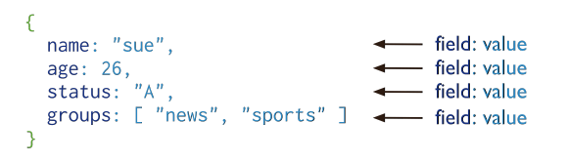
Philosophy
What is MongoDB?
MongoDB is an open-source document database that provides high performance, high availability, and automatic scaling
What is a ‘Record’?
The following shows how MongoDB stores data called as Document:
Record in MongoDB is a Document, which is a data structure composed of field and value pairs. MongoDB Documents are similar to JSON objects. The values of fields may include other documents, arrays, and arrays of documents.

Slide 14
Philosophy
MongoDB instance can have more than one databases.
Database can have more than one Collections.
Collection is related to Table in RDBMS.
Database Collections can have more than one Documents:
Documents are related to Records in RDBMS.
Documents in the same Collection can have different fields.
Documents can be embed in document for detailed data.
Document have default _id column used as Primary Key.
Document can may have one or more fields.
MongoDB also uses Indexes as we have in RDBMS.

Slide 15
Features
High Performance
MongoDB provides high performance data persistence. In particular:
High Availability
To provide high availability, MongoDB’s replication facility, called replica sets, provide:
Automatic Scaling
MongoDB provides horizontal scalability as part of its core functionality.
Support for embedded data models reduces I/O activity on database system.
Indexes support faster queries and can include keys from embedded documents and arrays.
Automatic Failover
Data Redundancy
Replica set is a group of MongoDB servers that maintain the same data set, providing redundancy and increasing data availability.
Automatic sharding distributes data across a cluster of machines.
Replica sets can provide eventually-consistent reads for low-latency high throughput deployments.

Slide 16
RDBMS Features not in MongoDB
In MongoDB data is not stored in Table and Columns format.
Join cannot be used in MongoDB.
Multiple collections cannot be updated using single update command in MongoDB.
Subquery option is not available in MongoDB.
Writing SQL using aggregate functions is not simple in MongoDB as in RDBMS.

Slide 17
Data Modeling
MongoDB is schema less has a flexible schema. Collections do not enforce document structure.
MongoDB store data in JSON-style. The documents stored in the database can have varying sets of fields, with different types for each field.
Following is example of MongoDB collection:
Employee Collection
{_id : 20011, ename: {fname: Ajay, lastname: Dubey}, salary: 12200}
{_id : 20012, ename: {fname: Amir, lastname: Khan}, location: Pune, salary: 16500}
{_id : 20013, ename: “Raj Chauhan”, Dept: BIM, salary: 19800}
MongoDB use these relationships: References and Embedded documents to define data models.

Slide 18
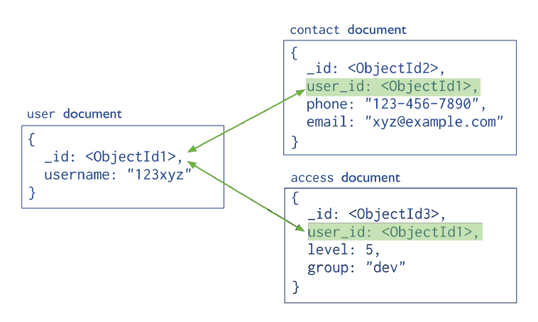
Reference Document
References store the relationships between data by including links or references from one document to another. This is related to Normalized data model like we do in RDBMS.

Slide 19
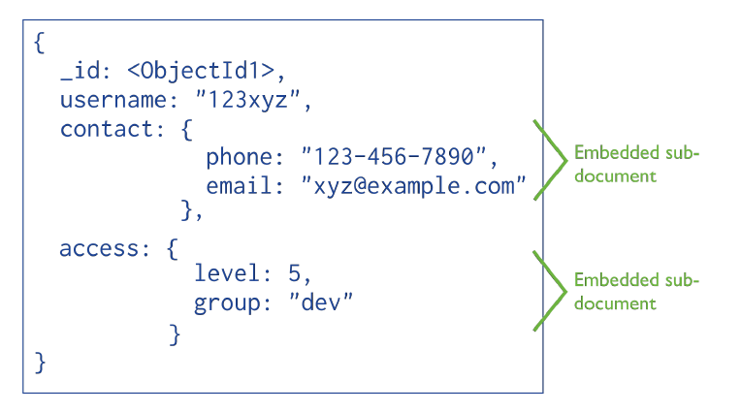
Embedded Document
Embedded documents capture relationships between data by storing related data in a single document structure. MongoDB documents make it possible to embed document structures in a field or array within a document. This is un-normalized data model.

Slide 20
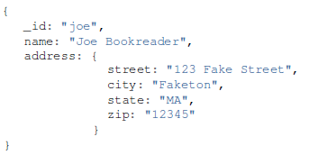
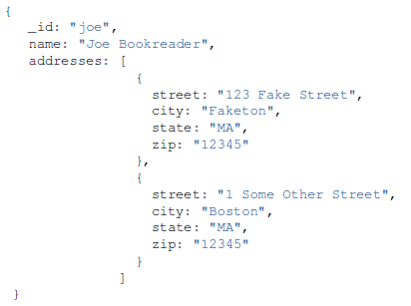
Model Relationships Between Documents
Model One-to-One Relationships with Embedded Documents.
Model One-to-Many Relationships with Embedded Documents.

Slide 21
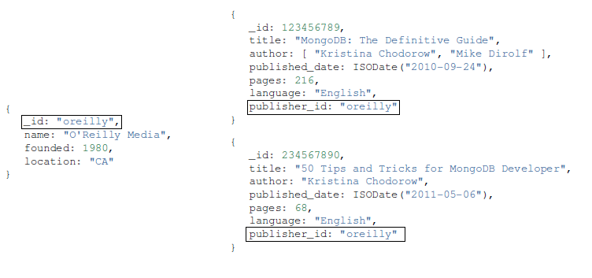
Model Relationships Between Documents …..
Model One-to-Many Relationships with Document References.
Note: MongoDB also support Model Tree Structures with Nested Sets presents a data model that organizes documents in a tree-like structure using the Nested Sets pattern. Refer MongoDB documentation.

Slide 22
CRUD
MongoDB provides rich semantics for reading and manipulating data. CRUD stands for create, read, update, and delete.
Create
db.collection.insert( <document> )
db.collection.save( <document> )
db.collection.update( <query>, <update>, { upsert: true } )
Read
db.collection.find( <query>, <projection> )
db.collection.findOne( <query>, <projection> )
Update
db.collection.update( <query>, <update>, <options> )
Delete
db.collection.remove( <query>, <justOne> )

Slide 23
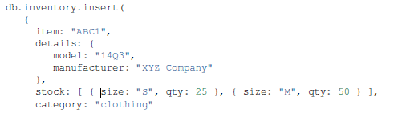
Create
Insert a document into a collection named inventory. The operation will create the collection if the collection does not currently exist.
The operation returns a WriteResult object with the status of the operation. A successful insert of the document returns the following object:
The nInserted field specifies the number of documents inserted. If the operation encounters an error, the WriteResult object will contain the error information.

Slide 24
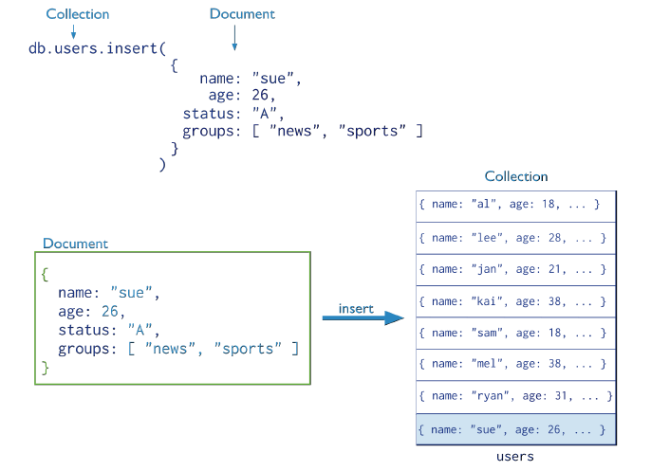
Create …..

Slide 25
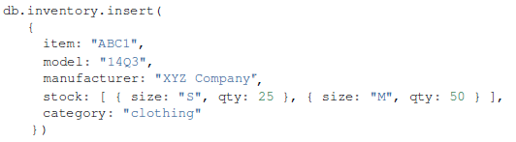
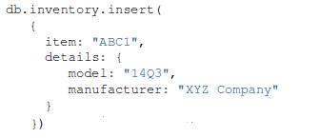
Create (contd.)
Array Documents
Embedded Document

Slide 26
Create (contd.)
use databasename will switch to database or create if not exists
db.dropDatabase()
db.createCollection("mycollection") -- command to create collections
db.emp.insert ({empname:”Raju”}) – Emp is the collection name and if it don’t exists then MongoDB create the Emp collection
show collections will show all collections in database
db.emp.insert ({empname:”Raju”}) This operation do not explicitly specify a value for the _id field, so mongo create a unique ObjectId value for the field before inserting it into the collection
db.emp.insert ({_id: 2010,empname:”Raju”}) This operation explicitly specify a value for the _id field, so mongo don’t create a unique ObjectId value and use 2010 as _id value
_id value is unique within a Collection

Slide 27
Read
In MongoDB, the db.collection.find() method retrieves documents from a collection. The db.collection.find() method returns a cursor to the retrieved documents.
The db.collection.findOne() method also performs a read operation to return a single document. Internally, the db.collection.findOne() method is the db.collection.find() method with a limit of 1.
Select All Documents in a Collection
Specify Equality Condition
Specify Conditions Using Query Operators

Slide 28
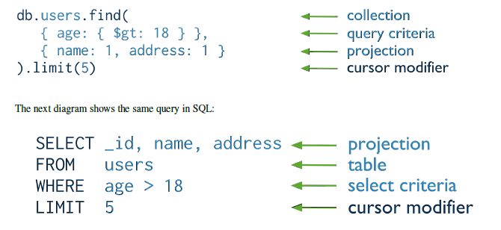

Read (contd.)

Slide 29
Read Examples
find() is act as cursor where as findOne() don‘t
find() display only 20 results
find() cursor close default in 10mins
db.emp.find().pretty() format the result in readable format
db.emp.find({deptno:[10,20,30]}) -- this will display exact match of array
db.emp.find({$or :[{deptno:10},{deptno:20}]}) -- OR command
db.foo.find({$and :[{deptno:20},{salary:2000}]}) -- AND command
db.foo.find().pretty().sort({a:-1}) sort data in descending
db.foo.find().pretty().sort({a:1}) sort data in ascending
db.bios.find().skip( 5 ) skips the first 5 documents, must apply cursor.skip() to the cursor before retrieving any documents from the database
db.emp.find().limit( 5 ) this apply on a cursor to specify the maximum number of documents the cursor will return
Operators available [$lt, $ne, $and, $or, $gt, $lt, $exists. $lte, $regex, $inc]

Slide 30
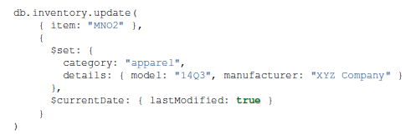
Update
MongoDB provides the update() method to update the documents of a collection. The method accepts as its parameters:
An update conditions document to match the documents to update,
An update operations document to specify the modification to perform, and
An options document.
To change a field value, MongoDB provides update operator $set to modify values.
To specify the update condition, use the same structure and syntax as the query conditions.
By default, update() updates a single document. To update multiple documents, use the multi option.
The update operation returns a WriteResult object which contains the status of the operation. A successful update
of the document returns the following object:
WriteResult({ "nMatched" : 1, "nUpserted" : 0, "nModified" : 1 })
The nMatched field specifies the number of existing documents matched for the update, and nModified specifies the number of existing documents modified.

Slide 31
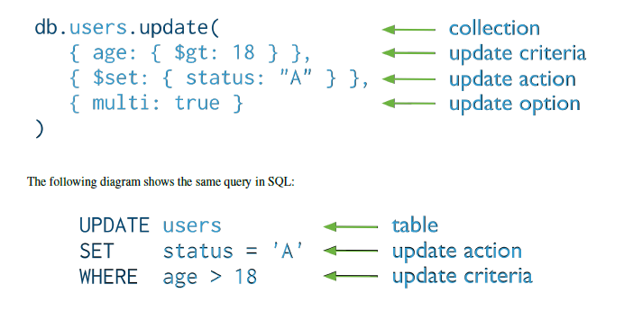
Update (contd.)

Slide 32

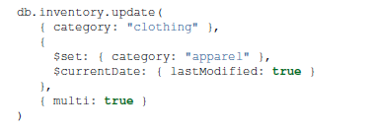
Update (contd.)
Update an embedded field
To update a field within an embedded document, use the dot notation. When using the dot notation, enclose the whole dotted field name in quotes.
Update multiple documents
By default, the update() method updates a single document. To update multiple documents, use the multi option in the update() method.

Slide 33
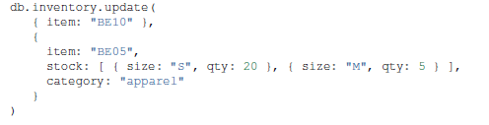
Update (contd.)
Replace a document
To replace the entire content of a document except for the _id field, pass an entirely new document as the second argument to update(). The replacement document can have different fields from the original document. In the replacement document, you can omit the _id field since the _id field is immutable. Here we don't use $set operator.
upsert Option
By default, if no document matches the update query, the update() method does nothing. However, by specifying upsert: true, the update() method either updates matching document or documents, or inserts a new document using the update specification if no matching document exists.

Slide 34
Update Examples …..
db.users.update({name:”Rajesh"},{$set:{name:”Rupesh"}}) $set is used to update only specific field
db.users.update({name:”Rajesh"},{name:”Rajesh"}) If $set is not used then it replace whole document with update condition
db.users.update({name:”Kumar"},{$inc:{age:2}}) to increment any numeric value of field
db.users.update({name:"Raju"},{$unset:{name:1}}) remove field from document
db.users.update({name:“Raju"},{$rename:{"age":"salary"}}) to rename any field
Update array value
db.emp.update({ename:”Raju"},{$addToSet:{Location:"Raipur"}}) will not add duplicate values
db.emp.update({ename:”Raju"},{$addToSet:{Location:{$each : ["Jaipur","Raipur"]}}}) add multiple values but no duplicates
db.emp.update({ename:”Raju"},{$pop: {Location:1}}) remove right value of array
db.emp.update({ename:”Raju"},{$pop: {Location:-1}}) remove left value of array
db.emp.update({ename:”Raju"},{$pull: {Location:"Raipur"}}) remove specific value from array
db.emp.update({ename:”Raju"},{$pullAll: {Location: ["Raipur","Delhi"]}}) will remove all value, allow multi value
db.emp.update({ename:”Raju"},{$push:{Location:"Raipur"}}) It work same as addToSet but allow duplicates and if you use array value then it add as array
db.emp.update({ename:”Raju"},{$pushAll:{Location:["Jaipur","Bhilai"]}}) add multiple value

Slide 35
Delete
In MongoDB, the db.collection.remove() method removes documents from a collection. You can remove all documents from a collection, remove all documents that match a condition, or limit the operation to remove just a single document.
To remove all documents from a collection, it may be more efficient to use the drop() method to drop the entire collection, including the indexes, and then recreate the collection and rebuild the indexes.
Remove Documents that Match a Condition
Remove a Single Document that Matches a Condition

Slide 36
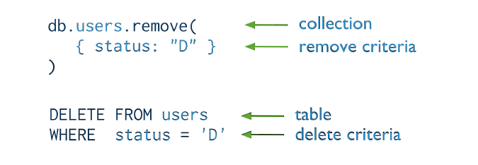
Delete (contd.)

Slide 37
Time for a Break!
Notes:
Time on clock: 55-60 minutes past start time

Slide 38
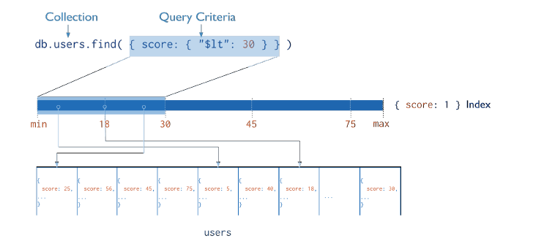
Index
Like RDBMS, MongoDB also has Indexes to provide high performance read operations for frequently used queries. MongoDB must scan every document in a collection to select those documents that match the query statement.
Indexes are special data structures that store a small portion of the collection’s data set in an easy to traverse form. The index stores the value of a specific field or set of fields, ordered by the value of the field.

Slide 39
Index (contd.)
MongoDB uses Indexes
Sorted Results
MongoDB can use indexes to return documents sorted by the index key directly from the index without requiring an additional sort phase.
An index is traversable for sorting in either direction (ascending or descending].
Covered Results
When the query criteria and the projection of a query include only the indexed fields, MongoDB will return results directly from the index without scanning any documents or bringing documents into memory. These covered queries can be very efficient.

Slide 40

Index (contd.)
We can create indexes on any field or embedded field within a document or embedded document. All indexes in MongoDB are B-tree indexes, which can efficiently support equality matches and range queries. Collection cannot have more than 64 indexes.
MongoDB indexes may be ascending, (i.e. 1) or descending (i.e. -1) in their ordering. Nevertheless, MongoDB may traverse the index in either direction. As a result, for single-field indexes, ascending and descending indexes are interchangeable. This is not the case for compound indexes: in compound indexes, the direction of the sort order can have a greater impact on the results.
MongoDB can use the intersection of indexes to fulfil queries with compound conditions.
By default, all collections have an index on the _id field, and applications and users may add additional indexes to support important queries and operations.

Slide 41
Types Of Indexes
Default _id
All MongoDB collections have an index on the _id field that exists by default. If applications do not specify a value for _id the driver or the mongod will create an _id field with an ObjectId value. The _id index is unique, and prevents clients from inserting two documents with the same value for the _id field.
Single Field
MongoDB supports user-defined indexes on a single field of a document.
Compound Index
MongoDB also supports user-defined indexes on multiple fields. These compound indexes behave like single-field indexes; however, the query can select documents based on additional fields. The order of fields listed in a compound index has significance. In compound index we can have max 31 fields
Multikey Index
MongoDB uses multikey indexes to index the content stored in arrays. MongoDB creates separate index entries for every element of the array. MongoDB automatically determines whether to create a multikey index if the indexed field contains an array value; we do not need to explicitly specify the multikey type.

Slide 42
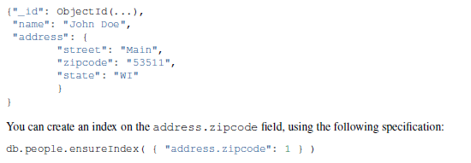
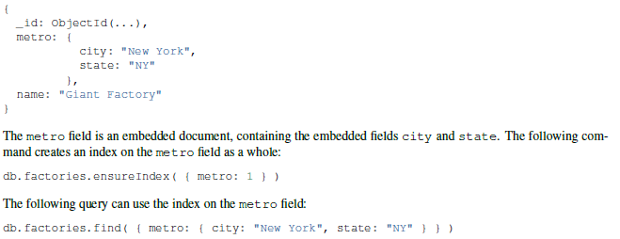
Types Of Indexes (contd.)
Indexes on Embedded Fields
We can create indexes on fields within embedded documents, just as single field index in documents. Indexes on embedded fields differ from indexes on embedded documents. indexes on embedded fields allow you to use a “dot notation,” to introspect into embedded documents.
Indexes on Embedded Documents

Slide 43
Types Of Indexes (contd.)
Geospatial Index
To support efficient queries of geospatial coordinate data, MongoDB provides two special indexes: 2d indexes that uses planar geometry when returning results and 2sphere indexes that use spherical geometry to return results.
Text Indexes
MongoDB provides a text index type that supports searching for string content in a collection. These text indexes do not store language-specific stop words (e.g. “the”, “a”, “or”) and stem the words in a collection to only store root words.
db.articles.ensureIndex( { subject: "text" } )
db.articles.find( { $text: { $search: "coffee" } } )
Hashed Indexes
To support hash based sharding, MongoDB provides a hashed index type, which indexes the
hash of the value of a field. These indexes have a more random distribution of values along their range, but only support equality matches and cannot support range-based queries.
Hashed indexes are not compatible with multi-key indexes.

Slide 44
Index Properties
Unique Indexes
The unique property for an index causes MongoDB to reject duplicate values for the indexed field. To create a unique index on a field that already has duplicate values.
Sparse Indexes
The sparse property of an index ensures that the index only contain entries for documents that have the indexed field. The index skips documents that do not have the indexed field. You can combine the sparse index option with the unique index option to reject documents that have duplicate values for a field but ignore documents that do not have the indexed key. If we create unique index on column of documents and it don’t exists in another documents then it will give error which will be taken care by sparse : true
TTL Indexes
TTL indexes are special indexes that MongoDB can use to automatically remove documents from a collection after a certain amount of time. This is ideal for certain types of information like machine generated event data, logs, and session information that only need to persist in a database for a finite amount of time.
Note : By default, creating an index blocks all other operations on a database. When building an index on a collection, the database that holds the collection is unavailable for read or write operations until the index build completes. Any operation that requires a read or write lock databases and will wait for the foreground index build to complete.

Slide 45
Explain Plan in MongoDB
Like in other RDBMS database, MongoDB also provide Explain Plan option to find query is doing full table scan or Index scan.
{
"cursor" : "BtreeCursor location_1",
"isMultiKey" : false,
"n" : 1,
"nscannedObjects" : 1,
"nscanned" : 1,
"nscannedObjectsAllPlans" : 1,
"nscannedAllPlans" : 1,
"scanAndOrder" : false,
"indexOnly" : false,
"nYields" : 0,
"nChunkSkips" : 0,
"millis" : 0,
"indexBounds" : {
"location" : [
[
null,
null
]
]
},
"server" : “MongoDB_BIM",
"filterSet" : false
}
n = no of document matches query selection criteria or query results
nscanned = indicate no of document mongodb scanned index entry
nscannedObjects = total number of documents scanned. when this is equal to nscanned then collection scan
indexOnly = true means that mongodb used only the index to match and return result of query

Slide 46
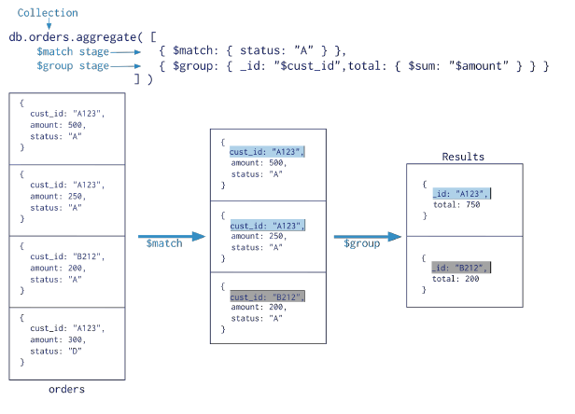
Agrregation
MongoDB 2.2 introduced a new aggregation framework, modeled on the concept of data processing pipelines. Documents enter a multi-stage pipeline that transforms the documents into an aggregated result.
The pipeline provides efficient data aggregation using native operations within MongoDB, and is the preferred method for data aggregation in MongoDB.

Slide 47
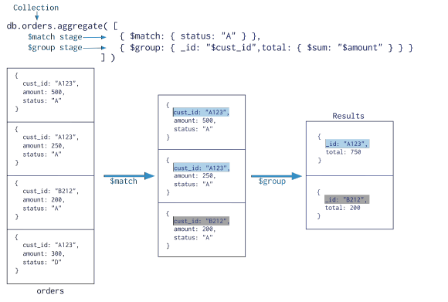
Aggregation Pipeline
The aggregation pipeline is a framework for data aggregation modeled on the concept of data processing pipelines. Documents enter a multi-stage pipeline that transforms the documents into an aggregated results. The MongoDB aggregation pipeline consists of stages. Each stage transforms the documents as they pass through the pipeline.

Slide 48
Stages in Aggregation Pipeline
$project: Used to select some specific fields from a collection.
$match: This is a filtering operation and thus this can reduce the amount of documents that are given as input to the next stage.
$group: This does the actual aggregation as discussed above.
$sort: Sorts the documents.
$skip: With this it is possible to skip forward in the list of documents for a given amount of documents.
$limit: This limits the amount of documents to look at by the given number starting from the current position.
$unwind: This is used to unwind document that are using arrays.

Slide 49
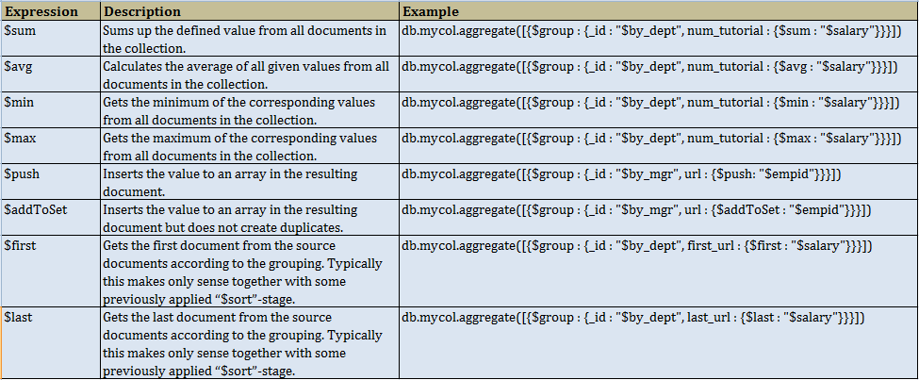
Aggregate Functions in MongoDB

Slide 50
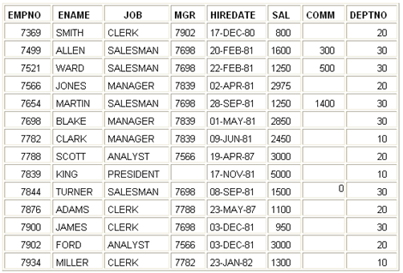
Examples of Aggregate in MongoDB
Below is very common table (EMP) that is available in Oracle database.

Slide 51
Examples of Aggregate in MongoDB (contd.)
Count employee by Job
db.emp.aggregate (
{ $group : {_id : "$job", total : { $sum : 1 }} }
);
The equivalent SQL
SELECT job, COUNT(empid) AS total FROM emp GROUP BY job
Count employee by Job and display count in descending order and return only two documents.
db.emp.aggregate (
{ $group : {_id : "$job", total : { $sum : 1 }} },
{ $sort : {total : -1} },
{ $limit : 2 }
);
Count employee of Job = 'CLERK'
db.emp.aggregate (
{ $match : {job : "CLERK"} },
{ $group : {_id : "$job", total : { $sum : 1 }} }
);

Slide 52
Examples of Aggregate in MongoDB (contd.)
db.emp.aggregate({$project:{dept:1,designation:1,salary:1,_id:0}},
{$match : {dept:10}},
{$group : {_id :{"Designation":"$designation"},empcnt:{$sum:1},sumsalary:{$sum:"$salary"}}},
{$match : {sumsalary: {$gte:10000}}})
db.emp.aggregate({$project :{dept:1,salary:1,_id:0}},
{$group : {_id:{"department":"$dept"},"sumsal":{$sum:"$salary"}}},
{$sort:{sumsal:1}},
{$group : {_id:"$_id.department","topsal":{$last:"$sumsal"}}})
db.emp.aggregate( {$match : {deptno : 20}},
{$project : {empid:1,deptno:1,salary:1,region:1}},
{$group : {_id :{"Deptno":"$deptno","Region":"$region"},empcnt:{$sum:1},avgsalary:{$avg:"$salary"}}},
{$group : {_id :{"Reg":"$_id.Region"},avgsal:{$avg:"$avgsalary"}}},
{$project : { _id:0,region_avgsalary : {region: "$_id.Reg", avgsal: "$avgsal"} }},
{$match : {avgsal: {$gte:5000}}},
{$sort : {avgsal:1}},
{$skip :1},
{$limit:2}
)

Slide 53
Replication
Replication provides redundancy and increases data availability. With multiple copies of data on different database servers, replication protects a database from the loss of a single server. Replication also allows to recover from hardware failure and service interruptions. With additional copies of the data, can dedicate one to disaster recovery, reporting, or backup.
In some cases, we can use replication to increase read capacity. Clients have the ability to send read and write operations to different servers. We can also maintain copies in different data centers to increase the locality and availability of data for distributed applications.
A replica set in MongoDB is a group of mongod processes that maintain the same data set. Replica sets provide redundancy and high availability, and are the basis for all production deployments.

Slide 54
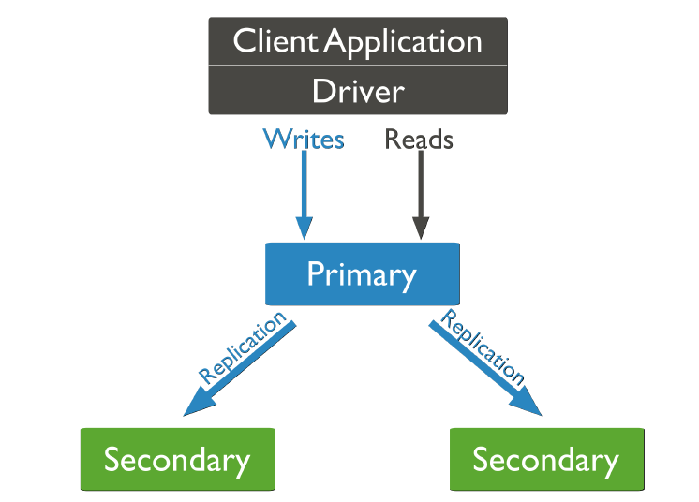
Replication in MongoDB
A replica set is a group of mongod instances that host the same data set. One mongod, the primary, receives all write operations. All other instances, secondaries, apply operations from the primary so that they have the same data set.
The primary accepts all write operations from clients. Replica set can have only one primary. Because only one member can accept write operations, replica sets provide strict consistency for all reads from the primary. To support replication, the primary logs all changes to its data sets in its oplog.

Slide 55
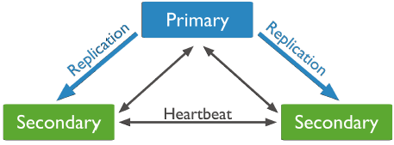
Replication in MongoDB (contd.)
The secondaries replicate the primary’s oplog and apply the operations to their data sets. Secondaries’ data sets reflect the primary’s data set. If the primary is unavailable, the replica set will elect a secondary to be primary.
By default,clients read from the primary, however, clients can specify a read preferences to send read operations to secondaries.

Slide 56
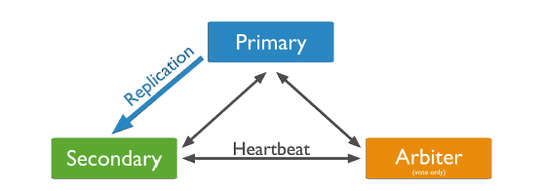
Replication in MongoDB (contd.)
We can add an extra mongod instance to a replica set as an arbiter. Arbiters do not maintain a data set. Arbiters only exist to vote in elections. If your replica set has an even number of members, add an arbiter to obtain a majority of votes in an election for primary. Arbiters do not require dedicated hardware.

Slide 57
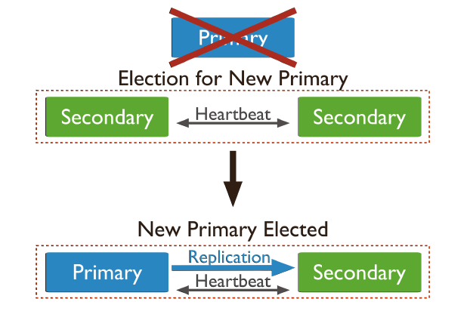
Replication in MongoDB (contd.)
Automatic Failover
When a primary does not communicate with the other members of the set for more than 10 seconds, the replica set will attempt to select another member to become the new primary. The first secondary that receives a majority of the votes becomes primary.

Slide 58
Replica Set Members
Primary: Receives all write operations.
Secondaries: Replicate operations from the primary to maintain an identical data set. Secondaries may have additional configurations for special usage profiles.
Arbiters: Do not keep a copy of the data. However, arbiters play a role in the elections that select a primary if the current primary is unavailable.
Priority 0 Replica Set Members: A priority 0 member is a secondary that cannot become primary. Priority 0 members cannot trigger elections. Otherwise these members function as normal secondaries. A priority 0 member maintains a copy of the data set, accepts read operations, and votes in elections. Configure a priority 0 member to prevent secondaries from becoming primary, which is particularly useful in multi-data center deployments. It can be used as standby.
Hidden Replica Set Members: A hidden member maintains a copy of the primary’s data set but is invisible to client applications. Hidden members are good for workloads with different usage patterns from the other members in the replica set. Hidden members must always be priority 0 members and so cannot become primary.
Delayed Replica Set Members: Delayed members contain copies of a replica set’s data set. However, a delayed member’s data set reflects an earlier,or delayed, state of the set. For example, if the current time is 09:52 and a member has a delay of an hour, the delayed member has no operation more recent than 08:52. It help to recover from various kinds of human error. For example, a delayed member can make it possible to recover from unsuccessful application upgrades and operator errors including dropped databases and collections.
A replica set can have up to 12 members. However, only 7 members can vote at a time. The minimum requirements for a replica set are: A primary, a secondary, and an arbiter.

Slide 59
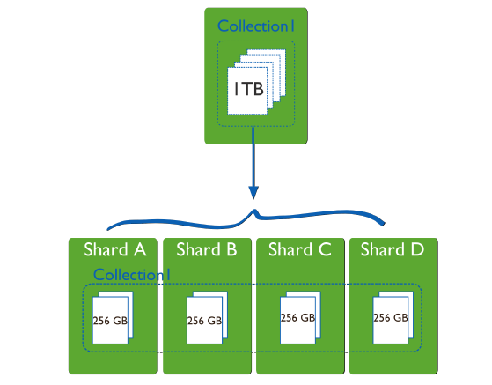
Sharding
Database systems with large data sets and high throughput applications can challenge the capacity of a single server. High query rates can exhaust the CPU capacity of the server. Larger data sets exceed the storage capacity of a single machine. Finally, working set sizes larger than the system’s RAM stress the I/O capacity of disk drives. To address these issues of scales, database systems have two basic approaches: vertical scaling and sharding.
Vertical scaling adds more CPU and storage resources to increase capacity. Scaling by adding capacity has limitations. high performance systems with large numbers of CPUs and large amount of RAM are disproportionately more expensive than smaller systems.
Sharding, or horizontal scaling, by contrast, divides the data set and distributes the data over multiple servers, or shards. Each shard is an independent database, and collectively, the shards make up a single logical database.

Slide 60
Sharding (contd.)
Sharding addresses the challenge of scaling to support high throughput and large data sets:
Sharding reduces the number of operations each shard handles. Each shard processes fewer operations as the cluster grows. As a result, a cluster can increase capacity and throughput horizontally.
For example, to insert data, the application only needs to access the shard responsible for that record.
Sharding reduces the amount of data that each server needs to store. Each shard stores less data as the cluster grows.
For example, if a database has a 1 terabyte data set, and there are 4 shards, then each shard might hold only 256GB of data. If there are 40 shards, then each shard might hold only 25GB of data.
Note: Sharding is the process of storing data records across multiple machines. As the size of the data increases, a single machine may not be sufficient to store the data nor provide an acceptable read and write throughput. Sharding solves the problem with horizontal scaling. With sharding, add more machines to support data growth and the demands of read and write operations.

Slide 61
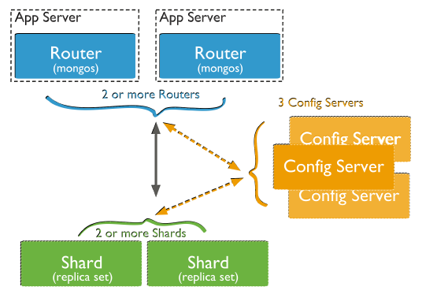
Sharding in MongoDB
Sharded cluster has the following components:
Shards store the data. To provide high availability and data consistency, in a production sharded cluster, each shard is a replica set
Query Routers, or mongos instances, interface with client applications and direct operations to the appropriate shard or shards. The query router processes and targets operations to shards and then returns results to the clients. A sharded cluster can contain more than one query router to divide the client request load. A client sends requests to one query router. Most sharded clusters have many query routers.
Config servers store the cluster’s metadata. This data contains a mapping of the cluster’s data set to the shards. The query router uses this metadata to target operations to specific shards. Production sharded clusters have exactly 3 config servers.

Slide 62
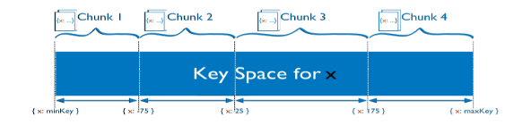
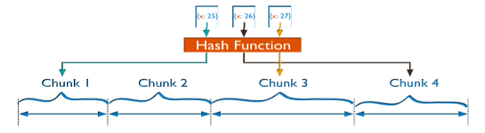
Data Partitioning
MongoDB distributes data, or shards, at the collection level. Sharding partitions a collection’s data by the shard key.A shard key is either an indexed field or an indexed compound field that exists in every document in the collection.
MongoDB divides the shard key values into chunks and distributes the chunks evenly across the shards. To divide the shard key values into chunks, MongoDB uses either range based partitioning or hash based partitioning.
Range Based Sharding: MongoDB divides the data set into ranges determined by the shard key values to provide range based partitioning.
Hash Based Sharding: MongoDB computes a hash of a field’s value, and then uses these hashes to create chunks.

Slide 63
GridFS
MongoDB provides GridFS specification for storing and retrieving files such as images, audio files, video files that exceed the BSON-document size limit of 16MB.
GridFS divides a file into parts, or chunks, and stores each of those chunks as a separate document.
By default GridFS limits chunk size to 255k.
GridFS uses two collections to store files:
fs.files
fs.chunks
When we query a GridFS store for a file, the driver or client will reassemble the chunks as needed.
We can also access information from arbitrary sections of files, which allows you to “skip” into the middle of a video or audio file.
GridFSCan store any types of file.

Slide 64


Adding Files in GridFS
run mongofiles exe from command prompt as shown below:
mongofiles.exe -d <database> -c <collection> -prefix <string> put <filename>
mongofiles.exe -d <database> get <filename>
mongofiles -d records list [to list lists in GridFS]

Slide 65
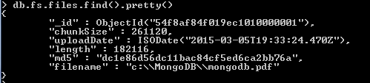
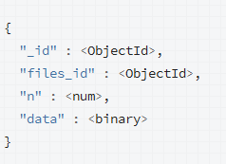
GridFS collections
Note: fs.chunks store binary data and querying this collection will return binary data of file.
Structure is shown right side.

Slide 66

Retrieving Files from GridFS
Run mongofiles exe from command prompt as shown below:
mongofiles.exe -d <database> get <filename>
Note: MongoDB copy file to same location from where it has copied. To copy to different location change the file location by renaming filename in fs.files collection.

Slide 67









MongoDB used by

Slide 68








NoSQL Products Available
Key-value
Graph database
Document-oriented
Column family

Slide 69
Appendix

Slide 70
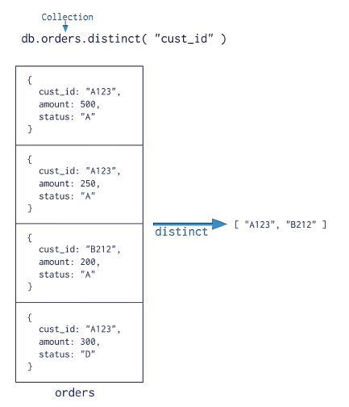
Appendix
Find Distinct value of a column

Slide 71
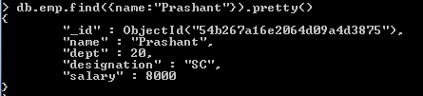
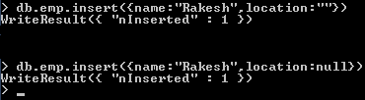
Appendix
Output without pretty() when used with find()
Output of pretty() when used with find()
Using Null value in MongoDB

Slide 72

Appendix
Document with Array
Unwind function used on array value of document

Slide 73
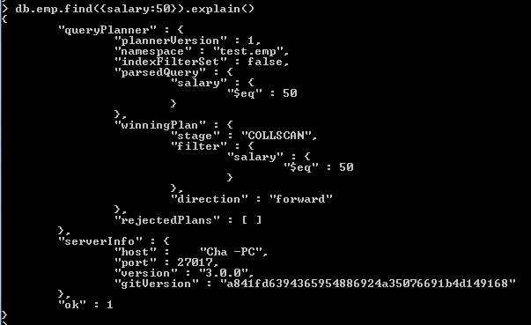
Appendix
Explain Plan with out Index in MongoDB 3.0

Slide 74
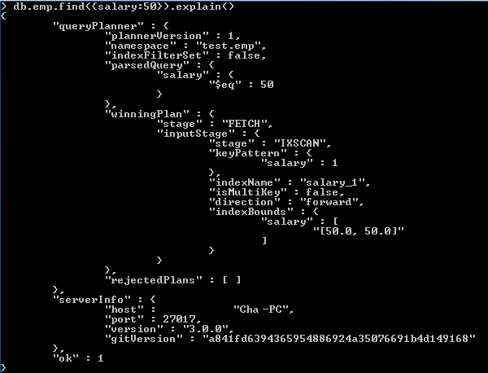
Appendix
Explain Plan with Index in MongoDB 3.0

Slide 75
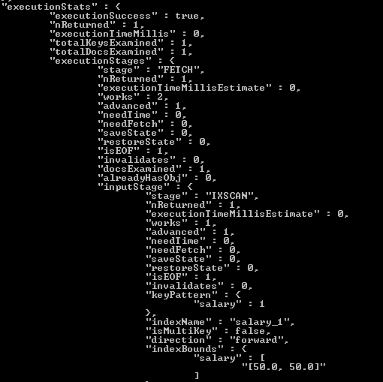
Appendix
Explain Plan with executionStats option in MongoDB 3.0.0 this is not provided in version 2.6.0
db.emp.find({salary:50}).explain("executionStats")

Slide 76
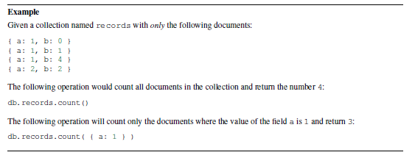
Appendix
Count documents in collection

Slide 77
Knowledge-Checks

Slide 78

Your Questions

Slide 79
References for you
Watch
<Youtube/other videos>
Read
<Tutorials, books, blogs, wikis, whitepapers etc>
Complete
<elearning from MyLearning/other open sources>

Slide 80
Key take-aways and Action Plans
What did I learn
What will I do differently
What benefits should I see
Notes:
The goals can be professional as well as personal. Give the class a few minutes to reflect and capture their plans.
Time on clock: 50 minutes past start time

Slide 81
Congratulations!
You’re now mongoDB Aware!

