Slide 1

From Noob To Game Developer
Overview Lecture
academy.zariba.com

Slide 2
Lecture Content
The Course
Lecturers
Modules Overview
How to study
What to expect

Slide 3
The Course
It’s FREE!
Highly competitive course in Game Development.
You do not need any programming knowledge.
By the end you will be able to make your own games.
2 times a week from 18:30 to 21:30 (sometimes later)
Additional Workshop on Saturday from 11:00 to 13:00
Successful candidates can start working at Zariba Group

Slide 4


Lecturer
Martin Antonov
Co-Founder and Game Designer at Fractal Games
Founder of YoYoBulgaria and EfreetYoYoCompany
Graduated Mathematics at the University of Warwick
Studied one year at the Telerik Software Academy
I like:
Tennis, yoyos, computer games (DOTA anyone?), snowboard, billiards, table football etc.

Slide 5
Modules Overview
There will be 5 modules
Intro to Programming with Games
OOP & Quality Code
Introduction to JavaScript
Making a Game with Phaser and TypeScript
Introduction to Unity3D and Algorithms

Slide 6

Modules Overview
Intro to Programming with Games
1. Introduction to Programming
2. Primitive Data Types
3. Operators and Expressions
4. Console Input Output
5. Conditional statements
6. Loops
7. Arrays
8. Multidimensional arrays
9. Strings
10. Methods
11. Introduction to Classes and Objects
12. Creating Console Games – Hangman, Snake, Falling Rocks, 2048

Slide 7
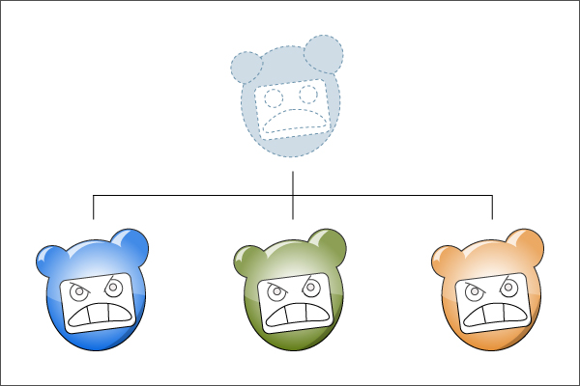
Modules Overview
Object-oriented Programming and Quality Code
Course Introduction
Defining Classes Part 1
Defining Classes Part 2
Extension methods, delegates, lambda, dynamic and LINQ
OOP Principles Part 1
OOP Principles Part 2
Common Type System in .Net
Quality Code Part 1
Quality Code Part 2
Creating a Larger Game from scratch using the best coding practices (starts from lecture 1)

Slide 8
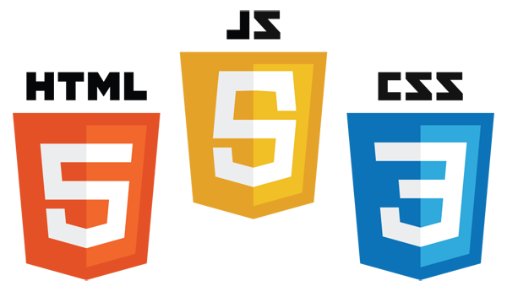
Modules Overview
Introduction to JavaScript
Course Introduction
HTML5 Part 1
HTML5 Part 2
CSS Part 1
CSS Part 2
Introduction to JavaScript
JavaScript UI and DOM Part 1
JavaScript UI and DOM Part 2
Canvas – simple game and graphical demos

Slide 9
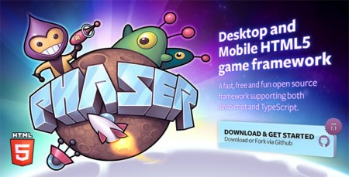
Modules Overview
Making Games with Phaser and TypeScript
Course Introduction
Game Designing
Choosing a game for our project – brainstorming session
Introduction to TypeScript
Introduction to Phaser
Advanced Phaser
Introduction to Cordova
Making the Game Part 1
Making the Game Part 2
Finalizing the Game
Publishing on the App Stores.

Slide 10

Modules Overview
Introduction to Unity3D and Algorithms
Module currently in development

Slide 11

Modules Overview
Evaluation
Most courses will be evaluated in the following way:
25% Homework
25% Teamwork Project
50% Exam
To successfully complete the course:
You must not skip lectures
You must present your homework on time
You must participate in teamwork projects
You must do well on the exam

Slide 12

How to study
Do your homework
Participate in lectures
Ask questions
Watch the videos online
Participate in teamwork
USE GOOGLE!

Slide 13
Timeline
5-6 months
2 times a week from 18:30 to 21:30
Optional workshop on Saturday from 11:00 to 13:00

Slide 14
What to expect
Upon successful completion of the course:
You will know the basics of C#, OOP, Quality Code, JavaScript, TypeScript, Phaser and Unity3D
You will have made 10+ games
You will have sufficient experience to work as a Game Developer
The best (all) who complete this course can start working at Zariba Group

Slide 15

References

Slide 16



Zariba Academy
Questions

