Slide 1

Welcome to Zariba Academy
Overview Lecture
academy.zariba.com

Slide 2
Lecture Content
About Zariba
Zariba Academy

Slide 3
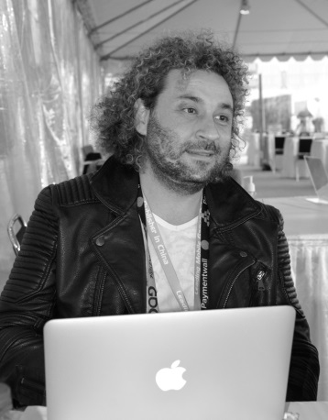

About Zariba
Zariba was founded in 2007 by Radostin Petrov and Galin Dinkov.
Radostin Petrov is a serial entrepreneur and CEO of number of companies.
Мore than 20 years of investment and project management experience in the IT field, such as: Pi Consult Ltd, Podaraci.bg, Ocean solutions Ltd, among others.
Since 2007 Radostin has established various businesses – Waphoo, App Chef, Casualino, Zariba Games, Fractal Games with Galin.
Galin started programming when he was at school in the early 90s.
Developed several indie games and game engines.
Collaborated on multiple international projects as a developer and project manager.
He’s experienced in planning, development, publishing and marketing large software projects on multiple platforms.

Slide 4

About Zariba
Zariba is an international company with divisions in USA, Spain, Bulgaria and Philippines.
At present, Zariba has more than 50 employees and plans to expand further.
Founded in 2007, Zariba has released many games on a multitude of mobile platforms, utilizing a wide range of technologies. development is strongly focused on iOS and Android smartphones and tablet computers.
Links:
Mobile Games
Belotbg

Slide 5





About Zariba
Zariba is home for multiple game studios

Slide 6
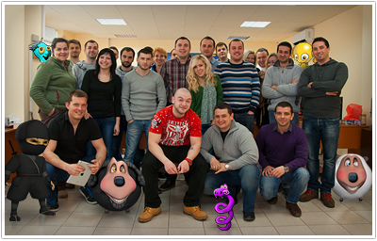
About Zariba
We are one happy family :)

Slide 7
Zariba Academy
It is free!
There will be courses and lectures in:
development, design, marketing, monetization, photoshop, hacking and most importantly game development
You have the unique opportunity to become a game developer in just about 6 months, but:
You have to work hard!
You have to do your homework!
You have to participate in team projects!
You have to ace your exams!

Slide 8

Zariba Academy
Our first course is:

Slide 9
Zariba Academy
Let’s get started!

Slide 10
Zariba Academy
But first…

Slide 11



Zariba Academy
Questions

