Slide 1
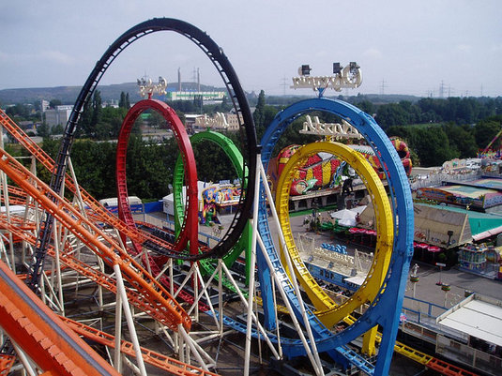
1.6 Loops
academy.zariba.com

Slide 2
Lecture Content
While loops
Do-While loops
For loops
Foreach loops
Loop operators – break, continue
Nested Loops

Slide 3
What is a loop
A loop is a statement which repeats an execution of a block.
Loops can be executed a finite number of times(for), while a certain condition holds(while, do-while) or for each member of a collection (foreach).

Slide 4


1. The While Loop
The While Loop is executed while a certain condition holds.

Slide 5
2. The Do-While Loop
The Do-While Loop is similar to while, but is executed at least once.

Slide 6

3. The For Loop
The For loop iterates a block a given number of times.

Slide 7

4. The Foreach Loop
The Foreach Loop iterates over the members of a collection.
foreach(beer in beers)
{
Drink();
}

Slide 8

5. Nested Loops

Slide 9
Homework
Write a program that prints all the numbers from 1 to N.
Write a program that prints all the numbers from 1 to N, that are not divisible by 3 and 7 at the same time.
Write a program that reads from the console a sequence of N integer numbers and returns the minimal and maximal of them.
Write a program that calculates N!/K! for given N and K (1<K<N).
Write a program that calculates N!*K! / (K-N)! for given N and K (1<N<K).
Write a program that, for a given two integer numbers N and X, calculates the sum S = 1 + 1!/X + 2!/X² + … + N!/X^{N}
Write a program that reads a number N and calculates the sum of the first N members of the sequence of Fibonacci: 0, 1, 1, 2, 3, 5, 8, 13, 21, 34, 55, 89, 144, 233, 377, …

Slide 10
Homework
Write a program that calculates the greatest common divisor (GCD) of given two numbers. Use the Euclidean algorithm (find it in Internet).
Write a program that prints all possible cards from a standard deck of 52 cards (without jokers). The cards should be printed with their English names. Use nested for loops and switch-case.
10. Write a program that reads from the console a positive integer number N (N < 20) and outputs a matrix like the following:
N = 3 N = 4
1 | 2 | 3 | 4
2 | 3 | 4 | 5
3 | 4 | 5 | 6
4 | 5 | 6 | 7
1 | 2 | 3
2 | 3 | 4
3 | 4 | 5

Slide 11
Homework
* Write a program that reads a positive integer number N (N < 20) from console and outputs in the console the numbers 1 ... N numbers arranged as a spiral.
Example for N = 4
N = 4
1 | 2 | 3 | 4
12 | 13 | 14 | 5
11 | 16 | 15 | 6
10 | 9 | 8 | 7

Slide 12

References

Slide 13



Zariba Academy
Questions

