Slide 1

1.7 Arrays
academy.zariba.com

Slide 2
Lecture Content
Basic Operations with Arrays
Console Input & Output of Arrays
Iterating Over Arrays
List<T>
Cloning Arrays

Slide 3
What is an Array
An array is a sequence of elements of the same type. It has a fixed order of the elements and a fixed size.

Slide 4


1. Basic Operations with Arrays
Declaring, initializing, accessing elements with examples.

Slide 5
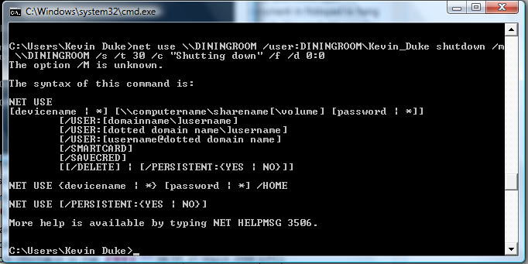
2. Console Input Output of Arrays

Slide 6
3. Iterating Over Arrays
Iteration using for and foreach.

Slide 7

4. List<T>
List<T> is a dynamically resizable array. “T” stands for any data type, e.g. int, string, char…

Slide 8
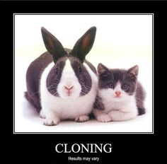
5. Cloning arrays

Slide 9
Homework
Write a program that allocates array of 20 integers and initializes each element by its index multiplied by 5. Print the obtained array on the console.
Write a program that reads two arrays from the console and compares them element by element.
Write a program that compares two char arrays lexicographically (letter by letter).
Write a program that finds the maximal sequence of equal elements in an array. Example: {2, 1, 1, 2, 3, 3, 2, 2, 2, 1} → {2, 2, 2}.
Write a program that finds the maximal increasing sequence in an array. Example: {3, 2, 3, 4, 2, 2, 4} → {2, 3, 4}.
Write a program that reads two integer numbers N and K and an array of N elements from the console. Find in the array those K elements that have maximal sum.
Sorting an array means to arrange its elements in increasing order. Write a program to sort an array. Use the "selection sort" algorithm. Hint: Search on Google.

Slide 10
Homework
Write a program that finds the sequence of maximal sum in given array. Example: {2, 3, -6, -1, 2, -1, 6, 4, -8, 8} → {2, -1, 6, 4}
Can you do it with only one loop (with single scan through the elements of the array)?
Write a program that finds the most frequent number in an array. Example:
{4, 1, 1, 4, 2, 3, 4, 4, 1, 2, 4, 9, 3} → 4 (5 times)
Write a program that finds in given array of integers a sequence of given sum S (if present). Example: {4, 3, 1, 4, 2, 5, 8}, S=11 → {4, 2, 5}
Write a program that finds the index of given element in a sorted array of integers by using the binary search algorithm (find it in Wikipedia).
Write a program that creates an array containing all letters from the alphabet (A-Z). Read a word from the console and print the index of each of its letters in the array.
Write a program that sorts an array of strings using the quick sort algorithm. Search on Google.

Slide 11
Homework
14. Write a program that finds all prime numbers in the range [1...10 000 000]. Use the sieve of Eratosthenes algorithm (find it in Wikipedia).
* We are given an array of integers and a number S. Write a program to find if there exists a subset of the elements of the array that has a sum S. Example: arr={2, 1, 2, 4, 3, 5, 2, 6}, S=14 → yes (1+2+5+6)
16. * Write a program that reads three integer numbers N, K and S and an array of N elements from the console. Find in the array a subset of K elements that have sum S or indicate about its absence.
17. * Write a program that reads an array of integers and removes from it a minimal number of elements in such way that the remaining array is sorted in increasing order. Print the remaining sorted array. Example:
{6, 1, 4, 3, 0, 3, 6, 4, 5} → {1, 3, 3, 4, 5}
18. * Write a program that reads a number N and generates and prints all the permutations of the numbers [1 … N]. Example:
n = 3 → {1, 2, 3}, {1, 3, 2}, {2, 1, 3}, {2, 3, 1}, {3, 1, 2}, {3, 2, 1}

Slide 12
Homework
19. Write a program that reads two numbers N and K and generates all the variations of K elements from the set [1..N]. Example:
N = 3, K = 2 → {1, 1}, {1, 2}, {1, 3}, {2, 1}, {2, 2}, {2, 3}, {3, 1}, {3, 2}, {3, 3}
20. Write a program that reads two numbers N and K and generates all the combinations of K distinct elements from the set [1..N]. Example:
N = 5, K = 2 → {1, 2}, {1, 3}, {1, 4}, {1, 5}, {2, 3}, {2, 4}, {2, 5}, {3, 4}, {3, 5}, {4, 5}

Slide 13

References

Slide 14



Zariba Academy
Questions

