Slide 1
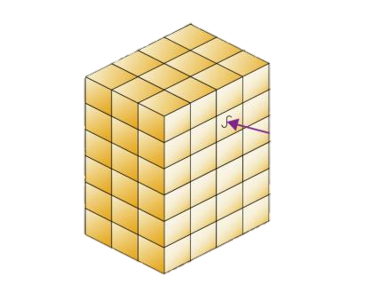
1.8 Multidimensional Arrays
academy.zariba.com

Slide 2
Lecture Content
Matrices and Multidimensional Arrays
The Array Class
Structs and Array.Sort

Slide 3
Multidimensional Arrays
An array is multidimensional if it has more than one dimensions (duh!) – imagine matrix(a table), cube, hypercube etc.
The most important multidimensional arrays have 2 dimensions, i.e. matrices.

Slide 4


1. Matrices
Declaring, initializing, accessing elements, input, output with examples.

Slide 5

2. The Array Class

Slide 6

3. Structs and Array.Sort

Slide 7
Homework
Write a program that prints the following matrices with n rows and n columns for a given number n: All examples are for n=4.
a) b) c)
2. Write a program that reads a rectangular matrix of size N x M and finds in it the square 3 x 3 that has maximal sum of its elements.
3. Write a program, that reads from the console an array of N integers and an integer K, sorts the array and using the method Array.BinSearch() finds the largest number in the array which is ≤ K.
1 | 5 | 9 | 13
2 | 6 | 10 | 14
3 | 7 | 11 | 15
4 | 8 | 12 | 16
1 | 8 | 9 | 16
2 | 7 | 10 | 15
3 | 6 | 11 | 14
4 | 5 | 12 | 13
7 | 11 | 14 | 16
4 | 8 | 12 | 15
2 | 5 | 9 | 13
1 | 3 | 6 | 10

Slide 8
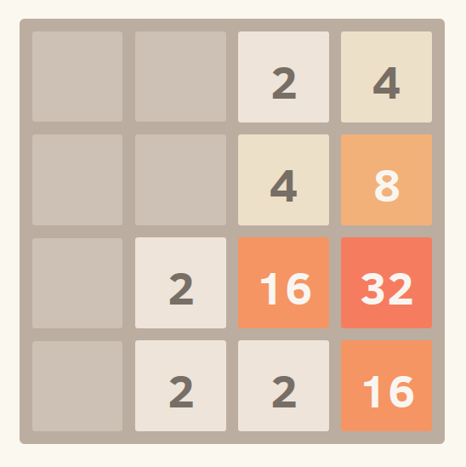
Homework
Make a struct of students each having an ID, Name, Age, Gender and Score out of 100. Create an Array of 10 students and sort them by:
ID, Name, Name (reverse), Age, Score, Name Length and (first by Gender and then by Name).
YOU ARE NOT ALLOWED TO USE LINQ
5.* Implement the game 2048 in the Console (optional).

Slide 9

References

Slide 10



Zariba Academy
Questions

