Slide 1
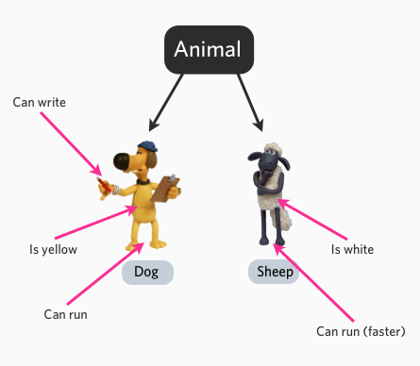
1.11 Introduction to OOP
academy.zariba.com

Slide 2
Lecture Content
What is OOP and why use it?
Classes and objects
Static classes
Properties, fields and methods
Encapsulation
OOP structure in C#
Namespaces
Enumerations and Structs

Slide 3
1. What is OOP? Why use it?
Object-oriented programming (OOP) attempts to provide a model for programming based on objects. Objects are an abstract data type with the addition of polymorphism and inheritance. An object has both state (data) and behavior (code).
Objects are designed in hierarchies.
OOP is meant to make it easy both to reuse existing components as well as to easily extend the functionality.
OOP will generally make your application structure more logical, easy to follow and self-contained.

Slide 4
2. Classes and Objects
A Class can be thought of as a skeleton or a template for a specific object.
Classes have a set of attributes (to hold their state) and a set of actions (to hold their behaviours).
An Object is the specific instance of a class.
Examples: Bank Accounts, Animals, Games

Slide 5

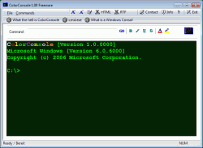
3. Static Classes
Static classes cannot be instantiated. They only “exist once”. Examples for static classes: Math, Console, etc.

Slide 6
4. Properties, fields and methods
Properties and fields are the data members of a class. They can be variables or constants.
Fields do not invoke actions.
Properties can contain more complex logic. They have accessors – get or set.
Properties can be read-only (get), read and write(get and set) or write-only (set).
Examples -> String.Length, Console.BackgroundColor

Slide 7
4. Properties, fields and methods
Methods manipulate the data of a class(properties or fields).
Methods can be static – they are common for all instances of a class (shared between instances).
Examples: Console. … , String. … , Math. …,
Constructors are special methods using to assign initial values of the object’s fields.
Examples: new String, new DateTime, new Int32 …

Slide 8

5. Encapsulation
Encapsulation allows selective hiding of properties and fields to protect the data from accidental corruption. It packs the data/object into a single component which can easily be used.
e.g Computer, Remote Control, “Capsules”

Slide 9
6. OOP structure in C#
Interfaces, Abstract Classes, Classes, Inheritance and Objects.

Slide 10
7. Namespaces
Namespaces are like “folders” to help you organize your classes, interfaces and Object-Oriented structure.

Slide 11
8. Enumerations and Structs
Structs are similar to classes. Structs are value types, while classes are reference types. Structs are normally used only to store data (no methods). E.g. Geometrical Coordinates.
Enumerations are simply lists of objects under a common name.

Slide 12
Homework
*Optional* Create a class diagram in a C# Console Application and add at least 50 (total) classes, abstract classes, interfaces, properties and methods for your favourite game.
e.g. LOL, WOW, Dota 2, CS … etc. You can include weapons, characters, spells, mana, health, damage, speed etc.

Slide 13

References

Slide 14



Zariba Academy
Questions

