Slide 1

1.2 Primitive Data Types and Variables
academy.zariba.com

Slide 2
Lecture Content
1. Primitive Data Types
Numbers
Boolean
Character
String
Object
2. Variables
Identifiers
Declaring and Using
Literals
3. Nullable Types

Slide 3

How Variables Work?
Computers process data.
Data is stored in the computer’s memory as variables.
Variables have data type, name and value.

Slide 4
What is a Data Type?
A data type is a set of values with similar characteristics, e.g. numbers, characters, text etc.
A data type is specified by its name, size, bounds and default value.
E.g. Integers:
Name: int
Size: 32 bits (4 bytes)
Bounds: -2,147,483,648 to 2,147,483,647
Default Value: 0

Slide 5
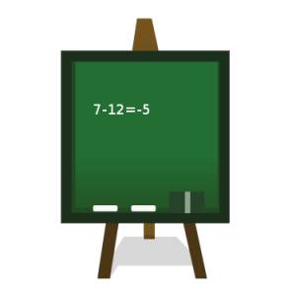
1. Integer Types
sbyte (-128 to 127): signed 8-bit
byte (0 to 255): unsigned 8-bit
short (-32,768 to 32,767): signed 16-bit
ushort (0 to 65,535): unsigned 16-bit
int (-2,147,483,648 to 2,147,483,647): signed 32-bit
uint (0 to 4,294,967,295): unsigned 32-bit
long (-9,223,372,036,854,775,808 to 9,223,372,036,854,775,807): signed 64-bit
ulong (0 to 18,446,744,073,709,551,615): unsigned 64-bit
BigInteger (limit depends on RAM): limit depends on RAM

Slide 6

2. Floating-Point and Decimal Floating-Point Types
float (±1.5 × 10⁻⁴⁵ to ±3.4 × 10³⁸): 32-bits, precision of 7 digits
double (±5.0 × 10⁻³²⁴ to ±1.7 × 10³⁰⁸): 64-bits, precision of 15-16 digits
decimal (±1,0 × 10⁻²⁸ to ±7,9 × 10²⁸): 128-bits, precision of 28-29 digits
Default Values
float: 0.0F
double : 0.0D
Decimal: 0.0M

Slide 7

3. Boolean Types
The Boolean Type is the simplest. It is declared with the keyword bool and has two possible values: true or false.

Slide 8
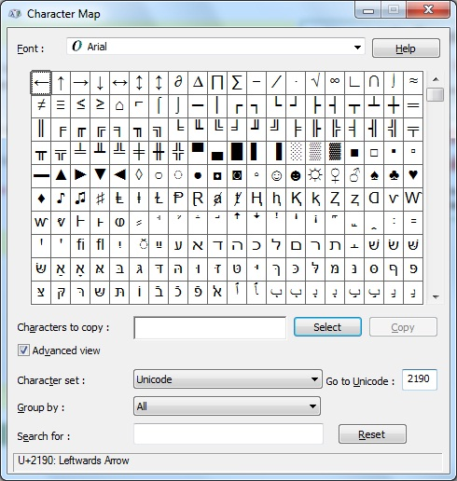
4. Character Type
The character type represents a symbol. It is declared with the keyword char, takes 16 bits of memory and has a default value of ‘\0’.

Slide 9
4. String Type
The string type represents text. It is declared with the keyword string and takes variable amount of memory.

Slide 10

5. Object Type
The object type can represent any type of data. It is declared with the object keyword.

Slide 11
6. Dynamic Type
The dynamic type can hold anything. Operations are evaluated at runtime.

Slide 12
Homework
Declare a variable for each of the data types in this lecture and assign an appropriate value.
Read two floating point numbers from the console. Write a program to successfully compare these floating point number with precision of 0.00001. e.g. 3.0006 and 3.1 false, 3.000007 and 3.000008 true
Assign an integer variable with the value of 107 in hexadecimal format. Hint: Use Windows Calculator.
Create a character variable and assign it with the character with Unicode 90. Hint: Same as 3.
Declare a boolean variable isItSunnyOutsideToday and give it an appropriate value.
Declare two string variables and assign them with “Zariba” and “Academy”. Declare an object variable and assign it with the concatenation of the first two variables (mind adding an interval). Declare a third string variable and initialize it with the value of the object variable (you should perform type casting).

Slide 13
Homework
7. Declare a string variable with the following text: My favourite movie is “[insert film here]”.
Draw on the console a 3 by 6 rectangle with the symbol ¿.
Read two integer values from the console and exchange their values.

Slide 14

References

Slide 15



Zariba Academy
Questions

