Slide 1

1.4 Operators and Expressions
academy.zariba.com

Slide 2
Lecture Content
Operators in C# and Order of Operators
Arithmetic Operators
Logical Operators
Binary Number System
Bitwise Operators
Comparison Operators
Assignment Operators
Other Operators
Implicit and Explicit Type Conversions
Expressions

Slide 3
What is an Operator
Operator is an operation performed over data at runtime. Takes one or more arguments and produces a new value.
Operators have order – determines which will be evaluated first.
Expressions are sequences of operators.

Slide 4
1. Operators in C#
Unary – take one operand
Binary – take two operands
Ternary – takes three operands

Slide 5
Operator Types in C#
Category | Operators
Arithmetic | + - * / % ++ --
Logical | && || ^ !
Binary | & | ^ ~ << >>
Comparison | == != < > <= >=
Assignment | = += -= *= /= %= &= |= ^= <<= >>=
String concatenation | +
Type Conversion | is as typeof
Other | . [ ] ( ) ?: new

Slide 6
Order of Operators
From Highest to Lowest:
( ) ++ -- (postfix) new typeof
++ -- (prefix) + - (unary) ! ~
* / %
+ -
<< >>
< > <= >= is as
== !=
&
^
|
&&
||
?:
= *= /= …

Slide 7

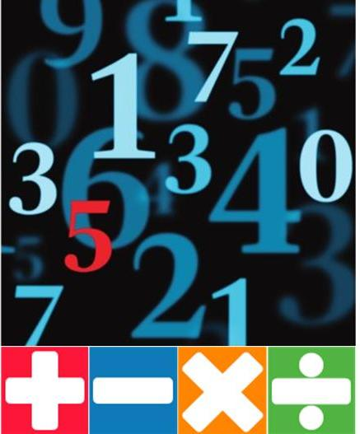
2. Arithmetic Operators
Arithmetic operators +, -, *: same as math
Division / gives the integer part
Division / works normally if used on real numbers
Division % gives the remainder of integer division
++, -- increment or decrement a variable by 1

Slide 8
3. Logical Operators
Logical operators take boolean operands and return boolean
Operator ! flips the boolean operand
Operation | || | || | || | || | && | && | && | && | ^ | ^ | ^ | ^
Operand1 | 0 | 0 | 1 | 1 | 0 | 0 | 1 | 1 | 0 | 0 | 1 | 1
Operand2 | 0 | 1 | 0 | 1 | 0 | 1 | 0 | 1 | 0 | 1 | 0 | 1
Result | 0 | 1 | 1 | 1 | 0 | 0 | 0 | 1 | 0 | 1 | 1 | 0
Credits to Georgi Georgiev for the examples

Slide 9

4. Binary Number System
We are normally using the decimal number system (base 10). For example: 657 = 6x10²+5x10¹+7x10⁰ (digits from 0 to 9)
There are other number systems. For example base 2:
11 = 1x2³+0x2²+1x2¹+1x2⁰
We can easily convert between systems.

Slide 10
5. Bitwise Operators
Bitwise operator ~ flips the boolean operand – same as !.
The operators |, & and ^ are the same as for Boolean.
The << and >> operators move the bits left or right.
Bitwise operators only work for
Operation | | | | | | | | | & | & | & | & | ^ | ^ | ^ | ^
Operand1 | 0 | 0 | 1 | 1 | 0 | 0 | 1 | 1 | 0 | 0 | 1 | 1
Operand2 | 0 | 1 | 0 | 1 | 0 | 1 | 0 | 1 | 0 | 1 | 0 | 1
Result | 0 | 1 | 1 | 1 | 0 | 0 | 0 | 1 | 0 | 1 | 1 | 0
Cool link here

Slide 11
6. Comparison operators
Comparison operators: == < > >= <= !=

Slide 12
7. Assignment Operators
Assignment Operators: = += -= |= …

Slide 13
8. Other Operators
+ can be used to concatenate strings
. is used to access object members
[ ] is used with arrays and indexers
( ) override the default order of operations
(type) is used for type casting
?: is the only ternary operator
new is used to create objects
typeof operator returns System.Type objects
is checks compatibility between objects

Slide 14
9. Type Conversions
We use explicit type conversion when we convert manually.
We use implicit when there is no loss of data or precision

Slide 15
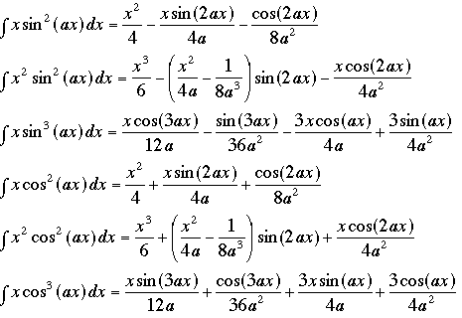
10. Expressions
Expressions are sequences of operators, literals and variables that are give a single result.

Slide 16
Homework
Write an expression that checks if given integer is odd or even.
Write a boolean expression that checks if an integer can be divided by 2, 3 and 5 without remainder (use logical operators).
Write a program that evaluates the area of a trapezium, given its sides and height.
Write an expression to check if the 3rd digit of an integer is 3. e.g. 2351 → true
Write a boolean expression for finding if the bit at position 2 (counting from 0) of a given integer is 1 or 0. e.g. If 1-> true
Write an expression that checks if a given point (x,y) is within a circle with radius 4 and centre at (0,0)
Write an expression that checks if a given positive integer n<=100 is prime.
Write a Boolean expression that returns if the bit at position p (counting from 0 ) in a given integer v has value of 1.

Slide 17

References

Slide 18



Zariba Academy
Questions

