Slide 1

1.9 Methods
academy.zariba.com

Slide 2
Lecture Content
What is a method? Why use methods?
Void Methods and methods with parameters
Methods which return a value
Overloading
Best Practices

Slide 3
1. What is a method?
A method is a building block that solves a single problem. It combines a part of your code, gives it a name and can be called from other parts of the code.
Methods are key for constructing large applications and games from smaller pieces
Methods are also known in other languages as functions, procedures and subroutines.

Slide 4
1. Why use methods?
They split large problems into small pieces
Better organization
Improve readability
Improve understandability
Avoid repetition of code
Code reusability

Slide 5
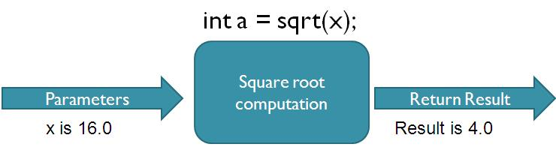

2. Void methods and parameters
Each method has a return type, name, parameters (optional) and body. Void methods don’t have return type. They just wrap a piece of code and give it a name.

Slide 6

3. Methods which return a value

Slide 7
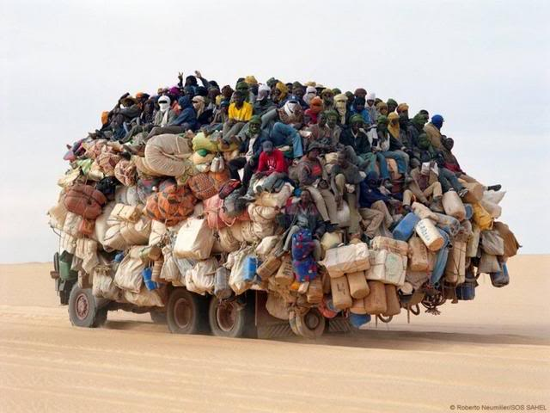
4. Overloading

Slide 8
5. Best practices
Each method should perform a single well- defined task.
The method’s name should clear and descriptive of the task it performs. Neither too long, nor too short
e.g. DrawDwarf(), GenerateRocks(), MovePaddle()…
bad e.g. Process(), Task(), DoSomething(), f(), function()

Slide 9
Homework
Write a method that asks the user for his name and prints “Hello, <name>” (for example, “Hello, Peter!”). Write a program to test this method.
Write a method that counts how many times given number appears in given array. Write a test program to check if the method is working correctly.
Write a method that reverses the digits of given decimal number. Example: 256 → 652
Write methods to calculate minimum, maximum, average, sum and product of given set of integer numbers. Use variable number of arguments.
Modify your last program and try to make it work for any number type, not just integer (e.g. decimal, float, byte, etc.). Use generic method (read in Internet about generic methods in C#).

Slide 10

References

Slide 11



Zariba Academy
Questions

