Slide 1
Deep Residual Learning for Image Recognition
Kaiming He - CVPR(2016)
He, K., Zhang, X., Ren, S., Sun, J.: Deep residual learning for image recognition.In:CVPR. (2016)
2019.10.13
Notes:
1st places in all five main tracks
ImageNet Classification: “Ultra-deep” (quote Yann)152-layer nets
ImageNet Detection:16%better than 2nd
ImageNet Localization:27%better than 2nd
COCO Detection:11%better than 2nd
COCO Segmentation:12%better than 2nd
深层网络是很难训练的，作者提出了一种新的结构，可以使训练层数达到152层 8*VGG 更低复杂性 2015 ILSVRC 3.57%

Slide 2
CONTENTS
PART 01 - Problem
PART 02 - Network Architectures
PART 03 - Experiments

Slide 3
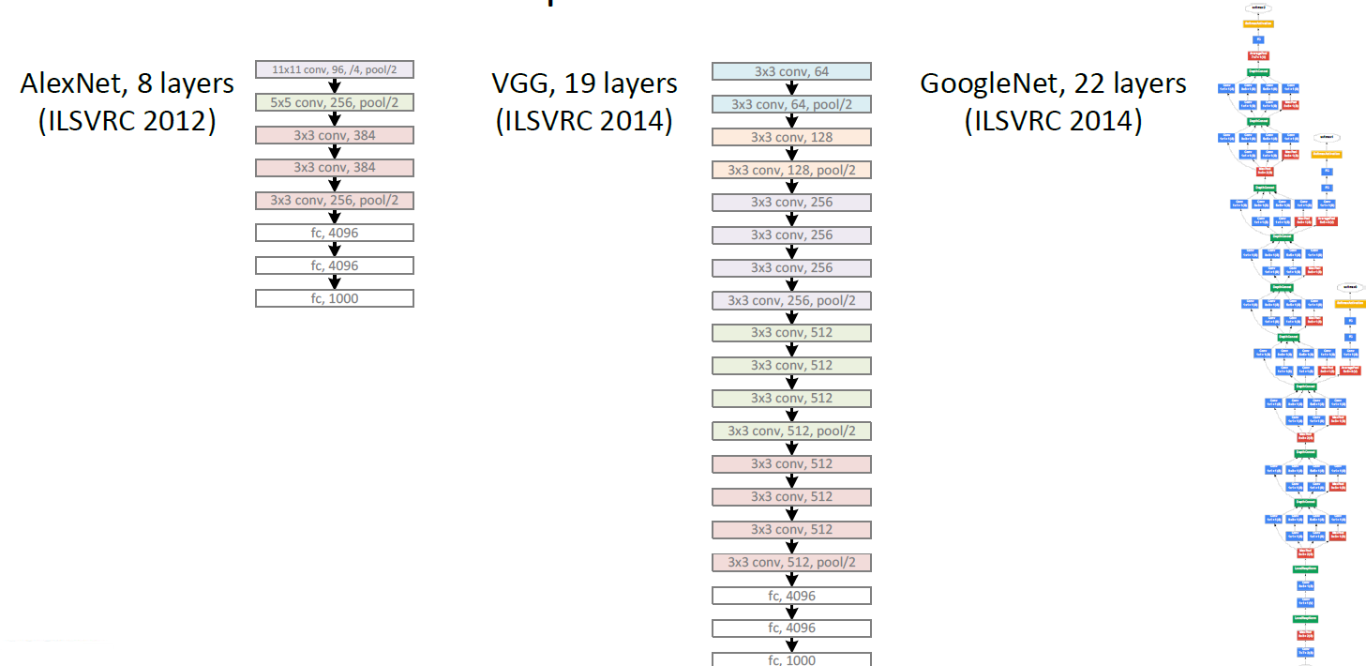
Revolution of Depth

Slide 4
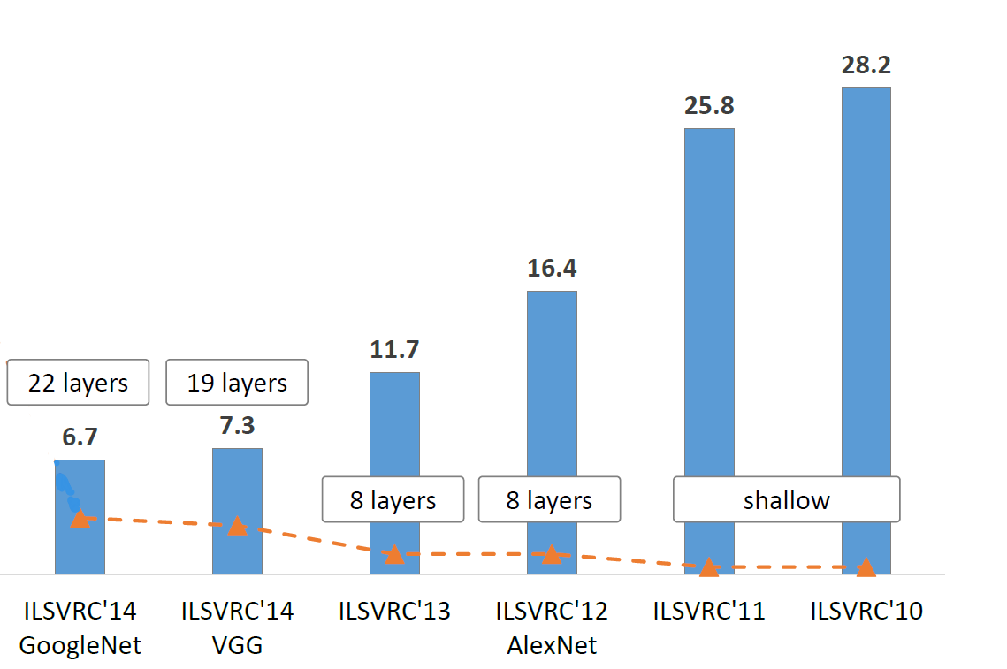
Revolution of Depth
Notes:
为什么随着层数加深，准确率会提升呢？
捕获特征会越来越多，等级会越来越高

Slide 5
Is learning better networks as simple as
stacking more layers?

Slide 6
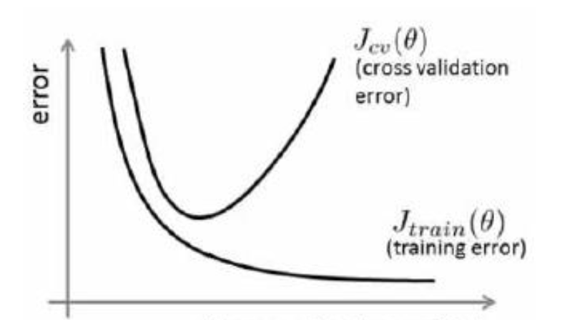
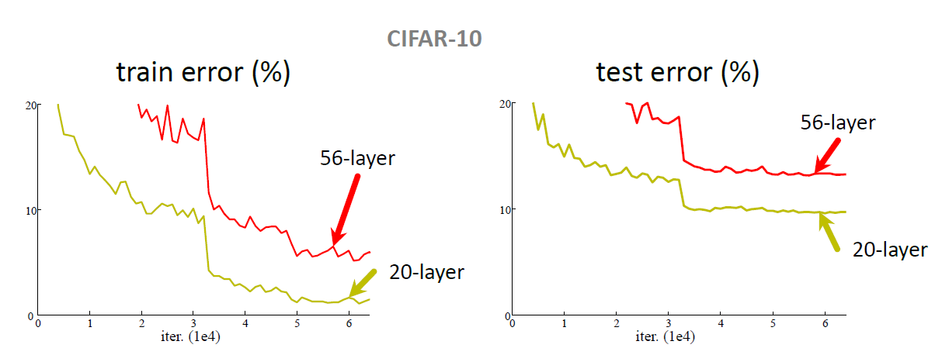
Simply stacking layers?
plainnets: stacking 3x3 conv layers…
56-layer net has higher training error and test error than 20-layer net
Notes:
1.这种degradation problem并不是由于过拟合造成的
2.由于梯度消失和梯度爆炸的问题，阻碍了模型的收敛

Slide 7
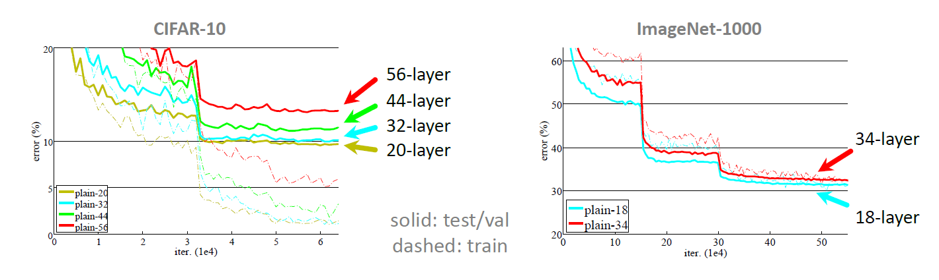
Simply stacking layers?
“Overly deep” plain nets have higher training error
A general phenomenon, observed in many datasets

Slide 8
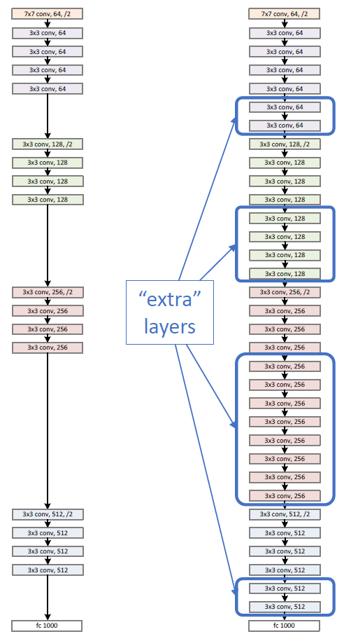
a shallower
model
(18 layers)
a deeper
counterpart
(34 layers)
•A deeper model should not have
higher training error
•A solution by construction:
-original layers: copied from a learned shallower model
-extra layers: set as identity
-at least the same training error
•Optimization difficulties: solvers cannot find the solution when going deeper…
Notes:
♥

Slide 9
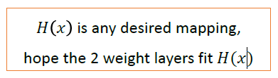
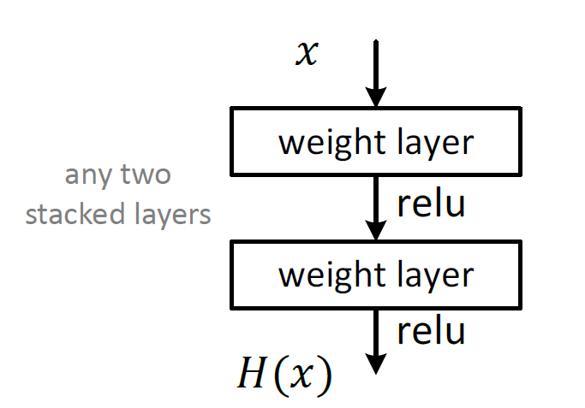
Plaint net
Notes:
♥

Slide 10
What is the residual？
Definition(statistics)：
The difference between results obtained by observation and by computation from a formula or between the mean of several observations and any one of them
Example：
Suppose we want to find an x such that f(x)=b,given an estimate x₀ of x, the residual is b−f(x₀)
Notes:
“残差在数理统计中是指实际观察值与估计值（拟合值）之间的差。”“如果回归模型正确的话， 我们可以将残差看作误差的观测值。”
更准确地，假设我们想要找一个 x，使得 f(x)=b，给定一个 x 的估计值 x0，残差（residual）就是 b−f(x0)，同时，误差就是 x−x0。
即使 x 不知道，我们仍然可以计算残差，只是不能计算误差罢了。

Slide 11
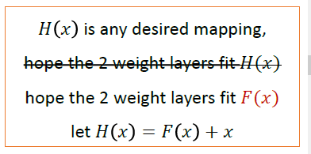
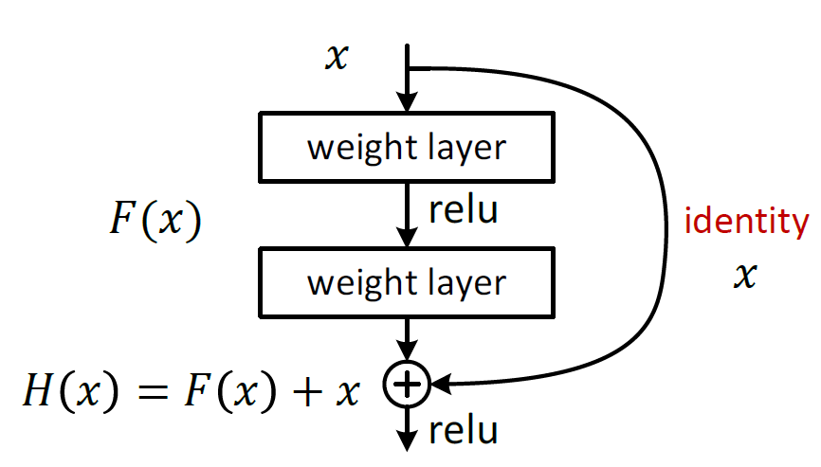
Residual net
Notes:
♥short connection “小路，捷径”一样的东西
不再直接学习潜在映射H(x),而去学习一个残差映射F(x)=H(x)-x
在实际情况下，恒等映射不太可能是最优的，但是我们的重新表达对于这个问题的预处理是有帮助的。如果最优函数更接近于恒等映射而不是零映射，则求解者应该更容易找到与恒等映射有关的扰动（perturbations），而不是将其作为新的扰动来学习。我们通过实验(图7)证明了学习的残差函数一般都有较小的响应，说明恒等映射提供了合理的预条件。

Slide 12
在实际情况下，恒等映射不太可能是最优的，但是我们的重新表达对于这个问题的预处理是有帮助的。如果最优函数更接近于恒等映射而不是零映射，则求解者应该更容易找到与恒等映射有关的扰动（perturbations），而不是将其作为新的扰动来学习。我们通过实验(图7)证明了学习的残差函数一般都有较小的响应，说明恒等映射提供了合理的预条件。

Slide 13
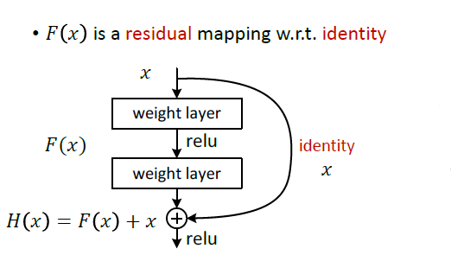
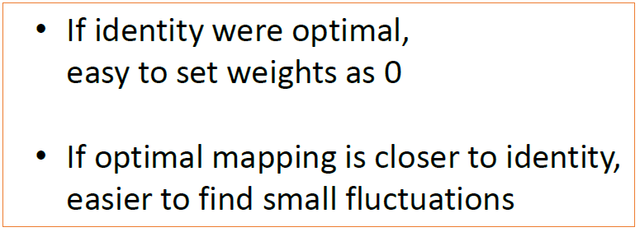
Residual net
Notes:
♡可能x经过卷积之后得到的数据的维数与x不同，这个时候我们可以在x前乘以一个矩阵Ws进行变换
If the dimension dismatch,we have two option:
A)The shortcut still performs identity mapping,with extra zero entries padded for increasing or reducing dimensions.
B)Use the 1x1 convolutions neural networks.

Slide 14
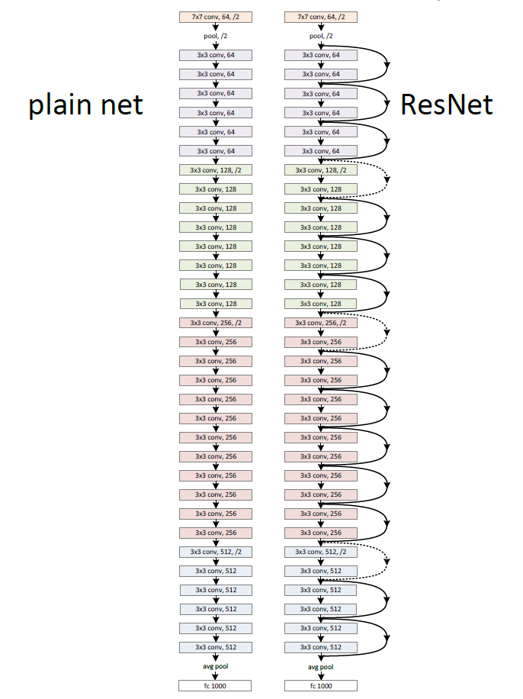
Network “Design”
Keep it simple
Our basic design(VGG-style)
-all 3x3 conv (almost)
-spatial size /2 => # filters x2
-Simple design; just deep!
Other remarks:no max pooling (almost)
-no hidden fc
-no dropout
Notes:
这两个网络都是当 feature map 减半时，filter 的个数翻倍，这样保证了每一层的计算复杂度一致。

Slide 15
Training
All plain/residual nets are trained from scratch
All plain/residual nets use Batch Normalization
Standard hyper-parameters & augmentation
Notes:
学习论文中的参数，提高收敛速度
Batch normalization
1、提高梯度在网络中的流动。Normalization能够使特征全部缩放到[0,1]，这样在反向传播时候的梯度都是在1左右，避免了梯度消失现象。
2、提升学习速率。归一化后的数据能够快速的达到收敛。

Slide 16
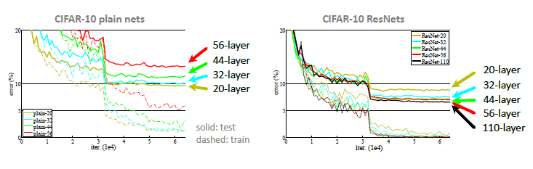
CIFAR-10 experiments

Slide 17
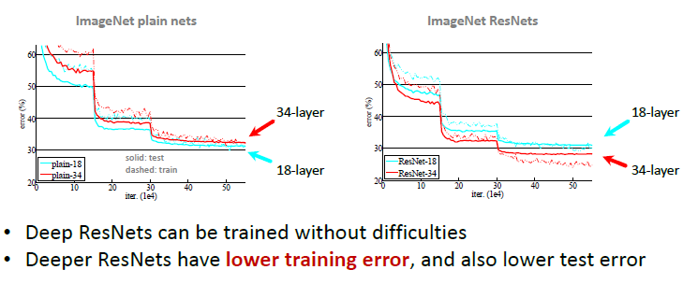
ImageNet experiments

Slide 18
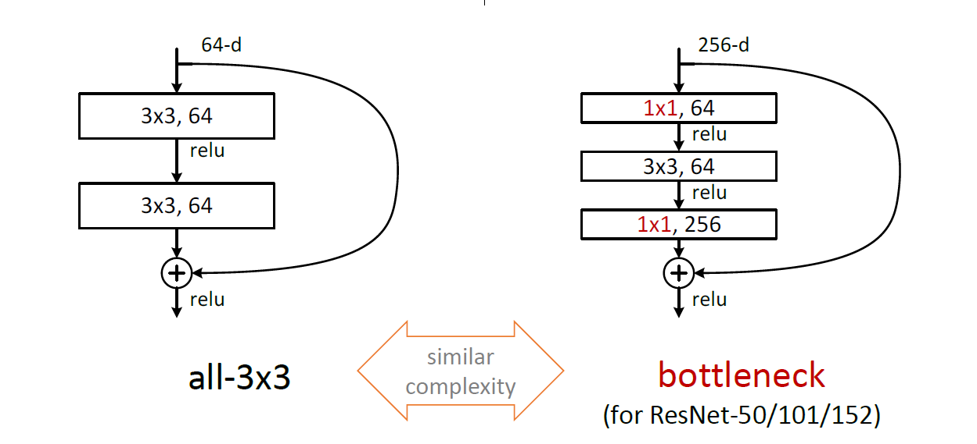
A practical design of going deeper
Notes:
The form of F is flexible,it can has many layers.Two or three is all ok!
But one can not show advantage,the performance may don’t show improved performance.
Similar time complexity!

Slide 19
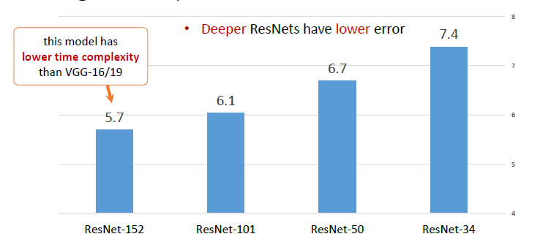
ImageNet experiments

Slide 20
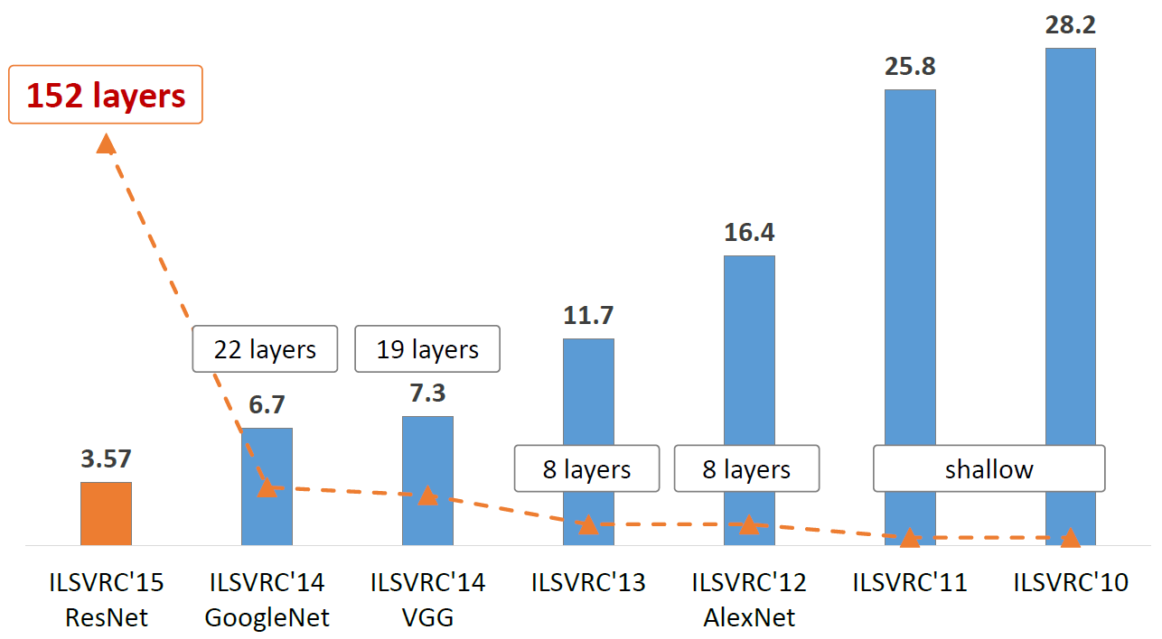
ImageNet experiments

Slide 21
Why residual works?
The main reason the residual network works is that it's so easy for these extra layers to learn the identity function that you're kind of guaranteed that it doesn't hurt performance. And then lot of time you maybe get lucky and even helps performance, or at least is easier to go from a decent baseline of not hurting performance, and then creating the same can only improve the solution from there.
𝑧^{[𝑙+1]}=𝑊^{[𝑙+1]}𝑎^{[𝑙]}+𝑏^{[𝑙+1]}
𝑎^{[𝑙+1]}=𝑔(𝑧^{[𝑙+1]})
𝑧^{[𝑙+2]}=𝑊^{[𝑙+2]}𝑎^{[𝑙+1]}+𝑏^{[𝑙+2]}
𝑎^{[𝑙+2]}=𝑔(𝑧^{[𝑙+2]})
𝑎^{[𝑙+2]}=𝑔(𝑊^{[𝑙+2]}𝑎^{[𝑙+1]}+𝑏^{[𝑙+2]}+𝑎^{[𝑙]})
Notes:
我们给一个网络不论在中间还是末尾加上一个残差块，并给残差块中的 weights 加上 L2 regularization（weight decay），这样图 1 中 F(x)=0是很容易的。这种情况下加上一个残差块和不加之前的效果会是一样，所以加上残差块不会使得效果变得差。如果残差块中的隐藏单元学到了一些有用信息，那么它可能比 identity mapping（即 F(x)=0F(x)=0）表现的更好。

Slide 22
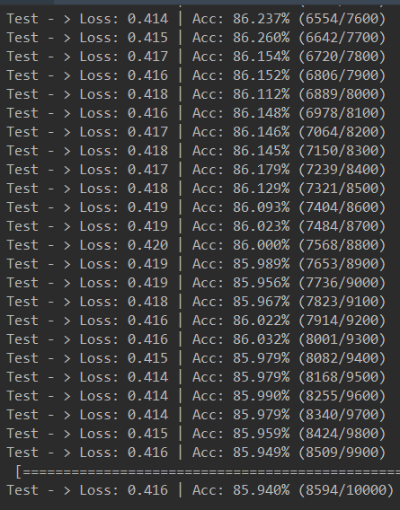
Personal experiment
Epoches:5000
ResNet-18
Simple preprocess

Slide 23
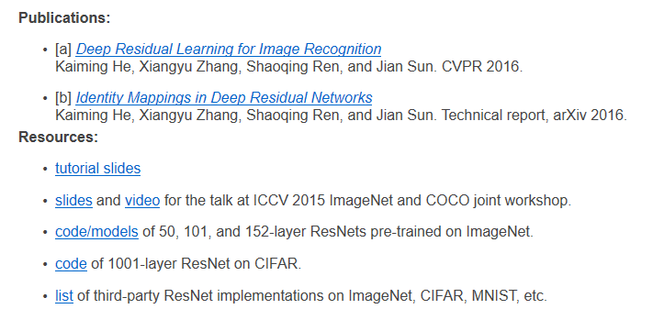
Futher study
http://kaiminghe.com/icml16tutorial/index.html
Notes:
ImageNet Detection:16%better than 2nd（15年）
ImageNet Localization:27%better than 2nd（15年）
COCO Detection:11%better than 2nd（Microsoft Common Objects in Context）
COCO Segmentation:12%better than 2nd

Slide 24
Thanks

