Slide 1
WaveletAE: A Wavelet-enhanced Autoencoder for Wind Turbine Blade Icing Detection
Binhang Yuan-SIAM(2019)

Slide 2
COTENTS
Introduction
WaveletAE Architechure
Experimental Setup

Slide 3
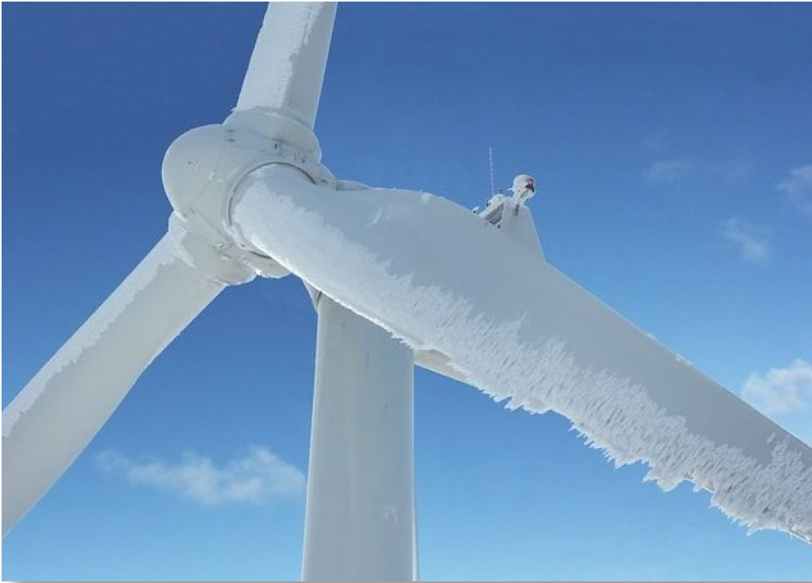
COTENTS

Slide 4
SCADA System
SCADA is an acronym for supervisory control and data acquisition, a computer system for gathering and analyzing real time data. SCADA systems are used to monitor and control a plant or equipment in industries such as telecommunications, water and waste control, energy, oil and gas refining and transportation.
Wind speed
Internal temperature
Yaw positions
Pitch angles
Power outputs

Slide 5
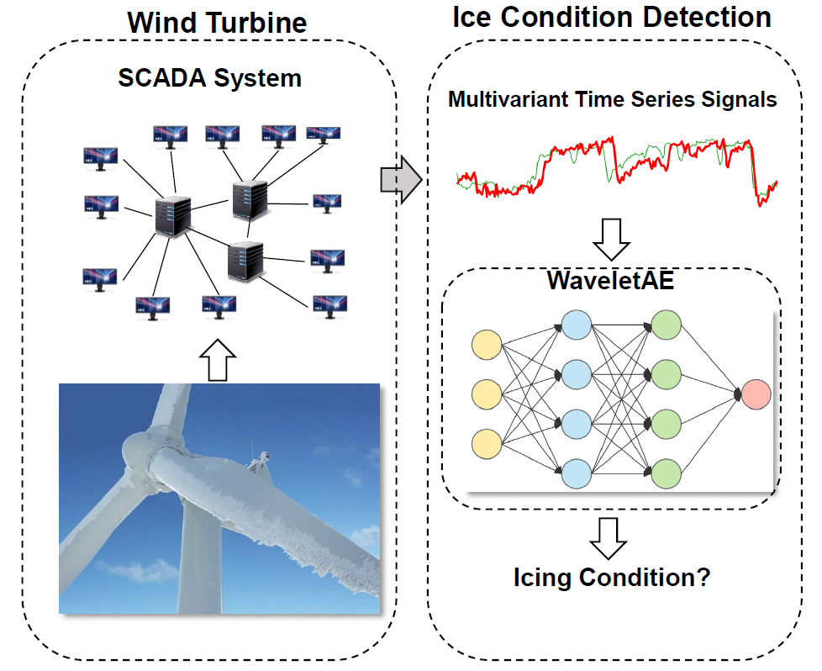
Workflow

Slide 6




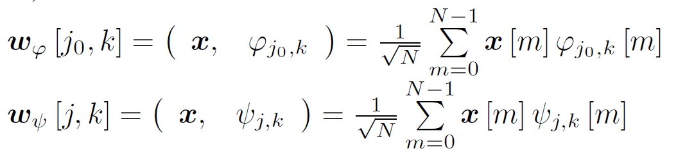


Discrete Wavelet Transform
Formally, given that represents a length N signal, and the basis functions of the form
and , then the coecients for each translation (indexed by k) in each scale level (indexed by j0 or j) are projections of the signal onto each of the basis functions:
where is called approximation coecient, and
is called detail coecient.

Slide 7
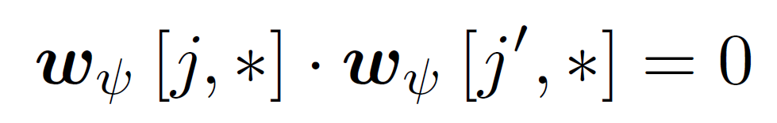
Discrete Wavelet Transform
The detail coecients at dffierent levels reveal variances of the signal on different scales, while the approximation coecient yields the smoothed average on that scale. One important property of the discrete wavelet transform is that detail coecients at each level are orthogonal, that says for any pair of detail coecients notin the same level, the inner product is 0:

Slide 8
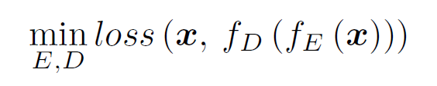
Deep Autoencoder
A deep autoencoder is a multi-layer neural network, in which the desired output is the original input. Internally, the autoencoder includes a hidden layer h that describes a low-dimensional code to represent the input x. The network consists of two parts: an encoder function h = f_{E}(x) parameterized by E that maps the input signal x to a code and a decoder function x = f_{D}(h) parameterized by D that produces a reconstruction x of the input. Intuitively, learning a low dimensional representation forces the autoencoder to capture the most salient features of the training data.

Slide 9
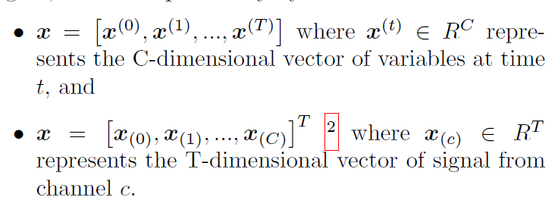
Problem Formalization
Given the multivariate time series x R^{CxT} , where
C is the number of channels, and T is the length of the signal, denoted equivalently by

Slide 10
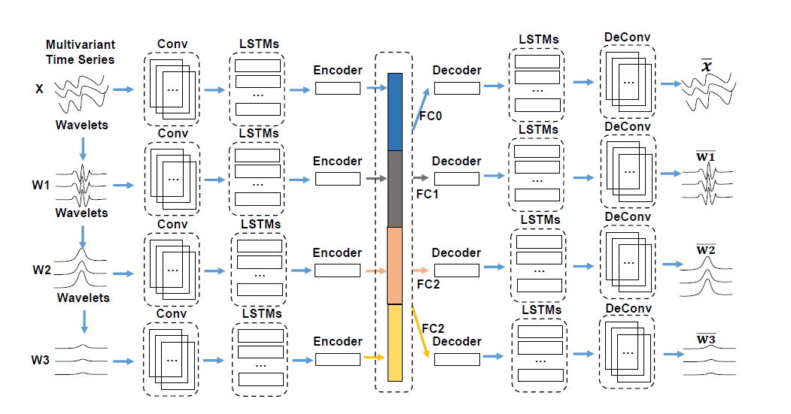
WaveletAE Architecture
Notes:
首先将输入的多元信号分解为多级小波细节系数。 然后，在每个刻度级别，原始信号或小波细节系数都经过卷积编码器和LSTM编码器，LSTM编码器的隐藏状态将被级联以创建全局代码。
在解码阶段，完全连接的层将首先将全局代码映射到每个比例的初始隐藏状态，然后LSTM解码器和卷积解码器将重建原始信号，然后小波细节系数。

Slide 11

Multilevel Discrete Wavelet Decomposition
According to the classic pyramid algorithm, we first apply the 1-dimensional discrete wavelet transform on each input signal channel x_{(c)} to compute the wavelet detail coeffcients in each channel to a speciffic level L, where L can be viewed as a hyper-parameter of WaveletAE. The input signal is first augmented with the wavelet detail coeffcients to multiple scales. Formally,in scale level l, the wavelet details coeffcients are noted as
Notes:
首先将输入的多元信号分解为多级小波细节系数。 然后，在每个刻度级别，原始信号或小波细节系数都经过卷积编码器和LSTM编码器，LSTM编码器的隐藏状态将被级联以创建全局代码。
在解码阶段，完全连接的层将首先将全局代码映射到每个比例的初始隐藏状态，然后LSTM解码器和卷积解码器将重建原始信号，然后小波细节系数。

Slide 12

Convolutional Encoder

Slide 13
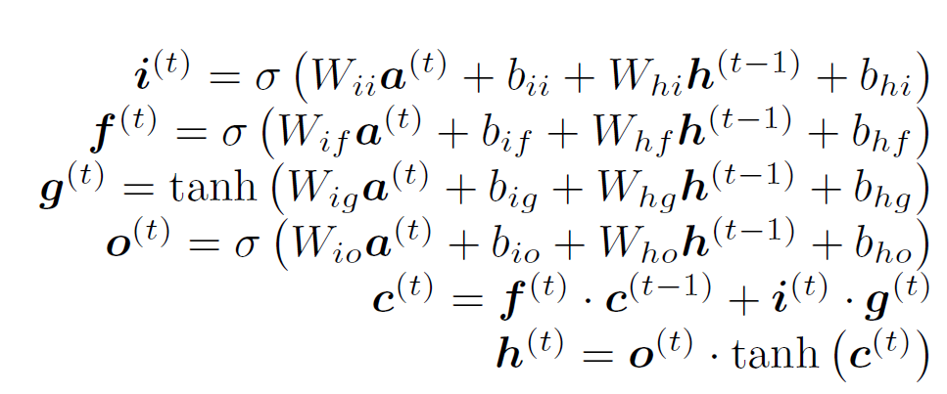
Multiple Scale LSTM Encoder-Decoder

Slide 14

Deep Autoencoder

Slide 15
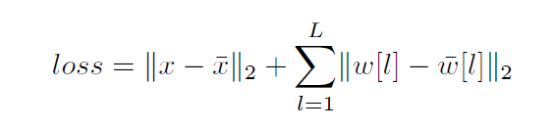
Reconstruct Loss
the approximation coeffcients represent some smoothed averages of the input signal, such knowledge should be easily learned by the convolutional layers when processing the original signal.
unlike the detail coeffcients,approximation coeffcients are not orthogonal to each other, the redundancy of the input can provide limited helpful information while enlarge the parameter space of the model.

Slide 16
SCADA Dataset
60% of the signal as the training set;
20% of the signal as the validation set to compare the generalization performance between WaveletAE and the state-of-the-art approaches;
20% of the signal as the nal test data in the case study of simulated deployment.

Slide 17
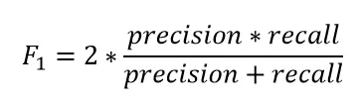
Metrics
Accuracy is the number of correct predictions
made by the model over all the predictions.
Precision is a measure that tells us what propor-
tion of positions that we diagnose as an anomaly,
actually are anomalies.
Recall measures what proportion of samples that
are anomalies is diagnosed by the model as an
anomaly.
F1 score is the Harmonic mean of precision and
recall as a general evaluation of the model.

Slide 18
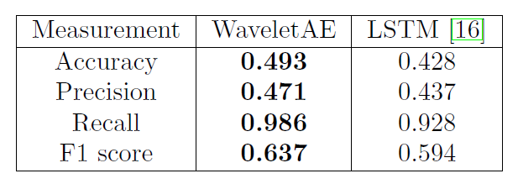
Semi-Supervised Anomaly Detection
Semi-supervised anomaly detection is required to construct models representing normal pattern from a given training data set which only include normal samples, and then output the likelihood of whether a test instanceis normal or abnormal.
τ=β·mean{loss_{train}}

Slide 19
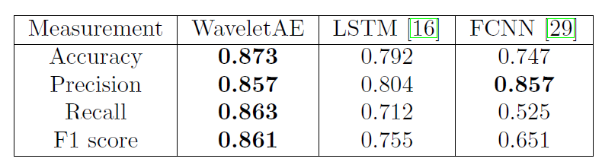
Supervised Anomaly Detection
In order to leverage the label information under supervised setting, we add a fully connected layer to map the global hidden states to the probability p_{a} of the abnormality, the training loss becomes a affine combination of reconstruction loss and the crossentropy binary classication loss loss_{c} = -[y log (p_{a}) +(1 - y) log (1 - p_{a})] dened as:
Loss =α·loss_{re} + (1-α)·loss_{c}

