Slide 1
Programming assignment sample Debugging Deutsch-Jozsa algorithm
Mariia Mykhailova
Senior Software Engineer
Microsoft Quantum Systems
(c) 2020 Microsoft. All rights reserved.

Slide 2
Step 1: Compilation errors
(c) 2020 Microsoft. All rights reserved.

Slide 3
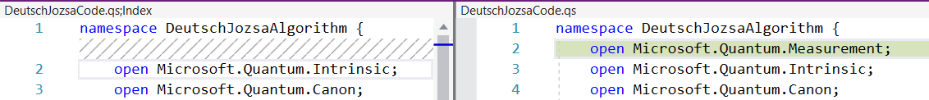
Missing open statement for library operation
(c) 2020 Microsoft. All rights reserved.

Slide 4

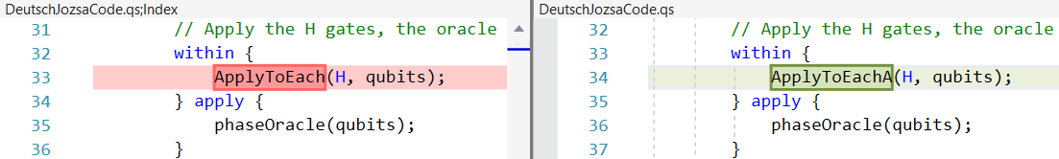
Cannot generate Adjoint automatically (within-apply block takes adjoint of its contents)
(c) 2020 Microsoft. All rights reserved.

Slide 5

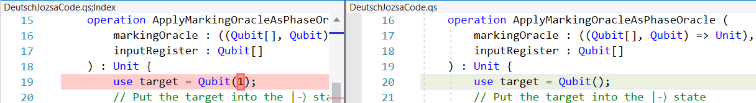
Incorrect syntax for qubit allocation
(c) 2020 Microsoft. All rights reserved.

Slide 6

Incorrect type for the first parameter of the operation produced by the Controlled functor (must be an array)
(c) 2020 Microsoft. All rights reserved.

Slide 7
Step 2: Runtime errors
(c) 2020 Microsoft. All rights reserved.

Slide 8
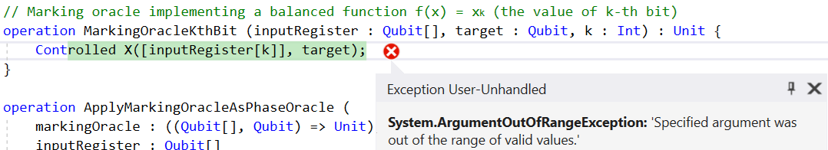
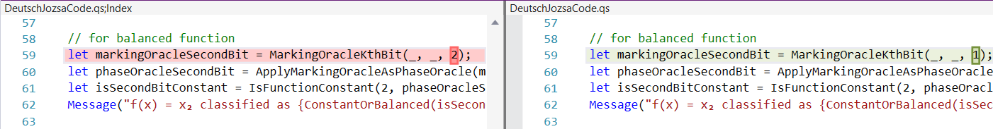
Incorrect range for array elements
(array elements are indexed from 0 to (Length - 1), inclusive)
(c) 2020 Microsoft. All rights reserved.

Slide 9
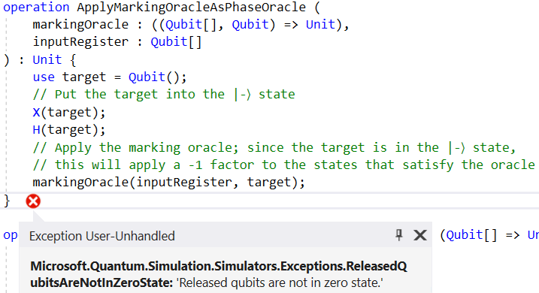
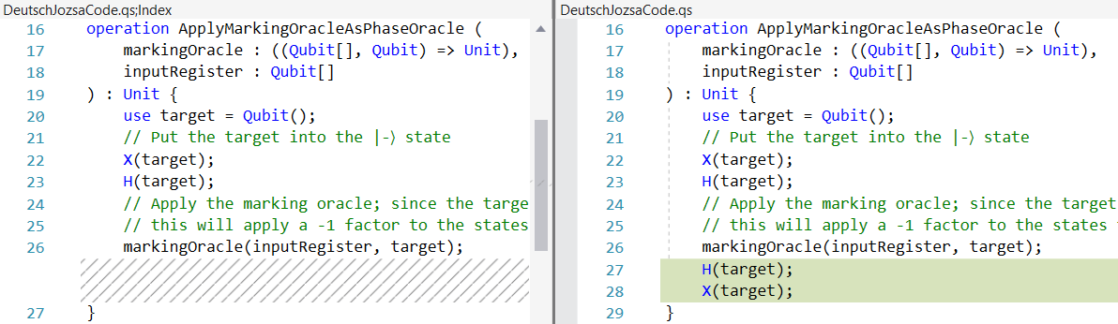
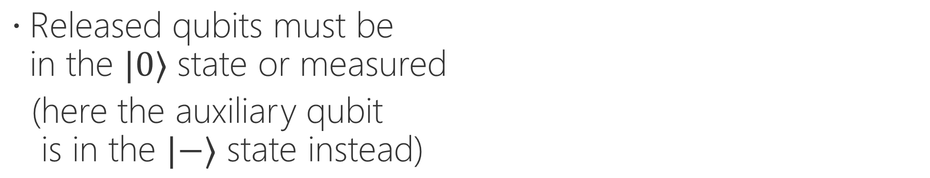
Released qubits must be in the $|0⟩$ state or measured
(here the auxiliary qubit is in the $|−⟩$ state instead)
(c) 2020 Microsoft. All rights reserved.

Slide 10
Step 3: Logic/runtime errors
(c) 2020 Microsoft. All rights reserved.

Slide 11
The code does not print the actual solution to 2nd test
Need to use interpolated string instead of a regular one
(c) 2020 Microsoft. All rights reserved.

Slide 12

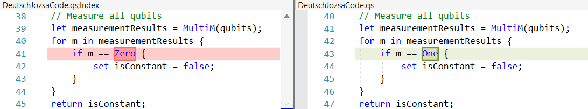
The code outputs incorrect result for f(x) = 0!
Deutsch-Jozsa algorithm should return “constant” iff all measurement results are Zeros, not Ones as written in the code
(c) 2020 Microsoft. All rights reserved.

