Slide 1
Programming assignment X Quantum oracles
Mariia Mykhailova
Senior Software Engineer
Microsoft Quantum Systems
(c) 2020 Microsoft. All rights reserved.

Slide 2
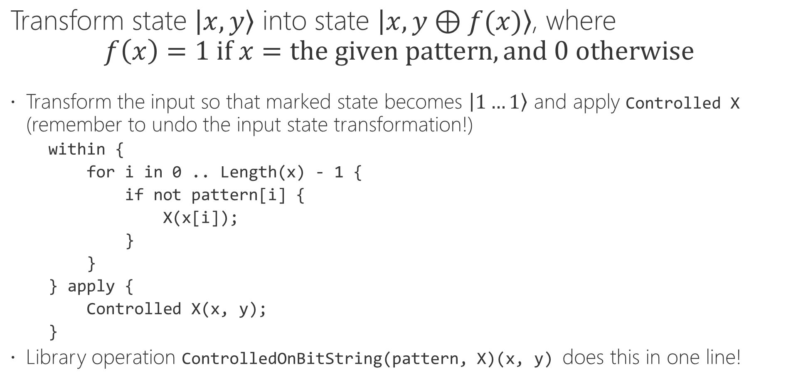
Task 1: Marking oracle for the given bit pattern
Transform state $\left|x, y\right\rangle$ into state $\left|x, y⊕f(x)\right\rangle$, where $$f\left(x\right)=1 if x=the given pattern, and 0 otherwise$$
Transform the input so that marked state becomes $\left|1…1\right\rangle$ and apply Controlled X (remember to undo the input state transformation!)
within {
for i in 0 .. Length(x) - 1 {
if not pattern[i] {
X(x[i]);
}
}
} apply {
Controlled X(x, y);
}
Library operation ControlledOnBitString(pattern, X)(x, y) does this in one line!
(c) 2020 Microsoft. All rights reserved.

Slide 3
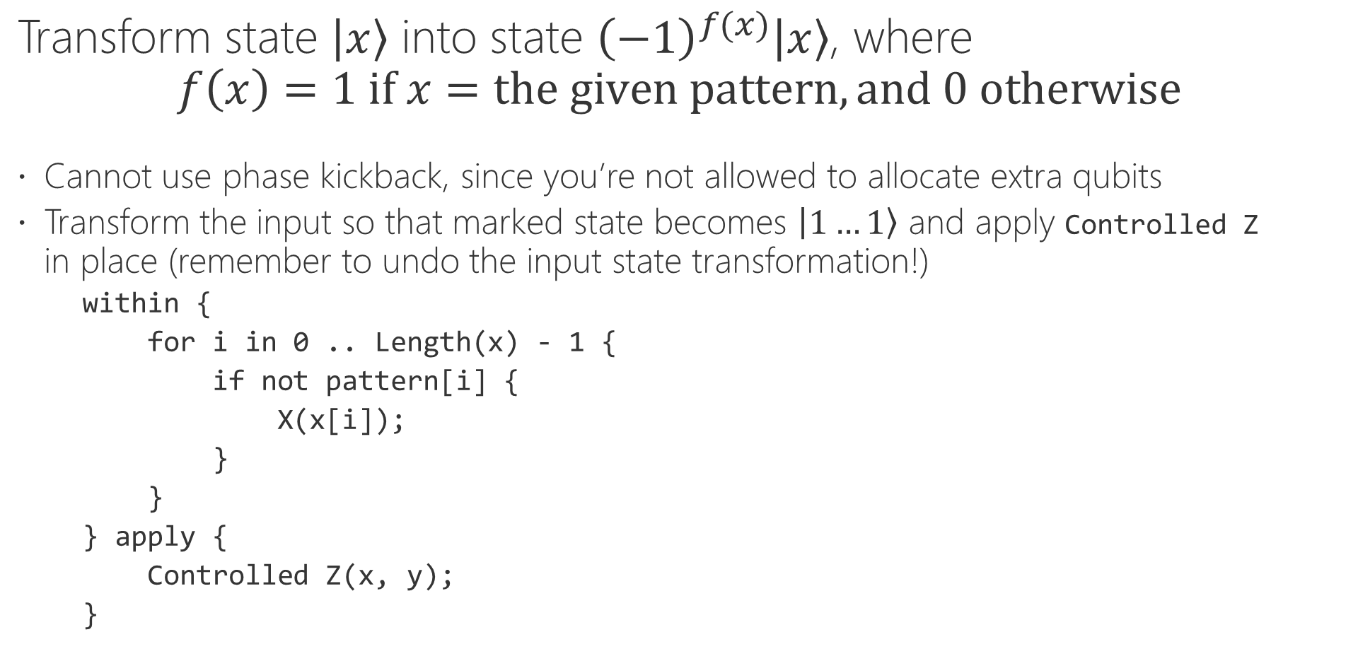
Task 2: Phase oracle for the given bit pattern
Transform state $\left|x\right\rangle$ into state ${\left(−1\right)}^{f(x)}\left|x\right\rangle$, where $$f\left(x\right)=1 if x=the given pattern, and 0 otherwise$$
Cannot use phase kickback, since you’re not allowed to allocate extra qubits
Transform the input so that marked state becomes $\left|1…1\right\rangle$ and apply Controlled Z in place (remember to undo the input state transformation!)
within {
for i in 0 .. Length(x) - 1 {
if not pattern[i] {
X(x[i]);
}
}
} apply {
Controlled Z(x, y);
}
(c) 2020 Microsoft. All rights reserved.

Slide 4
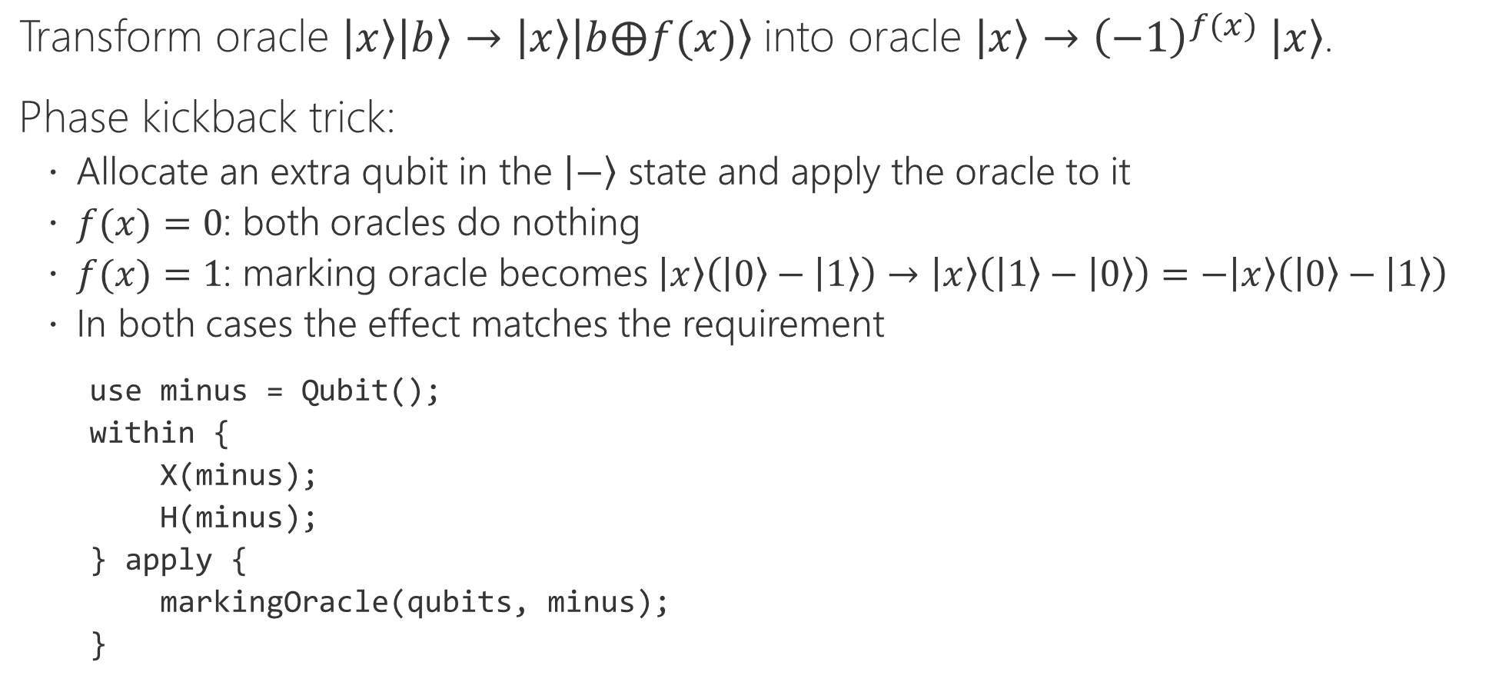
Task 3: Marking oracle to phase oracle
Transform oracle $\left|x\right\rangle \left|b\right\rangle →\left|x\right\rangle \left|b⨁f(x)\right\rangle$into oracle $\left|x\right\rangle →{\left(−1\right)}^{f(x)} \left|x\right\rangle$.
Phase kickback trick:
Allocate an extra qubit in the $\left|−\right\rangle$ state and apply the oracle to it
$f(x)=0$: both oracles do nothing
$f(x)=1$: marking oracle becomes $\left|x\right\rangle \left(\left|0\right\rangle −\left|1\right\rangle \right)→\left|x\right\rangle \left(\left|1\right\rangle −\left|0\right\rangle \right)=−\left|x\right\rangle \left(\left|0\right\rangle −\left|1\right\rangle \right)$
In both cases the effect matches the requirement
use minus = Qubit();
within {
X(minus);
H(minus);
} apply {
markingOracle(qubits, minus);
}
(c) 2020 Microsoft. All rights reserved.

